Slide 1
parhyale
Notes:
Euphausia important, but not especially good experimental animals – pelagic, swarms, depth, water quality.
Crustaceans interesting – pan crustacea and insects. Krill and components. Poly Q and macrobranchium.
Looking for alternative crustaceans to work with. Lin and Eurydice, for instance.
Amphipods – flies of the sea (ref).
Parhyale – fiji, hawaii, australia – circumtropical. Mangroves, found in leaf litter of mangrove trees (tidal with mangrove flooding).
Breed year round once females reach maturity, every two weeks, development is 10 days. Detritivores – eat carrot.
transgenics, cell ablation, inbreeding through brood collection and raising.

Slide 2
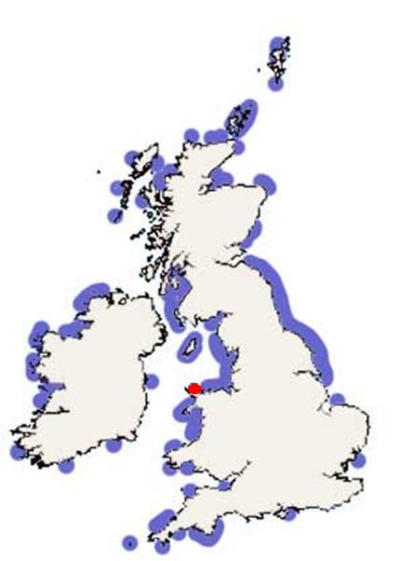
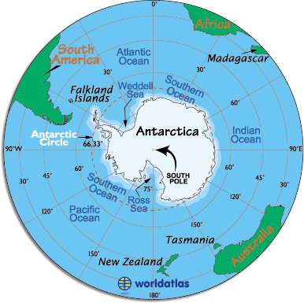

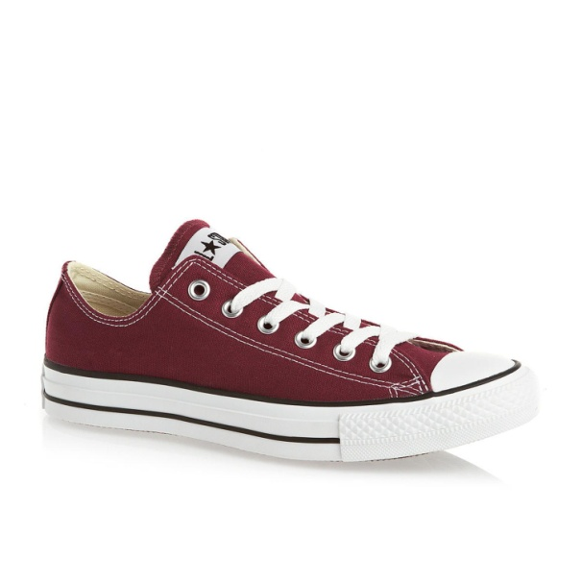
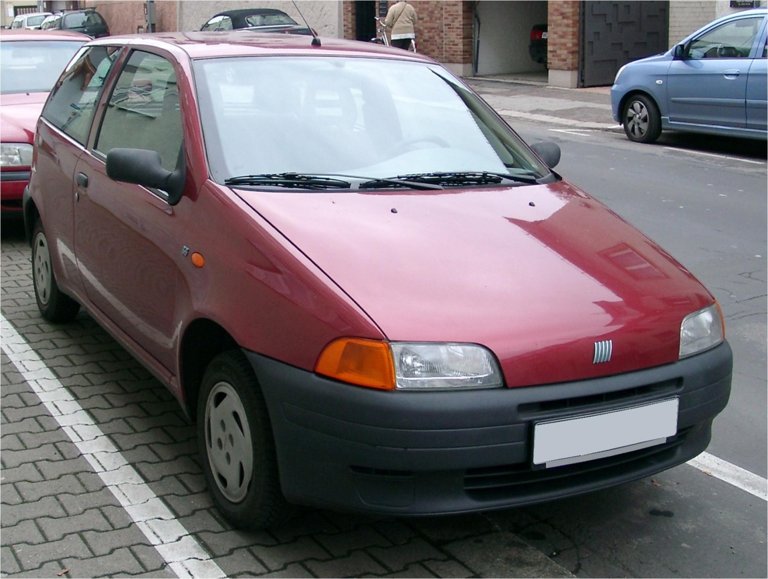
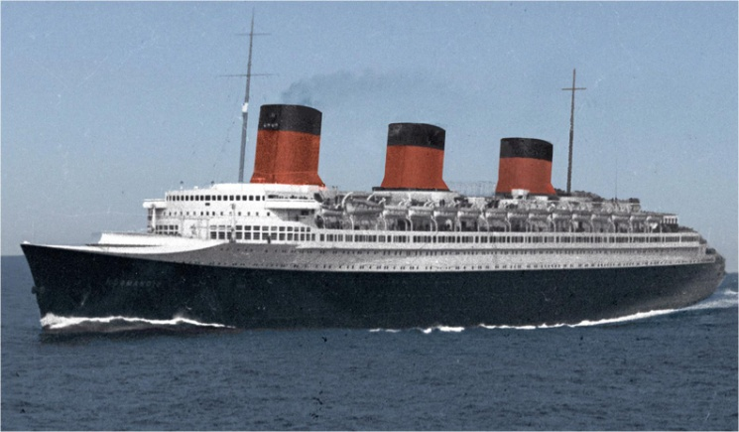



Drosophila
Eurydice
Euphausia
Location
Travel
Accident scenario
Notes:
Handy chart documenting the logistics of sample collection

Slide 3
