Slide 1
AspNet Core : Micro Services by Microsoft
1

Slide 2

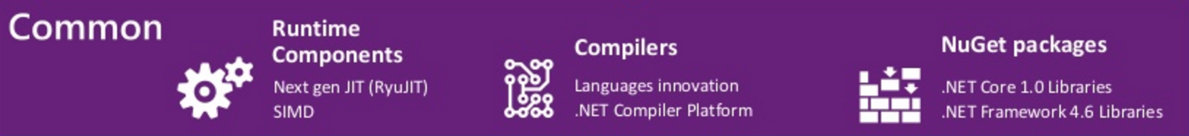
.Net Framework Overview
WPF
Windows Form
Asp.Net (4,X)
Asp.Net Core 1,0
Universal Windows Apps
.Net Framework 4.6
.Net Core 1.0

Slide 3
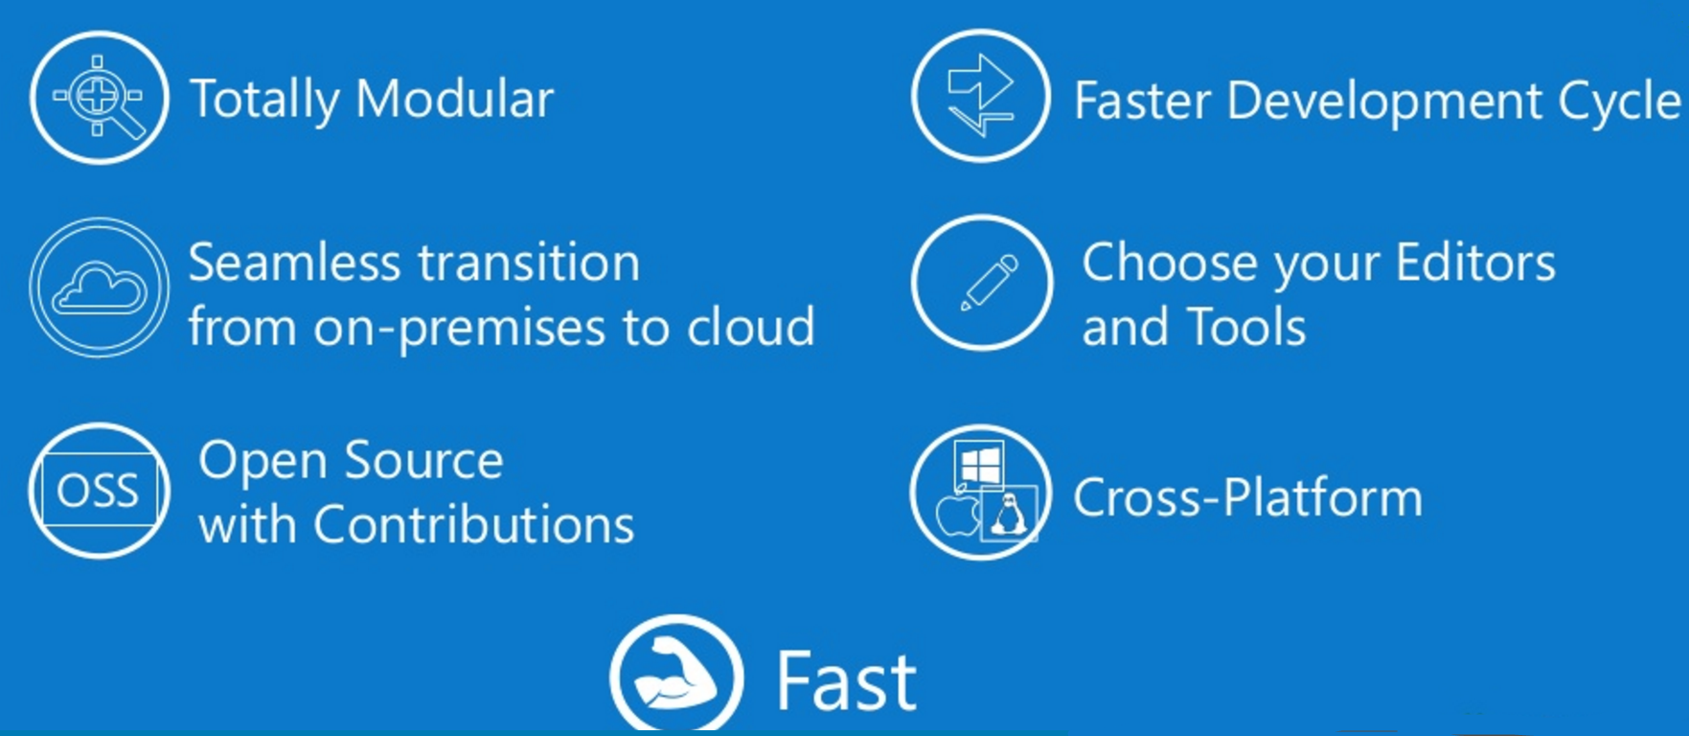

ASP.Net Core Key Values

Slide 4
Démo
Disclaimer :
Toute ressemblance avec des technologies existantes, des situations réelles ou ayant existé serait purement non fortuite et totalement dépendante de ma volonté

Slide 5
Démo
Dotnet CLI :
#dotnet new : to create a new project
#dotnet restore : to bring down NuGet packages required
#dotnet build/run : to build/run the application
Main
Model
Resources
Https
Security (IIS) : Core Identity
No authentication
Individual User Accounts – a security database will be created and you can configure individuals to access your application with a userid and password, an OAuth provider, or two-factor authentication, or any combination of these items.
Work and School Accounts – Using Azure Active Directory
Windows Authentication
Monitoring

Slide 6
Démo
Ressources
https://cdelmas.github.io/2015/11/01/A-comparison-of-Microservices-Frameworks.html
https://github.com/aspnet
https://blogs.msdn.microsoft.com/webdev/2016/03/11/first-look-authentication-in-asp-net-core/
https://readthedocs.com/projects/aspnet-aspnet/downloads/pdf/latest/

