Slide 1

Punking Up Dependency Hell
Benoit Baudry
Université de Montréal

Slide 2
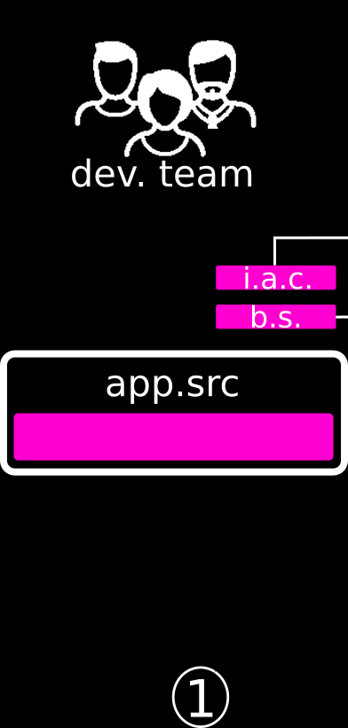

Slide 3
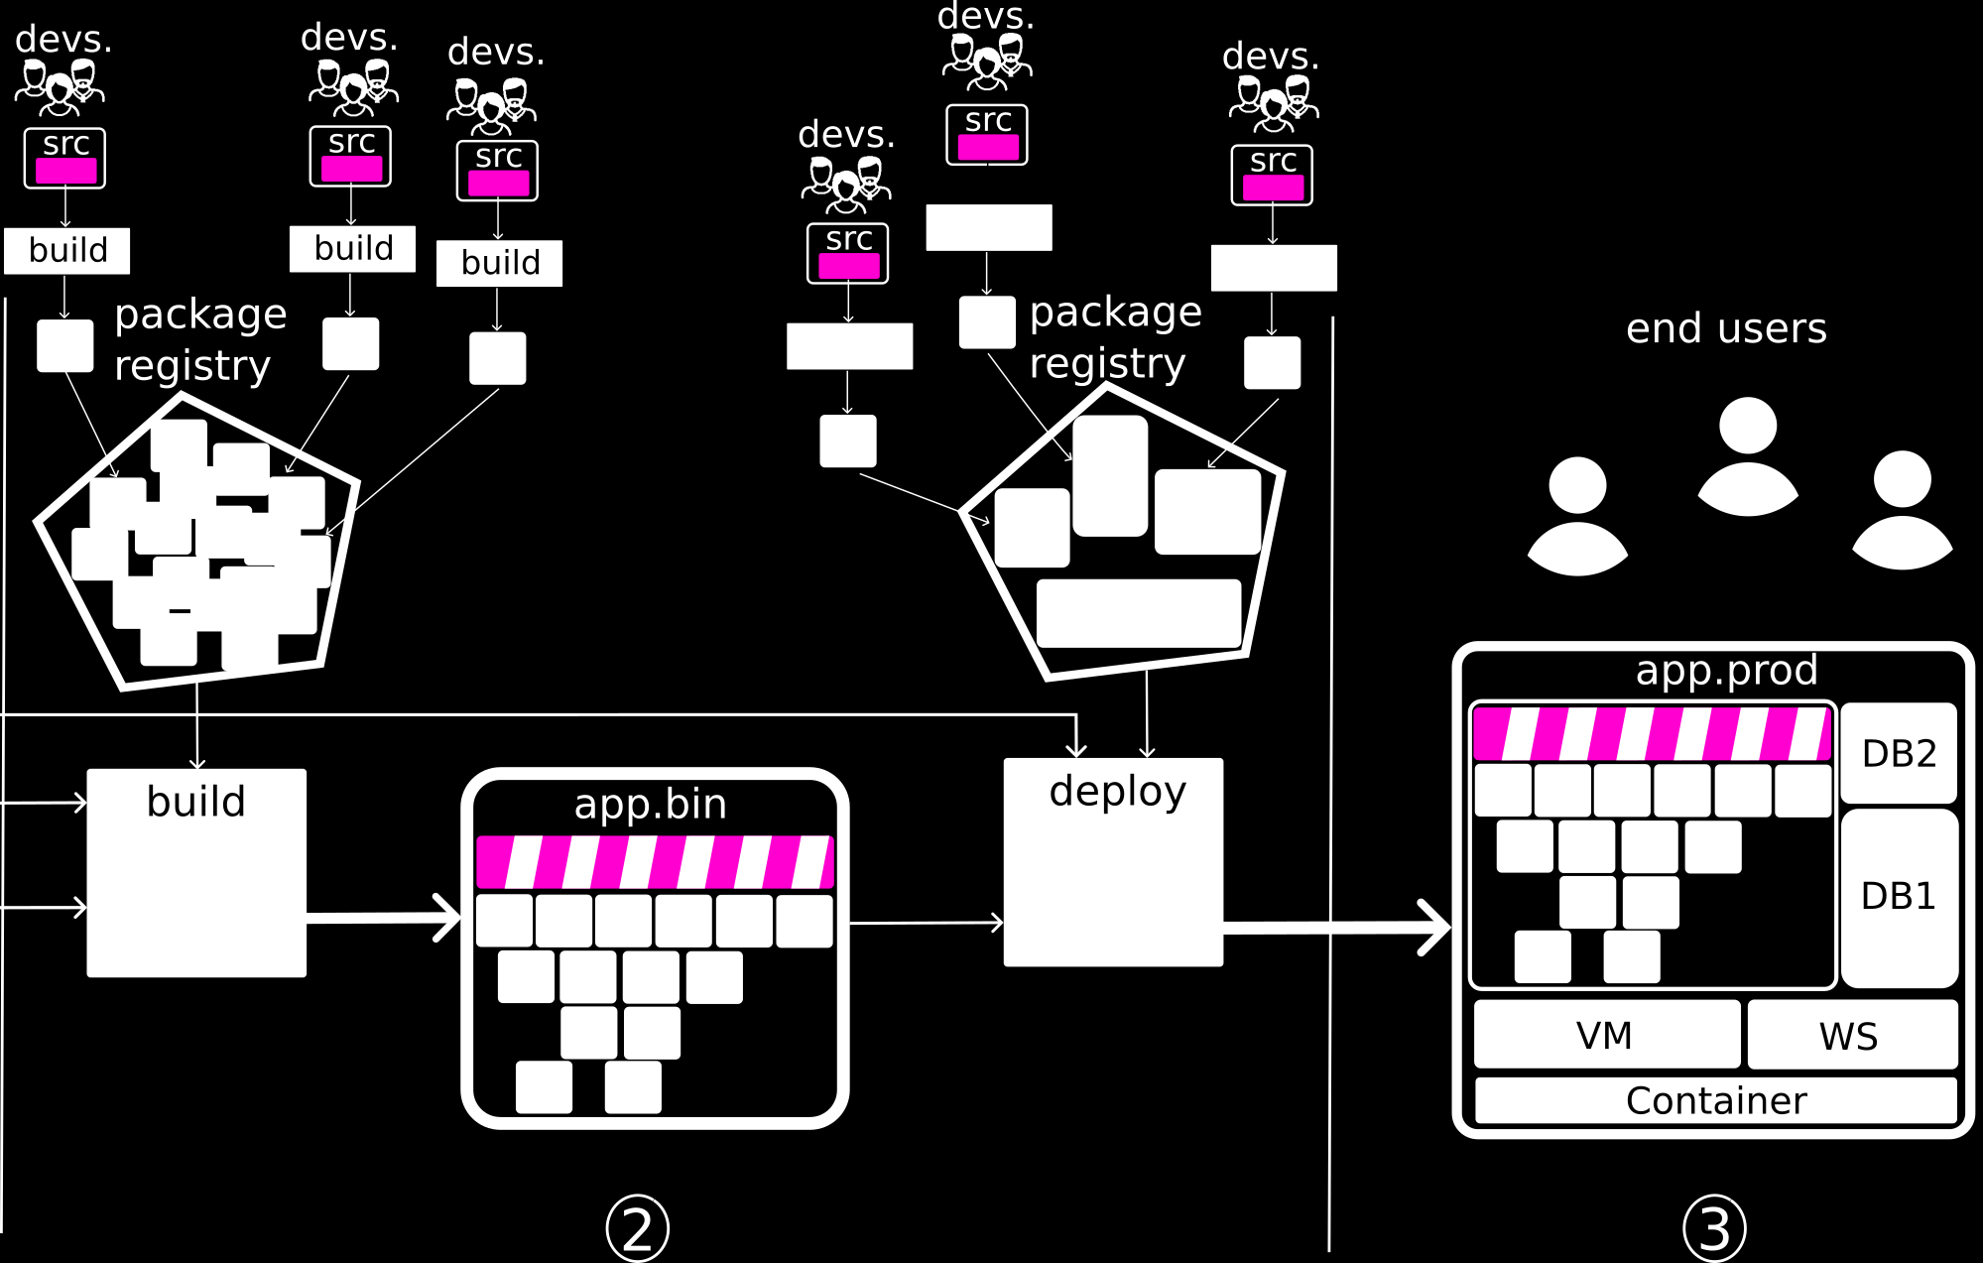
Software supply chain

Slide 4
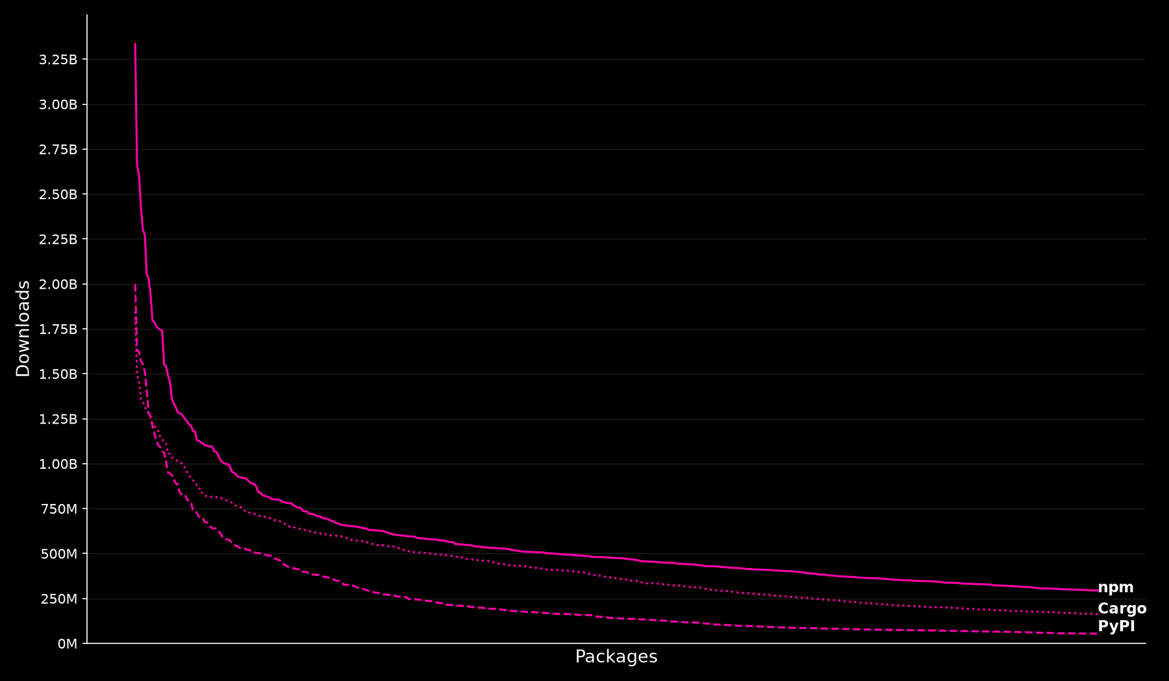
Software Supply Chain
Dependencies ripple
Third-party libraries, code analysis tools, continuous integration
Open source projects
Monoculture

Slide 5
Security
Trusting trust
  Trojan in compiler
  Malicious CI, e.g. Solarwinds
Tampering with reusable components
  Third-party libraries, e.g, Codecov, log4J, event-stream, xz
  Github actions, e.g., tj-action
  Typosquatting, e.g., Python packages, Minecraft mods
AI amplification
  Larger software supply chain (pre-trained models, agents, etc.)
  Reduce time to exploitation
  Agents operate with high privileges that can be exploited
Thompson, Ken. "Reflections on trusting trust." Communications of the ACM 1984.
Ladisa, Piergiorgio, et al. "Sok: Taxonomy of attacks on open-source software supply chains." IEEE S&P 2023.
Neupane, Shradha, et al. "Beyond typosquatting: an in-depth look at package confusion." USENIX security 2023.
Williams, Laurie, et al. "Research directions in software supply chain security." ACM TOSEM 2025.
Fares, Madjda, Yogya Gamage, and Benoit Baudry. "Unpacking Security Scanners for GitHub Actions Workflows." arXiv 2026.

Slide 6
Reliability
Conflicting dependencies
  Black-box resolution algorithms
  Pinning vs. floating
Breaking dependencies
  Incorrect dependencies
  Breaking updates
Wang, Ying, et al. "Will dependency conflicts affect my program's semantics?." IEEE TSE 2021
Venturini, Daniel, et al. "I depended on you and you broke me: An empirical study of manifesting breaking changes in client packages." ACM TOSEM 2023.
Jayasuriya, Dhanushka, et al. "Understanding the impact of APIs behavioral breaking changes on client applications." FSE 2024.

Slide 7
Human aspects
Pressure on OSS developers
  OSS developers quit and remove, e.g., left-pad
  OSS developers pressured to accept changes, e.g., xz
Political activism
  OSS developers protest through their packages
Mens, Tom. "An ecosystemic and socio-technical view on software maintenance and evolution." ICSME 2016
Kula, Raula Gaikovina, and Christoph Treude. "In war and peace: the impact of world politics on software ecosystems." ESEC / FSE 2022.

Slide 8
Addressing Reliability
Compatibility testing
  Target test generation on client – library usages
  Benchmark library updates with a pool of clients
  Dependency graph analysis for remediation
Fixing breaking updates
  Diff on dependency versions
  Client code analysis
  Patch generation
  Update transformation generation
Chen, Lingchao, et al. "Taming behavioral backward incompatibilities via cross-project testing and analysis." ICSE 2020.
Zhang, Lyuye, et al. "Compatible remediation on vulnerabilities from third-party libraries for java projects." ICSE 2023.
Zhong, Hao, and Na Meng. "Compiler-directed migrating API callsite of client code." ICSE 2024.
Fruntke, Lukas, and Jens Krinke. "Automatically fixing dependency breaking changes." FSE 2025.
Reyes, Frank, et al. "Byam: Fixing breaking dependency updates with large language models." EMSE 2026.

Slide 9
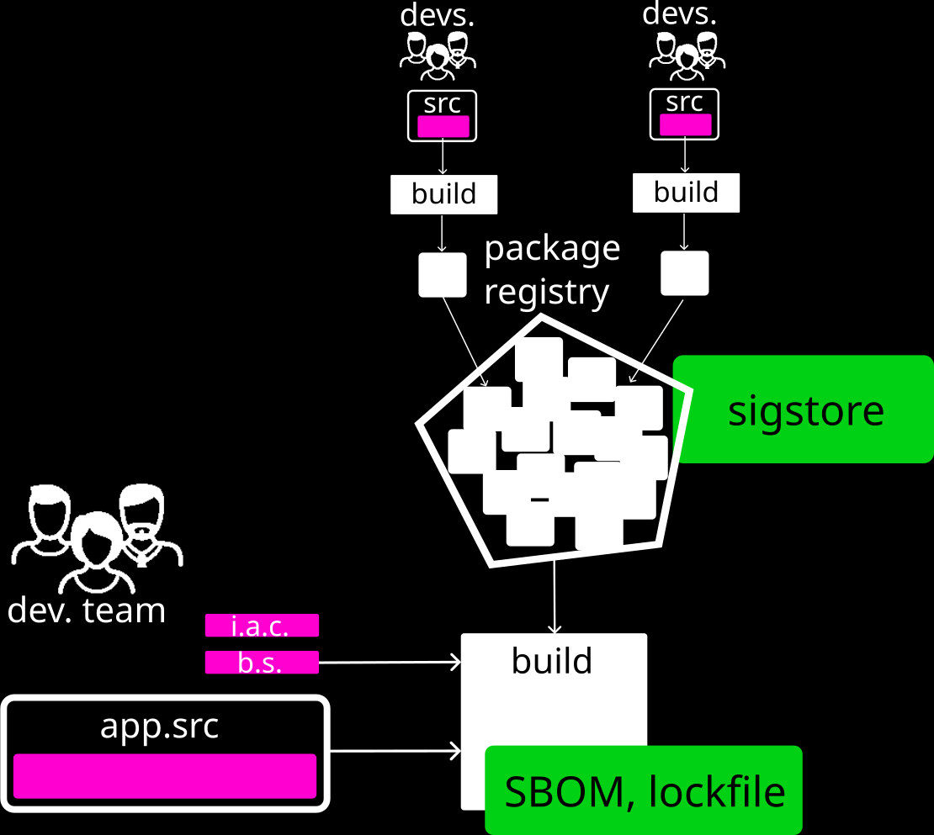
Addressing security
Transparency
Integrity
Provenance
Signing
Torres-Arias, Santiago, et al. "in-toto: Providing farm-to-table guarantees for bits and bytes." 28th USENIX Security Symposium (USENIX Security 19). 2019.
Schorlemmer, Taylor R., et al. "Signing in four public software package registries: Quantity, quality, and influencing factors." IEEE S&P 2024.
Mohayeji, Hamid, et al. "Securing dependencies: A comprehensive study of Dependabot’s impact on vulnerability mitigation." EMSE 2025.
Gamage, Yogya, et al. "The design space of lockfiles across package managers." EMSE 2026.

Slide 10
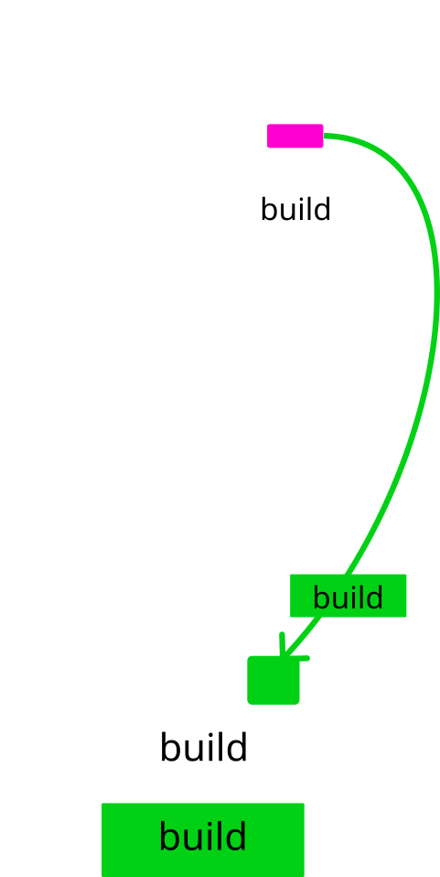
Addressing Security
Reproducible builds
  Concurrency
  Environment specificities
Canonicalization
Diverse compilers
Wheeler, David A. "Countering trusting trust through diverse double-compiling." ACSAC 2005.
Lamb, Chris, and Stefano Zacchiroli. "Reproducible builds: Increasing the integrity of software supply chains." IEEE Software 2021.
Fourné, Marcel, et al."It’s like flossing your teeth: On the importance and challenges of reproducible builds for software supply chain security." IEEE S&P 2023.
Dietrich, Jens, and Behnaz Hassanshahi. "DALEQ--Explainable Equivalence for Java Bytecode." ASE 2025.
Sharma, Aman, Benoit Baudry, and Martin Monperrus. "Causes and Canonicalization of Unreproducible Builds in Java." IEEE TSE 2025.

Slide 11
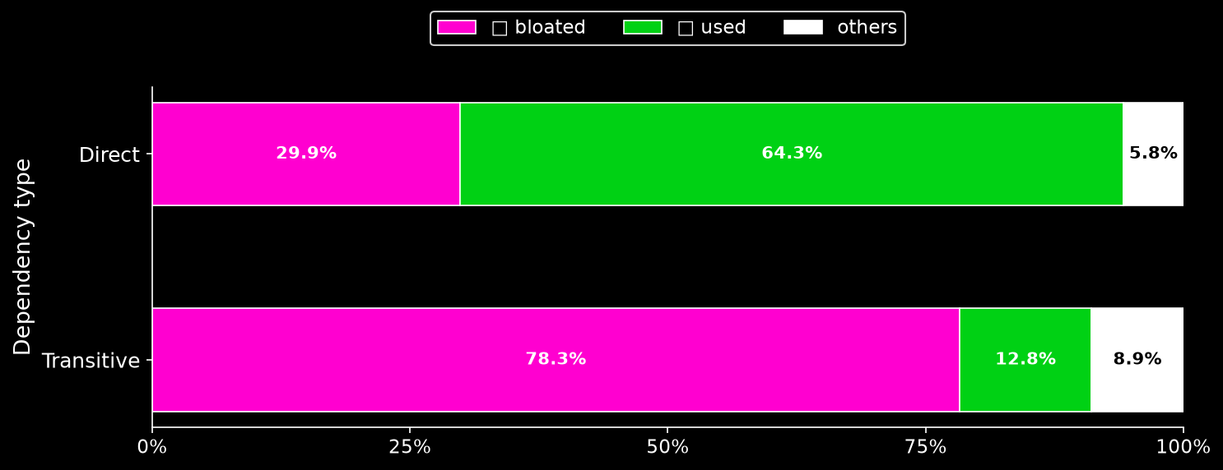
Oversized Supply Chain
Package managers simplify reuse
And we reuse too much
Soto-Valero, César, Thomas Durieux, and Benoit Baudry. "A longitudinal analysis of bloated java dependencies." ESEC/FSE 2021.

Slide 12

Dependency removal
Analyze the client / library interactions
  Statically or dynamically
  Identify unused library
Remove unused libraries
  Rewrite the dependency file
  Rewrite the binary
Bruce, Bobby R., et al. "Jshrink: In-depth investigation into debloating modern java applications." ESEC / FSE 2020.
Latendresse, Jasmine, et al. "Not all dependencies are equal: An empirical study on production dependencies in npm." ASE 2022.
Song, Xiaohu, et al. "Efficiently trimming the fat: Streamlining software dependencies with java reflection and dependency analysis." ICSE 2024.
Drosos, Georgios-Petros, et al. "Bloat beneath python’s scales: A fine-grained inter-project dependency analysis." FSE 2024.
Liu, Yuxin, et al. "Detecting and removing bloated dependencies in CommonJS packages." JSS 2025.

Slide 13

Dependency specialization
Analyze the client / library interactions
  Statically or dynamically
  Identify unused library parts
Remove unused parts
  Mocks
  Code Removal
Mishra, Shachee, and Michalis Polychronakis. "Shredder: Breaking exploits through API specialization." ACSAC 2018.
Soto-Valero, César, et al. "Automatic specialization of third-party java dependencies." IEEE TSE 2023.
Han, Jiaxuan, et al. "δ-SCALPEL: Docker Image Slimming Based on Source Code Static Analysis." IEEE TSE 2025.

Slide 14

Dependency reduction
Reduce necessary dependencies
Regenerate
Rewrite
Transplant
Vasilakis, Nikos, et al. "Supply-chain vulnerability elimination via active learning and regeneration." CCS 2021.
Jaisri, Pongchai, Brittany Reid, and Raula Gaikovina Kula. "A Preliminary Study on Self-contained Libraries in the NPM Ecosystem." Book chapter 2025.
Liu, Yuxin, Cristian Bogdan, and Benoit Baudry. "A Longitudinal Study of Dependency Reclassifications in JavaScript Projects." 2026.

Slide 15
more to come this week
Galápagos: Automated N-Version Programming with LLMs
Causes and Canonicalization of Unreproducible Builds in Java
Understanding the Limitations of C/C++ Binary Third-Party Library Detection Tool: An Empirical Study at Scale
Pig: Leveraging Large Language Models for Python Library Migrations
Package Dashboard: A Cross-Ecosystem Framework for Dual-Perspective Analysis of Software Packages
CI/CD Configuration Practices in Open-Source Android Apps: An Empirical Study
JDetect: A Fine-Grained Detecting Method for Java Source SCA by Fusing Behavioral and Code Features
How Can ChatGPT Support Human Security Testers to Help Mitigate Supply Chain Attacks?
Break to Adapt: Knowledge-Based Updates of Breaking Dependencies in JavaScript
DependaFix: A GitHub App for Fixing Breaking Dependency Updates in CI Build for Java Projects
An Empirical Analysis of Machine Learning Model and Dataset Documentation, Supply Chain, and Licensing Challenges on Hugging Face
Towards Predicting Multi-Vulnerability Attack Chains in Software Supply Chains from Software Bill of Materials Graphs
Uncovering Similar but Different Packages in PyPI and Potential Security Threats

Slide 16
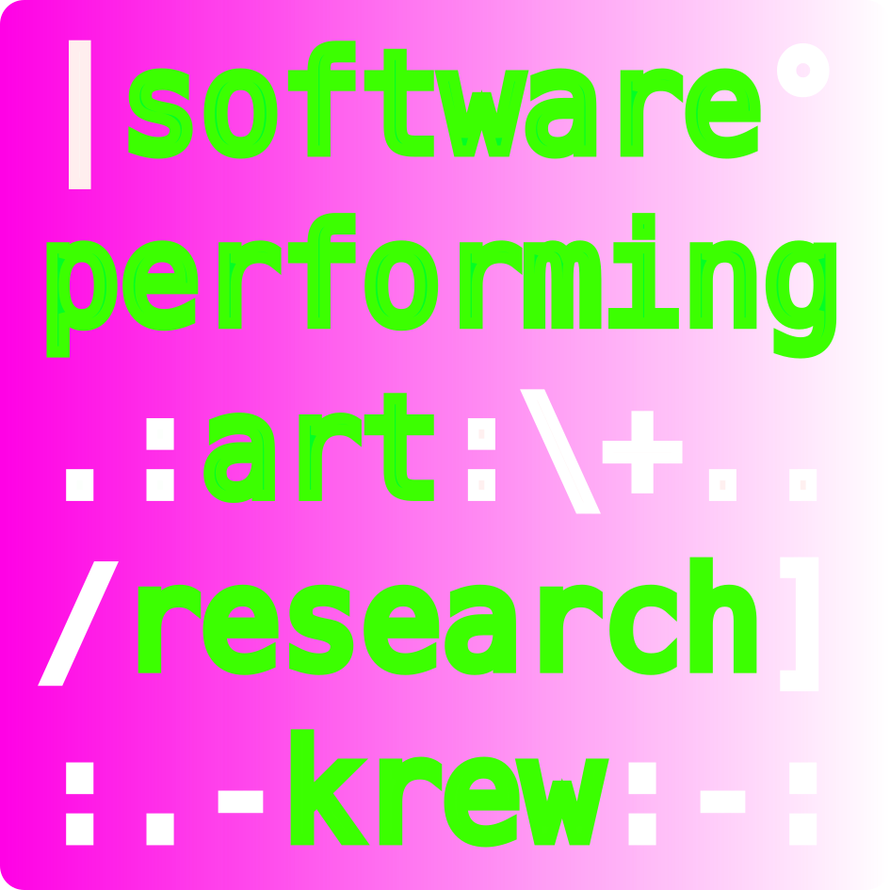
Conclusion *
Dependencies ripple across the supply chain
AI amplifies the challenges
The supply chain can be drastically reduced
Crew: Y. Gamage, M. Fares, N. Gonzalez, A. Nasirianfar, J. Ron, A. Sharma, F. Reyes, C. Soto-Valero, D. Tiwari, T. Durieux, M. Monperrus
* “security teams do not consider rickrolling as malicious behavior”. Ladisa et al. "Journey to the center of software supply chain attacks." IEEE S&P 21.6
Spracklen, Joseph, et al. "We have a package for you! a comprehensive analysis of package hallucinations by code generating LLMs." USENIX Security 2025
Carmine Cesarano, and Martin Monperrus. “The Grand Software Supply Chain of AI Systems”. 2026

