Slide 1
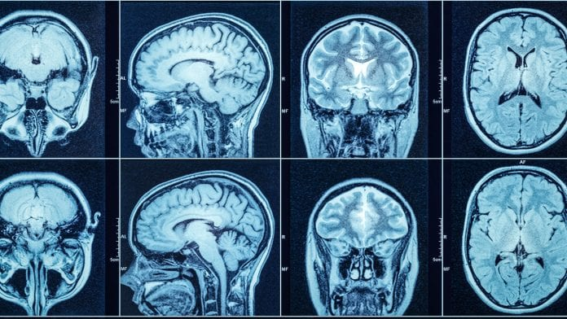
Alzheimer’s Disease, Cognitive Function, and the Entorhinal Cortex
Presentation by jesse Birchfield
Research with Andrew Holbrook (UCLA), nick tustison (UVA)
For the Alzheimer’s disease neuroimaging initiative
Notes:
I'm Jesse. I'm working with Dr. Andrew Holbrook from UCLA biostat, and Dr. Nick Tustison from UVA Radiology,
as part of a wider network of neuroscientists, radiologists, statisticians and other experts for the Alzheimer's Disease Neuroimaging Initiative.

Slide 2
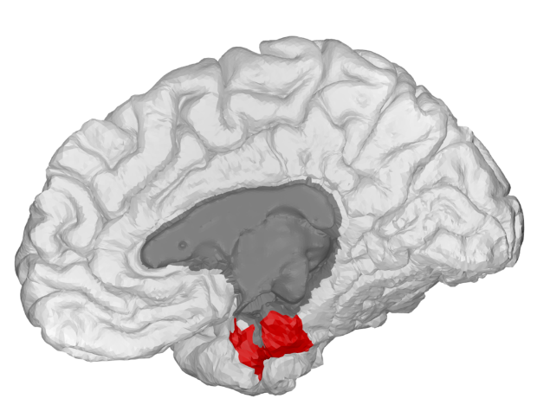
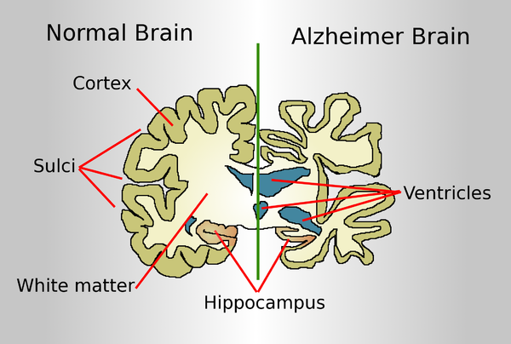
Scientific background
Cerebral cortex: outer layer of brain.
Entorhinal cortex (ERC): region shown in red.
With Alzheimer’s, entire cortex loses mass.
ERC first region affected.
Notes:
Let's jump right into the scientific question. The human cerebral cortex is a layer of tissue, less than a centimeter thick, wrinkled and folded to fit inside the skull.
Each hemisphere contains a region called the entorhinal cortex (shown in red), which plays a role in spatial memory formation.
In patients with Alzheimer's, the entire cortex loses mass and literally gets thinner, as you can see in the bottom image.
Neuroscientists believe that the ERC is the first region affected.

Slide 3

Data
Data: up to 6 longitudinal observations, over 36 months, on 663 unique subjects, collected by ADNI.
Diagnosis: cognitively normal (CN), mild cognitive impairment (MCI), or Alzheimer’s disease (AD), based on cognitive test.
Each observation: from MRI scan of brain, computational algorithms estimate thickness of 62 cortical regions (including ERC), in mm.
Biological question: how cognitive diagnosis relates to ERC thickness.
Notes:
Our data set contains 2515 longitudinal observations on 663 unique subjects, with up to 6 per subject.
At the first visit, researchers gave each subject a diagnosis of cognitively normal, mild cognitive impairment, or Alzheimer's Disease, based on his/her performance on a cognitive test.
At each visit, researchers conducted an MRI scan of the subject's brain.
From the raw images, they used computational algorithms to measure the thickness of 62 different cortical regions, including the entorhinal cortex, which we're looking at.
Our biological question is how cognitive diagnosis relates to ERC thickness.
Later we'll see how this gives rise to some questions about image interpretation algorithms, and some more general questions about statistical methodology.

Slide 4
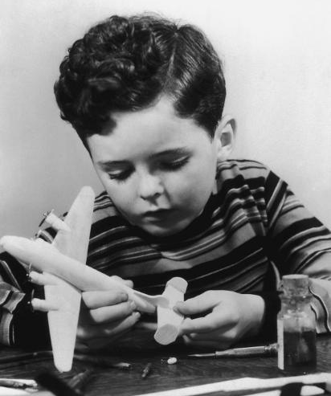
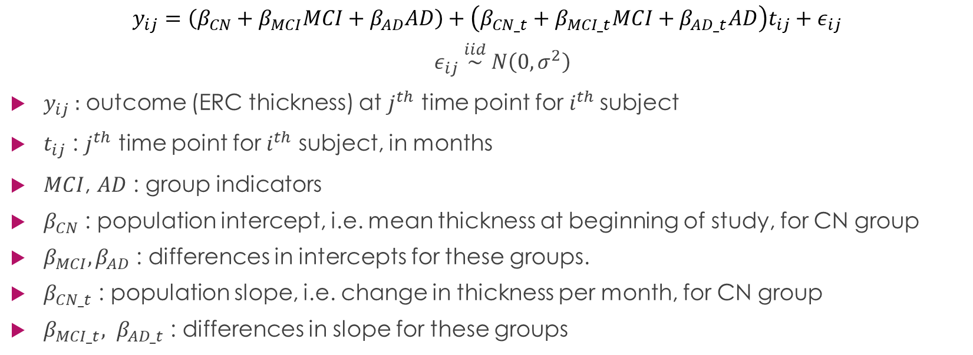
Model 1: linear
$$y_{ij}=\left(β_{CN}+β_{MCI}MCI+β_{AD}AD\right)+\left(β_{CN_t}+β_{MCI_t}MCI+β_{AD_t}AD\right)t_{ij}+ε_{ij}$$
$ε_{ij} \overset{iid}{\sim } N\left(0, σ^{2}\right)$
$y_{ij}$ : outcome (ERC thickness) at $j^{th}$ time point for $i^{th}$ subject
$t_{ij}$ : $j^{th}$ time point for $i^{th}$ subject, in months
$MCI$, $AD$ : group indicators
$β_{CN}$ : population intercept, i.e. mean thickness at beginning of study, for CN group
$β_{MCI}, β_{AD}$ : differences in intercepts for these groups.
$β_{CN_t}$ : population slope, i.e. change in thickness per month, for CN group
$β_{MCI_t}, β_{AD_t}$ : differences in slope for these groups
Notes:
I haven't been working on this for very long, and the results won’t take long to discuss.
What has been most fun for me so far is the process of building up a more and more complex statistical model.
I get to be the little boy in the picture, putting the airplane together, starting with elementary tools but later on, getting to play with some power tools.
A lot of these techniques were actually brand new to me, and a lot of fun to try out, even if they're standard in the field.
If they're boringly familiar to you, thank you for humoring me.
I'd like to take you through the process so far.
Shown here is our starting point, which I'll call Model 1.
We'll take a minute to learn what the variables stand for.
This a basic linear model with intercept, slope, and random error.
The outcome y_ij is the ERC thickness for the i^th subject at the j^th time point.
T_ij represents how many months have gone by for the j^th time point for the i^th subject.
CN, or cognitively normal, is the reference group.
MCI and AD are indicators for membership in the "mild cognitive impairment" or "Alzheimer's disease" group.
Remember, every subject is in exactly one of these three groups.
Beta_CN is the population intercept, i.e. the mean outcome at the beginning of the study, for the CN group.
Beta_MCI and Beta_AD are the differences in mean for these groups. So each group has its own intercept.
Beta_CN_t is the slope, or change in outcome per month, for the CN group.
Beta_MCI_t and Beta_AD_t are the differences in slope for these groups.
What we have then, is a three different lines, each with its own slope and intercept, for the three different groups.
Finally, epsilon_ij is the error term. The interpretation that makes the most sense to me is that the error term epsilon_ij captures all the influences on y_ij that aren't accounted for by the other variables in the model. It's the "everything else" term. In the Bayesian interpretation, which I like, the definition of random is unknown, so the outcome is the sum of knowns and unknowns. We always assume the mean of the error term is 0 over all the observations, because if it were anything else, we could just change the intercept by that amount. The Central Limit Theorem tells us that the sum of lots of small independent deviations has, roughly, a normal distribution.
Although this first model is not completely naïve, we can improve it in various ways.
For one thing, it assumes that, not only over all subjects, but even for a given subject i, the average of the epsilon_ij’s is 0.
This usually doesn't fit the data when there are nested observations.
In fact, for a given subject, the differences from the group mean tend to be systematic -- above the mean for all time points, or below.
Put another way, the within-subject errors are correlated.

Slide 5
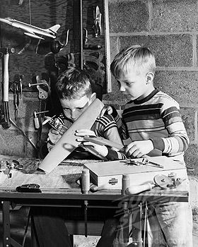
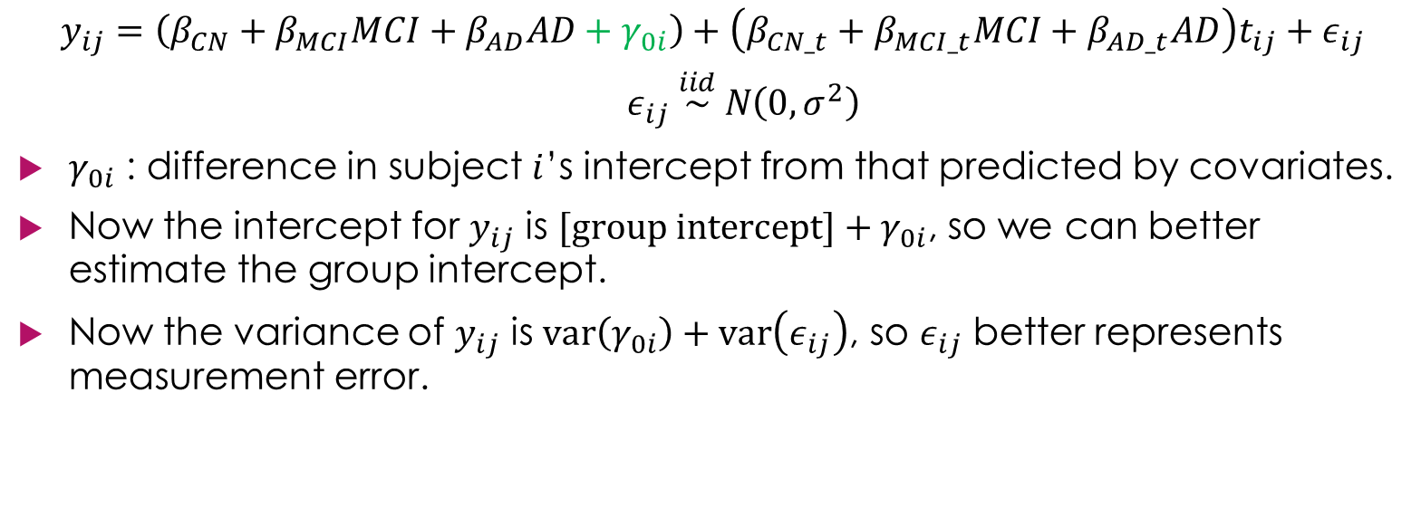
Model 2: random intercepts
$$y_{ij}=\left(β_{CN}+β_{MCI}MCI+β_{AD}AD+γ_{0i}\right)+\left(β_{CN_t}+β_{MCI_t}MCI+β_{AD_t}AD\right)t_{ij}+ε_{ij}$$
$ε_{ij} \overset{iid}{\sim } N\left(0, σ^{2}\right)$
$γ_{0i}$ : difference in subject $i$’s intercept from that predicted by covariates.
Now the intercept for $y_{ij}$ is $[group intercept]+γ_{0i}$, so we can better estimate the group intercept.
Now the variance of $y_{ij}$ is $var\left(γ_{0i}\right)+var\left(ε_{ij}\right)$, so $ε_{ij}$ better represents measurement error.
Notes:
We can account for this by adding "random," i.e. subject-specific, effects. This is what I've done in Model 2.
(I'm going to use the convention of showing the changes in green, so you don't have to reread everything.)
Here, gamma_0i represents the difference in subject i's intercept from that predicted by the covariates.
It's random, in the Bayesian sense, because we don't know, in real world terms, what accounts for it.
I just learned about random intercepts. Everybody else here has probably seen them before. But I think it's amazing what this one addition to the model accomplishes.
First, it decomposes the intercept for the i^th subject into the sum of two components, the overall group intercept and the individual deviation.
We can get a better estimate of the group intercepts--our real interest--if they're not distorted by the individual deviations.
Second, it decomposes the variance of y_ij into the variance in gamma_0i plus the variance of epsilon_ij.
Remember, epsilon represents "everything else" that influences y_ij.
But that no longer includes subject specific effects, so it more closely represents something like measurement error, which is something we want to estimate.
But what about subject specific characteristics that affect change over time, the progression of the disease?
This would cause the subject to differ from the mean by an increasing or decreasing amount.

Slide 6

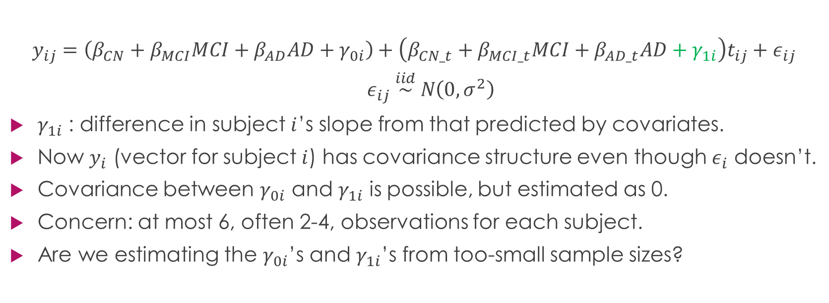
Model 3: random slopes
$$y_{ij}=\left(β_{CN}+β_{MCI}MCI+β_{AD}AD+γ_{0i}\right)+\left(β_{CN_t}+β_{MCI_t}MCI+β_{AD_t}AD+γ_{1i}\right)t_{ij}+ε_{ij}$$
$ε_{ij} \overset{iid}{\sim } N\left(0, σ^{2}\right)$
$γ_{1i}$ : difference in subject $i$’s slope from that predicted by covariates.
Now $y_{i}$ (vector for subject $i$) has covariance structure even though $ε_{i}$ doesn’t.
Covariance between $γ_{0i}$ and $γ_{1i}$ is possible, but estimated as 0.
Concern: at most 6, often 2-4, observations for each subject.
Are we estimating the $γ_{0i}$’s and $γ_{1i}$’s from too-small sample sizes?
Notes:
We solve that in a similar way. We also add a random slope.
Let gamma_1i be the difference in subject i's slope from that predicted by the covariates.
The random intercept and slope induce a certain covariance pattern on y_i, even without a covariance pattern in epsilon_i.
I like that – I like my epsilons to be uncorrelated.
We could also allow for covariance *between* the random intercept and slope.
It turns out, though, that for our data, the best estimate for this was zero, so we left it out to simplify the model.
My concern at this point was this.
The random effects are doing a lot of work.
But random effects for subject i are estimated only from subject i, who has at most 6, and often as few as 2, observations.
If the sample size is small, and the observation happens to be unrepresentative of the population, the estimate will be very wrong.

Slide 7

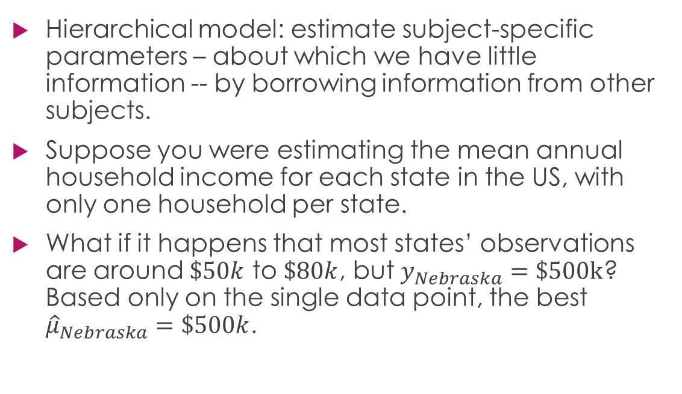
Hierarchy
Hierarchical model: estimate subject-specific parameters – about which we have little information -- by borrowing information from other subjects.
Suppose you were estimating the mean annual household income for each state in the US, with only one household per state.
What if it happens that most states’ observations are around $\$50k$ to $\$80k$, but $y_{Nebraska}=\$500k$? Based only on the single data point, the best ${\hat{μ}}_{Nebraska}=\$500k$.
Notes:
So what we're going to do is add hierarchy to the model.
This is a way of estimating parameters on one subject by borrowing information from other subjects.
Again, you’ve probably seen this before, but I’d just like to reflect on how brilliant this is.
To people who don't understand how this works -- not anybody here -- I like to explain it with an extreme example.
Suppose you were studying the mean household income in each of the fifty nifty United States, and you only could take one observation from each state.
And suppose that for most states, your observation was between $50k and $80k, but the household you surveyed in Nebraska answered $500k.
What is the "best" estimate of the Nebraska mean household income, based on your data?
Strictly speaking, the maximum likelihood estimate, the best linear unbiased estimate, etc. are all equal to the sample mean, which is equal to that one data point, $500k.
There is nothing illogical about that estimate.
But if it seems implausible to you, it's because you know more than just that one data point.
You know that Nebraska is one of the United States, and that mean income between states does differ, but not by THAT much.
How do we incorporate this knowledge to estimate Nebraska?

Slide 8

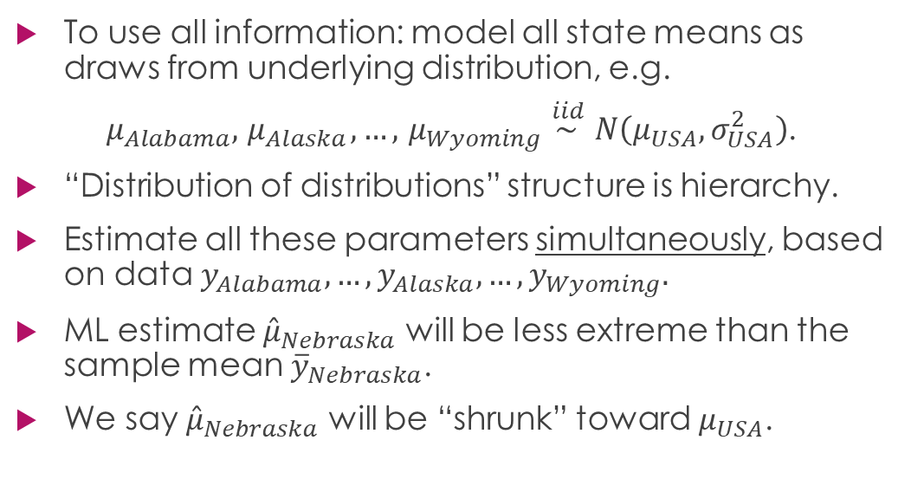
Shrinkage
To use all information: model all state means as draws from underlying distribution, e.g.
$μ_{Alabama}, { μ}_{Alaska}, …,{ μ}_{Wyoming} \overset{iid }{\sim }N\left(μ_{USA}, σ_{USA}^{2}\right)$.
“Distribution of distributions” structure is hierarchy.
Estimate all these parameters simultaneously, based on data $y_{Alabama}, …,y_{Alaska}, …,y_{Wyoming}.$
ML estimate ${\hat{μ}}_{Nebraska}$ will be less extreme than the sample mean ${\overline{y}}_{Nebraska}$.
We say ${\hat{μ}}_{Nebraska}$ will be “shrunk” toward $μ_{USA}$.
Notes:
Model each state mean mu_Alabama, mu_Alaska, ... mu_Wyoming as a draw from a distribution of state means N(mu_USA, sigma2_USA).
Now estimate all of these parameters *simultaneously* from the data y_Alabama, ... y_Wyoming. The ML estimate for mu_Nebraska will be less extreme than the sample mean ybar_Nebraska. Why? It’s more likely that our observation of Nebraska is extreme than that Nebraska itself is extreme.
We say that the estimate for mu_Nebraska will be "shrunk" toward mu_USA.

Slide 9

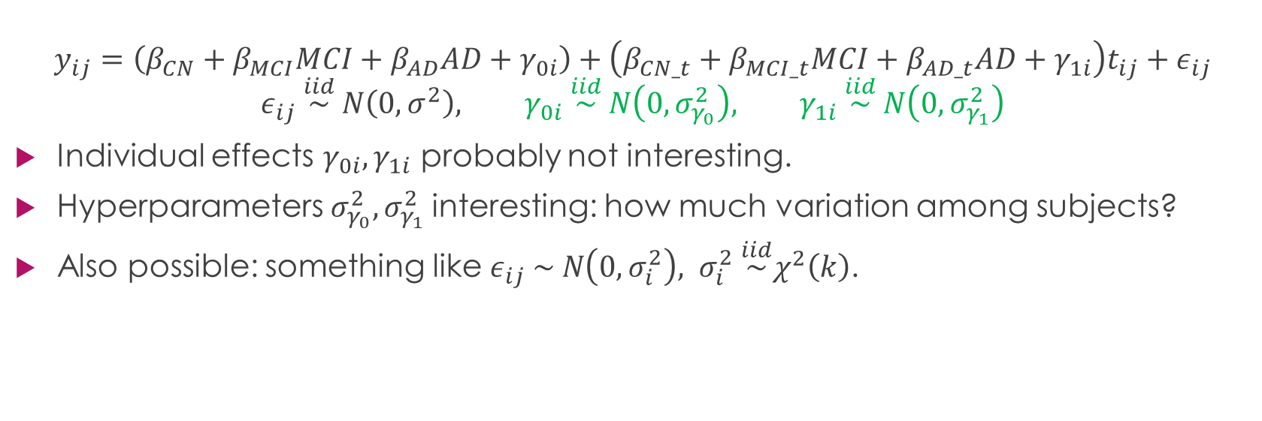
Model 4: hierarchy
$$y_{ij}=\left(β_{CN}+β_{MCI}MCI+β_{AD}AD+γ_{0i}\right)+\left(β_{CN_t}+β_{MCI_t}MCI+β_{AD_t}AD+γ_{1i}\right)t_{ij}+ε_{ij}$$
$$ε_{ij} \overset{iid}{\sim } N\left(0, σ^{2}\right), γ_{0i} \overset{iid}{\sim } N\left(0,σ_{γ_{0}}^{2}\right), γ_{1i} \overset{iid}{\sim } N\left(0,σ_{γ_{1}}^{2}\right)$$
Individual effects $γ_{0i}, γ_{1i}$ probably not interesting.
Hyperparameters $σ_{γ_{0}}^{2},σ_{γ_{1}}^{2}$interesting: how much variation among subjects?
Also possible: something like $ε_{ij} \sim N\left(0,σ_{i}^{2}\right), σ_{i}^{2} \overset{iid}{\sim }χ^{2}\left(k\right)$.
Notes:
So here's Model 4. We borrow information from all of our 663 subjects to estimate each subject's random effects.
Scientifically, we are not really interested in estimates of individual effects,
but we might be interested in hyperparameters like sigma2_gamma_0, which captures how much the intercepts differ from the mean of their group.
What if the measurement error, or whatever is captured by epsilon, differs by subject?
It's also possible to put hierarchy on the epsilons, by making each sigma_i^2 a draw from an underlying distribution.
We have to weigh the benefits against the computational cost. The model already has 1335 parameters.
Sometimes we just try adding something like this and see if it makes a difference or not.
For our data, it doesn’t.
Other than making the model more complex, how else can we improve our parameter estimates?

Slide 10

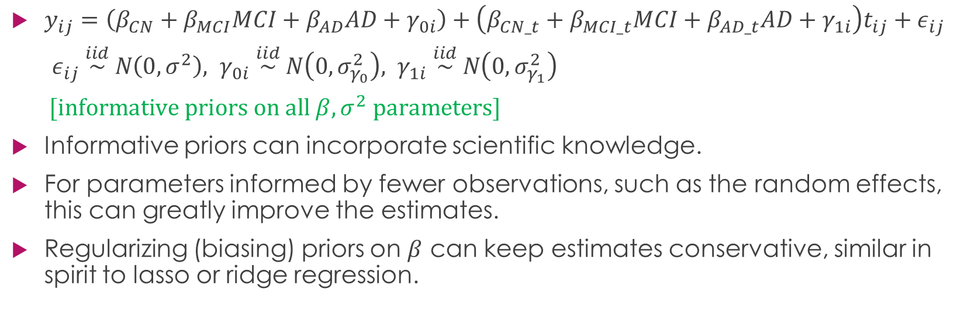
Model 5: priors
$y_{ij}=\left(β_{CN}+β_{MCI}MCI+β_{AD}AD+γ_{0i}\right)+\left(β_{CN_t}+β_{MCI_t}MCI+β_{AD_t}AD+γ_{1i}\right)t_{ij}+ε_{ij}$
$ε_{ij} \overset{iid}{\sim } N\left(0, σ^{2}\right), γ_{0i} \overset{iid}{\sim } N\left(0,σ_{γ_{0}}^{2}\right), γ_{1i} \overset{iid}{\sim } N\left(0,σ_{γ_{1}}^{2}\right)$
$[informative priors on all β, σ^{2} parameters]$
Informative priors can incorporate scientific knowledge.
For parameters informed by fewer observations, such as the random effects, this can greatly improve the estimates.
Regularizing (biasing) priors on $β$ can keep estimates conservative, similar in spirit to lasso or ridge regression.
Notes:
Add priors.
So far there is nothing Bayesian about the model.
But now we can use informative priors to incorporate scientific knowledge.
There is lots of data already about the thickness of different cortical regions, at different ages, with and without Alzheimer's disease.
Part of my job is finding it and translating it into priors for the model.
We can also use what are called "regularizing" priors to keep our estimates conservative.
For estimates of beta, this is analogous to lasso or ridge regression.
We probably don't need this technique for this model, since we don't have many covariates and variable selection is not the main challenge we're facing.
So now we've added random effects, hierarchy, and priors.
The next feature we're going to add to the model is what some writers call robustness.
You’ll notice that every distribution in the model above is Normal.

Slide 11


Robust likelihood estimation
Normal model: outliers extremely unlikely.
Density of $N(0,1)$ is .40 at 0, but .004 at 3.
Modeled with Normal distribution, outliers pull mean away from center of the data and inflate variance.
Student $t$ distribution has three parameters:
location/mean $μ$
scale $σ$
kurtosis $ν$ (formerly known as “degrees of freedom”).
Small $ν$ : heavy tails. Large $ν$ : almost-Normal. Thus, t model with $ν$ to be estimated reflects “open-mindedness” about outliers.
Density of t($ν=1$) is only 10 times smaller at 3 than at 0.
Notes:
This guy pities the fool who won’t consider other distributions.
Here’s why. The density of the standard normal distribution at 0 is about .40, and at 3 about .004.
So a z-score of 3 is roughly 100 times less likely than a z-score of 0.
If we use a Normal model for the likelihood, we are encoding a belief that observations more than a couple sd's from the mean are extremely rare.
The model will avoid them at great cost.
So an outlier tends to pull the mean away from the center of the data and inflate the variance.
I'll show you a picture on the next slide.
However, while the Normal has only two parameters, the extended Student t has three: mean mu, scale sigma, and kurtosis nu.
If nu is small, we have fat tails; if large, maybe 30 or more, the curve is nearly Normal.
So using a t reflects "open mindedness" about outliers.
Consider: for a t(1df) distribution, a z-score of 3 is only 10 times less likely, not 100 times less likely, than a z-score of 0.

Slide 12
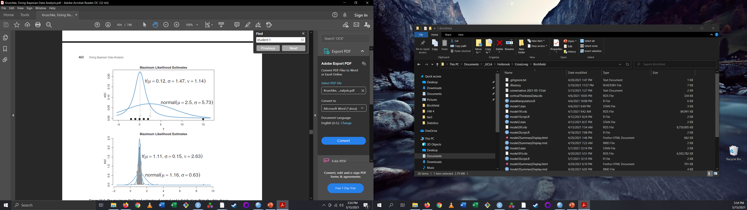
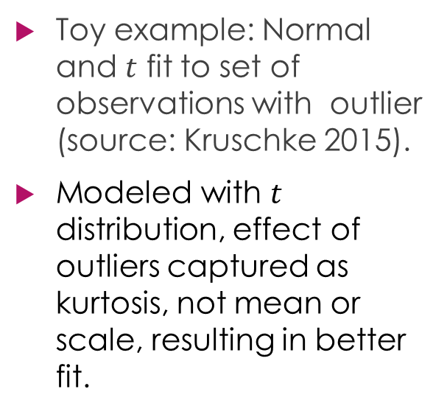
Illustration: Normal vs t likelihood
Toy example: Normal and $t$ fit to set of observations with outlier (source: Kruschke 2015).
Modeled with $t$ distribution, effect of outliers captured as kurtosis, not mean or scale, resulting in better fit.
Notes:
To show you what I mean, look at this toy example.
Under the Normal assumption, it's more likely that all observations are kind of far from the mean than that one is really far.
The mean has to move, and the sd has to be large, so that no observation is very many sd's from the mean.
But the t has the flexibility to consider that y=15 as an outlier, and it affects the kurtosis rather than the mean or scale.
I would consider that a better fit, but if you don't, we can agree to disagree.

Slide 13


Model 6: robust
$$y_{ij}=\left(β_{CN}+β_{MCI}MCI+β_{AD}AD+γ_{0i}\right)$$
$+ \left(β_{CN_t}+β_{MCI_t}MCI+β_{AD_t}AD+γ_{1i}\right)t_{ij}+ε_{ij}$
$$ε_{ij} \overset{iid}{\sim } t\left(0, σ,ν\right), γ_{0i} \overset{iid}{\sim } N\left(μ_{γ_{0}},σ_{γ_{0}}^{2}\right), γ_{1i} \overset{iid}{\sim } N\left(μ_{γ_{1}},σ_{γ_{1}}^{2}\right)$$
$[informative priors on all β, σ^{2}, ν parameters]$
Our data: estimates for $ν$ are low, indicating $t$ a better fit.
Hereafter, for compactness, write
$y_{ij}=x_{ij}^{T}β+z_{ij}^{T}γ+ε_{ij}$, etc.
Notes:
Here's model 6. All we’ve done is change the error distribution to t, which is equivalent to changing the likelihood to t.
When we ran the model, our estimates for nu were low, indicating that the t shape is a better fit.
This is now a pretty sophisticated model, but there’s one more big challenge before launch. We’re going to make one more revision today. Hereafter, write y_ij = x_ij T beta + z_ij T gamma + epsilon_ij.

Slide 14
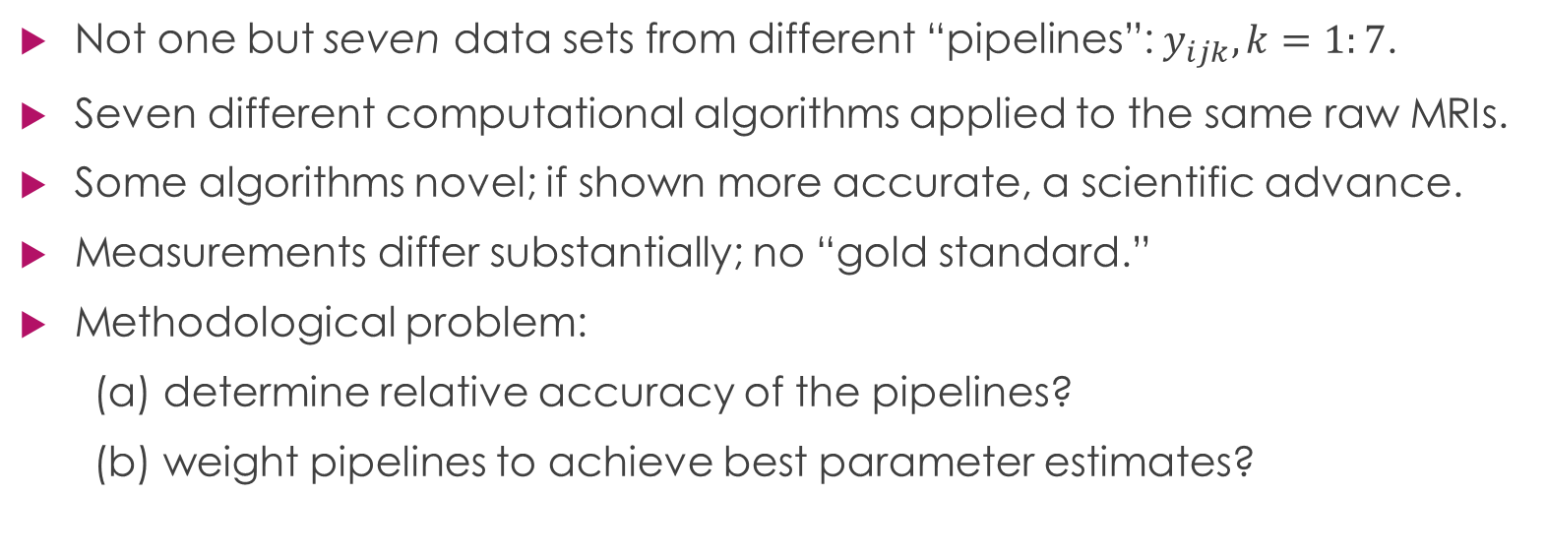
The puzzle: data selection
Not one but seven data sets from different “pipelines”: $y_{ijk}, k=1:7$.
Seven different computational algorithms applied to the same raw MRIs.
Some algorithms novel; if shown more accurate, a scientific advance.
Measurements differ substantially; no “gold standard.”
Methodological problem:
(a) determine relative accuracy of the pipelines?
(b) weight pipelines to achieve best parameter estimates?
Notes:
Here’s the challenge. We don’t just have one data set. We have seven data sets from what we’re calling different “pipelines.”
Each represents a different computational algorithm applied to the same raw MRIs.
Some of the algorithms were developed by this research team and associates, and if they are shown to be more accurate than the others, that will be an important scientific advance.
So that’s a second research question: which algorithm(s) is best?
The problem is, the measurements differ substantially, and there’s no objective gold standard by which to compare them.
There is a truth of the matter about these human beings’ cortical thicknesses at these particular points in time, but we’ll never know what it is.
So there’s an open methodological problem as well: how can we determine the relative accuracy of the pipelines? how should we weight them to achieve the best parameter estimates?
I think those questions will be answered together.

Slide 15

Model 7
$w_{ij}=$ $x_{ij}^{T}β+z_{ij}^{T}γ+δ_{ij}, δ_{ij} \sim N\left(0, σ^{2}\right)$
$y_{ijk}=w_{ij}+ε_{k}$, $ε_{k} \sim t\left(λ_{k}, τ_{k},ν_{k}\right)$
$w_{ij}$: true, unobserved cortical thicknesses.
Observations are true value plus random measurement error.
Each pipeline: different $t$ distribution of measurement errors.
Errors for pipeline $k$: systematic additive over/underestimation $λ_{k}$ and spread described by $τ_{k}$ and $ν_{k}$.
Nice feature: $w_{ij}$’s now parameters estimated by model, using all data.
Notes:
We have a first step, and it’s pretty clever. We’re going to model the true cortical thickness as a latent variable.
Sorry about the change in notation, but it’s unavoidable.
Suppose the true, unobserved cortical thickness w_ij are draws from this normal distribution.
Our observations, the y_ijk’s, are modeled as the true value plus a random measurement error.
We give pipeline has a different t distribution of measurement errors.
We estimate all three parameters, so each pipeline has a systematic over/underestimation lambda_k, and a spread described by tau_k and nu_k.
A nice feature is that the w_ij’s -- which again are the true values -- are estimated using all the data!
This is a brilliant move, and also hard to understand, so I’m going to let it sit a for a second.

Slide 16
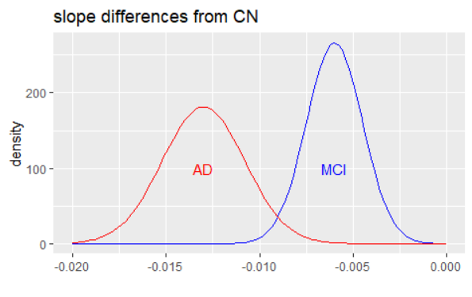
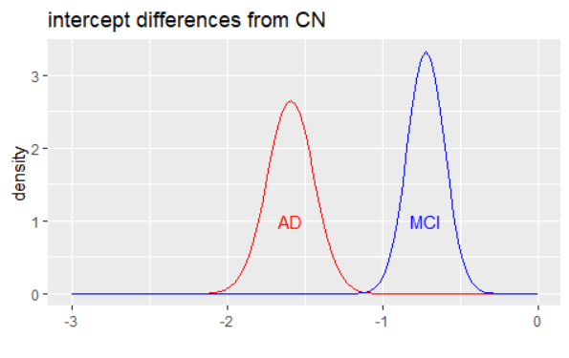
Some results
Posterior distributions:
Notes:
You’ve watched me spend the whole presentation constructing a model with lots of bells and whistles to give us the best possible estimates, so I should probably show you some.
These are posterior distributions of the differences in intercept (starting thickness) and slope (rate of thinning) of the two disease groups, compared with the CN group.
The important things to recognize are that the bulk of the distributions don’t include 0, so both disease groups are different from the reference. And the bulk of the distributions don’t overlap, so the disease groups are different from each other.

Slide 17
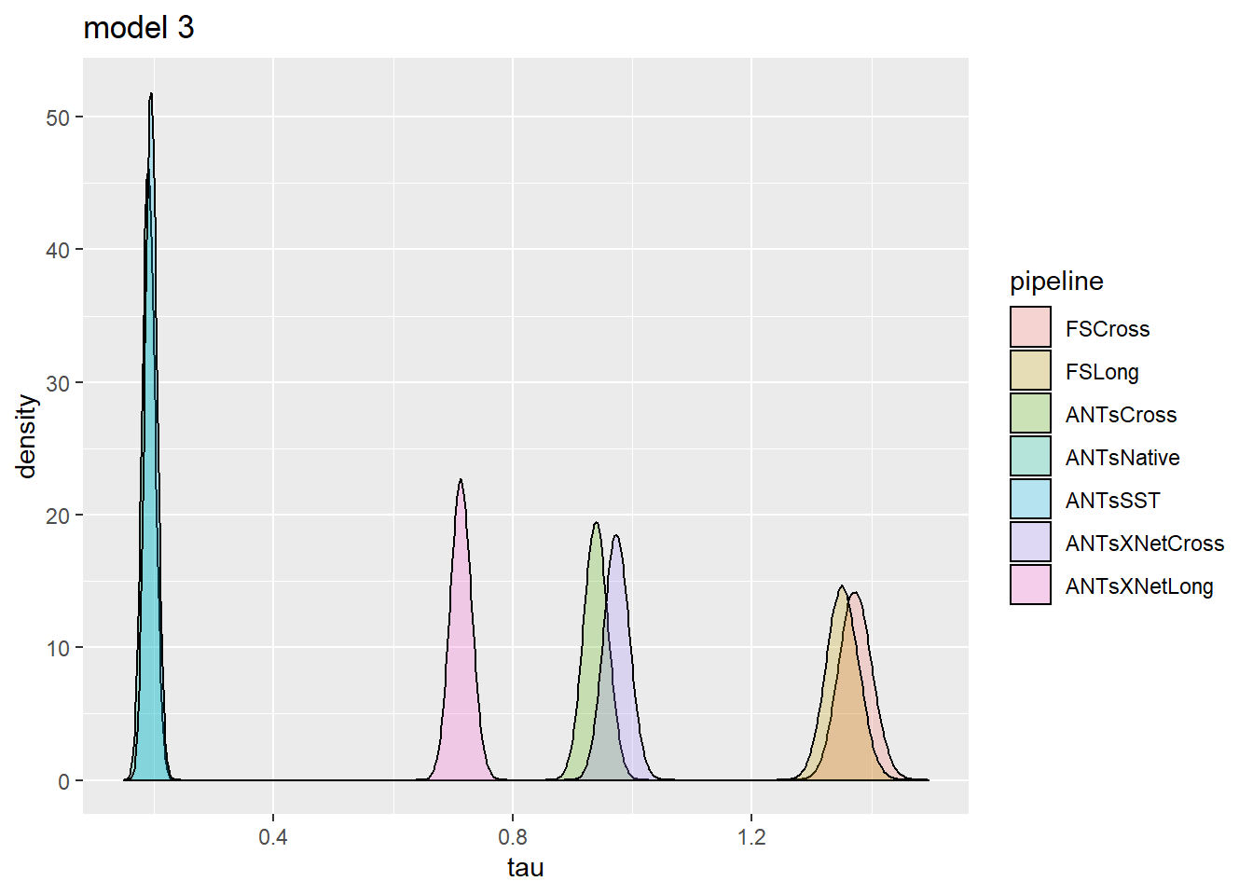
Posteriors for estimated relative accuracy of pipelines (smaller tau means more accurate):
Notes:
In the last model I showed you, tau_k is the scale parameter of the error in the k^th pipeline. A larger tau means a less accurate algorithm.
The model has a pretty definite opinion on the relative accuracy: the ANTsNative and ANTsSST perform the best. I’m told that this is good news, what the team was hoping to hear.
A Bayesian posterior, however, represents what a perfectly rational being would believe after seeing the data…
GIVEN the assumptions encoded in the model specification and the priors.
We realize that we’ve made some debatable assumptions, especially in the model specification.
For example, so far we’ve represented the seven pipelines as uncorrelated. I’m currently trying to think through the consequences of that.
Looking for creative ideas – lend us your cortical thickness!
There is of course more to say, but I’ll end here.

Slide 18
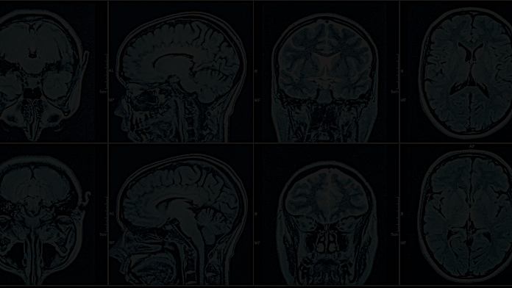
Whither now?
Based on the encoded assumptions, this model gives a clear answer about the accuracies of the pipelines. We are still debating those assumptions, however.
For example, in the current model, all seven pipeline errors are mutually independent and have the same priors. The result (I think) is that the model gives equal weight to all seven data sets.
Consider: two witnesses testify a criminal trial. The second testimony is very similar to the first. Does this add credibility to the first? If the two witnesses have never met, then yes. If they have collaborated, or copied from each other, then no.
To me, this suggests the following: if two pipelines generate similar measurements by different methods, they should be given more weight, but if by similar methods, they should be given less weight. Now the problem is, can this be determined from the data?
Those with great cortical thickness, please weigh in!

