Slide 1
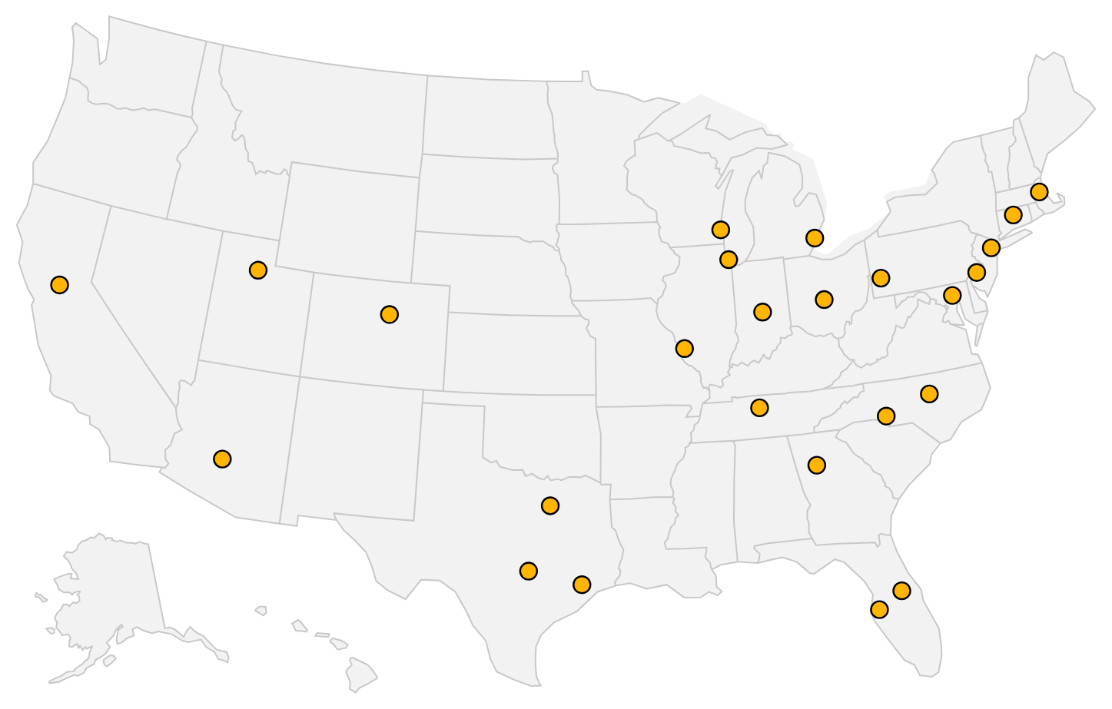
Stockflow
Branch-level demand forecasting and inventory rebalancing
Right product at the right branch, so surgeons, hospitals and their patients are not left waiting.
Bryce Biyeba
Data Science Intern · October 2026
25 branches · 300 SKUs · 4,889 branch × SKU combinations
Synthetic data – for demonstration
1
Notes:
Good morning. I'm Bryce Biyeba, a data science intern, and this is Stockflow: a tool that forecasts demand for every product at every branch and recommends moving stock between branches before anyone runs out.
Why it matters for Stryker: when an implant or a piece of equipment isn't at the branch that needs it, a surgeon waits, and so does the patient. Our mission is to make healthcare better together with our customers, and having the right product at the right branch is a very concrete part of that.
One thing to say up front, in the spirit of integrity: everything you'll see runs on synthetic data I generated to behave like a real distributor's ERP and warehouse extracts: 25 branches, 300 SKUs, three years of daily history, deliberately messy. The method is real; the dollar figures describe that simulated network, not Stryker.
In the next eight minutes: the problem, how the system works, how accurate the forecasts are, what the rebalancing engine recommends, the business impact, what the dashboard looks like for a branch manager, and a proposal for a pilot.
Likely question: "Why synthetic data?" Answer: I didn't have access to company data, so I built a generator that includes the problems real extracts have (outages, keying errors, stock-outs) so the cleaning and modeling had to handle them for real.

Slide 2
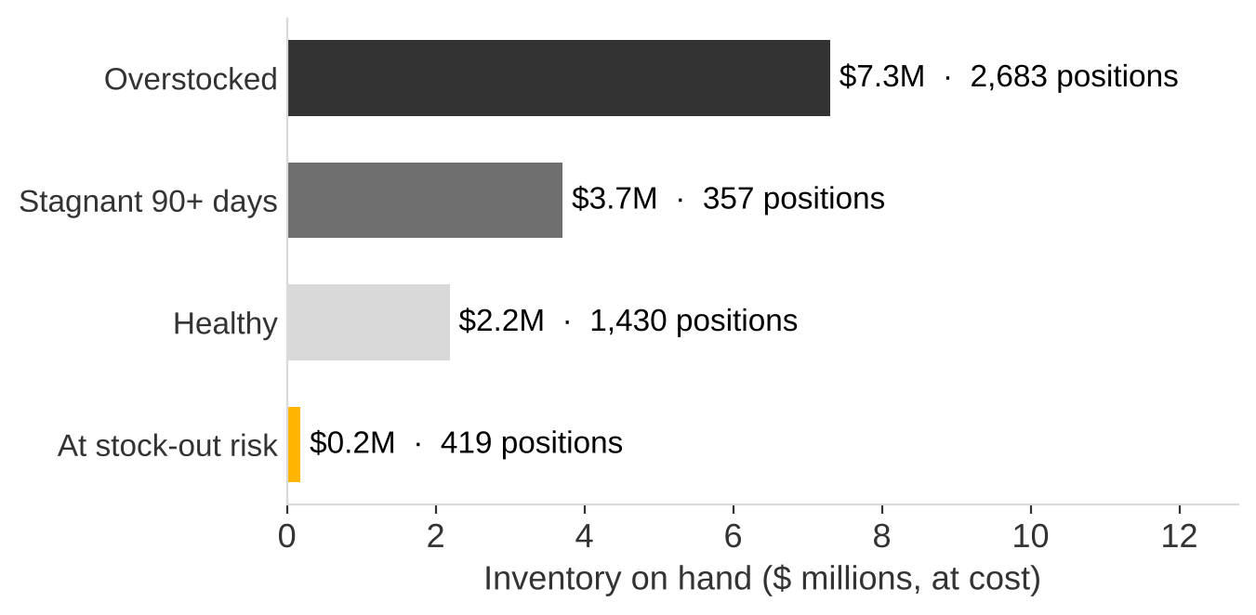
62% of inventory dollars sit above target while 419 branch positions face stock-outs
5.8%
of branch × SKU days were stock-out days (3 years)
$8.3M
above target, of $13.4M on hand
$3.7M
stagnant: no sale in 90+ days
Inventory on hand by position status, at cost
Synthetic data – for demonstration
2
Notes:
Here's the problem in one picture. Across the network there's $13.4M of inventory on hand. $8.3M of it, 62%, sits above the level each branch actually needs. At the same time, 419 branch-and-product combinations are likely to run out before their next replenishment arrives.
Over three years of history, 5.8% of all branch-product days were stock-out days, days when a customer could have asked for something the branch didn't have.
The chart shows where the money is. The gold bar is the inventory at the positions facing stock-outs: only $186k. The shortage isn't a lack of inventory; it's inventory in the wrong place. A branch in one city has months of supply while another is about to stock out of the same item.
And $3.7M hasn't sold in more than 90 days. Almost all of that, $3.7M, is product the whole network can't sell within a year, so that's a liquidation decision, not something transfers can fix. I call that out separately so we don't pretend the model solves it.
Likely question: "How is 'above target' defined?" Answer: target is forecast demand over the lead time plus the review period, plus safety stock at a 95% service level. Anything above that is excess.

Slide 3
One pipeline turns three years of branch data into transfers a planner approves
ERP / WMS
extracts
Clean &
validate
Forecast
Inventory
policy
Rebalancing
optimizer
Dashboard
Planner
approval
sales, stock moves,
POs, promotions
outages, returns,
stock-out days
LightGBM + statistical,
P10 / P50 / P90
safety stock,
reorder point, risk
min-cost transfers
under constraints
plain-language
reason per move
nothing moves
without sign-off
Every step checks its inputs; every assumption is documented in the repository.
Synthetic data – for demonstration
3
Notes:
This is the whole system on one line, left to right.
It starts from the extracts any ERP and warehouse system already produces: daily sales, stock movements, open purchase orders, promotions and lane costs. The first step cleans and validates them: duplicates, returns, system outages, keying errors, and, importantly, days when a branch was out of stock, because sales on those days understate real demand.
Then the forecast: a single machine-learning model, LightGBM, trained across all 4,889 branch-product combinations, alongside classic statistical models for slow movers. The best one is picked per segment. Every forecast comes with a range, not just a number.
The inventory policy turns that range into safety stock, reorder points and a stock-out probability for every position.
The optimizer then finds the cheapest set of transfers that covers shortfalls from branches with excess, respecting safety stock, storage capacity and transit time.
Finally, the dashboard: and this last box in gold matters most. Nothing moves until a planner approves it. Every approval or rejection is logged with who, when and why. That's accountability built in.
Likely question: "How long does a run take?" Answer: about five minutes for this network; I also tested a network ten times larger, which completes on a single 4-core machine.

Slide 4
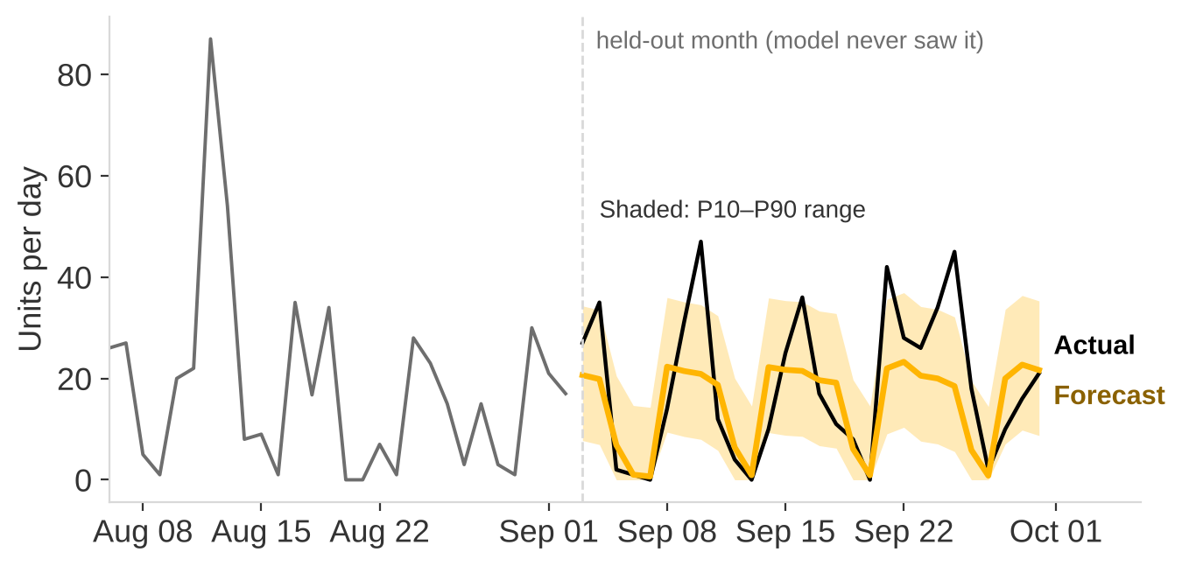
Forecasts are 33% more accurate than the seasonal baseline on a month the model never saw
Model (held-out month) | WAPE | MAE | Bias
Seasonal naive (baseline) | 74.9% | 3.38 | +1.2%
Exponential smoothing | 56.6% | 2.55 | +2.5%
Croston (intermittent) | 57.3% | 2.58 | +0.9%
LightGBM (global ML) | 49.8% | 2.25 | +0.0%
Selected per segment | 49.8% | 2.25 | +0.0%
WAPE = absolute error ÷ actual units; MAE in units per day. P10–P90 band held 83% of actual days (target 80%).
Branch B24, SKU S0057 (Tools), 2026-09-03 to 2026-09-30
Synthetic data – for demonstration
4
Notes:
To keep the evaluation honest, I chose the models using three earlier months and then scored them on a fourth month that played no part in any decision. That's the month you see here.
The chart is one real branch-product pair, B24 and S0057, a Tools item. I picked it by rule, not by eye: it's the A-class item whose error is closest to the A-class median. Grey is the month before, black is what actually sold, gold is the forecast, and the shaded band is the 10th-to-90th percentile range. Daily demand is noisy; the forecast tracks the weekly rhythm and the level.
The table compares models on the held-out month. WAPE is total absolute error as a share of actual units. The seasonal-naive baseline, which just repeats last week, misses by 75%. The selected models miss by 50%, a 33% improvement, with bias under one percent. Over a full 28-day total, which is what drives safety stock, the error is 13%.
The P10-to-P90 band contained 83% of actual days against an 80% target: slightly conservative, which I've documented.
Likely question: "Why is daily error still around fifty percent?" Answer: many items sell a few units a day or less, so daily numbers are inherently noisy; that's why we plan on totals and ranges, not single days.

Slide 5
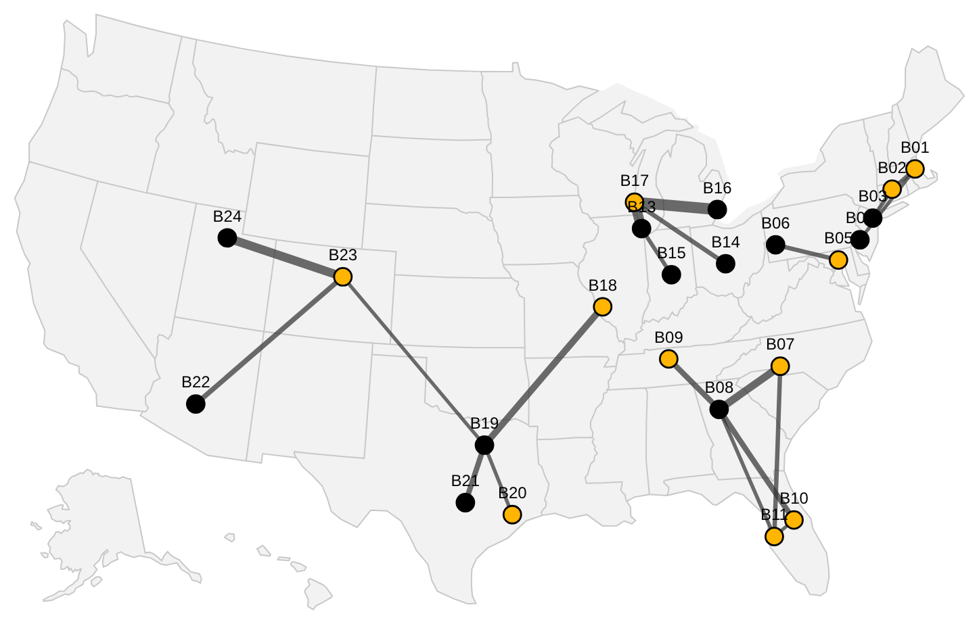
895 transfers cost $46k to move and save $216k net, $11k more than a rule of thumb
From → To | SKU | Units | Net savings | Reason
B10 → B17 | S0190 | 208 | $4,318 | Excess → shortfall
B19 → B23 | S0190 | 215 | $4,206 | Excess → shortfall
B14 → B19 | S0285 | 202 | $3,781 | Excess → shortfall
B10 → B07 | S0190 | 132 | $3,330 | Excess → shortfall
B19 → B09 | S0134 | 216 | $3,249 | Excess → shortfall
Each move ships with a plain-language reason a branch manager can check.
Top 20 of 259 corridors · line width = units · black = sending branch, gold = receiving
Synthetic data – for demonstration
5
Notes:
This is the rebalancing engine's output. It weighs three costs at once: the freight to move a unit, the lost sale if a branch runs out, and the holding and obsolescence cost of excess left sitting. It also never pulls a sending branch below its own reorder point, never overfills a receiver, respects storage capacity, skips tiny moves, and only uses lanes of four transit days or less.
The map shows the 20 busiest corridors, out of 259; they carry 45% of the units. Black dots are branches sending stock, gold dots are branches receiving it.
The table is the five most valuable moves. Every one is "excess to shortfall": a branch with more than it needs sending to a branch about to run out. For example, the top move sends 208 units of S0190 from B10 to B17 for $1k in freight and saves about $4k.
Overall: 895 transfers, $46k in freight, $216k net savings, compared with $206k from a simple rule of thumb that serves the most urgent shortages first.
Likely question: "How stable is the plan?" Answer: I re-solved it with service level, freight cost, forecast error and forecast level each changed. 67% to 92% of the same moves survive, and net savings stay between $182k and $248k.

Slide 6
Rebalancing frees $1.2M of excess and avoids 85% of expected lost sales
Measure | Before | After
Excess above target | $8.3M | $7.1M
Annual carrying cost of excess | $2.18M | $1.90M
Expected lost-sale units (lead time) | 10,533 | 1,585
Positions at stock-out risk | 419 | 76
Inventory turns | 8.5 | 9.0
Net savings (one cycle) | – | $216k
$1.2M
excess inventory put back to work
8,948 lost-sale units avoided
Model estimates for one planning cycle versus doing nothing.
Synthetic data – for demonstration
6
Notes:
Here is the impact of executing the recommended plan, compared with doing nothing.
The headline, in gold: $1.16M of excess inventory put back to work. Those units go where they'll sell instead of sitting on a shelf, which also means purchases the distribution center doesn't have to make.
For patients this is the line that matters most: expected lost-sale units during the replenishment lead time drop from 10,533 to 1,585. That's 85% of the units that would otherwise have been missing when someone asked for them. Positions at stock-out risk fall from 419 to 76.
The annual carrying cost of excess falls from $2.18M to $1.90M, and inventory turns improve from 8.5 to 9.0.
Two honest caveats. First, these are model estimates on synthetic data, so the size of the numbers won't transfer, but the method will. Second, stagnant stock barely changes ($3.7M before, $3.7M after), because nobody else in the network wants it; that needs a liquidation decision.
Likely question: "How are turns measured if transfers don't remove inventory?" Answer: on projected inventory after one replenishment cycle; units moved out of excess replace new purchases.

Slide 7
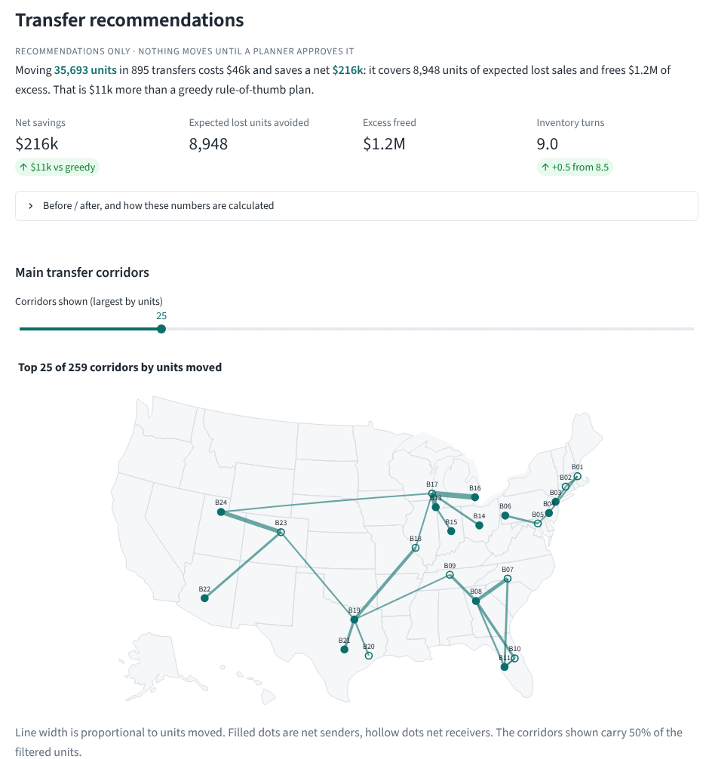
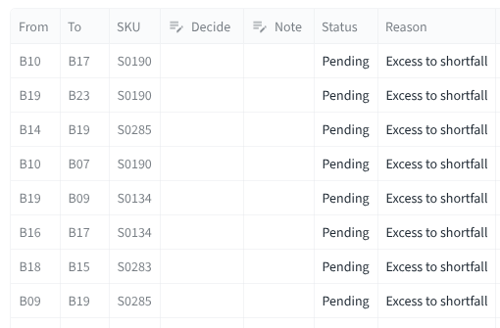
A branch manager sees what to move, why, and approves it on one screen
3
1
2
1
The plan in one sentence
2
Where stock flows
3
Approve or reject; logged
Live demo (view-only): stockflow-six-mu.vercel.app
Synthetic data – for demonstration
7
Notes:
This is the dashboard planners would actually use. It's built for branch and inventory teams, not data scientists: business language, every number in dollars, units or days.
Callout one: the page opens with the decision, in a sentence: how many units to move, what it costs and what it saves.
Callout two: the corridor map shows where stock is flowing, so a regional manager can sanity-check the plan at a glance.
Callout three, on the right: every recommended transfer is a row. The planner sets Approve or Reject and can add a note. That decision is recorded in an audit log with their name, the time and which model run it came from. Each row also carries a plain-language reason, for example: "B17 is short of S0190: on-hand covers 1 days of demand and stock-out risk is 100% before replenishment arrives. B10 holds 190 days of supply, above it..."
Other pages show inventory health by branch and category, a forecast explorer for any branch and product with the drivers explained in plain language, and an accuracy page that reports bias by branch so nobody is quietly short-changed.
There's a live, view-only demo at stockflow-six-mu.vercel.app.
Likely question: "Can it execute transfers in the ERP?" Answer: deliberately not. It recommends; people decide and then raise the transfer. That keeps accountability with the planner.

Slide 8
Next: a 12-week pilot at 2–3 branches on real ERP and warehouse data
Weeks 1–4
Weeks 5–10
Weeks 11–12
Connect data
Shadow pilot
Decide
7 standard extracts,
validated on load
2–3 branches; planners
approve or reject
Monitor error and bias;
retrain on drift
Limitations
Synthetic data so far
Plans one replenishment cycle
Normal error model for safety stock
Costs need finance approval
Right product, right branch: surgeons don't wait, so patients don't either.
Synthetic data – for demonstration
8
Notes:
To move from a demonstration to a decision, I'd propose a 12-week pilot.
Weeks one to four: connect real data. The tool reads seven standard extracts (sales, stock movements, open orders, promotions, branch and product masters, lane costs), all documented in the repository with validation rules, so a bad file is rejected with a clear message instead of a wrong answer.
Weeks five to ten: run it in shadow mode at two or three branches. Planners see the recommendations, approve or reject them, and we compare what the tool suggested with what actually happened. Rejections are valuable: they tell us where the cost assumptions are wrong.
Weeks eleven and twelve: decide. Monitoring is already built: weekly checks of forecast error and bias against the baseline, data drift, and an alert that triggers retraining.
The limitations, stated plainly: the data so far is synthetic; the plan looks one replenishment cycle ahead, not a multi-week schedule; safety stock assumes a normal error distribution; and the cost settings, like the price of a lost sale, need sign-off from finance before any dollar figure is trusted.
To close where we started: getting the right product to the right branch is one concrete way we make healthcare better with our customers. Surgeons don't wait, so patients don't either. Thank you; I'm happy to take questions.
Likely question: "What would you need from us?" Answer: read-only extracts for two or three branches, a planner willing to review recommendations weekly, and thirty minutes with finance on the cost settings.

