Slide 1
Web router

Slide 2
contents
Web Router Overview
Guide
More?

Slide 3
1. Web Router Overview
Functionality
Visually Striking
Modern and Quicker
Intuitive
Stub-ability

Slide 4
Functionality
Before: http://ipstudio-master.rd.bbc.co.uk/ipp-web/apps/webrouter/html/index.html
After: http://ipstudio-master.rd.bbc.co.uk/ips-web/#/web-router?_k=4zf4kf
Missing things
Tabs
Thumbnails
More Info

Slide 5
Visually striking
POSTCSS CSSNEXT: http://cssnext.io/
GEL:
Grid http://www.bbc.co.uk/gel/guidelines/grid
Iconography http://www.bbc.co.uk/gel/guidelines/iconography
Typography http://www.bbc.co.uk/gel/guidelines/typography
No bootstrap and no jQuery

Slide 6
Modern and Quicker
React: https://facebook.github.io/react/
Redux: http://redux.js.org/
React Router: https://github.com/ReactTraining/react-router
ES6: https://github.com/lukehoban/es6features
Webpack: https://webpack.github.io/
Node (6): https://nodejs.org/en/

Slide 7
Intuitive
No more toggling to do routing
Side by side not top bottom
Simple filtering
Consistent UI
Curvy lines

Slide 8
Stub-ability
IPS NMOS API: https://github.com/bbc/ips-nmos-api
Jest https://facebook.github.io/jest/

Slide 9
2. guide
This is an screenshot based guide on using the new Web Router broken up into two parts
Part One: UI
Part Two: The Code

Slide 10
Part One: UI
Home Page
Loading Screen
Web Router
Choose
Route
There is a video at the end to go into more depth of the UI

Slide 11
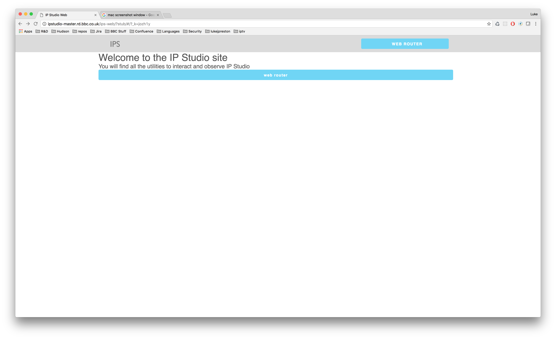
Home screen
A very simple navigation with room for things like
Configurator
Investigation Tools
Stats and Monitoes

Slide 12
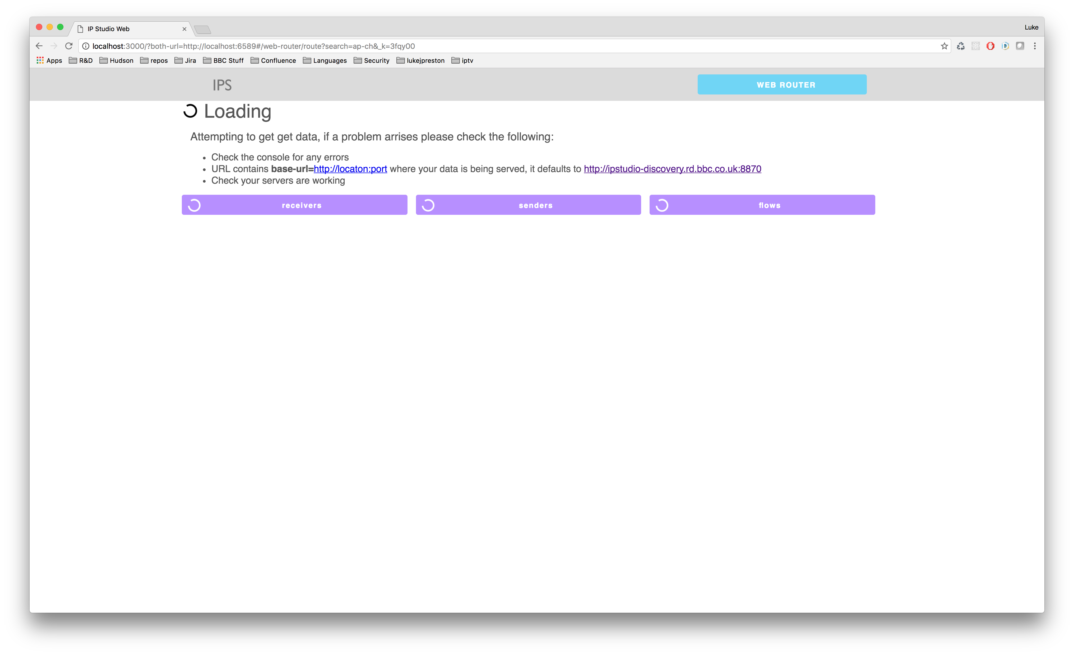
Loading
This is the initial loading screen, it will go red when things error

Slide 13
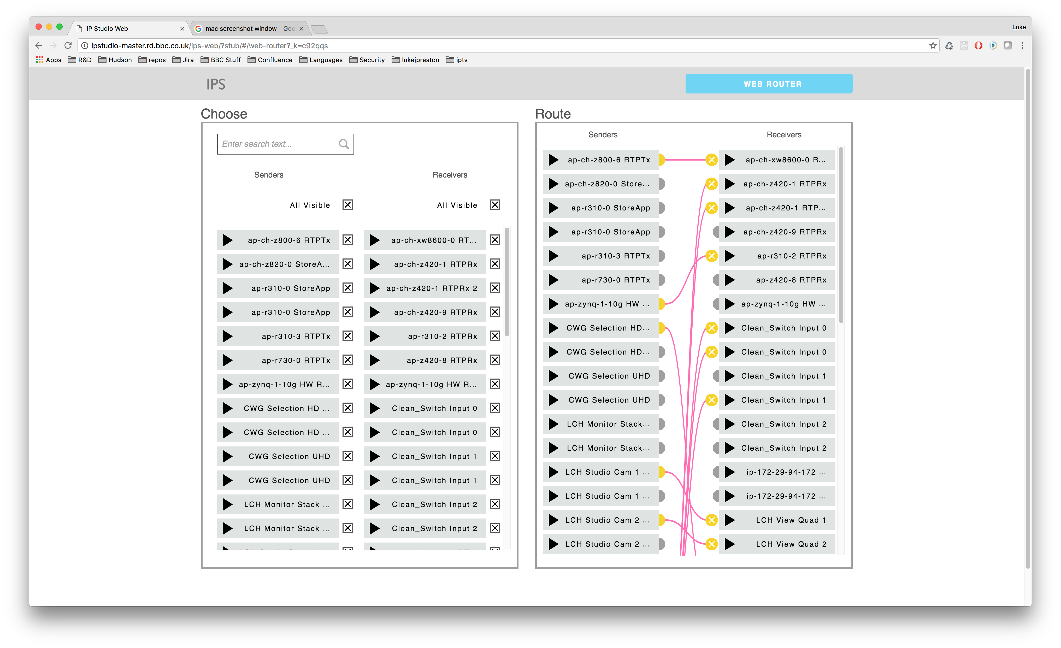
Web Router
This is the full screen Web Router with the Choose view beside the Route view

Slide 14
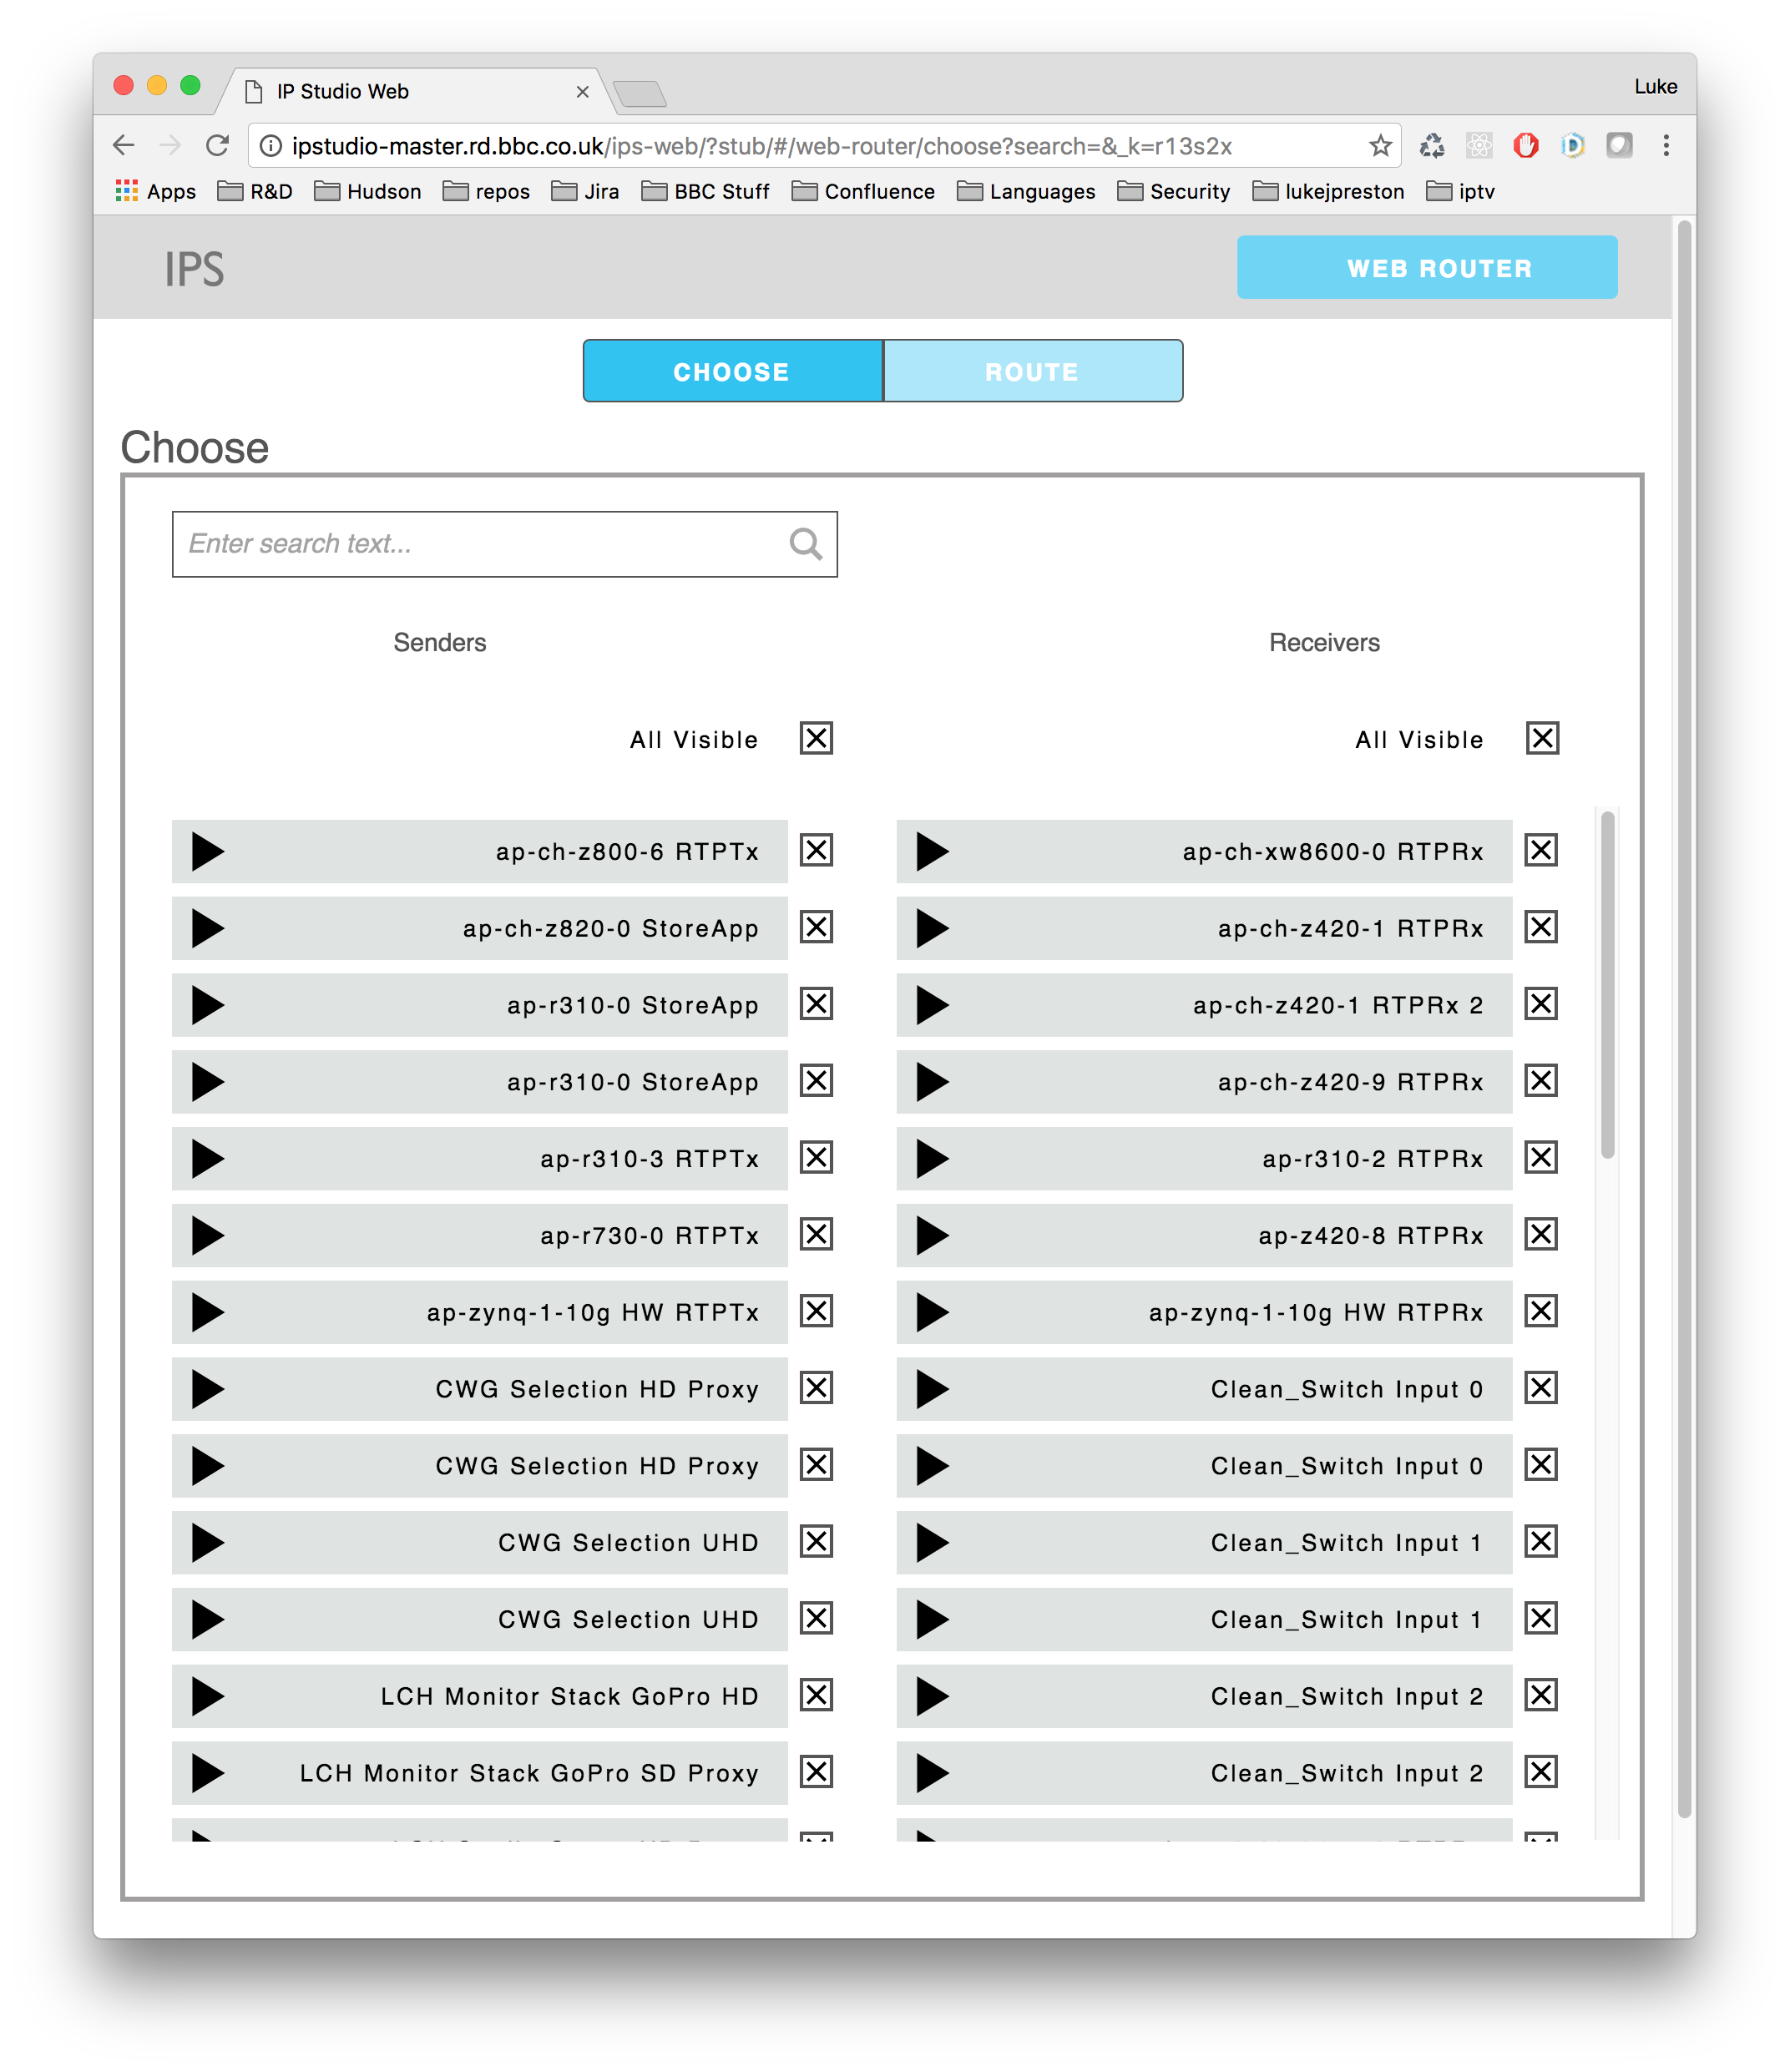
choose
The Choose view lets you filter the Route by applying filtering
Search to find your Routables
Anything checked will be on the Route view
New Routables will be unchecked initially
Dead Routables will be greyed out
Refreshing the page will clear these

Slide 15
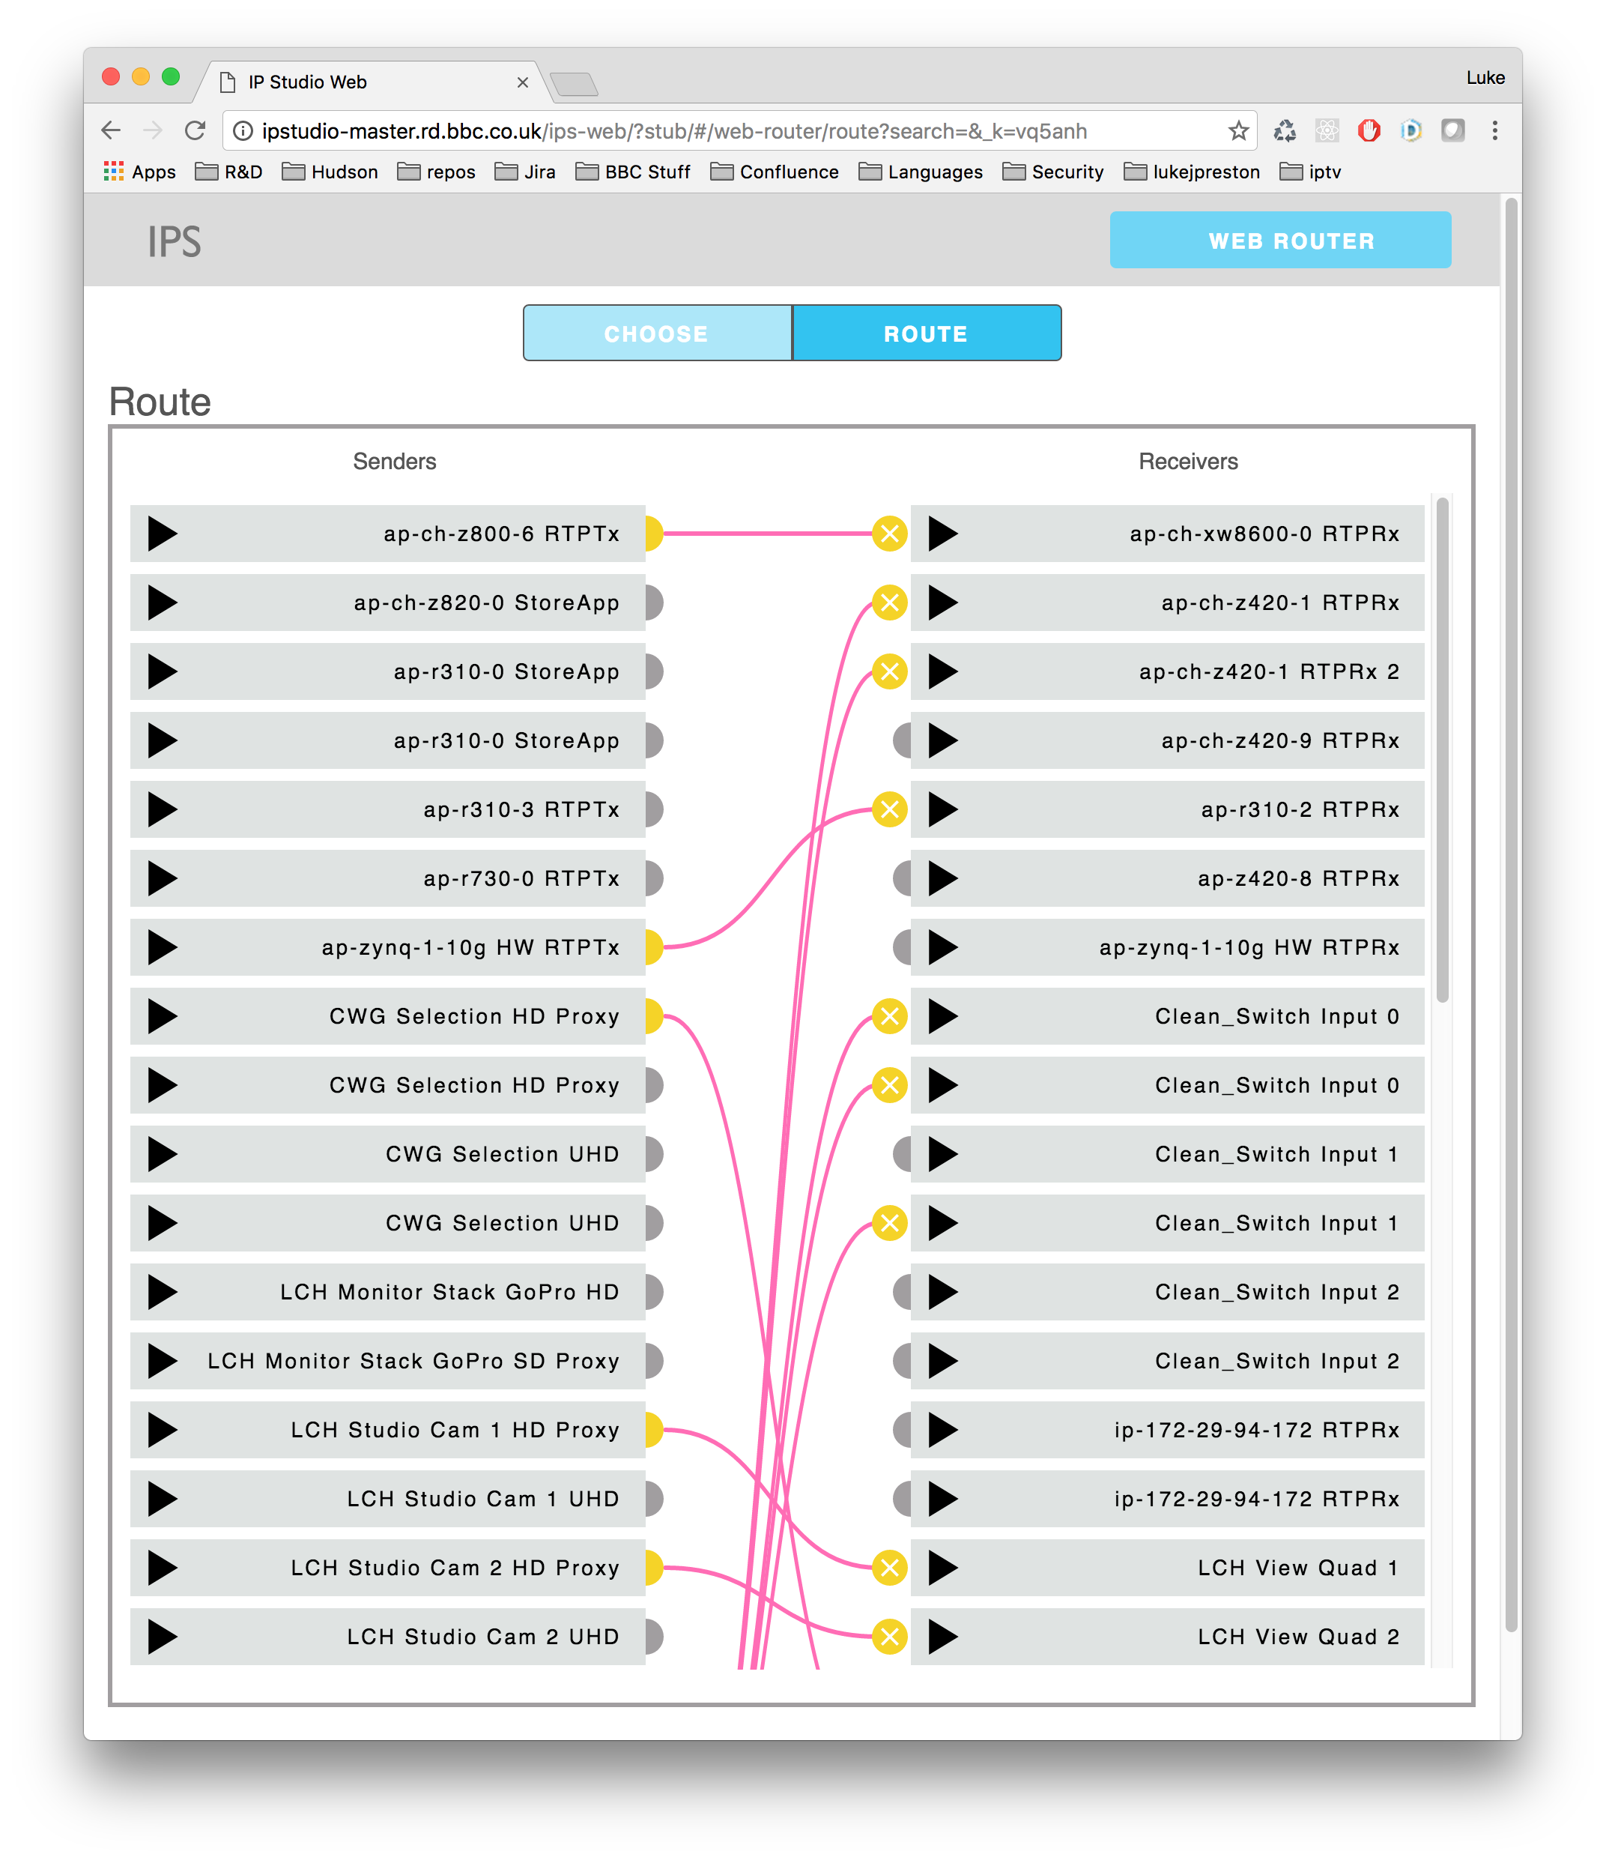
Route
The Route view shows all Routables and their Routes
Senders on the left
Receivers on the right
Routes are indicated by lines
Create a Route by click a Sender and clicking the corresponding Receiver
Remove a route by clicking a remove button indicated by an “x”
Dead Routables a greyed out and loose their node
Refreshing the page will remove these
Selecting a Routable will highlight all connected Routes

Slide 16
Responsive video

Slide 17
USAGE video

Slide 18
PART TWO: the code
Node
Docker
React + Redux + React Router
Jest
ES6 + Webpack
IPS NMOS API
Layout, CSSNEXT

Slide 19
node
A node 6 project (current LTS)
eslint
Extends eslint-standard
Extends eslint-standard-react
Using yarn https://yarnpkg.com/

Slide 20
Docker
Using Docker
Primarily used for building
Also able to use for testing and local serving
The build is served on Apache (inherited from ipp-web)

Slide 21
React + Redux + React Router
React
Created by FaceBook
Used in the BBC
BBC Sport
BBC Three
Write in JSX => transpile to JS
Virtual DOM
Redux
Nice way update the view
Quick and immutable
Works well with React
Follows React’s Flux model https://facebook.github.io/fluxx
React Router
Can use virtual url
This uses hash url because of Apache
Allows for single page experience
All pages are deeplinkable
Let’s you have search query param for free

Slide 22
jest
Created by FaceBook for React
Extends Jasmine https://jasmine.github.io/
They are specs
Comes with amazing command line tools, like watch
Easy React mocking
Quick
Used for unit testing and only testing the Components and Reducers as everything else is either trivial or tested else where
There is no style testing (e.g. phantomcss) and no integration testing. Do we need them?

Slide 23
Es6 + webpack
ES6 brought a lot of new features which allow for immutable code and write better functional code
Webpack is a tool to build websites using node
Webpack takes things which everyone has done before and does it for you by using configuration
It does the transpiling of JSX to JS and the styling
In the dev environment it also runs linting of both JS and CSS, build a server which watches these files and then updates in the browser
Side note: This project does not use grunt, gulp or any other task runner. It does not need to use them and they slow webpack and jest down

Slide 24
Ips nmos api
HTTP requests to get and put things using the NMOS API
Web sockets in order to subscribe to the NMOS API
Same API works from node and in browser
Brings in lokijs http://lokijs.org/ to simulate the above by using an in memory database and simple generated data using http://chancejs.com/
Can either stub in browser or from node
Can start a node REPL which starts the sockets and lets you hit it with HTTP requests, then you can interact with Web Router
Was extracted into GitHub for re-use, could be a candidate for open sourcing
Can anyone think of a better name?

Slide 25
Layout, CSSNEXT
GEL is used for the most part
GEL sorts out the responsive behaviour for you
Added a React wrapper around GEL to make it easier for people new to GEL to use; it is optional, just stop using it and use the classes instead
CSSNEXT is the future of css, it will be the next implementation of CSS but lets you write all your old CSS

Slide 26
3. More?
Pivotal: https://www.pivotaltracker.com/n/projects/577043
Slack channel #ips-web in bbcexperiencelabs.slack.com
All you need to sign up with Slack is your BBC account

Slide 27
What would you like to know?
Deep dive sessions, some which come to mind
React, Redux, React Router
ES6 (and maybe ES5)
IPS NMOS API
CSSNEXT
GEL
JEST

Slide 28
Coming next
Confirm screen
Giving the ability to do batch operations
Filtering
Advanced filtering with things like tags
Sorting
Advanced sorting to visualize data quicker
Notifications
As the new Web Router is being used a better notification system will evolve

Slide 29
Thank You

