Slide 1
Vagrant & Docker
AMT – Labo 2 (more or less)
Authors: Bignens Julien & Brito Carvalho Bruno

Slide 2
Summary
Introduction
Architecture
What we actually do
Sharing the volumes
Some magic
Basic example
Vagrantfile
Dockers
A few tricks

Slide 3
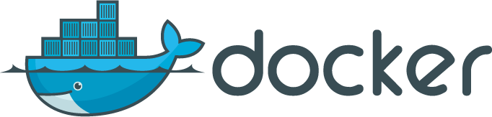

Introduction
This presentation is about our lab on Vagrant and Docker
The objective was to build an entire architecture of continuous integration and then deploy our first application on it
Using two technologies:
Vagrant
Docker
Repo : https://github.com/bbcnt/AMT_Vagrecker (private ATM)

Slide 4
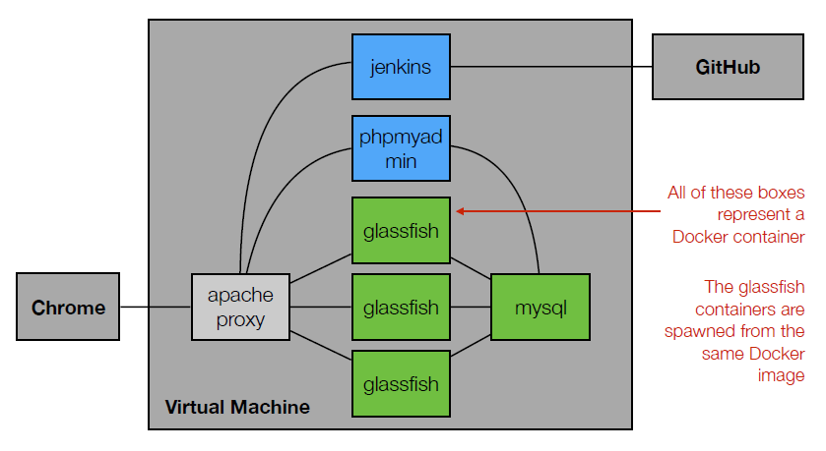
Architecture – The base
This is the wanted result:

Slide 5
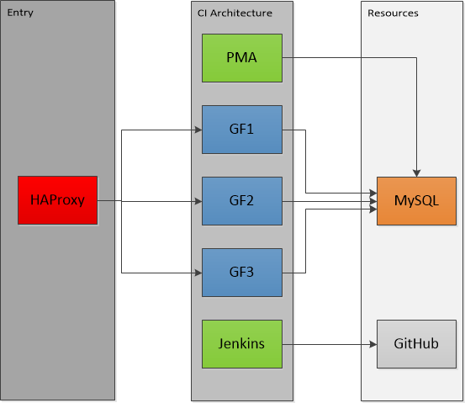
Architecture – Our version
Let’s take a look at the architecture that was built:

Slide 6
Architecture - Differences
What’s different ?
We replaced Apache by HAProxy
Why?
Because it was easier, and also, because it’s a real Load Balancer
One problem remains though
We can’t access the other services (Jenkins, PHPMyAdmin) with the same IP.
Example:
Jenkins: http://localhost:9001
PHPMyAdmin: http://localhost:9004
Web Application: http://localhost:9002
We make use of Docker’s NAT system (mapping IP and Ports)

Slide 7
What we actually do
Generate a .war file from the Maven project with Jenkins (the Maven project is pulled from GitHub)
Deploy this project on a glassfish instance
Link everything so the glassfish server can work with the MySQL database.
Add a few tools, like PHPMyAdmin, to be able to work efficiently with MySQL.
Add a few other instances of Glassfish (replicates of the first one).
Put in some load balancing and we are done.

Slide 8
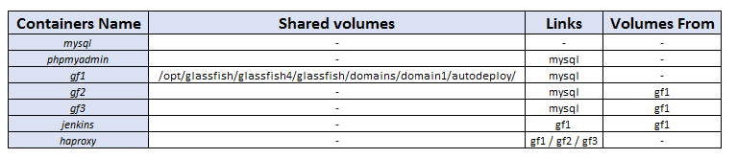
Sharing the volumes
We use the sharing of volumes offered by Docker to make our stuff work.
By sharing the autodeploy directory of gf1 with Jenkins and the other gf
(gf meaning glassfish, not girlfriend)
We can make some magic work.

Slide 9
Sharing the volumes
So, sharing this repo on gf1:
/opt/glassfish/glassfish4/glassfish/domains/domain1/autodeploy/
Will create the same directory on those who make use of this volume.
It will be very useful for deploying the application.

Slide 10
Some Magic
Glassfish offers a pretty cool thing, inside a domain, there is an “autodeploy” directory. Any war/jar/ear file inside will be deployed !
So for Jenkins, it’s easy, once it creates a war, it only need to copy it.
Where?
Remember the shared volume?
By sharing the volumes from gf1 with the other gf instances and Jenkins, we only have to do this after the build on Jenkins:
cp $JENKINS_HOME/jobs/AMT_REST/workspace/target/AMT_REST-1.0-SNAPSHOT.war /opt/glassfish/glassfish4/glassfish/domains/domain1/autodeploy/AMT_REST.war
And… that’s all ;=)

Slide 11
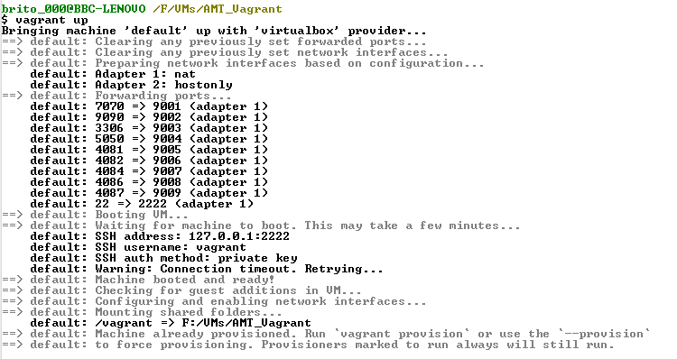
Basic example

Slide 12
Basic example
We will now see how to make the AMT REST project work.
First, we need to open a client in the Vagrant root directory
Where you’ll find the Vagrantfile
Start by typing:
vagrant up
vagrant provision (if not the first time)
Then go to Jenkins : http://localhost:9001, click on the build button and wait.
Access the app on http://localhost:9002/AMT_REST

Slide 13
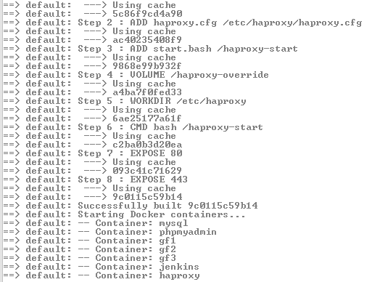
Basic example
Vagrant provision

Slide 14
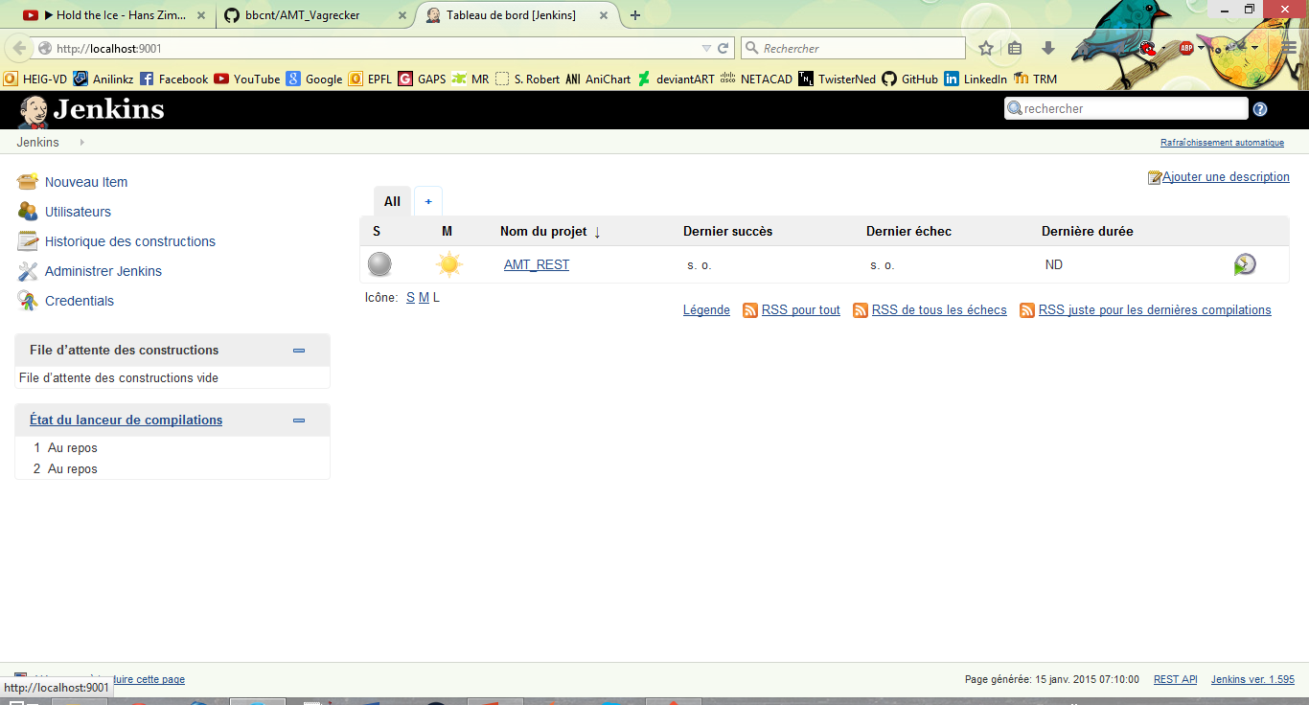
Basic example
Click Here

Slide 15
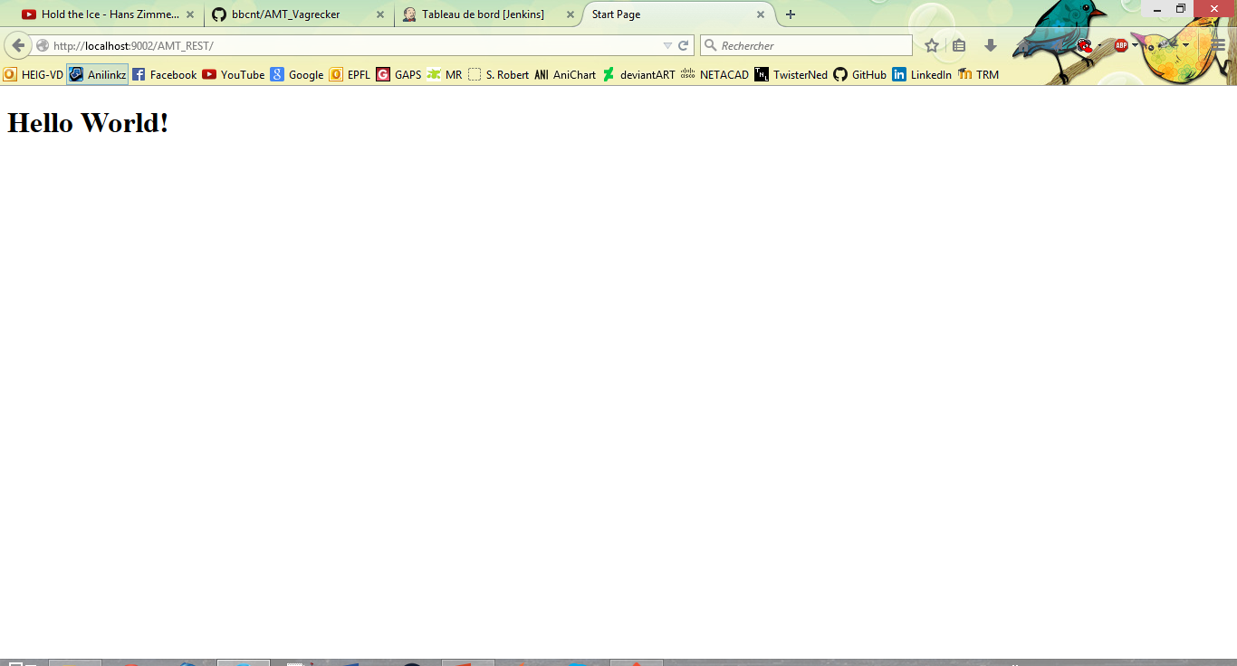
Basic example

Slide 16
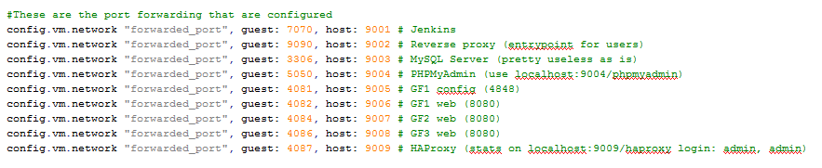
Vagrantfile
Mapping des ports

Slide 17
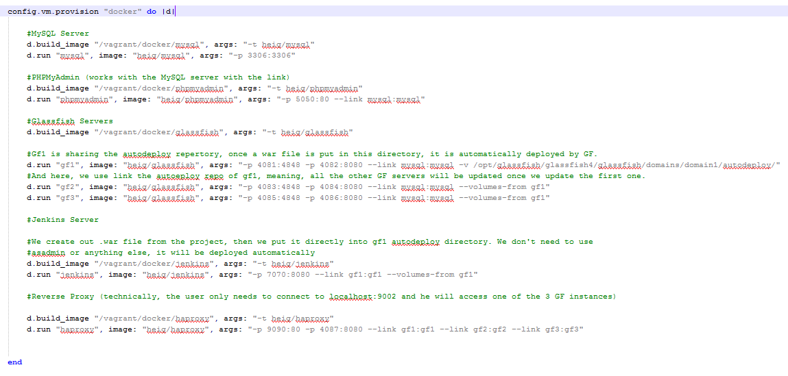
Vagrantfile

Slide 18
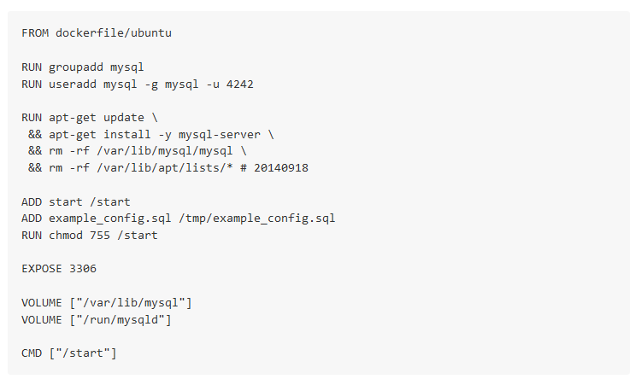
Docker - MySQL

Slide 19
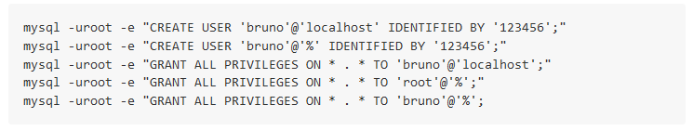

Docker - MySQL
We create users that can remotely connect:
And we add the PHPMyAdmin script in the DB

Slide 20
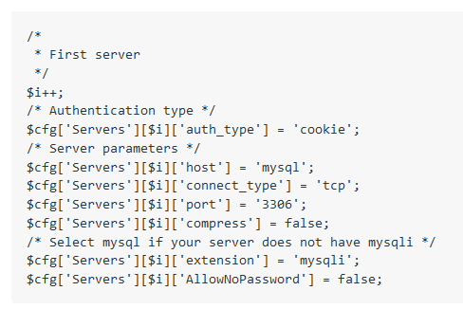
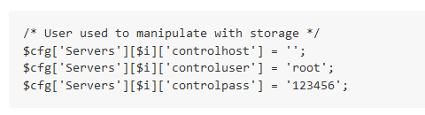
Docker - PHPMyAdmin
Dockerfile too big, and not very useful. We install:
PHP
Apache
PHPMyAdmin
Then interesting part is :

Slide 21
Docker - Glassfish
Again, too big to put here, but what we do:
We install Glassfish
We create the jdbc resource and pool linked to the MySQL container
We copy the mysql connector driver
And we start it.
RUN \
./asadmin start-domain && \
./asadmin --user admin --passwordfile pwdfile enable-secure-admin && \
./asadmin --user admin --passwordfile pwdfile create-jdbc-connection-pool --restype=javax.sql.XADataSource --datasourceclassname=com.mysql.jdbc.jdbc2.optional.MysqlXADataSource --property user=$DB_TECHNICAL_USER:password=$DB_TECHNICAL_USER_PASSWORD:serverName=mysql:portNumber=3306:databaseName=$DB_NAME $JDBC_CONNECTION_POOL_NAME && \
./asadmin --user admin --passwordfile pwdfile create-jdbc-resource --connectionpoolid $JDBC_CONNECTION_POOL_NAME $JDBC_JNDI_NAME && \
./asadmin stop-domain
Notes:
Script créé au début

Slide 22
Docker - Jenkins
What we do:
We install Java and Maven (to be able to create Maven projects)
We get Jenkins to work (install and setting environment)
We add the config files where we want and need them (we'll see those in a moment)
We also add the needed plugins (mostly for github support)
And that's all
We also need to save a few config files (xml).
Notes:
Sauver les fichiers pour les jobs, les credentiels, les emplacements de Java, Maven etc.

Slide 23
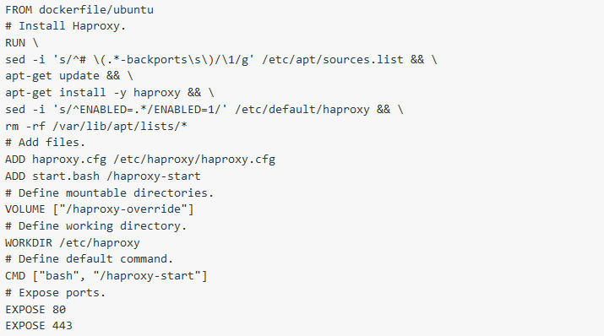
Docker - HAProxy

Slide 24
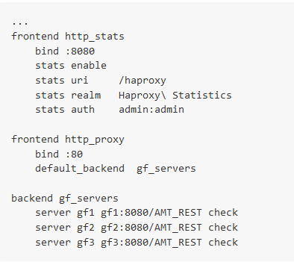
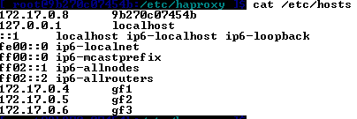
Docker - HAProxy
And setting HAProxy
Remember this:
We use the address given by the Vagrant VM.

Slide 25
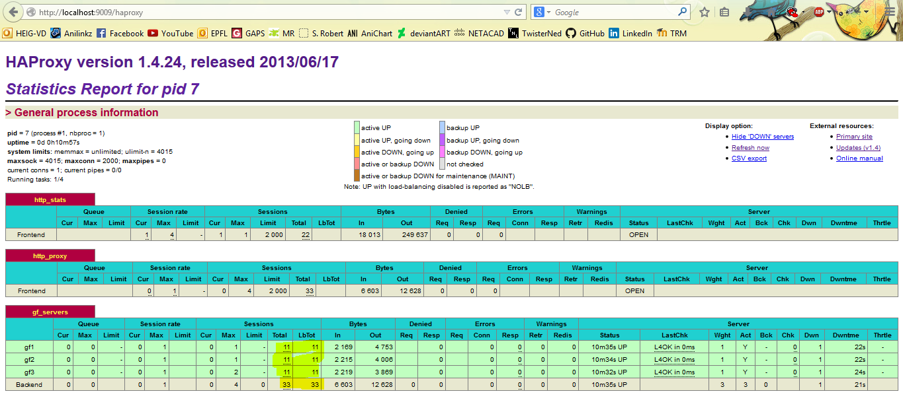
Docker - HAProxy
And that’s all, we can now work with the API.
Other cool thing, stats with HAProxy:

Slide 26
A few tricks
A few cool things we noted.
Connecting to a docker:
sudo docker exec -i -t container_name bash
Download of big files (max of GitHub is 50 Mo), here jdk 8u25
curl -v -j -k -L -H "Cookie: oraclelicense=accept-securebackup-cookie" http://download.oracle.com/otn-pub/java/jdk/8u25-b17/jdk-8u25-linux-x64.rpm > jdk-8u25-linux-x64.rpm
wget --no-check-certificate --no-cookies --header "Cookie: oraclelicense=accept-securebackup-cookie" http://download.oracle.com/otn-pub/java/jdk/8u25-b17/jdk-8u25-linux-x64.rpm
Otherwise it won’t work in a script ;)

Slide 27

Conclusion
We can’t show you everything, but as you can see, not so hard.
Took a lot of time to actually configure the dockers, more than setting them
We also tried to make this a light as possible
By downloading files inside the dockers and not keeping them in the host
Vagrant and Docker were supposed to be concurrent
In the end, they work pretty well together!

