Slide 1
Attendance Tracking
A Webcam and QR code integration
SAVeS
(Student Attendance Verification System)
Project Lead: Benjamin Dean
Programmer: Luke Brumfield (04/06/16)

Slide 2
Attendance Tracking – Business Needs
What is it Good For

Slide 3
Attendance Tracking – Business Needs
What is it Good For
Insights into Student Success

Slide 4
Attendance Tracking – Business Needs
What is it Good For
Insights into Student Success
How does attendance affect grades

Slide 5
Attendance Tracking – Business Needs
What is it Good For
Insights into Student Success
How does attendance affect grades
Are there attendance indicators to identify at risk students

Slide 6
Attendance Tracking – Business Needs
What is it Good For
Insights into Student Success
Tracking more than present

Slide 7
Attendance Tracking – Business Needs
What is it Good For
Insights into Student Success
Tracking more than present
Roll call, not easy for large classes

Slide 8
Attendance Tracking – Business Needs
What is it Good For
Insights into Student Success
Tracking more than present
Roll call, not easy for large classes
Attendance Sheet, validating real attendance

Slide 9
Attendance Tracking – Business Needs
What is it Good For
Insights into Student Success
Tracking more than present
Roll call, not easy for large classes
Attendance Sheet, validating real attendance
Not utilized by all classes

Slide 10
Attendance Tracking – Business Needs
What is it Good For
Insights into Student Success
Tracking more than present
Course insights

Slide 11
Attendance Tracking – Business Needs
What is it Good For
Insights into Student Success
Tracking more than present
Course insights
Are there courses with attendance issues

Slide 12
Attendance Tracking – Business Needs
What is it Good For
Insights into Student Success
Tracking more than present
Course insights
Are there courses with attendance issues
Identify potential prerequisites not previously considered

Slide 13
Attendance Tracking – Business Needs
What is it Good For
Insights into Student Success
Tracking more than present
Course insights
Course scheduling

Slide 14
Attendance Tracking – Business Needs
What is it Good For
Insights into Student Success
Tracking more than present
Course insights
Course scheduling
Optimizing attendance to minimize drops
Identify potential reductions in sections

Slide 15
Attendance Tracking – Business Needs
What is it Good For
Insights into Student Success
Tracking more than present
Course insights
Course scheduling
Optimizing attendance to minimize drops

Slide 16
Attendance Tracking - Solutions
Barriers to Implementation

Slide 17
Attendance Tracking - Solutions
Barriers to Implementation
Manual Attendance Entry

Slide 18
Attendance Tracking - Solutions
Barriers to Implementation
Manual Attendance Entry
Easy user experience

Slide 19
Attendance Tracking - Solutions
Barriers to Implementation
Manual Attendance Entry
Easy user experience
Reduce work for Instructors

Slide 20
Attendance Tracking - Solutions
Barriers to Implementation
Manual Attendance Entry
Cost of Equipment or Retrofitting

Slide 21
Attendance Tracking - Solutions
Barriers to Implementation
Manual Attendance Entry
Cost of Equipment or Retrofitting
Use existing student cards, nfc or rfid

Slide 22
Attendance Tracking - Solutions
Barriers to Implementation
Manual Attendance Entry
Cost of Equipment or Retrofitting
Use existing student cards, nfc or rfid
Stamp QR code on existing student card

Slide 23
Attendance Tracking - Solutions
Barriers to Implementation
Manual Attendance Entry
Cost of Equipment or Retrofitting
SIS integration

Slide 24
Attendance Tracking - Solutions
Barriers to Implementation
Manual Attendance Entry
Cost of Equipment or Retrofitting
SIS integration
Utilize existing APIs

Slide 25
Attendance Tracking - Solutions
Barriers to Implementation
Manual Attendance Entry
Cost of Equipment or Retrofitting
SIS integration
Utilize existing APIs
Configure push database integration

Slide 26
Attendance Tracking - Solutions
Barriers to Implementation
Manual Attendance Entry
Cost of Equipment or Retrofitting
SIS integration
Utilize existing APIs
Configure push database integration
Standalone pull database integration

Slide 27
Attendance Tracking - Solutions
Barriers to Implementation
Manual Attendance Entry
Cost of Equipment or Retrofitting
SIS integration
System Resources and Knowledge Base

Slide 28
Attendance Tracking - Solutions
Barriers to Implementation
Manual Attendance Entry
Cost of Equipment or Retrofitting
SIS integration
System Resources and Knowledge Base
Complete cloud based solution

Slide 29
Attendance Tracking - Solutions
Barriers to Implementation
Manual Attendance Entry
Cost of Equipment or Retrofitting
SIS integration
System Resources and Knowledge Base
Complete cloud based solution
Hands on local implementation

Slide 30
Attendance Tracking - Architecture

Slide 31
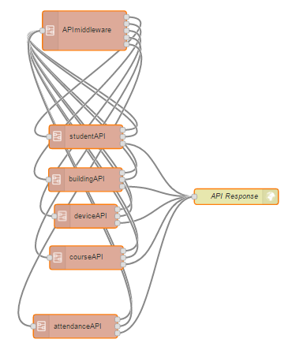
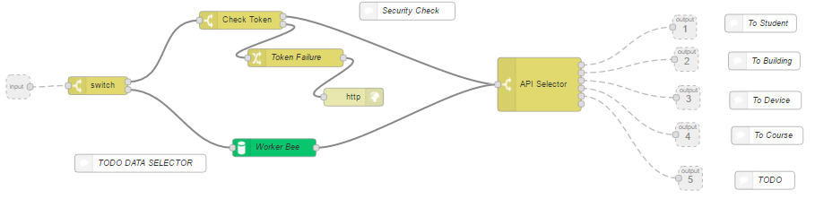
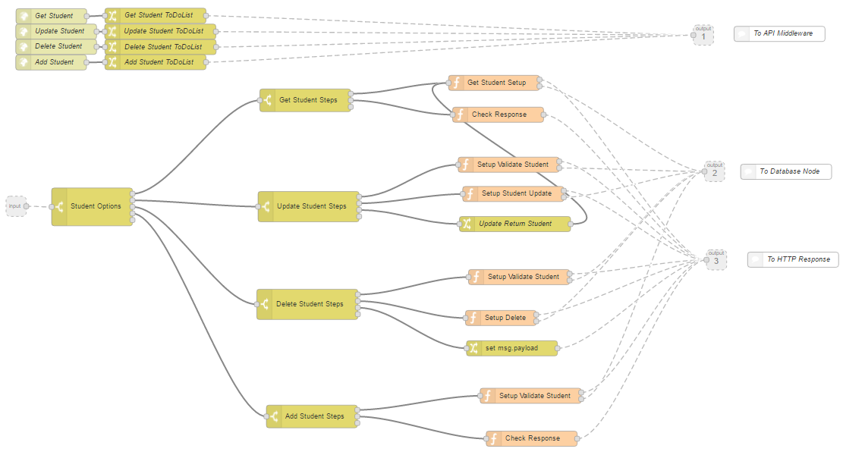
Attendance Tracking - API

Slide 32
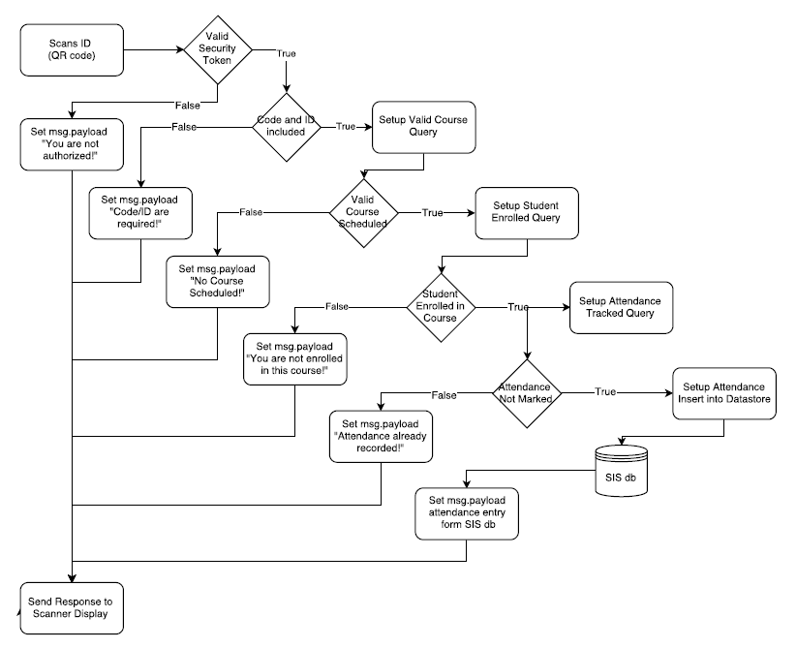
Attendance Tracking – Add Attendance

Slide 33
Attendance Tracking – Conclusion
Help Drive Student Success
Gain Insights into Courses and Teaching
Low Cost to Entry for Institutions
Flexible Architecture

