Slide 1
What do we know about changing provider behavior in primary health care?
Presented by Benjamin Daniels
bdaniels@worldbank.org

Slide 2
Part 1: What is quality in primary health care?

Slide 3
Key questions in quality improvement
What are health care providers providers doing?
Why are they doing it?
How do interventions change outcomes?
If we know where providers are on the quality spectrum and why, we can formulate a theory of change.

Slide 4
Three dimensions of care quality:
Provider can reach a correct diagnosis
Provider offers correct management
Provider avoids unnecessary treatment

Slide 5
Three measures of provider quality:
Knowledge: Does a provider know how to diagnose and treat a hypothetical patient?
Effort: Does the provider exert effort to apply their knowledge in real clinical settings?
Practice: Does the provider in practice form correct diagnoses, follow correct management practices, and avoid unnecessary treatments?

Slide 6
Main measurement tools:
Clinical Vignettes
Provider is “tested” for knowledge by role-playing with a formal examiner
Patient Observation and Exit Surveys
Formal observer records actual patient interactions in the clinical setting
Interviewer records information about patients after they leave
Standardized Patients
A trained actor poses as a patient and presents realistic symptoms to the provider in the clinical setting. They report what the provider does.
Facility Surveys and Demographics
Administrative/Billing Data

Slide 7
Part 2: What have we learned about quality in primary health care?

Slide 8
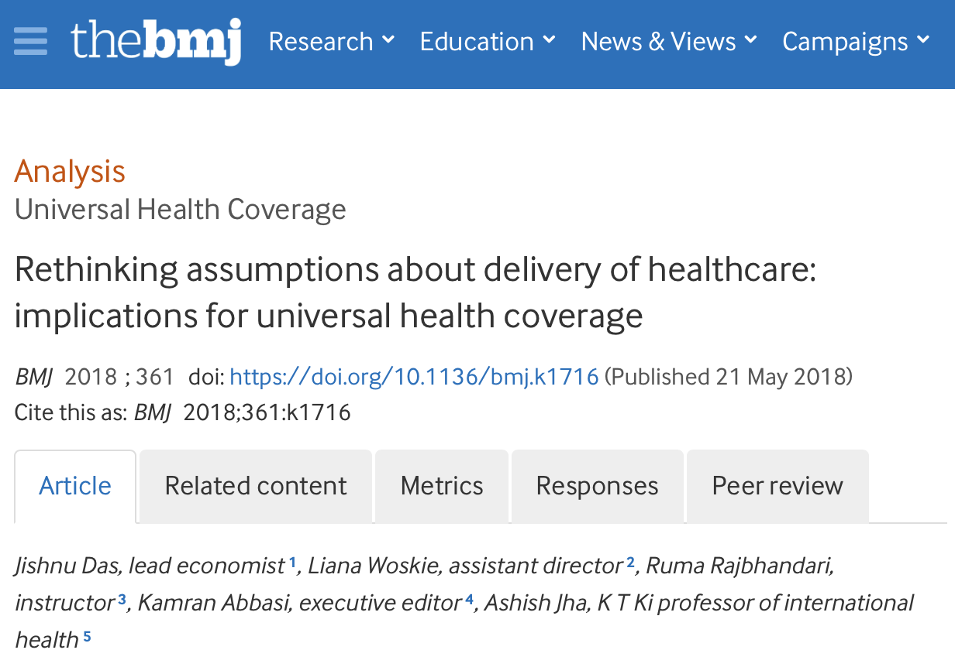
What do we know so far?
Most countries have high availability of health care providers, but quality is low
Medical qualifications don’t imply medical knowledge
Large “know-do” gaps exist between what medical providers show they know and what they do in real practice

Slide 9
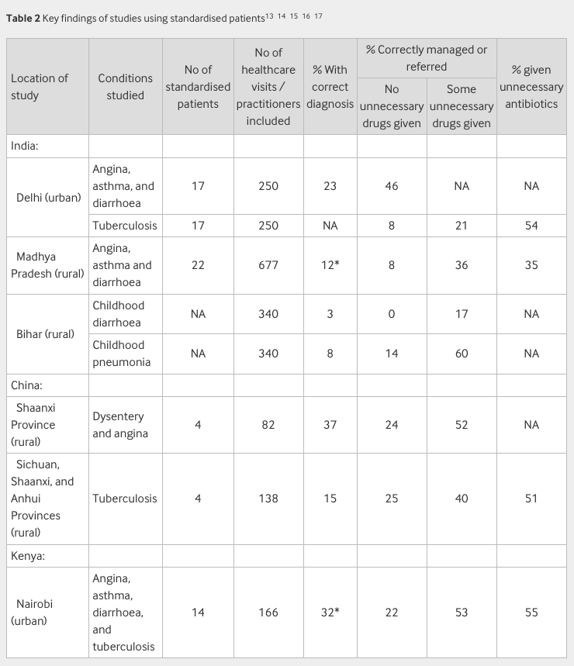
Most countries have high availability of health care providers, but quality does not follow directly

Slide 10
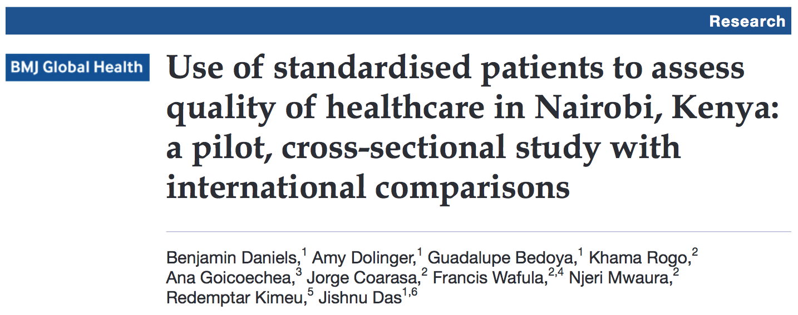
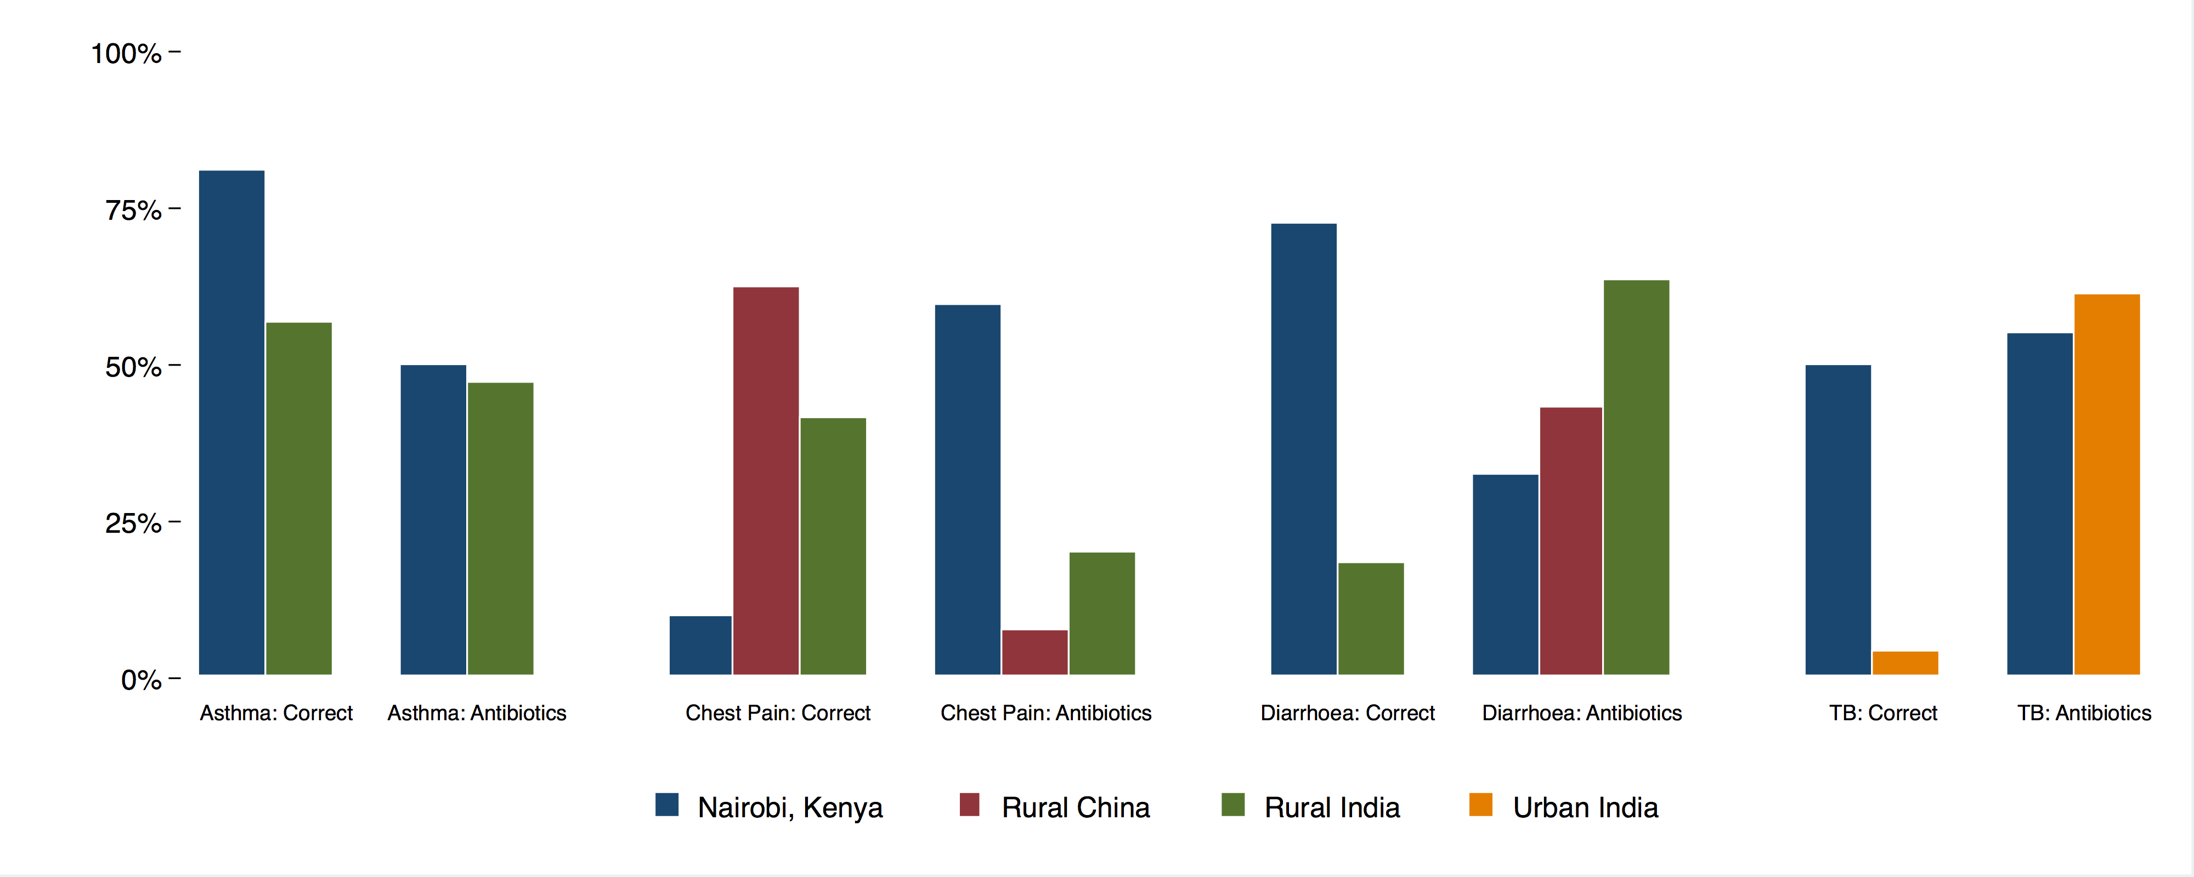
Quality is multi-dimensional
In a cross-country study, we found that the same providers’ quality depended on the disease: Nairobi providers outperformed others in three cases but were the worst in the fourth.

Slide 11
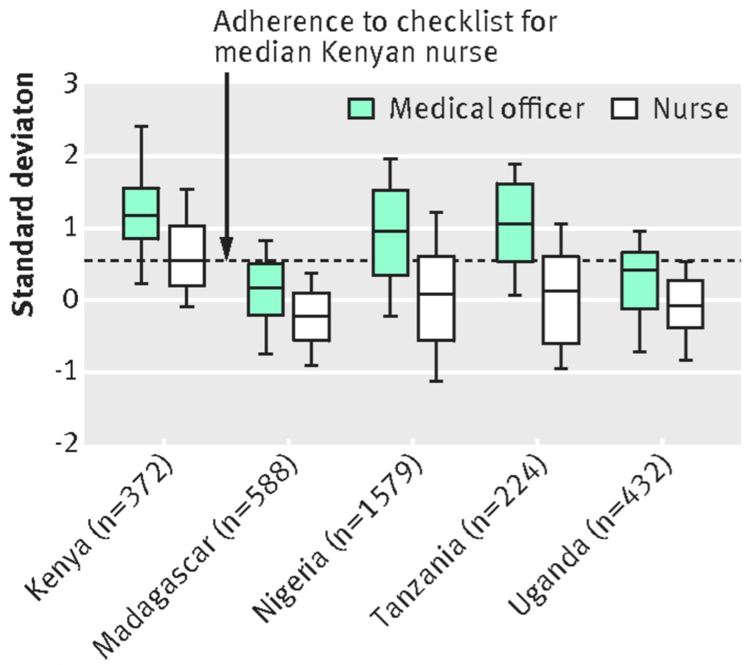
Medical qualifications don’t equal medical knowledge
There is wide variation in every group in every country, as well as across groups
In African settings, the top 25% of nurses are more knowledgeable than the bottom 25% of doctors.

Slide 12
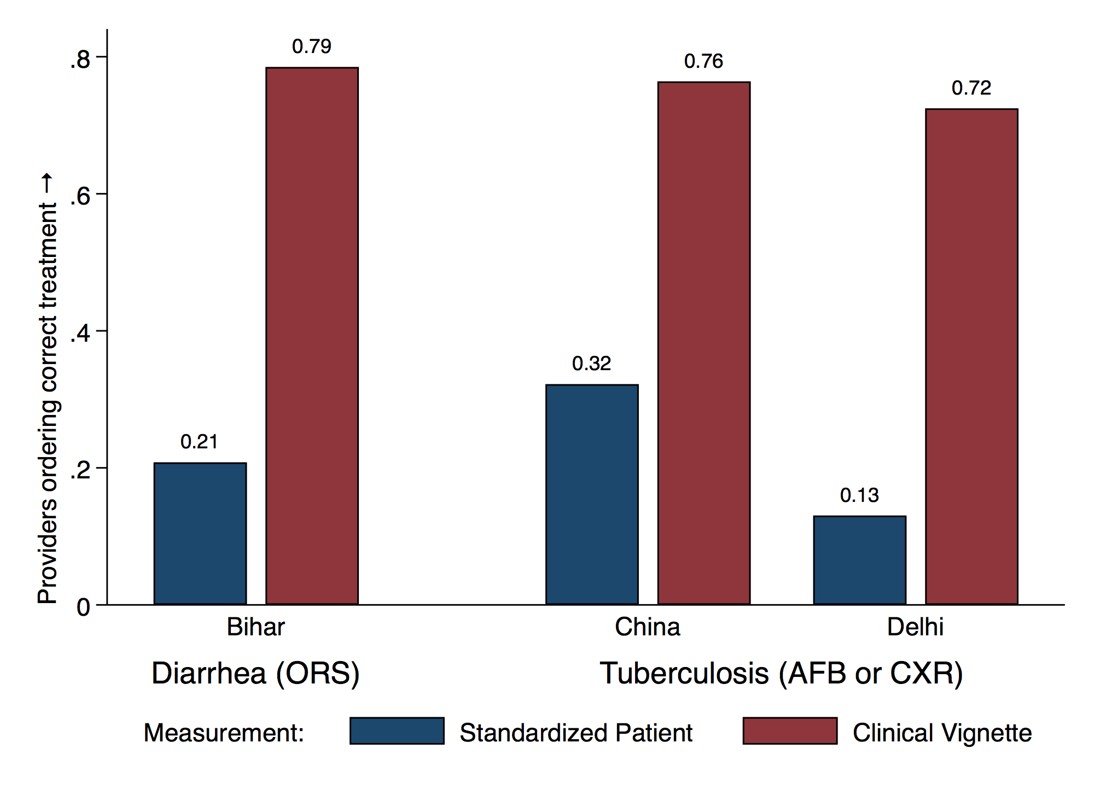
But large “know-do gaps” exist between what medical providers know and what they do in real practice

Slide 13
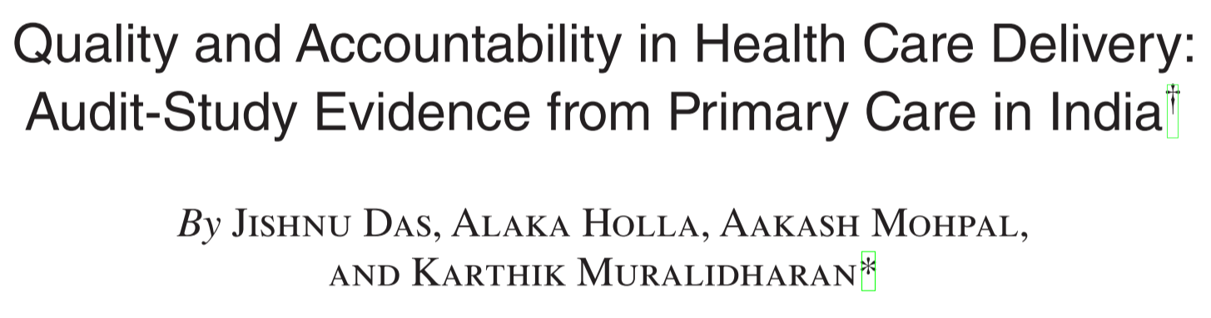
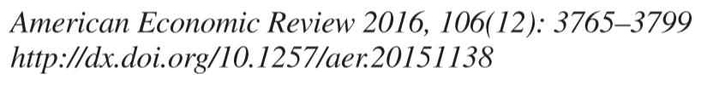
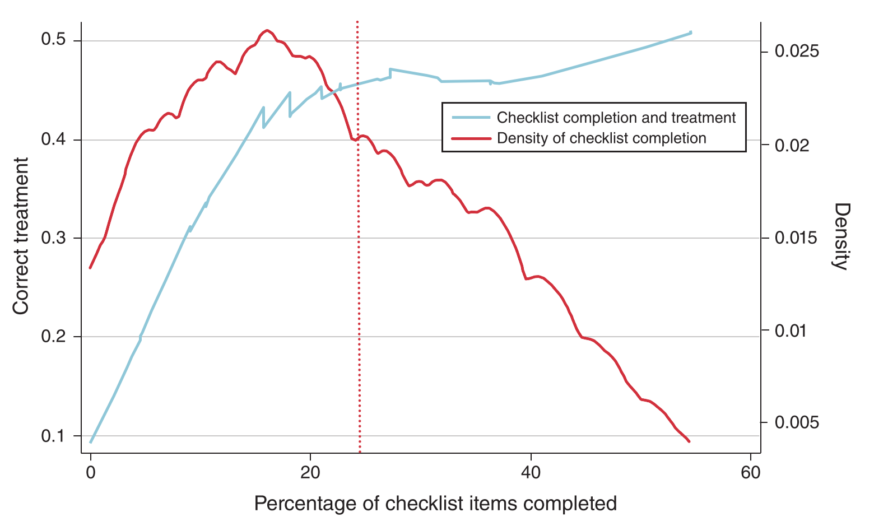

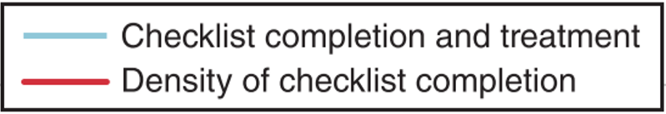
In standardized patients, effort predicts quality
In standardized patients data, we see that providers who follow appropriate diagnostic checklists also get the cases right more often.
+25% checklist
= +35% correct treatment

Slide 14
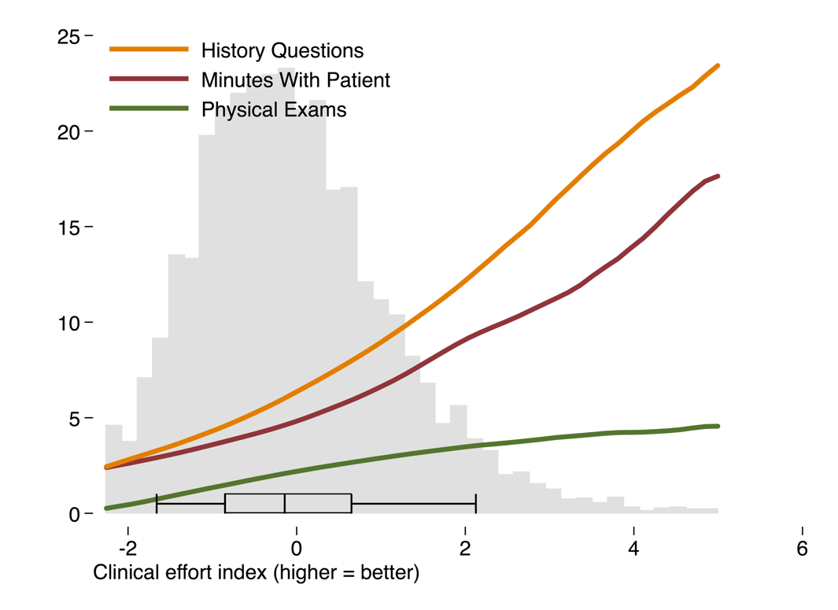
Effort is highly variable
Low average effort, roughly correlated with national income.
High variation: The best providers in Vietnam (shown), for example, would be average in Paraguay or even the UK, but the worst would be average in India.
India
Paraguay
UK
Vietnam data

Slide 15
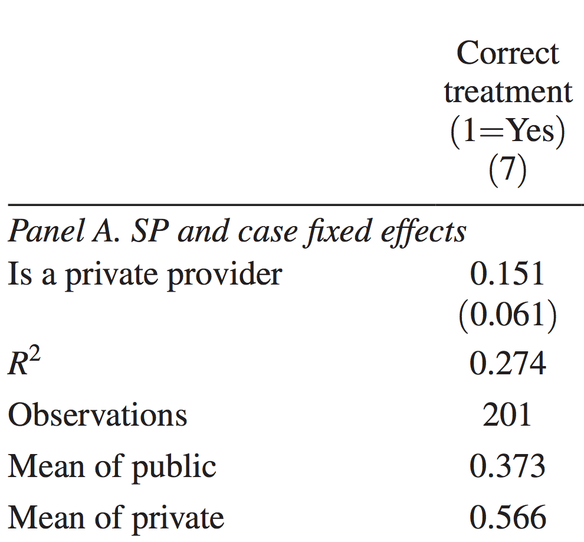
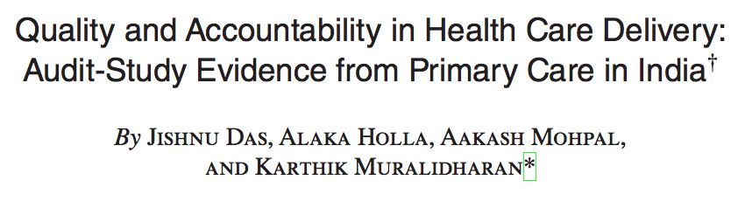
Variance is both across and within providers
In a recent AER study, the same providers provide much higher quality care with the same SPs when they move from their public practice to their private practice.

Slide 16
Part 3: What have we learned about changing behavior in primary health care?

Slide 17
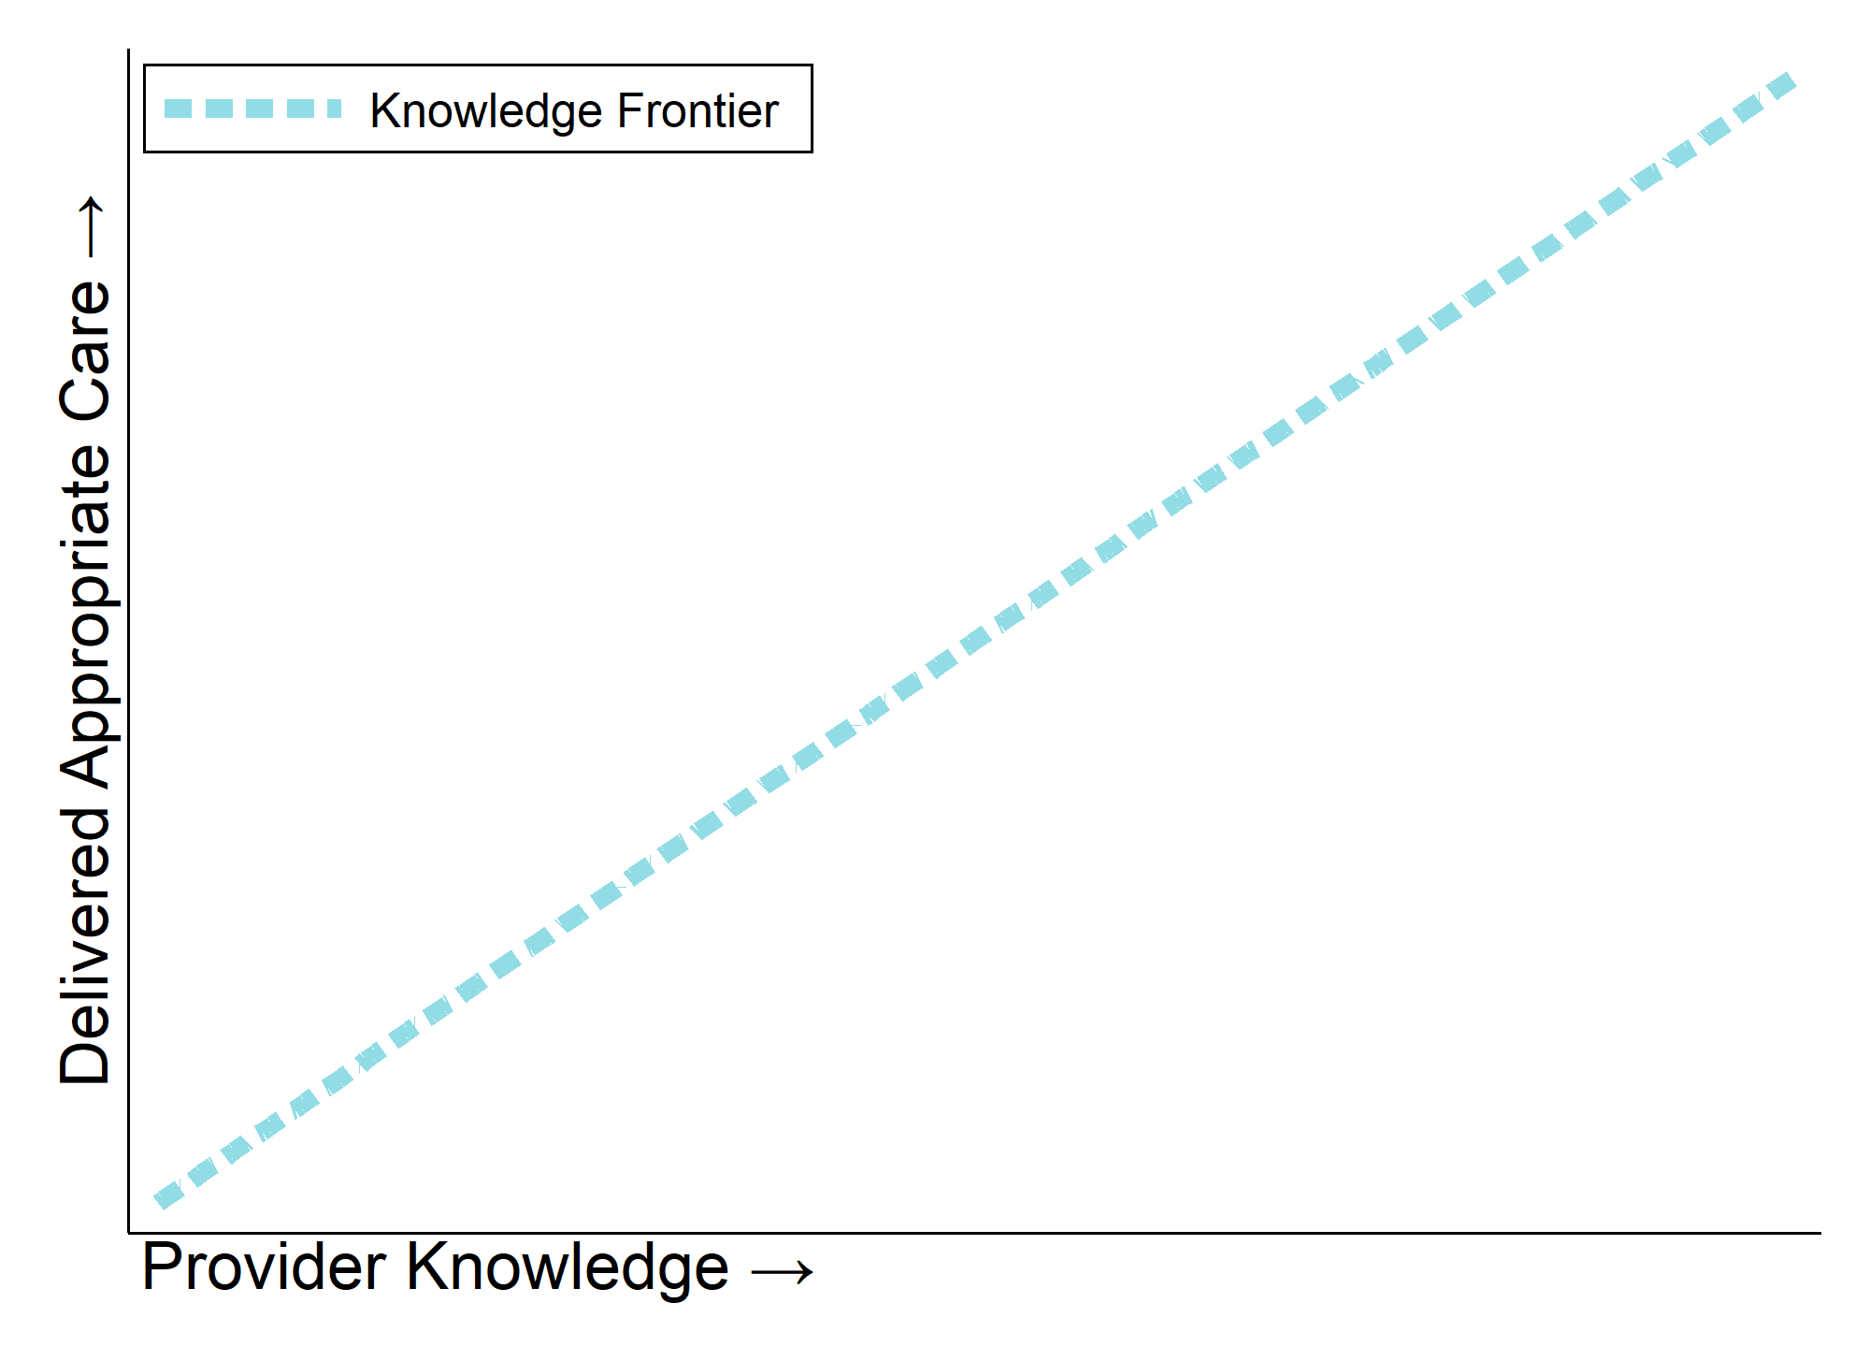
Theory of Knowledge
If providers do what they know, then the easiest way to improve performance is to improve knowledge directly.

Slide 18
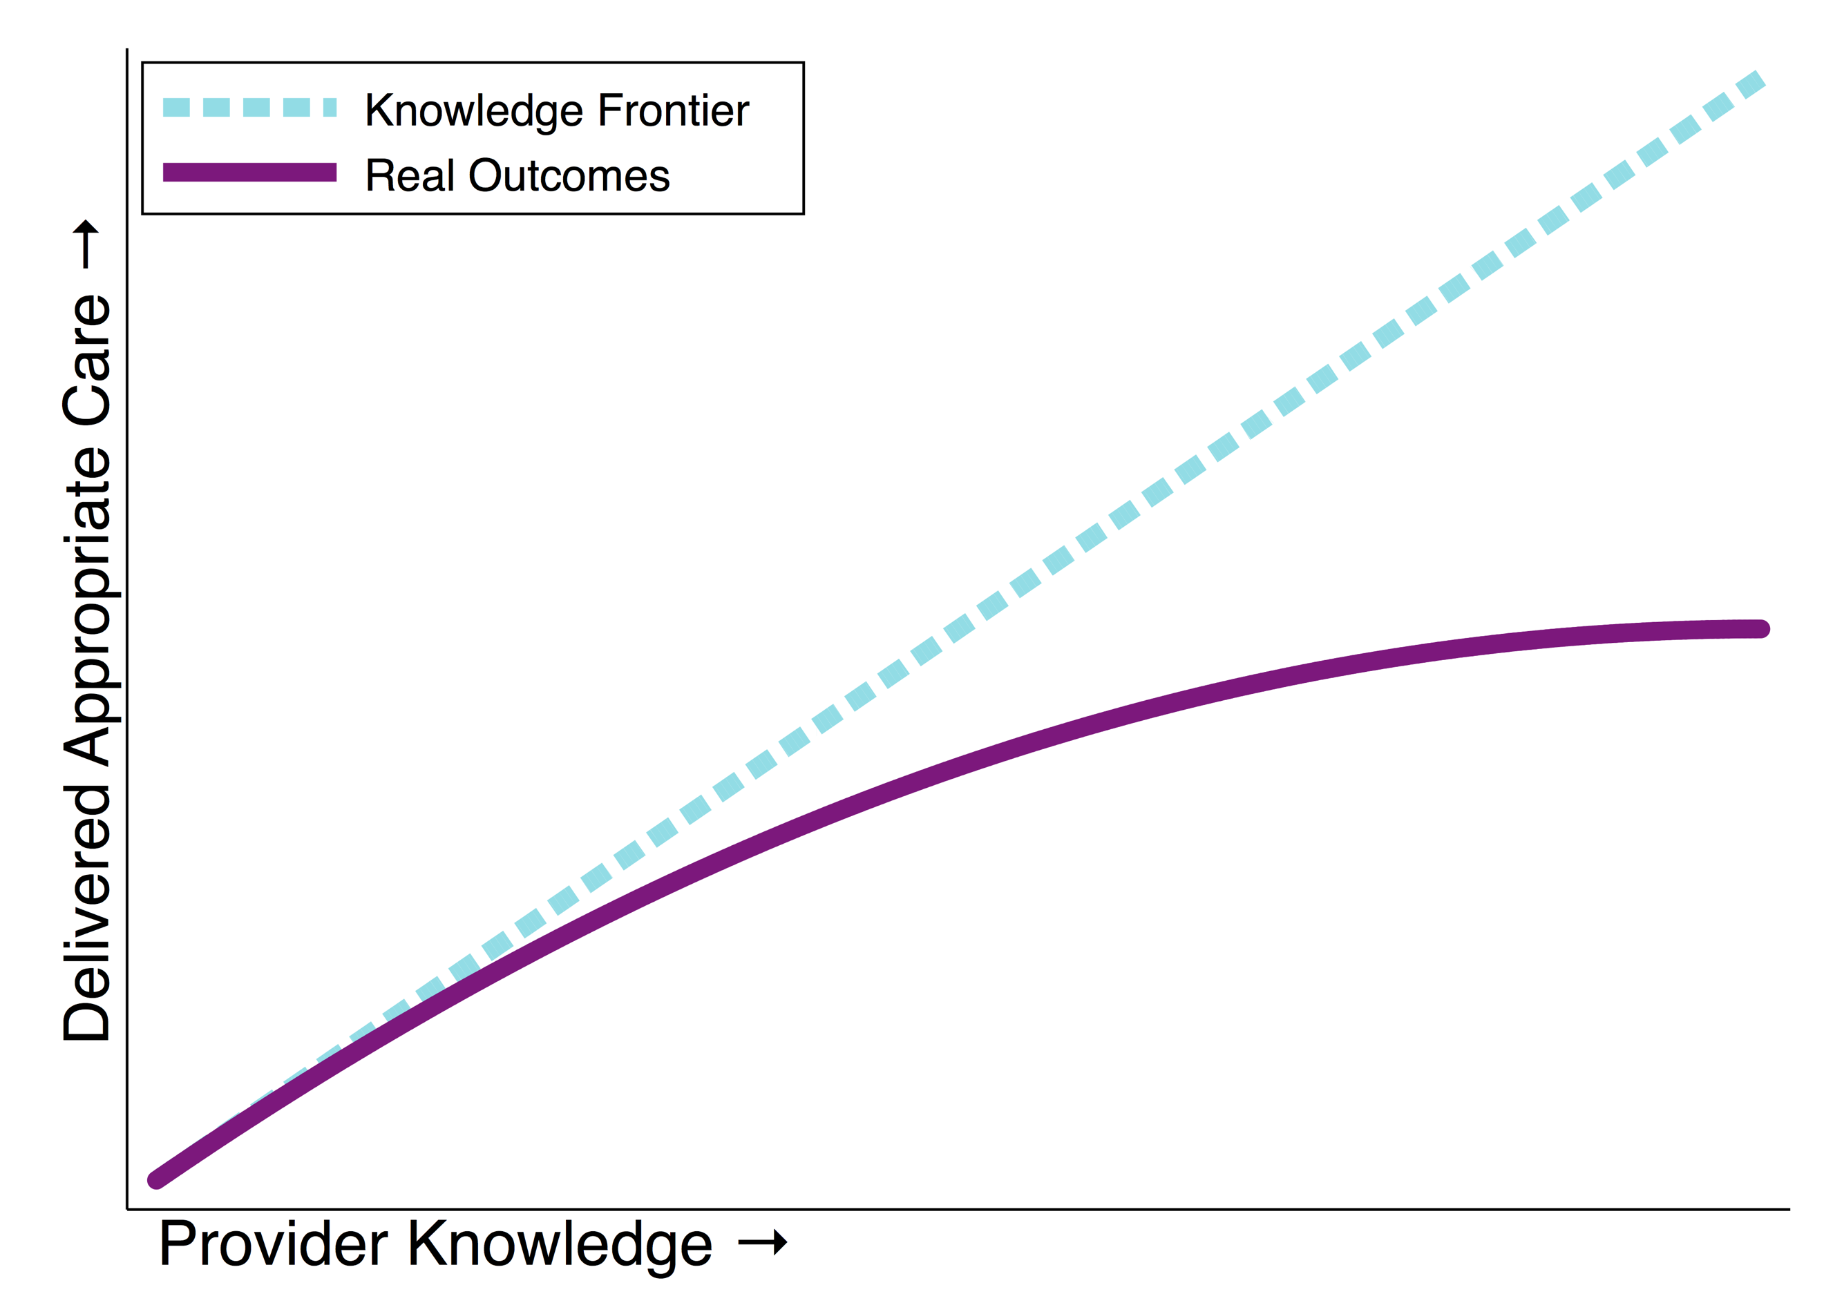
Theory of Practice
Returns to knowledge are diminishing and condition-specific in each context. Learning is important but above moderate levels it needs structures and incentives to translate to practice.
Know-do gap:

Slide 19
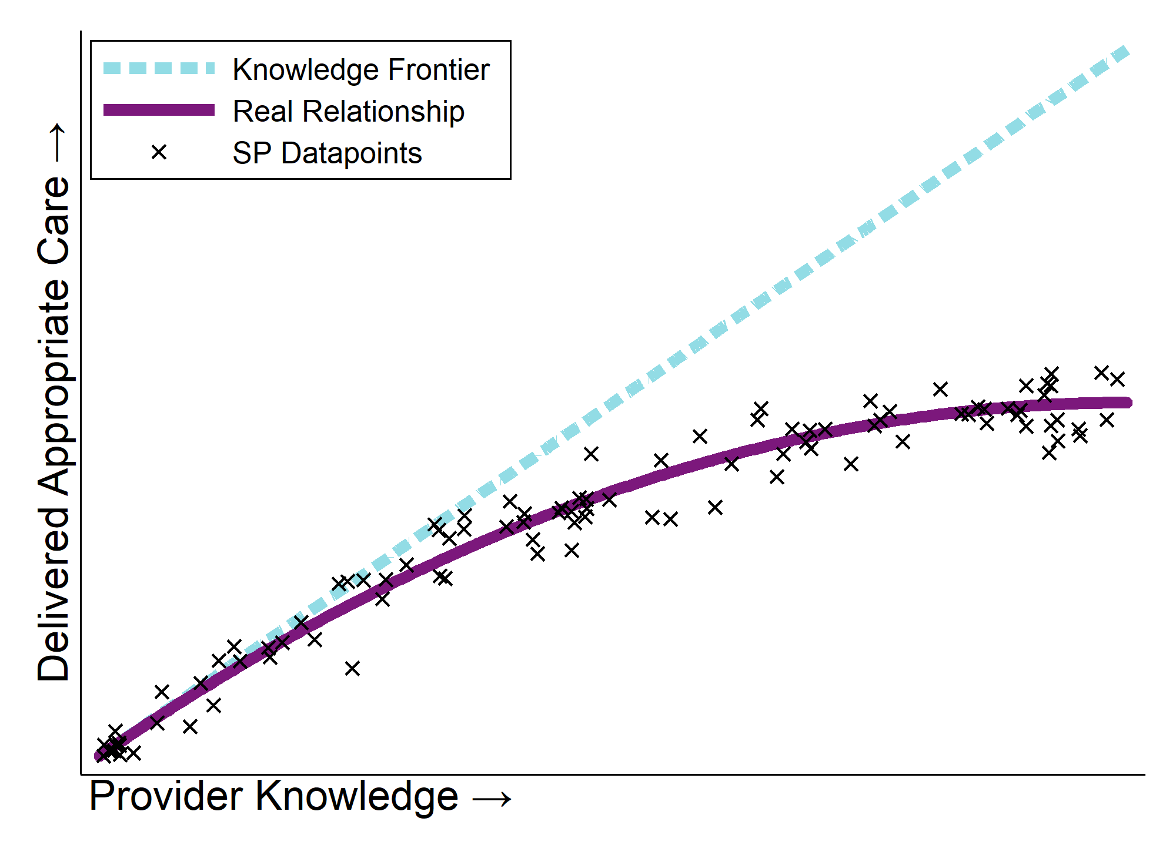
Lessons from Observations
Measuring knowledge allows us to determine where providers are and how their behavior might be improved
- If knowledge is low, training can yield large benefits.
- If knowledge is high, incentives can yield large benefits.
Incentivize effort if knowledge is high
Provide training if knowledge is low

Slide 20
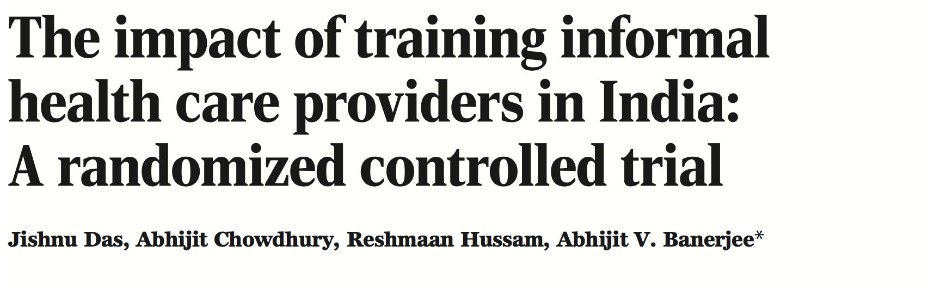
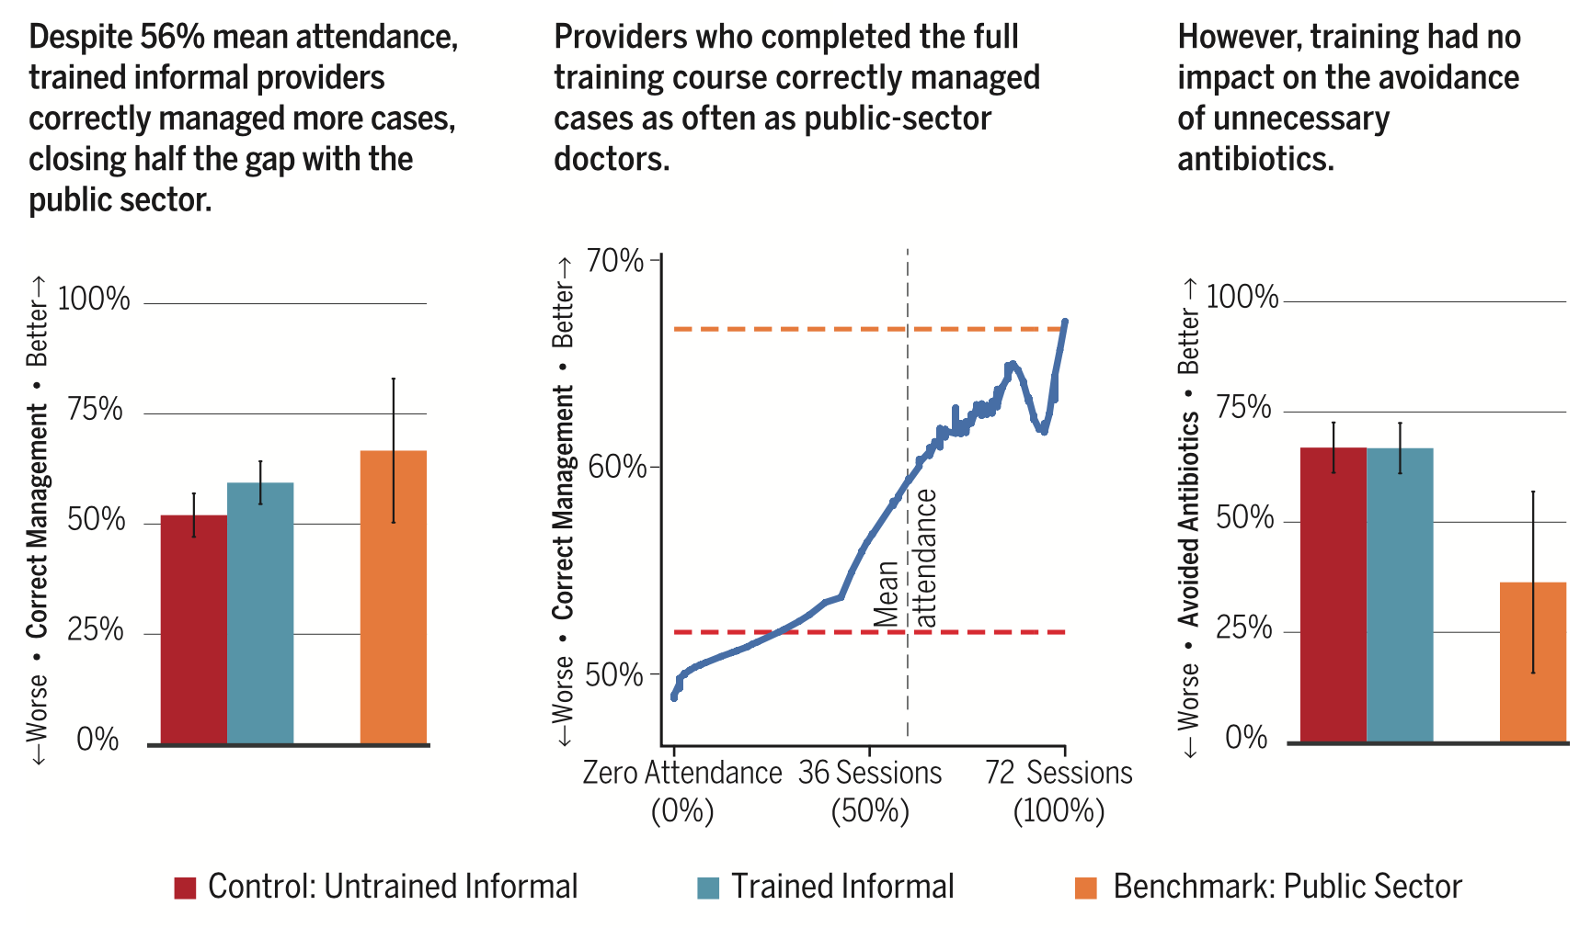
Interventions: Knowledge
In a randomized training program in rural West Bengal, India, an evaluation showed that nine months of basic training improved performance of uneducated providers to a similar level as the public sector.

Slide 21
Interventions: Practice
Preliminary results from this study:
Low-volume/low-quality providers are hard to change behavior through light touch intervention; need intensive training
High-volume/high-quality providers can be very responsive, but have capacity constraints; support from paramedical staff is very important
Take-up of new technology requires enough patient volume at each provider for experimentation and learning
In two Indian cities, the Gates Foundation is sponsoring QuTUB, the largest-ever SP study, to evaluate how citywide intervention programs including a new diagnostic and management protocol were adopted by providers

Slide 22
Summary: Key questions and answers
Knowledge: Does a provider know how to diagnose and treat a hypothetical patient?
→ Providers globally have a wide range of knowledge, but it is condition-specific, trainable, and not predicted well by education.
Effort: Does the provider exert effort to apply their knowledge in real clinical settings?
→ Provider effort is low but variable: providers can be incentivized to put more of their knowledge into action.
Practice: Does the provider in practice form correct diagnoses, follow correct management practices, and avoid unnecessary treatments?
→ Health care quality is low, due to two key gaps: education does not translate into knowledge and knowledge is not put into practice. But “rankings” are hard to construct due to multidimensionality.

Slide 23
Looking forward with EHIF
Comprehensive national insurance and billing data such as EHIF’s offers a new look at these problems.
We can construct detailed profiles of each providers’ caseload
We can observe historical data of provider behavior, including changes in response to training and price changes
We hope to understand how caseload, staffing, incentives, and training interact at large scale in Estonia
With such rich underlying data, we can carefully plan experimental and non-experimental investigations

Slide 24
Notes
This data is coming from low and middle income countries (our typical focus area)
We are relatively new to using billing data for research/experimentation as it is typically incomplete or non-existent in those settings
Data here uses “direct observation” methods such as standardized patients and medical vignettes
We hope lessons from Estonia will inform future work with emerging economies’ new insurance systems and universal health programs

Slide 25
Thank you!

