Slide 1



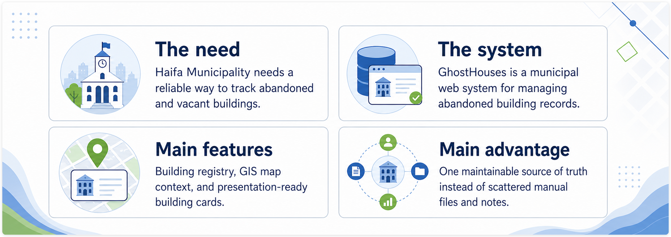
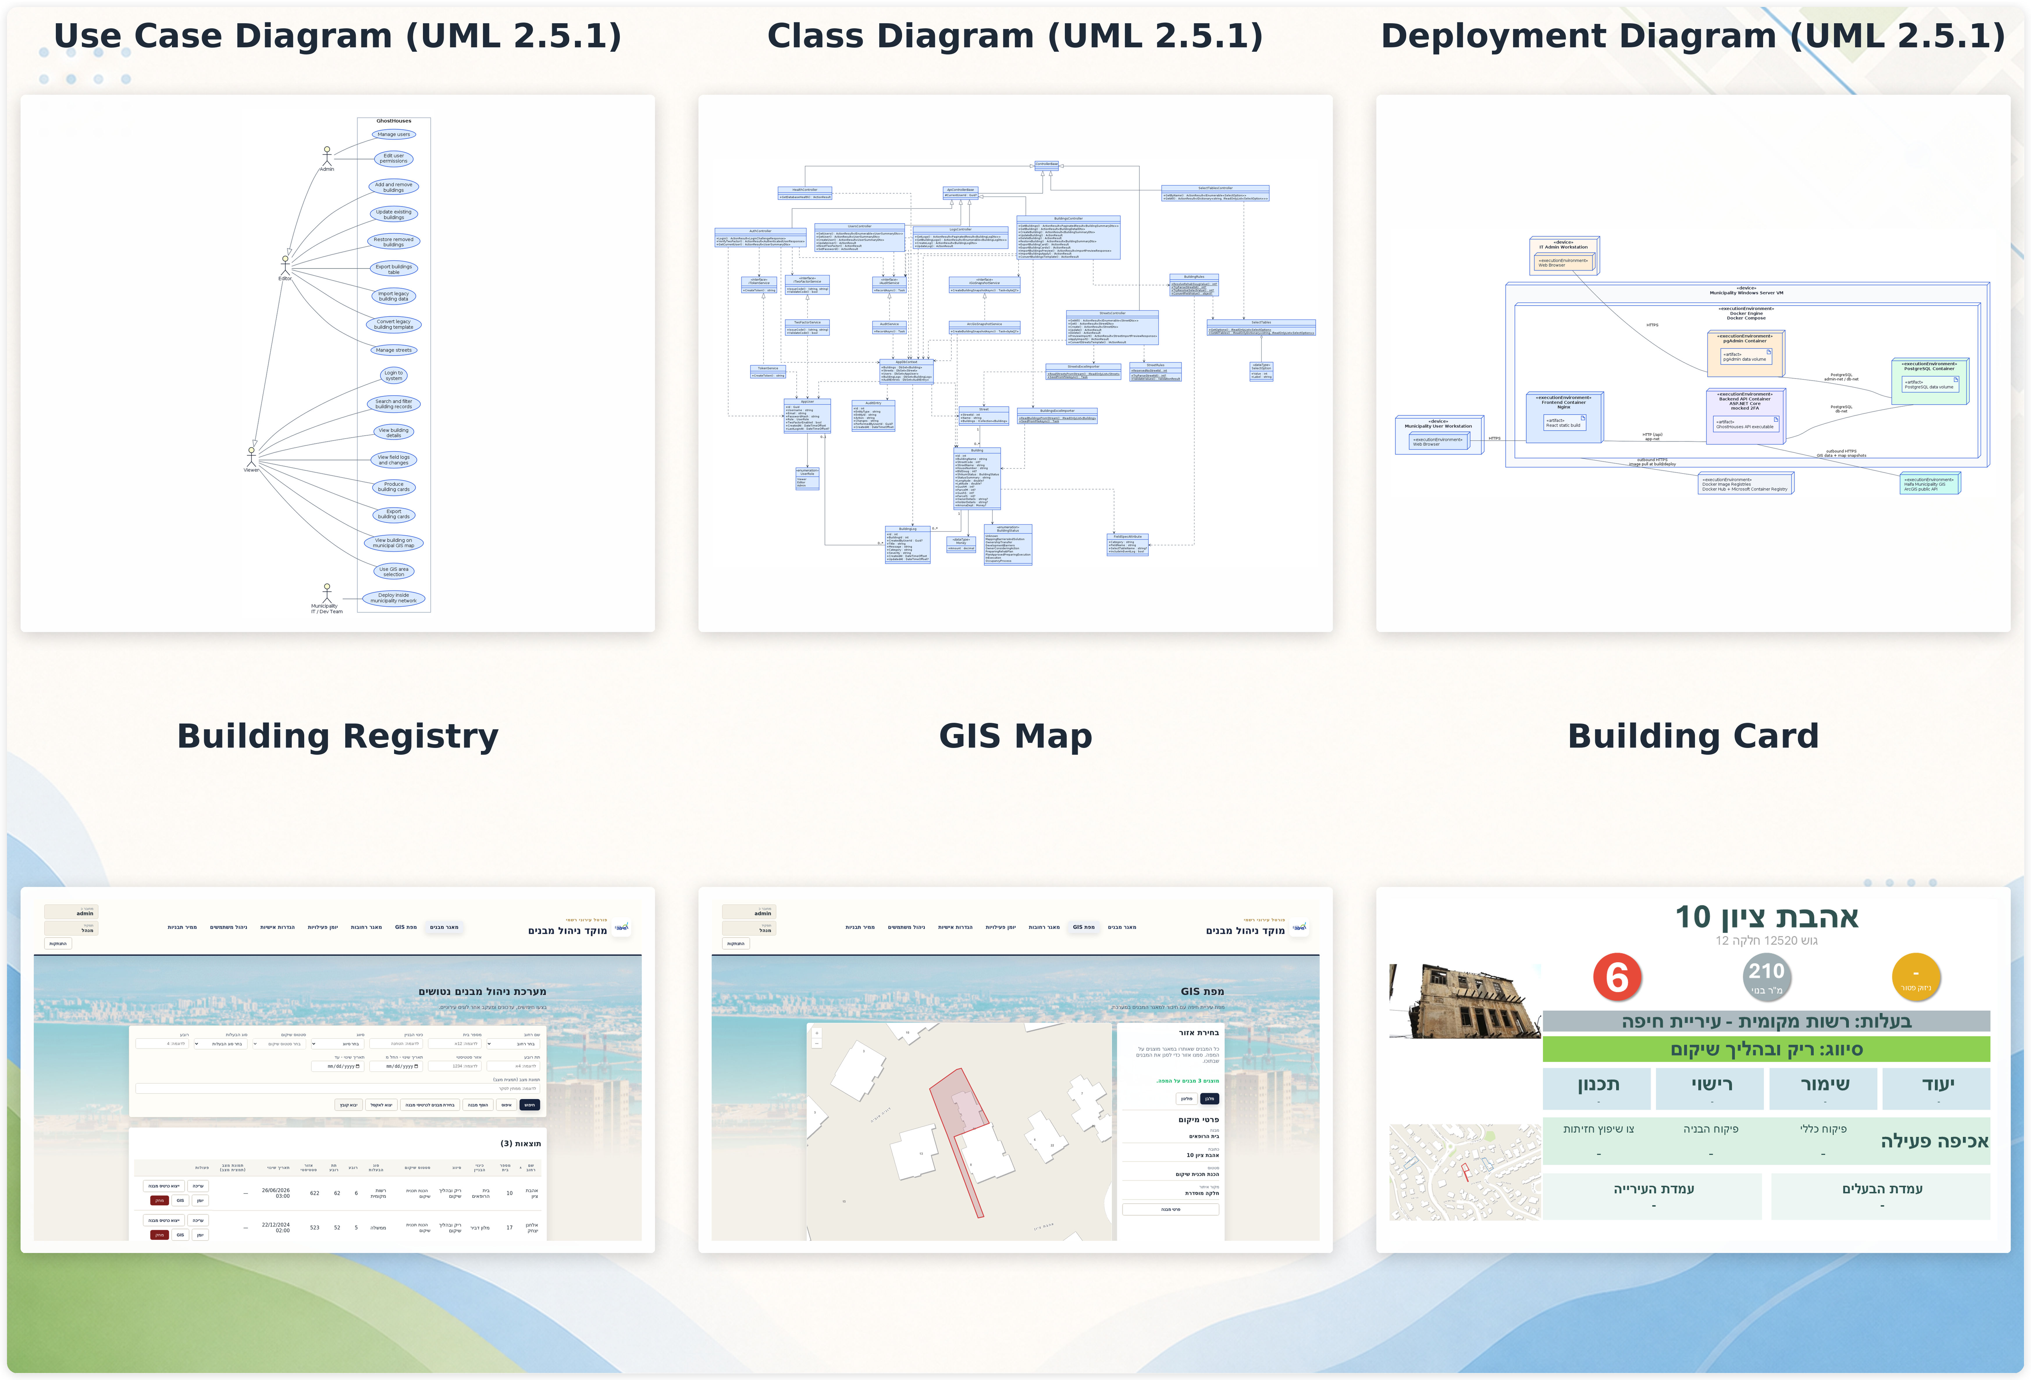
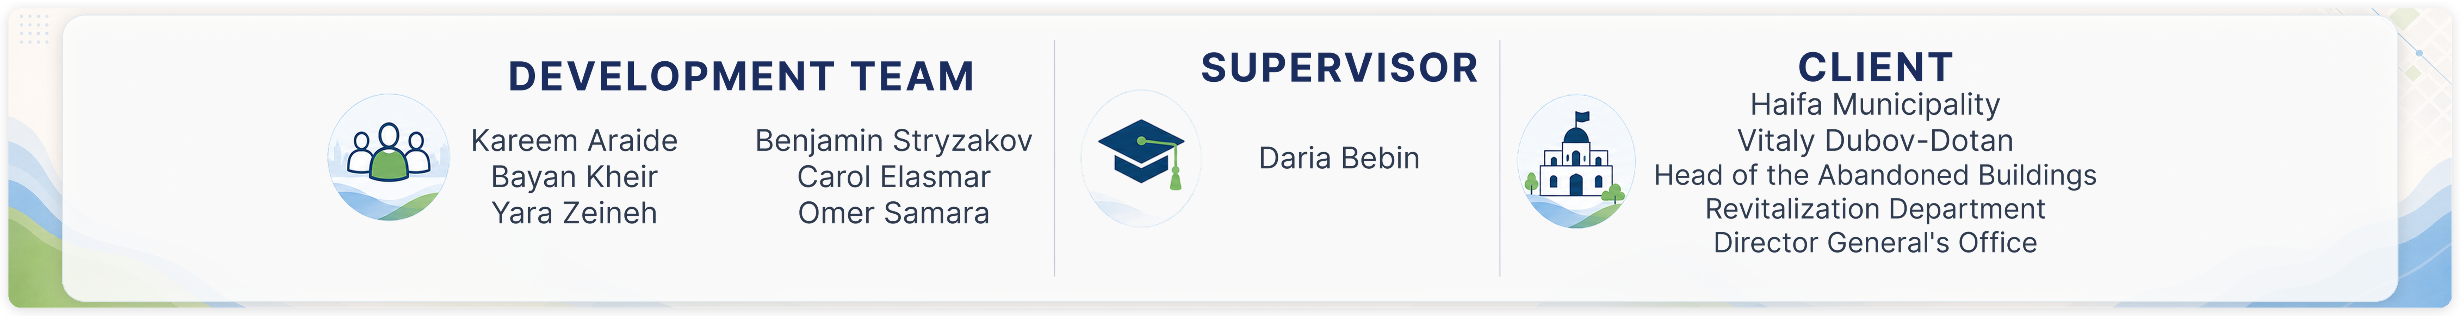
Notes:
tagline - Short teaser describing main advantage or function of your project. SHORT - UP TO 6 WORDS MAX. For example - "delivers the drink right to you!" , "learn programming basics without a computer" , "control your air conditioner remotely" , etc.

