Slide 1
chapter 5
Functions -- QuickStart

Slide 2
What is a function?

Slide 3
从数学函数讲起
Python建立了数学函书库
f(x)=√x
f(x)=sin(x)
f(x,y)=x*y
math.sqrt(x)
math.sin(x)
问题：
1能不能我们自己也定义函数？
2函数的功能除了计算以外，还能增加什么?

Slide 4
演示—--生日快乐
心得：
函数名具有可读性
通过函数名可以调用函数
参数化
封装，重用

Slide 5
演示—--圆面积函数
心得：
函数名具有可读性
通过函数名可以调用函数
参数化
封装，重用

Slide 6
函数基本特点
代表执行单独的操作
采用零个或多个参数作为输入
返回值（可能为复合对象）作为输出

Slide 7
Why have them?
分而治之
抽象
重用
共享
安全性
简化/可读性

Slide 8
Mathematical Notation
Consider a function which converts temperatures in Celsius to temperatures in Fahrenheit.
Formula: F = C * 1.8 + 32.0
Functional notation:
F ~ celsius_to_Fahrenheit(C) where
celsius_to_Fahrenheit(C) = C * 1.8 + 32.0

Slide 9
Python Invocation
Math: F = celsius_to_Fahrenheit(C)
Python, the invocation is much the same
F = celsius_to_Fahrenheit(cel_float)
Terminology: cel_float is the argument

Slide 10
Function defintion
Math: g(C) = C*1.8 + 32.0
Python
def celsius_to_Fahrenheit(param_float):
return param_float * 1.8 + 32.0
Terminology: cel_float is the parameter

Slide 12
return statement
The return statement indicates the value that is returned by the function
The statement is optional (the function can return nothing). If no return, function is often called a procedure.

Slide 13
Code Listing 6.1
Temp convert

Slide 15
Triple quoted string in function
A triple quoted string just after the def is called a docstring（文档字符串）
docstring is documentation of the function's purpose, to be used by other tools to tell the user what the function is used for. More on that later

Slide 16
Operation
1. Call copies argument C to parameter Temp
F = celsius_to_fahrenheit(C)
2. Control transfers to function
def celsius_to_Fahrenheit (param):
return param * 1.8 + 32.0

Slide 17
Operation (con't)
F = celsius_to_fahrenheit(C)
3. Expression in function is evaluated
4. Value of expression is returned to the invoker
def celsius_to_Fahrenheit (param):
return param * 1.8 + 32.0

Slide 19
Code Listing 6.2
Full Temp Program

Slide 21
练习---角度转换为弧度函数
弧度=角度乘以π后再除以180

Slide 22
练习---Drawline函数
任务1
在(x1,y1)与(x2,y2)两点之间画线代码
任务2
转换成画线函数

Slide 23
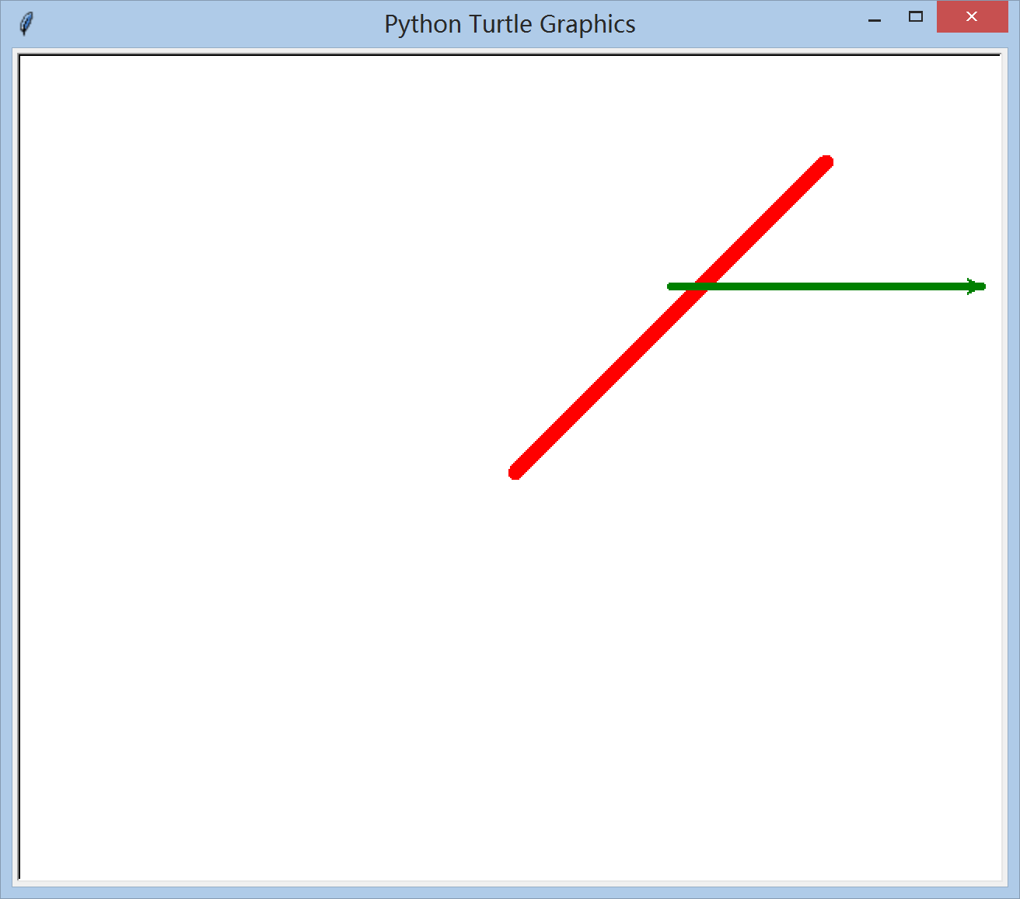
drawLine 画线

Slide 24
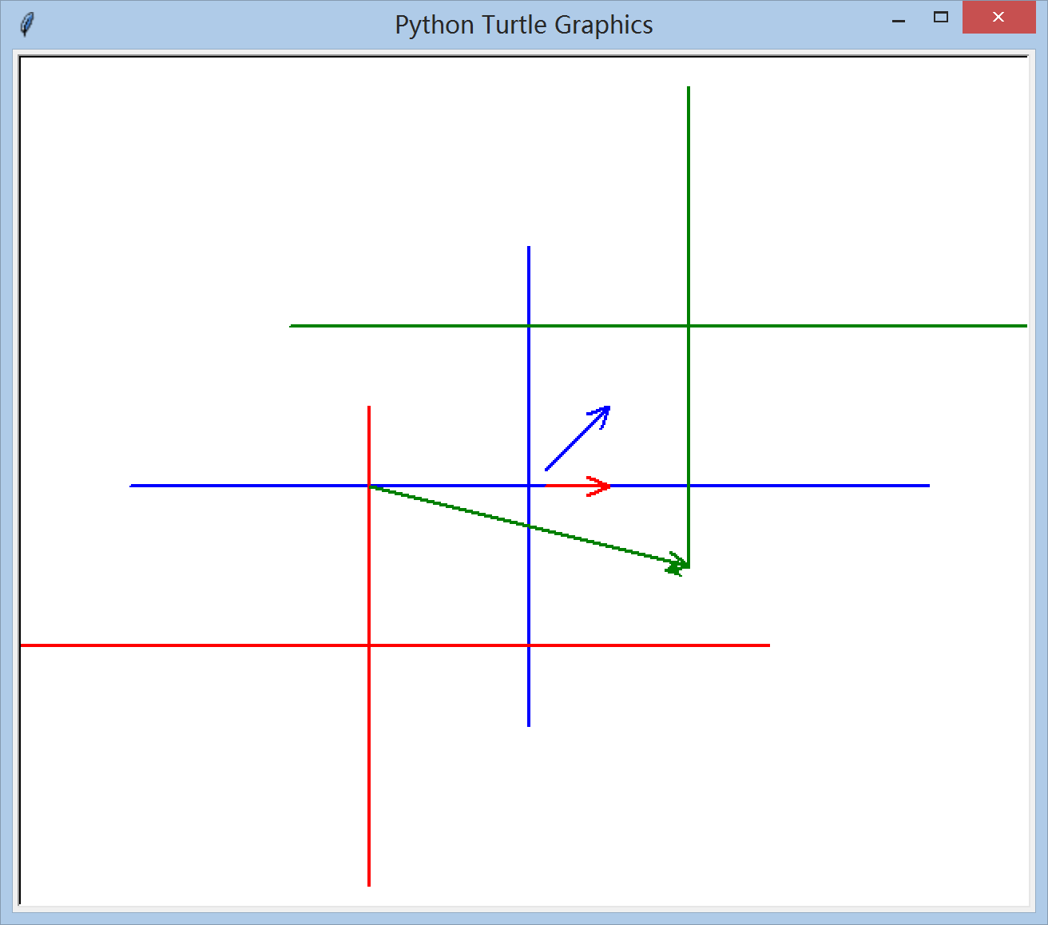
演示画箭头 drawArrow

Slide 25
重写五星红旗程序

Slide 26
Code Listing 6.3
re-implement len
DIY求字符串长度的函数len

Slide 28
Code Listing 6.4
Count letters in string

Slide 29
check membership in lowercase
import string
use string.ascii_lowercase, string of lowercase english letters
'abcdefghijklmnopqrstuvwxyz'
check if each char is a member (using in operator) of string.ascii_lowercase
char.lower() before membership (catch Capital Letters that way)

Slide 31
练习：统计小写字母和大写字母各多少个？

Slide 32
变量的作用域
全局变量
global_var=1
def f1():
local_var =2
print(global_var)
print(local_var)
f1()
print(global_var)
print(local_var)

Slide 33
x=1
def f2():
x=2
print(x)
f2()
print(x)

Slide 34
m = eval(input("Enter a number:"))
if m>0:
y = 4
print(y)

Slide 35
sum = 0
for i in range(5):
sum+=i
print(i)

Slide 36
x=1
def increase():
global x
x=x+1
print(x)
increase()
print()

Slide 37
但在一个函数中修改全局变量并不是一个好习惯

Slide 38
使用到的全局变量只是作为引用，不在函数中修改它的值的话，不需要加global关键字。
使用到的全局变量，需要在函数中修改的话，就涉及到歧义问题
结论：引用全局变量，不需要golbal声明，修改全局变量，需要使用global声明
同名全局变量的引用.py（尽量不取为同名）

Slide 39
关于位置
First函数
Second函数
First引用Second
函数位置异同.py

Slide 40
从上述例子总结：
From Mathematics we know that functions perform some operation and return one value.
They “encapsulate” the performance of some particular operation, so it can be used by others (for example, the sqrt() function)
函数执行一定操作，返回结果
封装代码，有自己的名字，可复用，有参数

Slide 41
例子 求三角形面积
P254 （定位P287 ） 5.3.4

Slide 42
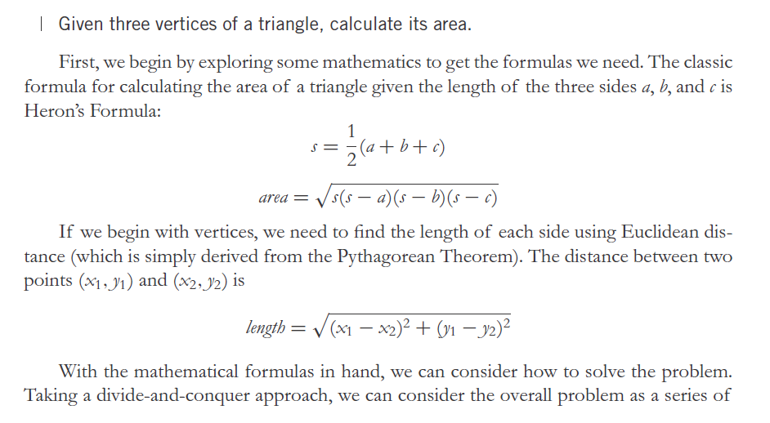

Slide 43
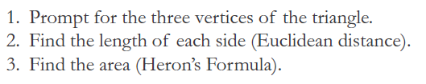

Slide 44
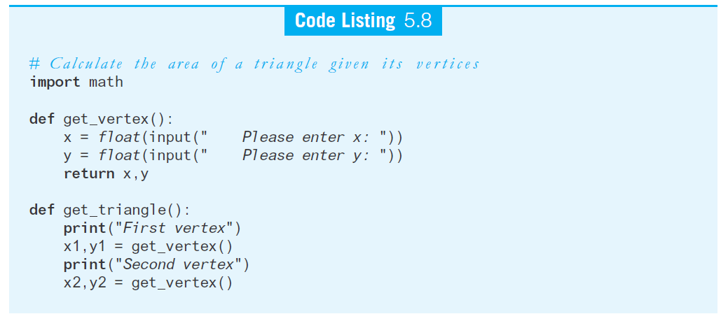

Slide 45
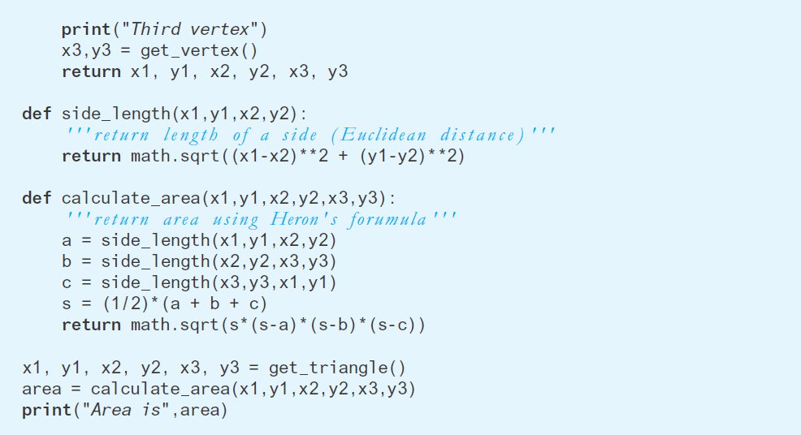

Slide 46

练习
将十进制数转换为十六进制数
记住：后余为高位

Slide 47
Did functions help?
Made our problem solving easier (solved smaller problems as functions)
main program very readable (details hid in the functions)

Slide 48
How to write a function
只做一件事. If it does too many things, it should be broken down into multiple functions (refactored)
可读. How often should we say this? If you write it, it should be readable
可重用. If it does one thing well, then when a similar situation (in another program) occurs, use it there as well.

Slide 49
More on functions
完整. A function should check for all the cases where it might be invoked. Check for potential errors.
重构

Slide 50
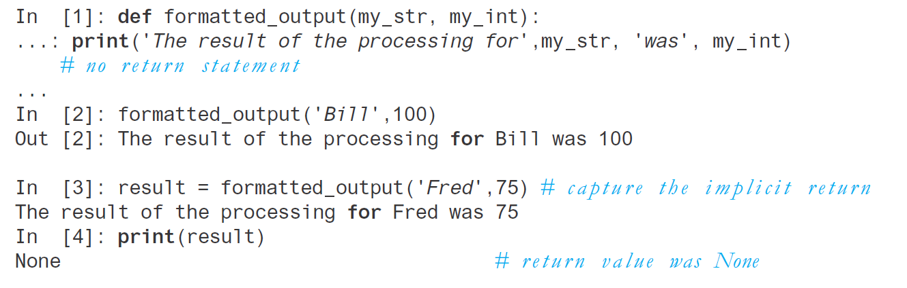
5.3.7 没有return语句
书上260（电子版定位293）

Slide 51
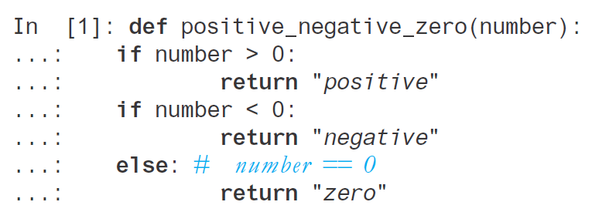
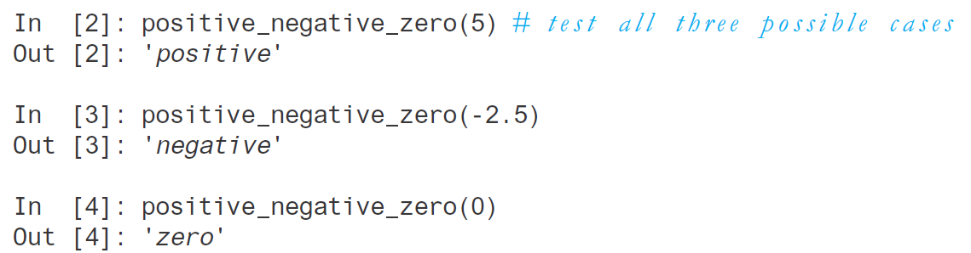
5.3.8 多条return语句

Slide 52
Rule 8
A function should do one thing

Slide 53
Procedures
Functions that have no return statements are often called procedures.
Procedures are used to perform some duty (print output, store a file, etc.)
Remember, return is not required.

Slide 54
Multiple returns in a function
A function can have multiple return statements.
Remember, the first return statement executed ends the function.
Multiple returns can be confusing to the reader and should be used judiciously.

Slide 55
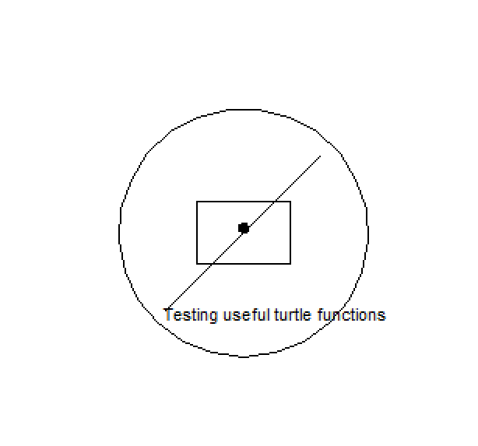
练习编写可重用图形函数
writeText
drawPoint
drawCircle
drawRectangle
drawLine

Slide 56
Reminder, rules so far
Think before you program!
A program is a human-readable essay on problem solving that also happens to execute on a computer.
The best way to imporve your programming and problem solving skills is to practice!
A foolish consistency is the hobgoblin of little minds
Test your code, often and thoroughly
If it was hard to write, it is probably hard to read. Add a comment.
All input is evil, unless proven otherwise.
A function should do one thing.

Slide 57
练习作业
重写五星红旗
drawArrow
绘制美国国旗，函数

