Slide 1
chapter 7
列表和元组

Slide 2
Opening Problem
Read one hundred numbers, compute their average, and find out how many numbers are above the average.

Slide 3
Solution
DataAnalysis

Slide 4
Data Structures

Slide 5
Data Structures and algorithms
Part of the "science" in computer science is the design and use of data structures and algorithms
As you go on in CS, you will learn more and more about these two areas

Slide 6
Data Structures
Data structures are particular ways of storing data to make some operation easier or more efficient. That is, they are tuned for certain tasks
Data structures are suited to solving certain problems, and they are often associated with algorithms.

Slide 7
Kinds of data structures
Roughly two kinds of data structures:
built-in data structures, data structures that are so common as to be provided by default
user-defined data structures (classes in object oriented programming) that are designed for a particular task

Slide 8
Python built in data structures
Python comes with a general set of built in data structures:
lists
tuples
string
dictionaries
sets
others...

Slide 9
Lists

Slide 10
The Python List Data Structure
a list is an ordered sequence of items.列表是一个有序序列
you have seen such a sequence before in a string. A string is just a particular kind of list (what kind)?

Slide 11
列表可以包含其他元素，而不仅包含字符。
不通类型元素可以混合在同一个列表中。
列表是可变类型

Slide 12
Make a List
Like all data structures, lists have a constructor （构造函数list构造列表）, named the same as the data structure. It takes an iterable data structure and adds each item to the list
使用[ ]构造列表
构造函数 或方括号[],逗号很重要

Slide 13
make a list

Slide 14
Creating Lists
Creating list using the list class
list1 = list() # Create an empty list
list2 = list([2, 3, 4]) # Create a list with elements 2, 3, 4
list3 = list(["red", "green", "blue"]) # Create a list with strings
list4 = list(range(3, 6)) # Create a list with elements 3, 4, 5
list5 = list("abcd") # Create a list with characters a, b, c
For convenience, you may create a list using the following syntax:
list1 = [] # Same as list()
list2 = [2, 3, 4] # Same as list([2, 3, 4])
list3 = ["red", "green"] # Same as list(["red", "green"])

Slide 15
任务
张三 | 56 | 72 | 85
请将此表格构造为list

Slide 16
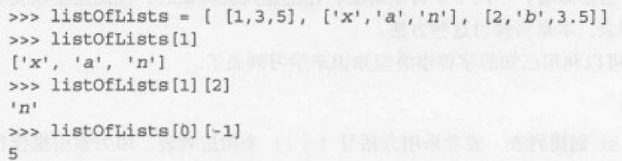
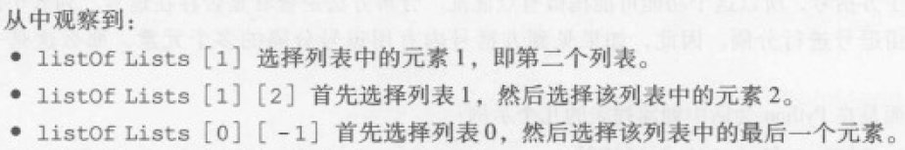
2 二维列表

Slide 17
2 二维列表List of Lists
my_list = ['a', [1, 2, 3], 'z']
What is the second element (index 1) of that list? Another list.
my_list[1][0] # apply left to right
my_list[1] ⇒ [1, 2, 3]
[1, 2, 3][0] ⇒ 1
二维列表

Slide 18
任务
张三 | 56 | 72 | 85
李四 | 72 | 56 | 90
王麻子 | 78 | 45 | 67
构造二维列表

Slide 19
6.2 操作列表 Similarities with strings
concatenate/+ (but only of lists)
repeat/*
indexing (the [ ] operator)
slicing ([:])
membership (the in operator)
len (the length operator)

Slide 20
Operators
[1, 2, 3] + [4] ⇒ [1, 2, 3, 4]
[1, 2, 3] * 2 ⇒ [1, 2, 3, 1, 2, 3]
1 in [1, 2, 3] ⇒ True
[1, 2, 3] < [1, 2, 4] ⇒ True
compare index to index, first difference determines the result

Slide 21
differences between lists and strings
lists can contain a mixture of any python object, strings can only hold characters
1,"bill",1.2345, True
lists are mutable, their values can be changed, while strings are immutable
lists are designated with [ ], with elements separated by commas, strings use " " or ' '

Slide 23
Indexer Operator []

Slide 24
Indexing
can be a little confusing, what does the [ ] mean, a list or an index?
[1, 2, 3][1] ⇒ 2
Context solves the problem. Index always comes at the end of an expression, and is preceded by something (a variable, a sequence)
注意方括号！

Slide 25
List of Lists
my_list = ['a', [1, 2, 3], 'z']
What is the second element (index 1) of that list? Another list.
my_list[1][0] # apply left to right
my_list[1] ⇒ [1, 2, 3]
[1, 2, 3][0] ⇒ 1

Slide 26
List Functions
len(lst): number of elements in list (top level). len([1, [1, 2], 3]) ⇒ 3
min(lst): smallest element. Must all be the same type!
max(lst): largest element, again all must be the same type
sum(lst): sum of the elements, numeric only

Slide 27
Iteration
You can iterate through the elements of a list like you did with a string:

Slide 28
Mutable

Slide 29
Change an object's contents
strings are immutable. Once created, the object's contents cannot be changed. New objects can be created to reflect a change, but the object itself cannot be changed
my_str = 'abc'
my_str[0] = 'z' # cannot do!
# instead, make new str
new_str = my_str.replace('a','z')

Slide 30
6.3.1 列表的可变性 Lists are mutable
Unlike strings, lists are mutable. You can change the object's contents!
my_list = [1, 2, 3]
my_list[0] = 127
print(my_list) ⇒ [127, 2, 3]

Slide 31
6.3.2 列表的方法 List methods
Remember, a function is a small program (such as len) that takes some arguments, the stuff in the parenthesis, and returns some value
a method is a function called in a special way, the dot call. It is called in the context of an object (or a variable associated with an object)

Slide 32
Again, lists have methods
my_list = ['a',1,True]
my_list.append('z')
arguments to
the method
the object that
we are calling the
method with
the name of
the method

Slide 33
Some new methods
A list is mutable and can change:
my_list[0]='a' #index assignment
my_list.append(), my_list.extend()
my_list.pop()
my_list.insert(), my_list.remove()
my_list.sort()
my_list.reverse()
my_list.count() P322例子

Slide 34
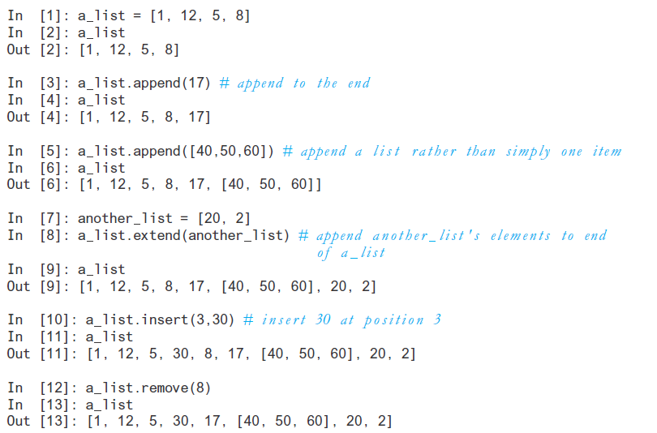

Slide 35
