Slide 1
Automatic Text Summarization
Submitted by: Sulav Rupakheti
IST 664 NLP, Thursdays 6PM

Slide 2
Introduction
Text Summarization is the process a creating a shorter, fluent summary of a longer text document.
With an ever-increasing and usually an exponential increase in volume of text content on the internet, automated text summarization can be a useful tool.

Slide 3
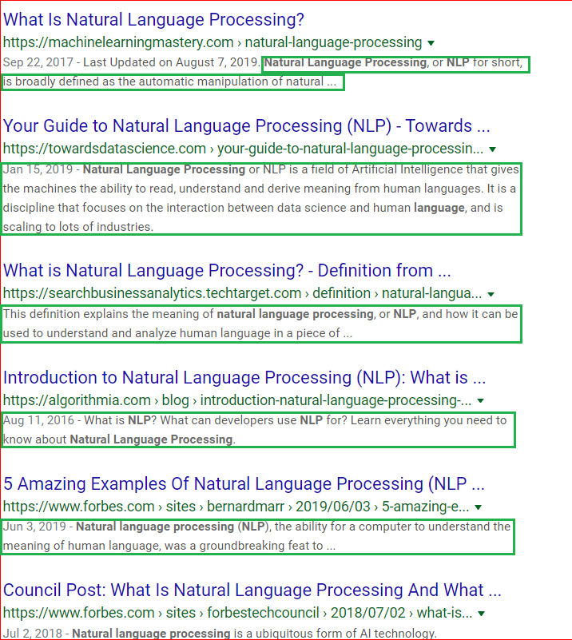
Example -1
Google/search engines are likely one of the first set of companies that made automatic text summarization mainstream
The highlighted part in green is an example of automatic text summarization that a user sees when performing a search on Google.
Multiple extractive text summarization techniques are likely being used (TF-IDF, Cosine similarity, etc.) to provide this to the users. Google does not disclose this information.
While the summaries tend to be helpful, they are not always 100% on-point and only contain keywords at times.
Fig.1: Example of a typical google search which includes text summarization [3]

Slide 4
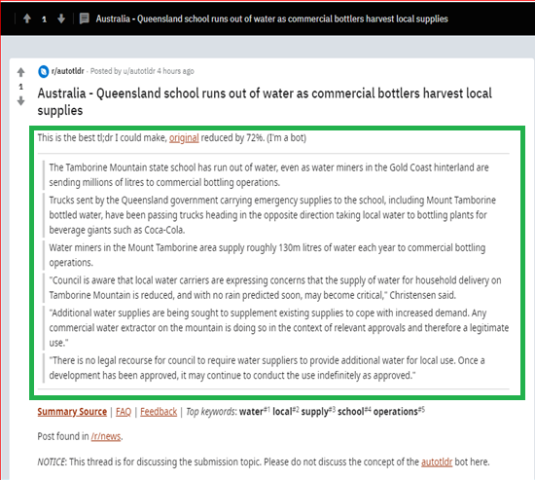
Example -2
Autotldr is a bot on reddit.com that automatically summarizes popular user-submitted webpages into summarized versions. It only provides summary, as a new post on reddit.com, if it can reduce the text content by at least 70%.
This bot uses smmry.com to create its content, which is a for profit entity that helps customers summarize text content, using NLP and machine learning.
While positively received by its users, Smmry.com does not disclose how it works or what algorithm it uses. It would have to be evaluated manually for its accuracy.
Fig.2: Screenshot showing a positively-reviewed bot on reddit.com, known for summarizing news articles [8]

Slide 5
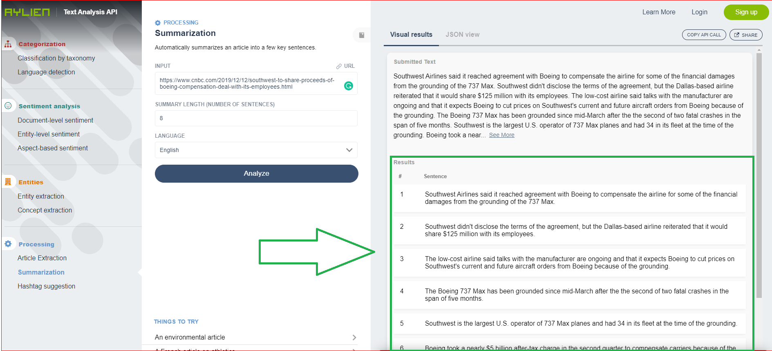
Example -3
The service lets user create summary for any webpage containing text.
It lets users decide the number of sentences required in summarized version of the text.
The company does not disclose how it works or what algorithm it uses. It would have to be evaluated manually for its accuracy.
Fig.3: Screenshot showing one of the for-profit text summarization service provided by aylien.com. [6]

Slide 6
Methods of Text Summarization
Extractive ➔ Create a summary using a subset of words present in the original source.[1],[4],[5]
Abstractive ➔ Create a summary expressing the ideas in source document, including words that do not appear in the original. It can be compared to how a human would read something and summarize in their own words. [1],[4],[5]

Slide 7
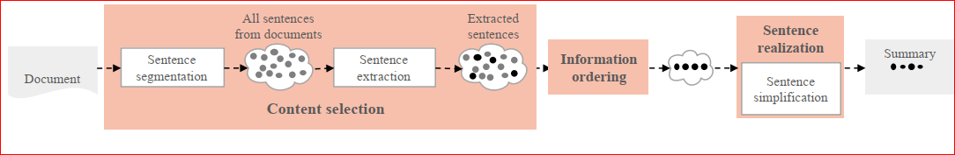
Typical Text Summarization Approach
Content Selection
Information Ordering
Sentence Realization
Create Summary
Fig.4: Typical workflow of a text summarization [5]

Slide 8
Content Selection
Document is parsed, and sentences are segmented. The segmented sentences are then extracted using methods such as selecting sentences based on the signature topic of the document (simple approach), computing probability of observing the word in the input more often than in the background corpus (centroid-based approach), scoring sentences using a ranking system (e.g. TextRank, LexRank, PageRank) [5]

Slide 9
Information Ordering
The selected sentences are then ordered chronologically, by topic – order in the same way the topics are ordered in the original document, and by coherence – choose orderings that make neighboring sentences similar [5]

Slide 10
Sentence Realization and Summary
Ordered sentences are simplified by getting redundant parts removed E.g. parts such as “On the other hand”, “As a matter of fact”, are removed [5]
Final summarized version is created. [5]

Slide 11
Examples: Step by Step guide to Try Extractive Text Summarization on Your Own
https://blog.floydhub.com/gentle-introduction-to-text-summarization-in-machine-learning/
https://towardsdatascience.com/understand-text-summarization-and-create-your-own-summarizer-in-python-b26a9f09fc70

Slide 12
References
[1]https://machinelearningmastery.com/gentle-introduction-text-summarization/
[2]https://www.reddit.com/r/autotldr/comments/e9k7cn/australia_queensland_school_runs_out_of_water_as/
[3]https://www.google.com/search?sxsrf=ACYBGNSOmPjE0FQkwjsU_zT1Vjc9lWbf1Q%3A1576146303356&ei=fxXyXbanFYmf_Qa52rewDg&q=natural+language+processing&oq=Natural+&gs_l=psy-ab.1.0.0i67j0i273j0i67l5j0j0i67j0.1770413.1774872..1777238...0.2..0.122.1626.23j1......0....1..gws-wiz.......0i71j0i131j0i131i67.UNXCtyqb7PY
[4]https://towardsdatascience.com/understand-text-summarization-and-create-your-own-summarizer-in-python-b26a9f09fc70
[5]Teaching materials provided by the professor in class
[6]https://developer.aylien.com/text-api-demo?text=http%3A%2F%2Fwww.bbc.com%2Fsport%2F0%2Ffootball%2F25912393&tab=concepts&run=1
[7]https://smmry.com/
[8]https://www.reddit.com/r/autotldr/comments/e9lppn/queensland_school_runs_out_of_water_as_commercial/

