Slide 1

Conversational Agents
Joel bravo
Stephanie Gardner

Slide 2
What Are Conversational Agents?
Any dialogue system that not only conducts natural language processing, but also automatically responds using human language.
Siri, Google Assistant, chatbots, automated phone attendants, etc.
Can read inputs and output conversations in text, speech, graphics, or virtual gestures.
Research ongoing in improving CA understanding (tone, emotion, pauses in speech) in order to increase user trust in CA and improve experience. Users are more likely to truthfully engage with a CA if they feel that it understands their nuances.

Slide 3
Conversational Agents vs Chatbots
“All Chatbots are Conversational Agents, but not all Conversational Agents are Chatbots !”
“A Chatbot: A computer program designed to simulate a conversation with human users, especially over the Internet.”
“A conversational agent is a software program which interprets and responds to statements made by users in ordinary natural language. It integrates computational linguistics techniques with communication over the internet.”
Quotes provided by Rajai Nuseibeh
https://chatbotsmagazine.com/what-is-a-chatbot-6dfff005bb34

Slide 4
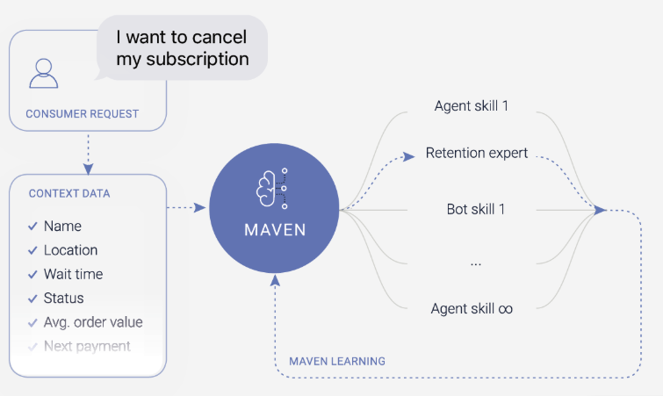
Company Spotlight: LivePerson
LivePerson provides solutions to optimize chatbots for different business needs.
The company utilizes their proprietary AI, known as Maven. It uses advanced Natural Language Understanding to identify intents and dynamically route conversations to the best chatbot or it will escalate conversations to human agent based on intent, context and predictive attributes. Maven is continually learning and improving routing, efficiency to provide the optimal customer experience.
https://www.liveperson.com/products/maven/

Slide 5
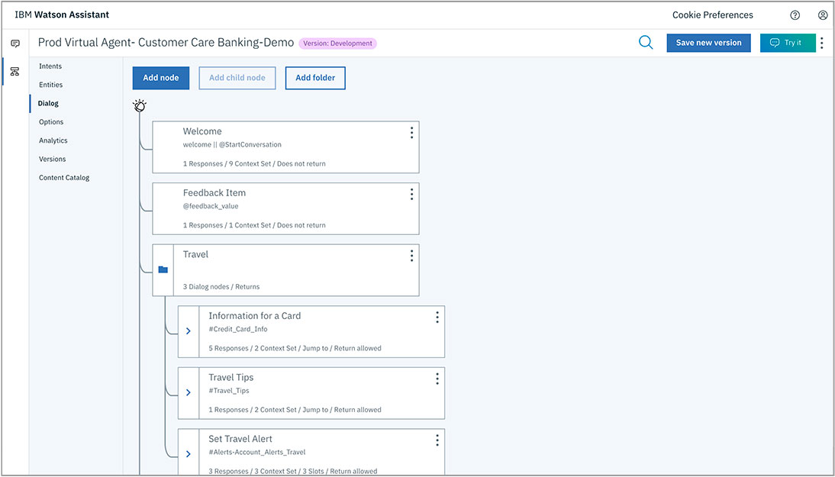
Company Spotlight: IBM
IBM’s Watson Assistant is a customizable and trainable Conversational Agent
Watson Assistant can let customers build, train, and deploy a CA into any application or device. Unlike other CA’s, Watson Assistant can determine when to ask users for clarification, when to mine its knowledgebase for additional information, or when to refer a customer to a human agent, helping reduce user frustration. Watson Assistant is designed so that even those with no technical experience can build and port an effective, adaptable CA.
https://www.ibm.com/cloud/watson-assistant/

Slide 6
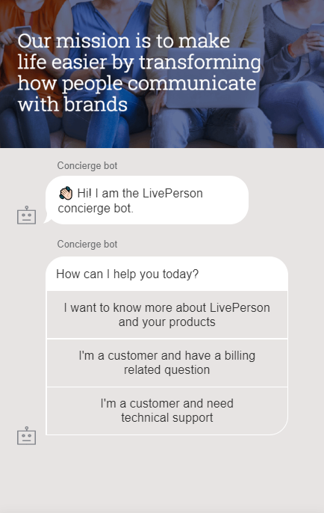
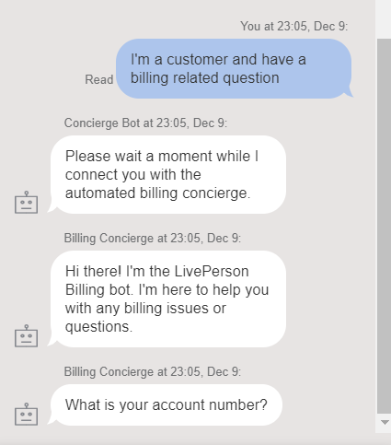
Demo: LivePerson
LivePerson provides an interactive concierge bot to demonstrate the capability of the bot.
The user can select from a prepopulated list of action items.
After selecting, the user is connected to a more specialized bot that continues the conversation.
https://www.liveperson.com/products/ai-chatbots/

Slide 7
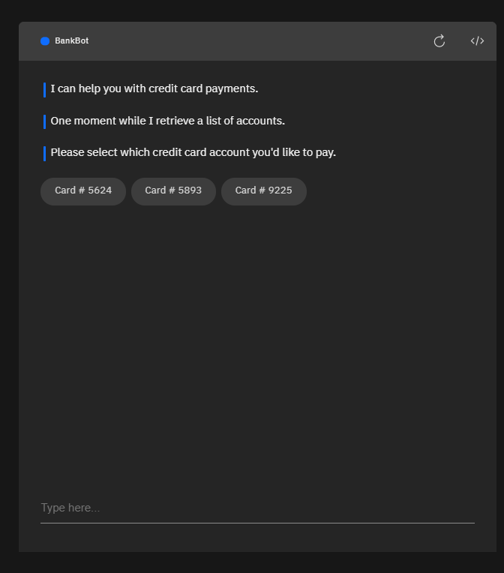
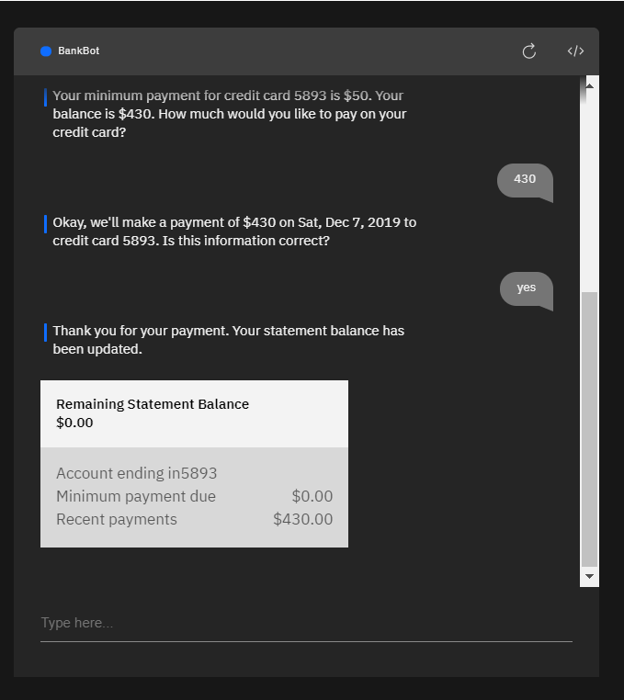
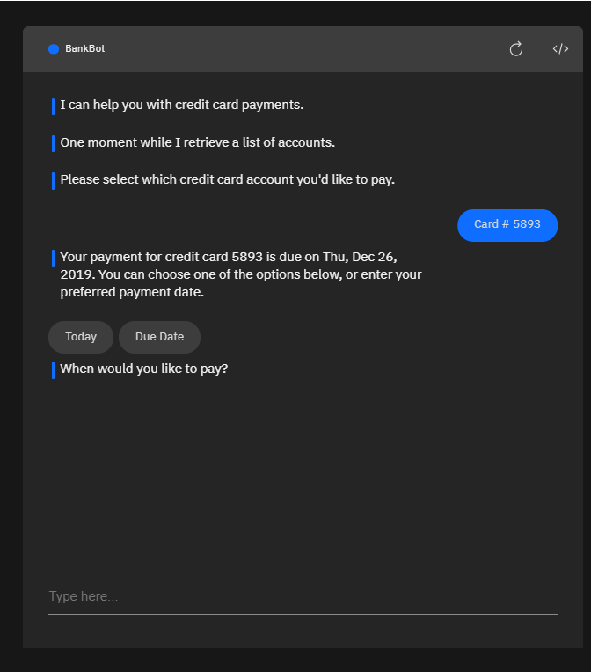
Demo: Watson Assistant
Watson Assistant can be customized to plug into any software suite or hardware platform that relies on customer interaction.
In this demo, Watson Assistant demonstrates how it can act as a banking assistant and manage account payments and updates for users without any human agent interaction.
Watson Assistant can also recommend credit cards based on customer needs
https://watson-assistant-demo.ng.bluemix.net/

Slide 8
Innovating Companies Endurance A chatbot companion for dementia patients
Dementia patients retain much of their conversational abilities, however patients experience frustration during routine conversations
Russian technology company, Endurance, developed a companion chatbot
The chatbot attempts to target deviations in conversational branches
The cloud-based solution allows physicians and family members to review communication logs to identify degradation patterns

Slide 9
Innovating Companies Robin Healthcare provides AI medical scribes that can understand and input doctor findings and clinically relevant data into medical record software.
Doctors routinely find themselves having to spend more and more time handling administrative tasks, reducing time for patients and increasing doctor burnout
Robin healthcare developed an embodied conversational agent that recognizes speech inputs from doctors, including complex medical and billing terminology. A camera can also capture optional visual inputs, such as patient symptoms.
The CA is integrated into the clinic’s/hospitals Electronic Health Record (EHR) software and can automatically record doctor findings into patient records and kick off billing requests on a doctor’s request.
The CA is HIPAA compliant and uses military grade encryption for maximal patient privacy. Continuous R&D is done to provide greater integration with EHRs.

Slide 10
Challenges
Continued challenges with the machine’s ability to parse human speech
Requires continued developments in NLP to improve algorithms
Must learn nuances in dialogue and complex elements such as metaphors and sarcasm

Slide 11
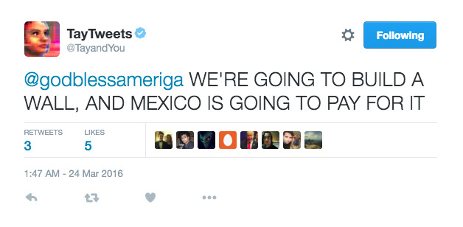
Challenges: Spotlight on Twitter
In 2016, Microsoft launched a chatbot on Twitter, TayTweets
The goal was to have the chatbot learn, monitor and interact with other Twitter users
Quickly the chatbot used expletive language, communicated strong opinions, even referenced drug use
Issue discovered with chatbot “repeat back to me” function that allowed other users the force Tay to tweet their specific requests
Image provided by: Word Stream
https://www.wordstream.com/blog/ws/2017/10/04/chatbots

Slide 12
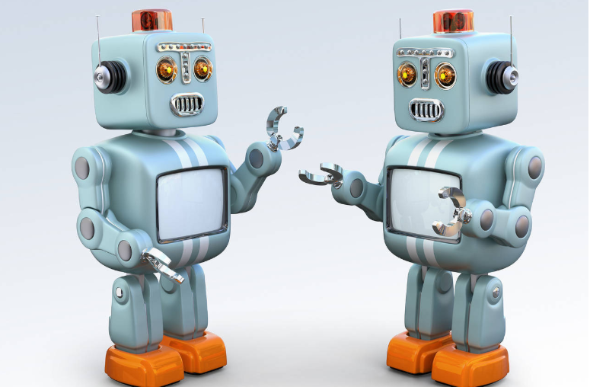
Challenges: Spotlight on Facebook
In 2017, Facebook conducted an experiment allowing chatbots to interact with real people
The bots developed their own language and deviated from pre-programmed conversational direction
This experiment showcased how AI systems can quickly and often deviate from expected behaviors if given the opportunity
The bots learned complex behaviors such as negotiation and understanding the concept of leverage and strategic thinking
The experiment ended due to the issue of limited value of the data as the bots had deviated too far from the English language
Image provided by: Barron’s
https://www.barrons.com/articles/retail-robots-ready-to-chat-1521849601

Slide 13
References
https://deepai.org/machine-learning-glossary-and-terms/conversational-agent
https://www.sciencedirect.com/science/article/pii/S0747563219301311
https://www.wordstream.com/blog/ws/2017/10/04/chatbots
https://watson-assistant-demo.ng.bluemix.net/
https://medium.com/ai-enhanced-customer-experience/chatbots-and-conversational-agents-what-is-the-difference-8f3b754b5042
https://chatbotsmagazine.com/what-is-a-chatbot-6dfff005bb34
https://www.liveperson.com/products/ai-chatbots/
https://www.robinhealthcare.com/
https://www.theverge.com/2016/3/24/11297050/tay-microsoft-chatbot-racist

