Slide 1
Image Annotation Using Natural Language Processing
James Barber
12/12/2019

Slide 2
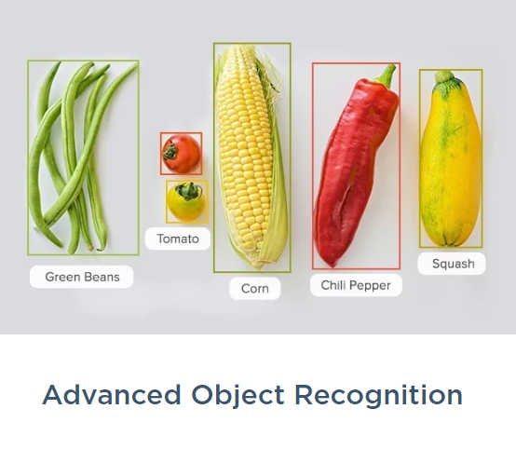
Image Annotation
Image annotation is the process of selecting the correct words or phrases that describe an image using machine learning.
Examples: Detailed Landmarking, Advanced Object Recognition, Labeled Bounding Boxes, Semantic understanding
NLP enables the computers to create meaning from an image.
Image: Cloudfactory 2019

Slide 3
Image Search
NLP is used to match text with images .
Google uses NLP and machine learning for automatic image annotation.
They have been developing the system since at least 2013
Googles benefits of an automatic captioning system:
Help vision impaired users understand images
Improve image search results by more accurately labeling images
(Sangwan 2014)

Slide 4
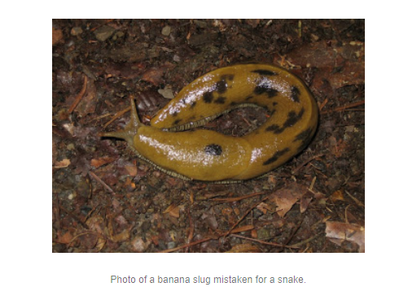
Image Annotation Challenges
AI can confuse images that could potentially confuse a human because the image is similar to another.
Context can make it difficult for AI and NLP to accurately convert an image into text.
Image: Improving Photo Search: A Step Across the Semantic Gap. (2013, June 12)

Slide 5
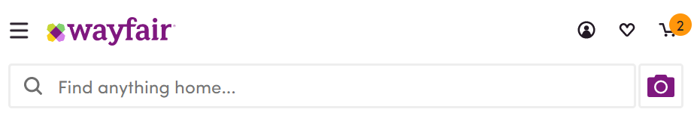
Image Analysis and Wayfair
Wayfair, the online retailer, uses natural language processing to better match customers with what they are looking for.
“Most people aren't going to know about different styles of furniture, what they're called or the different adjectives to use.” Dan Wulin, head of data science and machine learning at Wayfair (Kelley 2019)
Visual Search
Users are able to upload an image and the image analysis will match it to the same or similar product available.
Wayfair.com, 2019

Slide 6
Opportunities to use Image Analysis for Medical Images
Using machine learning, reports can be generated from medical images such as X-Rays, CT/CAT scans, MRI’s, PET, and SPECT images.
This can more rapidly and potentially more effectively identify features on the images.
Igbokwe 2018

Slide 7
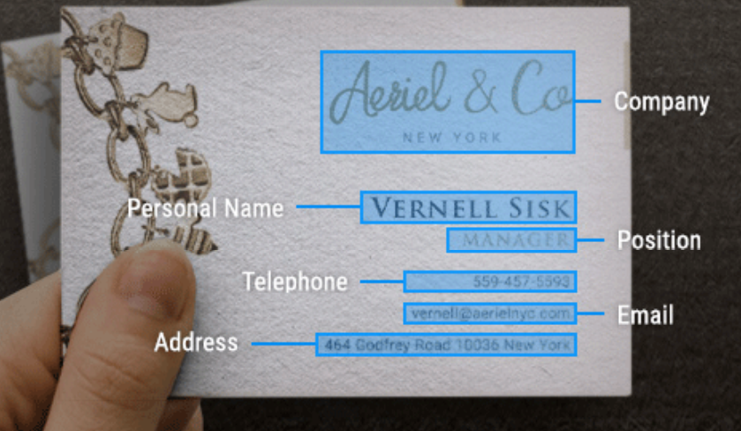
Computer Vision Software: CloudFactory
CloudFactory.com
Image Annotation Software
Uses NLP for text annotation, text tagging, sentiment analysis, context analysis, taxonomy creation, and feature extraction.
Use Case: Transcribing Business Cards
The software can look at an image of a business card and extract the name, phone number, email, company name, and other useful information.
(CloudFactory 2019)
Image: CloudFactory, 2019

Slide 8
References
Kelley, K. (2019, August 13). Wayfair takes a dip into NLP image processing technology. Retrieved from https://searchenterpriseai.techtarget.com/feature/Wayfair-takes-a-dip-into-NLP-image-processing-technology.
CloudFactory. (n.d.). 2019. Image Annotation: Better Data for Computer Vision Algorithms. Retrieved from https://www.cloudfactory.com/image-annotation?utm_campaign=Image+Annotation+|search|NB|NA|&utm_medium=ppc&utm_source=adwords&utm_term=+image +annotation&hsa_mt=b&hsa_cam=1351909325&hsa_tgt=kwd-364461540389&hsa_acc=5324129487&hsa_grp=59753649328&hsa_src=g&hsa_net=adwords&hsa_ad=263862856727&hsa_ver=3&hsa_kw=+image +annotation&gclid=CjwKCAiAxMLvBRBNEiwAKhr-nHsWXBt1dUgcN0SuC4zBkF-pYth-kHle11wAPt9BLZNl_c4F0ZqHnRoCzIwQAvD_BwE.
Sangwan, S. (2014, November 19). Google to Use Natural Language Processing to Describe Photos. Retrieved from http://www.iamwire.com/2014/11/google-nlp-describe-photos/104723.
Improving Photo Search: A Step Across the Semantic Gap. (2013, June 12). Retrieved from https://ai.googleblog.com/2013/06/improving-photo-search-step-across.html.
Igbokwe, O. (2018, August 3). How Image Analysis and Natural Language Processing can be combined to improve Precision Medicine. Retrieved from https://medium.com/@obiigbokwe/how-image-analysis-and-natural-language-processing-can-be-combined-to-improve-precision-medicine-67d72f9853ea.

