Slide 1

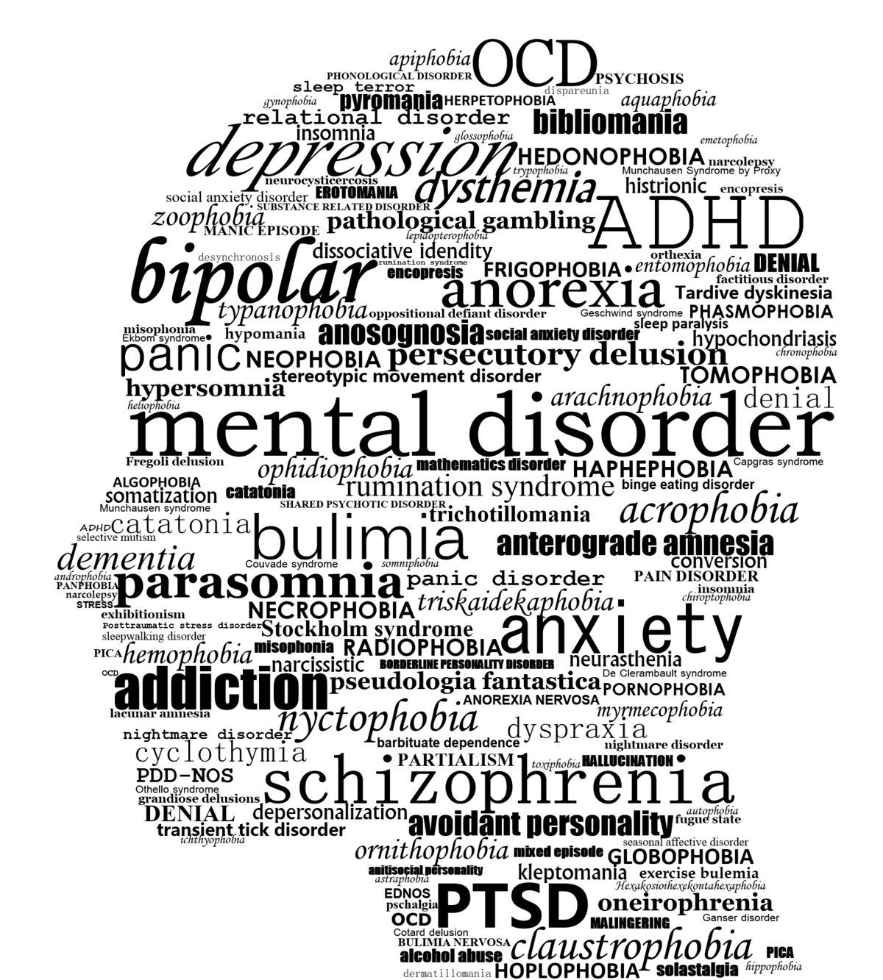
Using Data Science to Understand Mental Health in the Workplace
IST707
Professor Ying Lin, Ph.D.
Final Project
Walyon Abernathy,
Brian Hogan & David Madsen

Slide 2
Situation: Disclosing Mental Health in Workplace
Approximately “one in five adults in the U.S., or 9.8 million people, experiences mental illness each year*. Data science may be useful to help policy planners, communities, and businesses better understand mental health issues, their perceptions, and perhaps how to approach their existence in the workplace differently.
Decisions about whether an individual will or will not disclose a mental health issue to an existing or potential employer are complex.
Known or perceived stigmas as associated with mental health disorders and both employees and employers are uncomfortable approaching this topic.
Supervisors may be in a gateway position to understand individuals with a condition while simultaneously being able to help a business environment be more supportive of mental health while encouraging both personal and business health (Kirsh, Krupa, & Luong**).
“Employer interest in understanding and supporting workplace mental health is increasing worldwide…as prevalence rates reveal common mental health and substance abuse disorders affect at least 1 in 5 workers”**.
Perhaps data analytics can encourage employers to look differently regarding employee
mental health?
References:
* Clark,L., Woeppel, J. (2019). Importance of Analytics in Mental Health. Journal of AHIMA. Retrieved from: https://journal.ahima.org/2019/02/01/february-2019/
**Kirch, B., Krupa, T., Luong, D. (2018). How do supervisors perceive and manage employee mental health issues in their workplaces? IOS. DOI 10.3233/WOR-182698

Slide 3
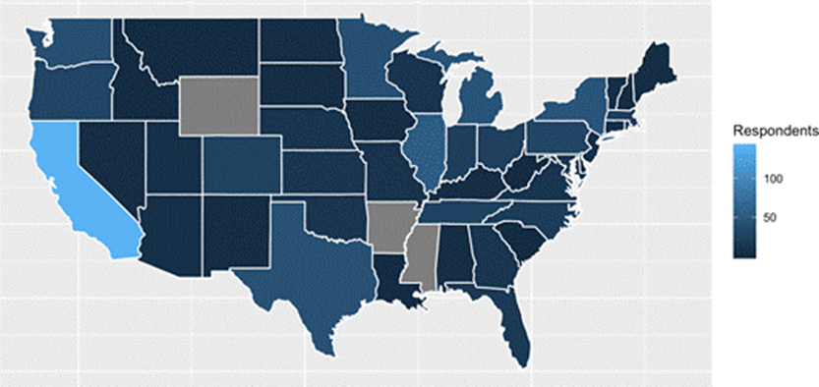
Data & Preprocessing: Open Sourcing Mental Illness
Significant attention was paid to NA categories across 56 data fields to maximize total available observations. This involved extensive programming around “self-employed,” and “text” fields transforming freeform data into discrete buckets. Location data included ‘country’ and ‘state’ (for those living or working in the United States).
Although many respondents were specifically from California, feature extraction of ‘continent’ and ‘region’ were still possible to assist in adding significance to other areas. Of the model’s 70,217 available data points, 1,000s of cells were recaptured with the “preprocessing_program_2” removing NAs.
Majority of respondents in California
Esther, K. Open Sourcing Mental Illness (OMSI). https://osmihelp.org.
Retrieved from: https://www.kaggle.com/osmi/mental-health-in-tech-2016/version/1#mental-heath-in-tech-2016_20161114.csv.

Slide 4
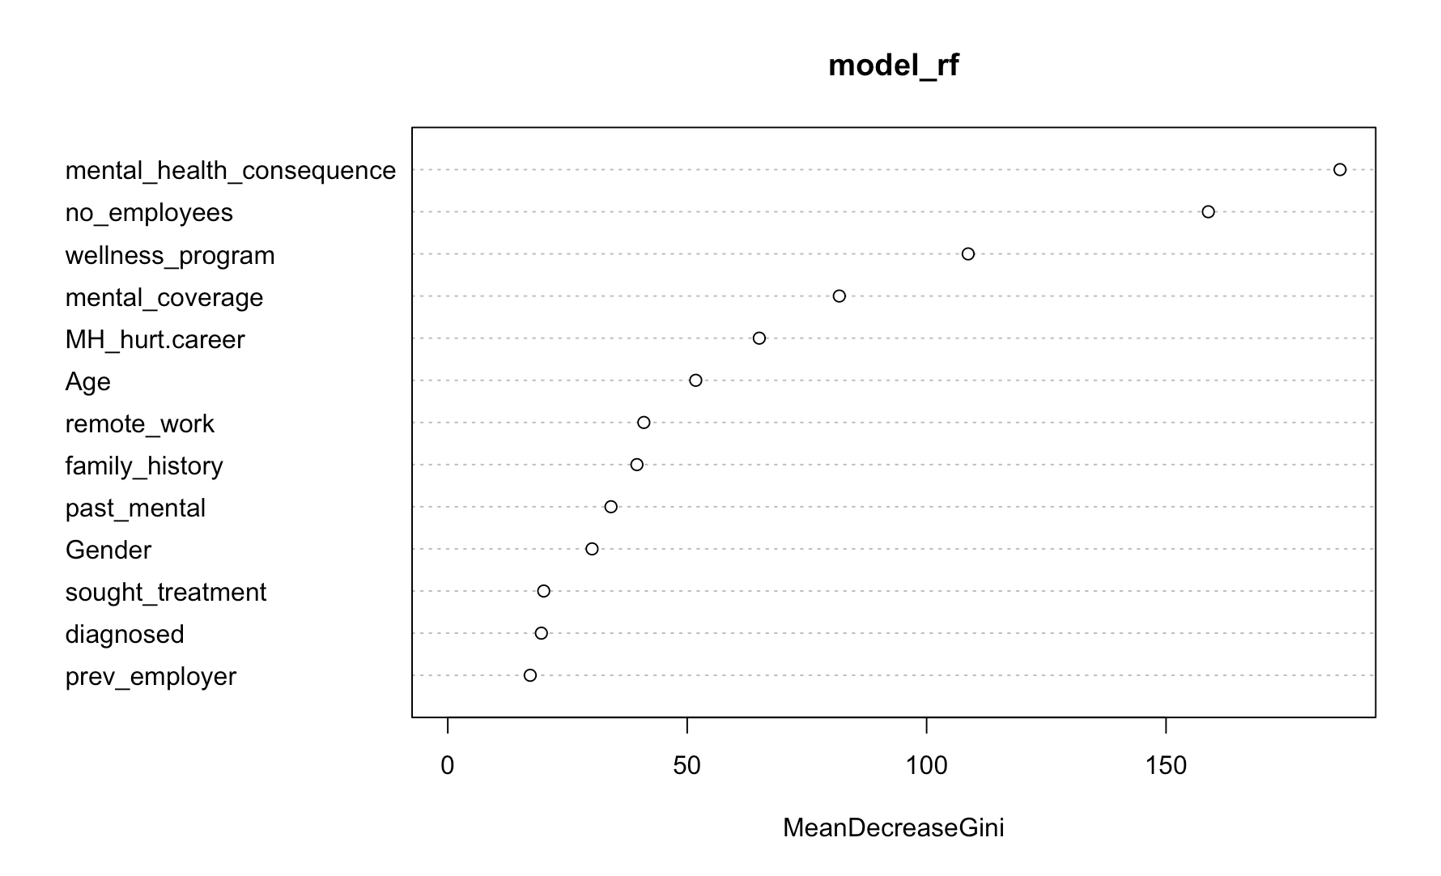



Random Forest Analysis
Random Forest was run initially to build an understanding of significant variables to guide analysis work. Tree modeling revealed the overall significance of “mental health consequence” even though it was coded “yes, no and maybe.” This field guided the design for associative rule mining revealing age and gender, particularly “male”, as contributing to not disclosing MH issues.
Descriptive statistics (next) indicated “diagnosed” was more important for prediction and also helped focus analysis work.

Slide 5

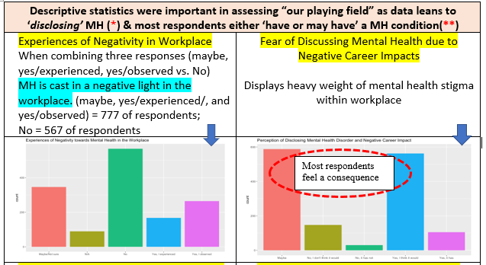
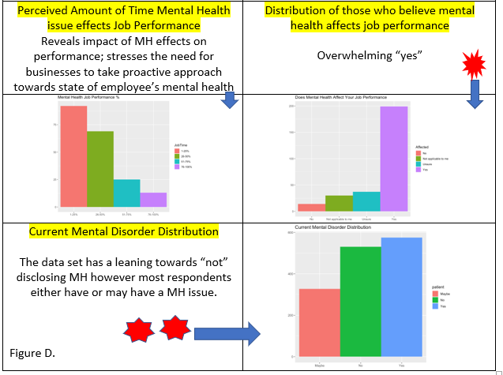
Descriptive statistics were important in assessing “our playing field” as data leans to ‘disclosing’ MH and most respondents either ‘have or may have’ a MH condition
Experiences of Negativity in Workplace…
(maybe & yes= 777) & (no = 567) of respondents
MH is cast in a negative light in the workplace
Fear of Discussing Mental Health due to Negative Career Impacts…
Displays heavy weight of mental health stigma within workplace
Perceived Amount of Time Mental Health issue effects Job Performance…
Reveals impact of MH effects on performance; stresses the need for businesses to take proactive approach towards state of employee’s mental health
Current Mental Disorder Distribution…
The data set has a leaning towards “not” disclosing MH however most respondents either have or may have a MH issue

Slide 6
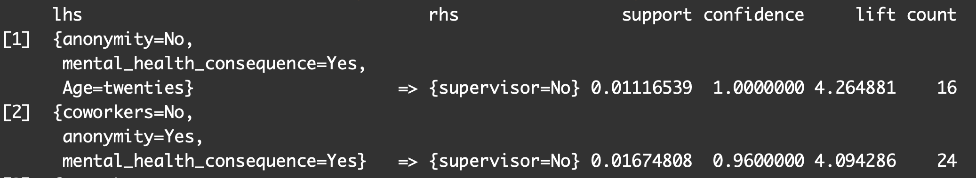
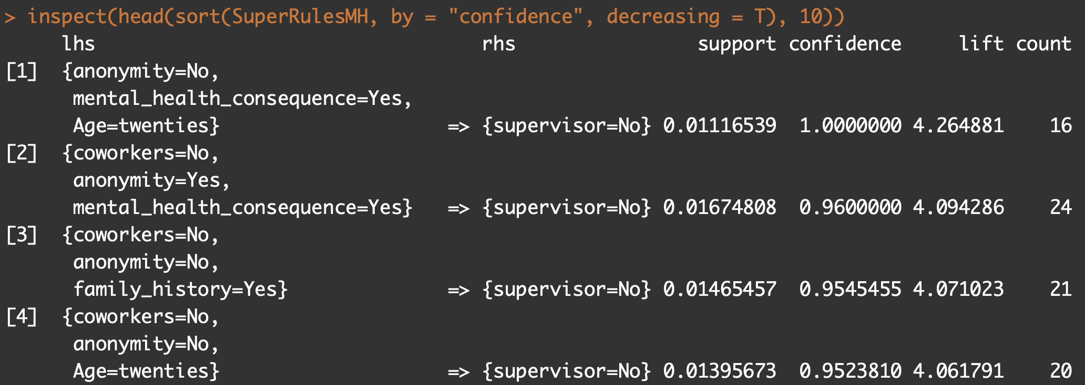
Association Rules Analysis
Respondents are going to keep MH issues to themselves if they don’t believe their anonymity is protected. AR rules help indicate a business may witness a negative consequence in the workplace.
AR mining indicates not having wellness programs, believing MH disclosure would hurt their career, and keeping MH disclosure from coworkers validates a lack of MH communication will be present with a direct supervisor.
This data confirms the supervisor’s position and ability to both positively and negatively influence MH issues in a business environment.
Respondents don’t trust MH anonymity in workplace and believe negative consequences result. The following finds negative responses towards MH leaving respondents cautious of disclosure.
AR confirms age group “twenties” are least likely to report MH to a supervisor. This speaks to organizations mistrust which could have been learned from MH in a respondent’s family history.

Slide 7
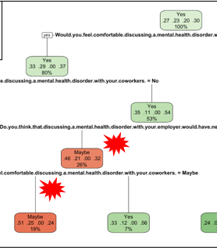
Decision Tree Analysis MH “stigma” effect is nicely revealed as respondents feel “maybe” there would be negative consequence if disclosed. A general atmosphere created by coworkers, i.e. “feeling comfortable discussing,” seems to play a big decision for those not self-employed. 41% of respondents did not think being identified as having a MH issue had affected or would affect their career. Of these, only 15% expressed definite willingness to bring up a MH issue in an interview.

Slide 8
Conclusions
Data mining approaches suggest caution when considering revealing a mental health issue either to peers or a supervisor.
Difficult to conclude companies are not receptive to employees discussing mental disorders, but companies do not seem to foster an environment where employees feel comfortable to speak openly about mental illness.
Employers can help: a) make employees feel their career will not be adversely affected by coming forward about mental illness, and b) help to create a culture where employees talk openly with each other about MH without stigmatizing those who suffer.
Employers can benefit: many respondents indicate a loss of productivity due to MH issues; by encouraging open communication, employers can help connect employees with needed resources.
A supervisor is key in establishing the work environment and supervising their employee assets. A supervisor is also a bridge between the employee and the major decision makers within a company.*
Training may be needed in cases to help supervisors identify individuals who may need assistance, to know how to approach these individuals, and to help foster an atmosphere of openness among their work groups without fear of repercussion for an employee.
References:
* Kirch, B., Krupa, T., Luong, D. (2018). How do supervisors perceive and manage employee mental health issues in their workplaces? IOS. DOI 10.3233/WOR-182698

