Slide 1
To Mine, or Not to Mine
Data Analysis of the Works of William Shakespeare
IST-736 Text Mining
Summer 2019
Dr. Gates
Jeff Victor, Arthur Fu, Olga Perera, Brian Hogan

Slide 2
William Shakespeare
Lived 1564 – 1616, England
Wrote or co-wrote 39 plays, 154 sonnets
“Widely regarded as the greatest writer in the English language and the world's greatest dramatist” – encyclopedia entry

Slide 3
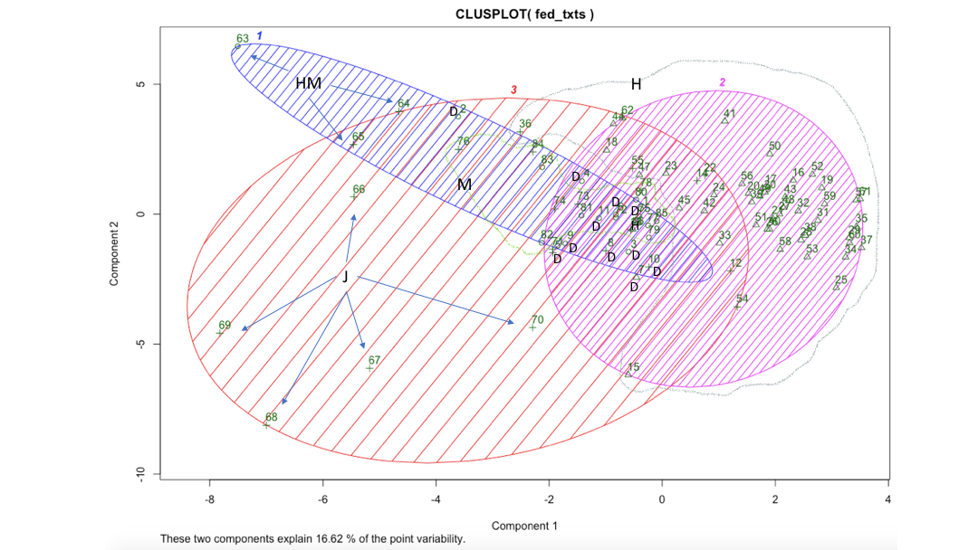
Shakespearean Musings…
Text Mining Pursuits:
How does vocabulary of comedies differ from tragedies?
How does vocabulary differ by character? Hero, heroine, villain…
What characters are similar or different?
Can algorithms predict if a sentence belongs to a comedy or tragedy?
COMEDIES All's Well That Ends Well As You Like It Comedy of Errors Love's Labour's Lost Measure for Measure Merchant of Venice Merry Wives of Windsor Midsummer Night's Dream Much Ado about Nothing Taming of the Shrew Tempest Twelfth Night Two Gentlemen of Verona Winter's Tale | HISTORIES Henry IV, Part I Henry IV, Part II Henry V Henry VI, Part I Henry VI, Part II Henry VI, Part III Henry VIII King John Pericles Richard II Richard III | TRAGEDIES Antony and Cleopatra Coriolanus Cymbeline Hamlet Julius Caesar King Lear Macbeth Othello Romeo and Juliet Timon of Athens Titus Andronicus Troilus and Cressida
Corpus

Slide 4
Data Preparation & Distributed Team Tasks
Scripts (“data”) available from MIT*
Wrote a custom HTML parser which labeled each line of dialogue
Team members independently answered their question, shared experience & findings
Each team-member directed and performed analysis by algorithm assignment and interest
Import
Clean
Analyze
* http://mit.shakespeare.edu

Slide 5
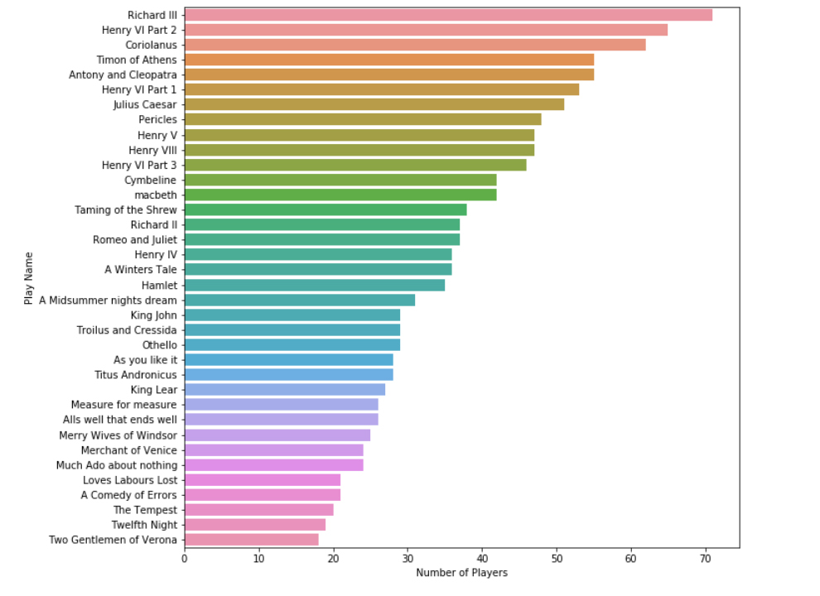
Player and Dialogue Visualizations
Frequency Distribution:
Number of Players by Play

Slide 6
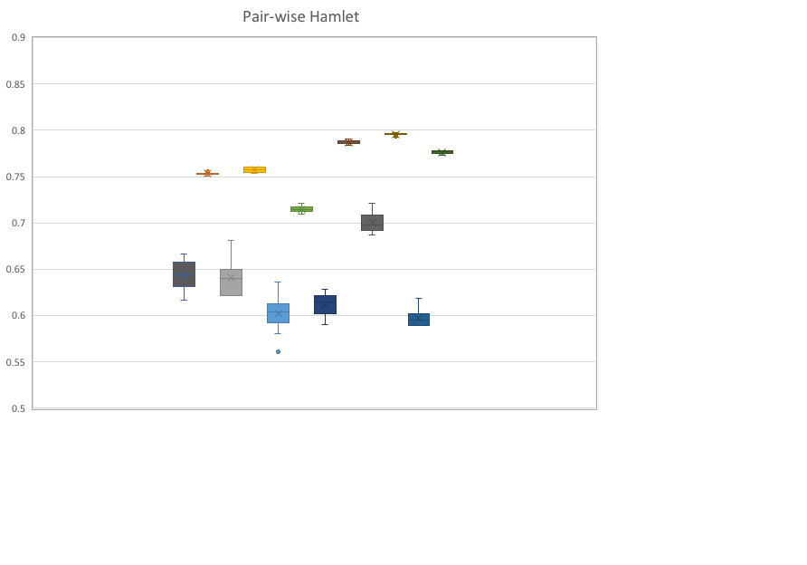
Character Distinction
The amount that the vocabulary of a play’s character differs from that of other characters
Determined with TFIDF vectorization and Naïve Bayes modeling in pairwise comparisons
Multinomial vs Bernoulli NB
Tested removal of English and “Shakespearean English” stopwords: no benefit for BNB
BNB
MNB

Slide 7
Only Hamlet’s word choices are distinctive

Slide 8
Henry VIII Only the female character stood out
Woman
Men

Slide 9
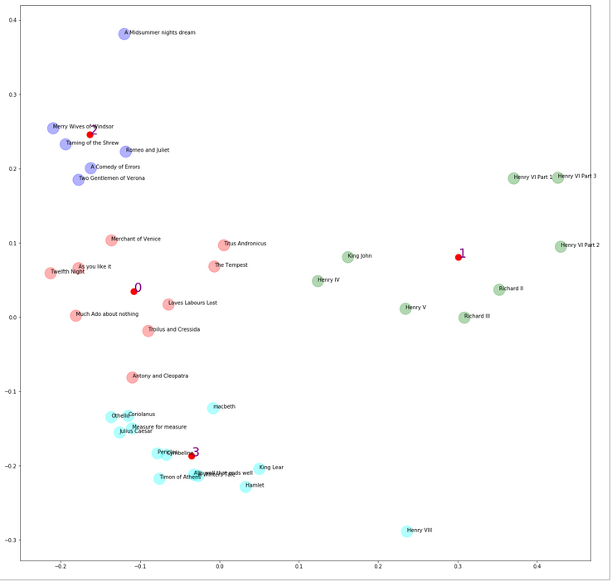
K-Means Clustering
Styles of Play
Number of Clusters (K)= 4
Cluster 0: As you like it, The Tempest, Merchant of Venice, Anthony and Cleopatra, Julius Caesar - Comedies, Tragedies, Romances
Cluster 1: King John, Henry VI Part 1-3, Henry IV, Henry V, Richard II, Richard III – The Histories
Cluster 2: Hamlet, King Lear, Othello, Winters Tale, Timon of Athens – Tragedies and a Comedy
Cluster 3: Romeo and Juliet, Merry Wives of Windsor, A Midsummer Night’s Dream, Titus Andronicus, Taming of the Shrew, Two gentleman of Verona - Comedies and Tragedies
Histories

Slide 10
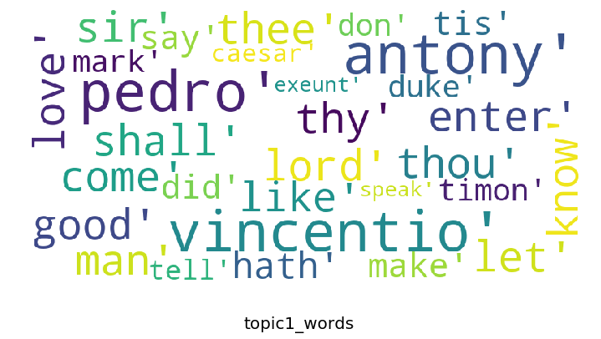
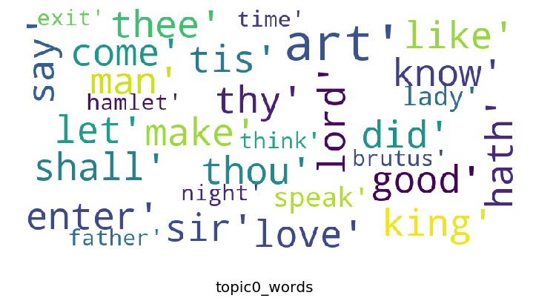
Comedy vs Tragedy : Topic Modeling (LDA)
Topic one
COMEDIES All's Well That Ends Well As You Like It Comedy of Errors Love's Labour's Lost Measure for Measure Merchant of Venice Merry Wives of Windsor Midsummer Night's Dream Much Ado about Nothing Taming of the Shrew Tempest Twelfth Night Two Gentlemen of Verona Winter's Tale | TRAGEDIES Antony and Cleopatra Coriolanus Cymbeline Hamlet Julius Caesar King Lear Macbeth Othello Romeo and Juliet Timon of Athens Titus Andronicus Troilus and Cressida
Topic 2

Slide 11
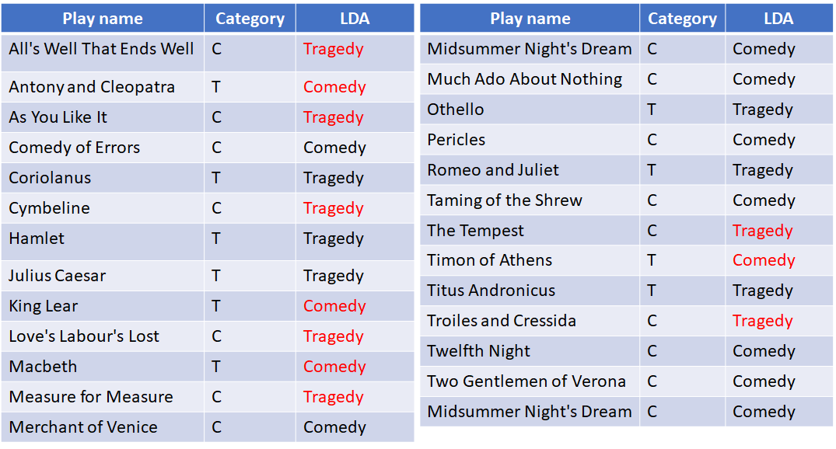
Comedy vs Tragedy : Topic Modeling (LDA)
 | LDA-Comedy | LDA-Tragedy
Comedy | 9 | 7
Tragedy | 4 | 6

Slide 12
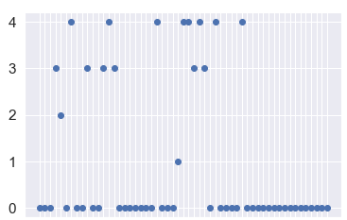
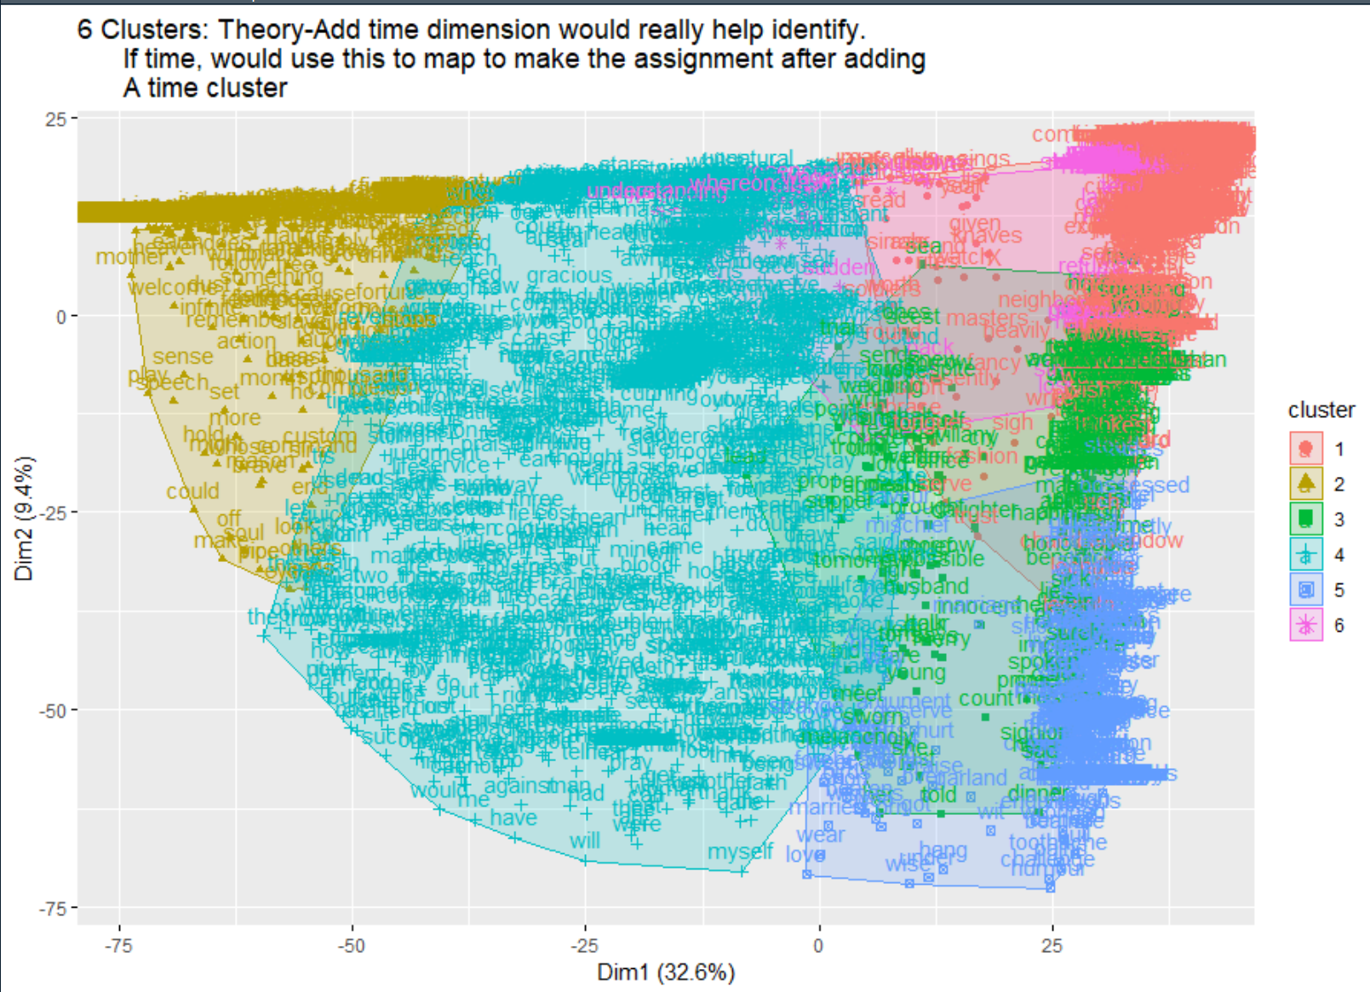
Much Ado About Stopwords with a k-means Assessment
Research has shown the importance of stopwords in literary text classification.
According to Dr. Bei Yu, extremely common words can influence machine learning algorithms. Sentimental novels and plays create complex storylines and words like “my” might be a common word in one collection but not another so they should not be readily excluded (Yu, p. 330).*
Shakespearean corpuses possess a small inventory of stopwords ~3% (average 5 play samples).
TF-IDF & cosine similarity were assessed.
Excluding stopwords did not impact k-means and SVM algorithm classifications.
Character Grouping with k-means by Vocabulary Usage – 55 Total Characters with 5 Clusters
With Stopwords | Without Stopwords
[8] Significant 2nd level cast (4)
[6] main family (3)
[1] Benedict – main character (2)
[1] Hamlet! – curious mistake distance math identified! (1)
[39] Ensemble cast (0)
No change in cast grouping based on words.
K-means visualization by words instead of characters.
*Bei, Y. (2008). An evaluation of text classification methods for literary study. Literary and Linguistic Computing 23( 3): 327-34

Slide 13
Conclusions
Shakespeare only occasionally used different vocabularies between characters
Word choice distinguished the Histories from the other genres, but not between the Comedies and Tragedies
Multiple modeling techniques showed the vocabulary used in the Comedies and Tragedies do not differ significantly
Reducing extremely common words with different techniques did not influence prediction outcomes

Slide 14
Backup Slides
Backup slides of other methods

Slide 15
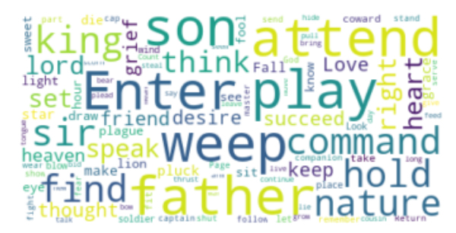
Total Words Across all Plays
Word count: 2,252,816
Frequency distribution of
most common tokens:
(',', 150763)
('"', 141184)
('the', 46815)
("'", 45151)
('.', 43273)
('I', 43251)
('and', 36292)
('to', 31590)
('of', 29857)
('."', 27740)
Remove stopwords and punctuation

Slide 16
Word Distribution: Hamlet
Play: Hamlet
Words per Character
Most: Hamlet
39% of all words

Slide 17
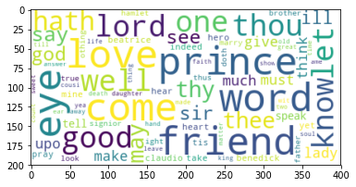
Wordcloud
Much Ado… w “Lord, good and shall” top 3 frequency
.
Asdf…

