Slide 1


Music Recommendation Analysis
IST718
Professor Lando
Tim Abrams, Telly Cooper, Ryan Fischer & Brian Hogan

Slide 2

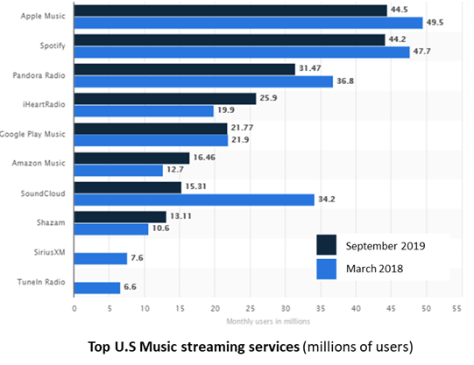
Specification
The IoT age, in combination with an almost global access to internet streaming bandwidth has created a consumer base with unprecedented exponential growth in demand for audio content.
Revenue from streaming services reached $8.8 billion in 2019, and now accounts for 79.5% of all recorded music revenues.
A rapidly expanding and competitive market has been developed almost entirely in the last decade
From March 2018 to September 2019 the streaming service providers Soundcloud, Shazam, SiriusXM and TuneIn Radio lost significant market share, and potentially long-term viability.
As the top providers compete for a larger share of revenues it is critical that they “must get playlists right” through relevant recommendations based in each users’ preferences

Slide 3
Problem Statement
The music streaming market is highly competitive with little differentiation beyond the core product (songs and artists). This results in rapid loss of market share and business viability in ancillary areas-primarily song recommendation algorithms to encourage streaming and product consumption beyond the intended consumer time frames. Companies that cannot leverage their user and service data to provide highly relevant song recommendations to their listeners risk irrelevance in as little as eighteen months, as the average consumer has almost zero barriers to transition.
Hypothesis
Analysis of data about the listener, songs and services enables a music streaming service to predict if a given user will listen to a song more than once.
Data
The data was sourced from the music recommendation system Kaggle competition hosted by The ACM International Conference on Web Search and Data Mining (WSDM) and based on a donated dataset from KKBOX

Slide 4
Situation
Team worked on assessing user likelihood of listening to a new song based on listening preferences
Prediction focused on likelihood a user would like to a new song a minimum of 2 times
Key factors include:
Membership information
Age, location, membership timeline, and listening history
Listening behavior
Genre music selected from
Song information
Artist, song, length, and genre

Slide 5
Obtain
Data was sourced from the following
Challenge website: https://www.kaggle.com/c/kkbox-music-recommendation-challenge/data
Additional resources used:
https://www.kaggle.com/myonin/music-recommendation-random-forest-xgboost
https://www.kaggle.com/rohandx1996/recommendation-system-with-83-accuracy-lgbm
https://www.kaggle.com/freshwater/basic-of-lgbm
The initial data was then imported from csv files into dataframes for analysis:

Slide 6
Scrub
The data is then cleaned:
Remove all non-English entries (as indicated by the float 52 in df_songs
Remove all non-Roman characters and punctuation from artist_name, composer and lyricist in df_songs
Replace all spaces with “_”
Create new feature for membership days (expiration_date - registration_init_time)
Remove all columns with NA values contributing to more than 1% of total values
Remove all ages younger than 15 years and older than 55

Slide 7
Scrub
The df_train dataframe is then merged with features from df_songs, df_song_extra_info and df_members and the df_test dataframe is merged with features from df_songs, df_song_extra_info and df_members:

Slide 8
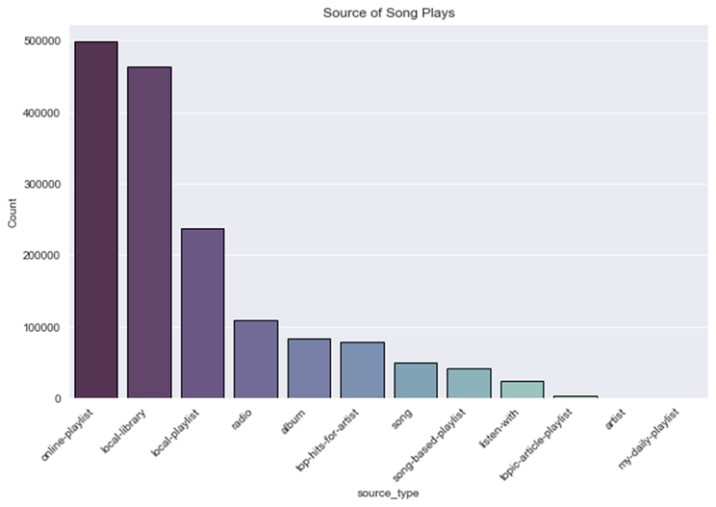
Explore

Slide 9
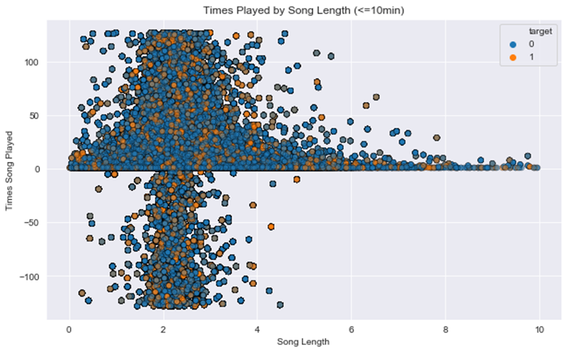
Explore

Slide 10
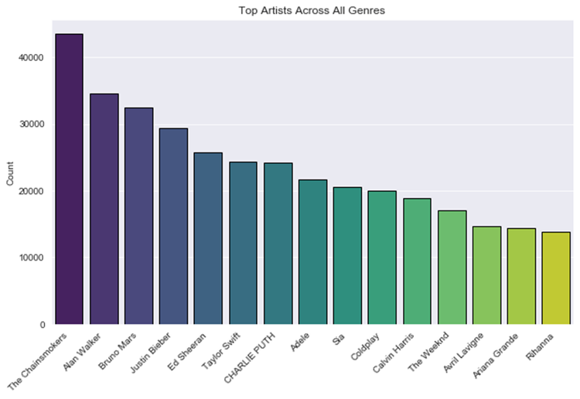
Explore

Slide 11

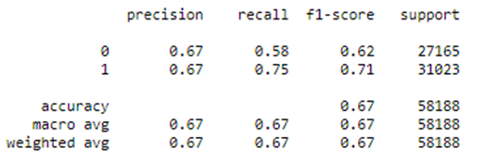
Model
CatBoostClassifier
The CatBoost Classifier was chosen as it is a performant classifier that can easily handle categorical features

Slide 12
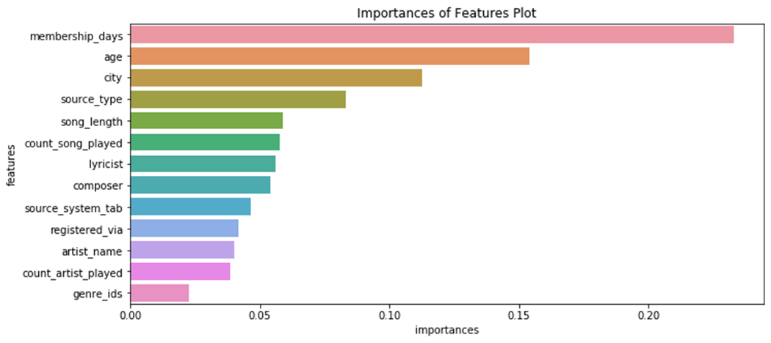
Model
A Random Forest Classifier is used to identify the importance of features. User ID {mnso} and the song id (song_id) are removed from the analysis as they will not scale analysis across new users or songs. Additionally, features with importance of < 0.05 are removed due to their limited impact on analysis.

Slide 13
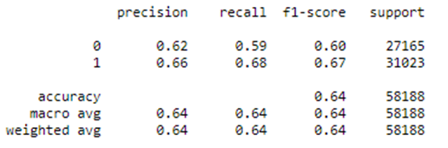
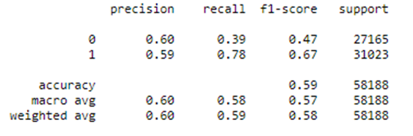
Model
Random Forest Classifier
A Random Forest algorithm is chosen for its ability to handle large datasets with high dimensionality, the ability to manage missing values without significantly impacting the outcome and to minimize overfitting by averaging results.
Naïve-Bayes
Naïve-Bayes was chosen due to the fast training and low resource usage

Slide 14

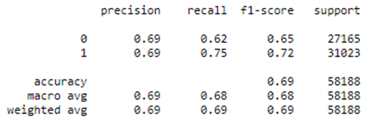
Model
XGBClassifier
Boosting ensemble techniques weight votes with a collection of classifiers by averaging the prediction over a collection of classifiers and combining a set of heterogeneous classifiers.
The XGB Classifier was chosen due to its speed and focus on minimizing potential loss for all possible splits and creates a new branch
Parameters
n_estimators = dictates how many subtrees will be trained and helps to manage overfitting.
max_depth = maximum tree depth each individual tree h can grow to
learning_rate = manages through local minima

Slide 15
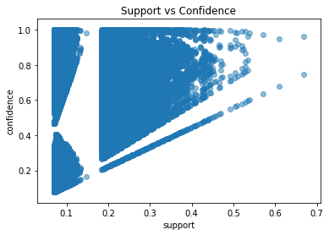
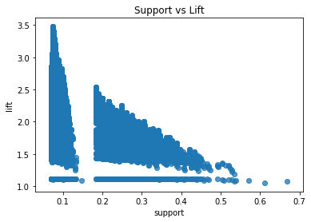
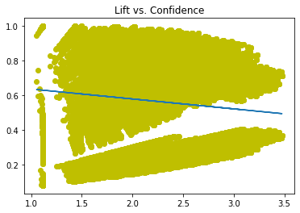
Association Rules
Out of 300 genres country music is easiest to predict what new genre a listener would be most receptive to

Slide 16
Conclusion
XGBClassifier had the greatest success in properly classifying
Length of membership and age had greatest impact on classifiers

