Slide 1
All about flights

Slide 2
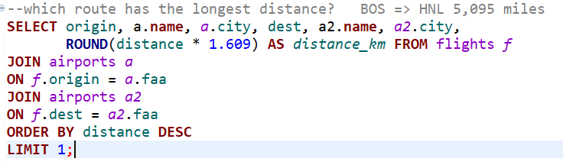
which route has the longest distance?
Boston Logan International Airport => Daniel K. Inouye International Airport
Boston to Honolulu
8199.6 km

Slide 3
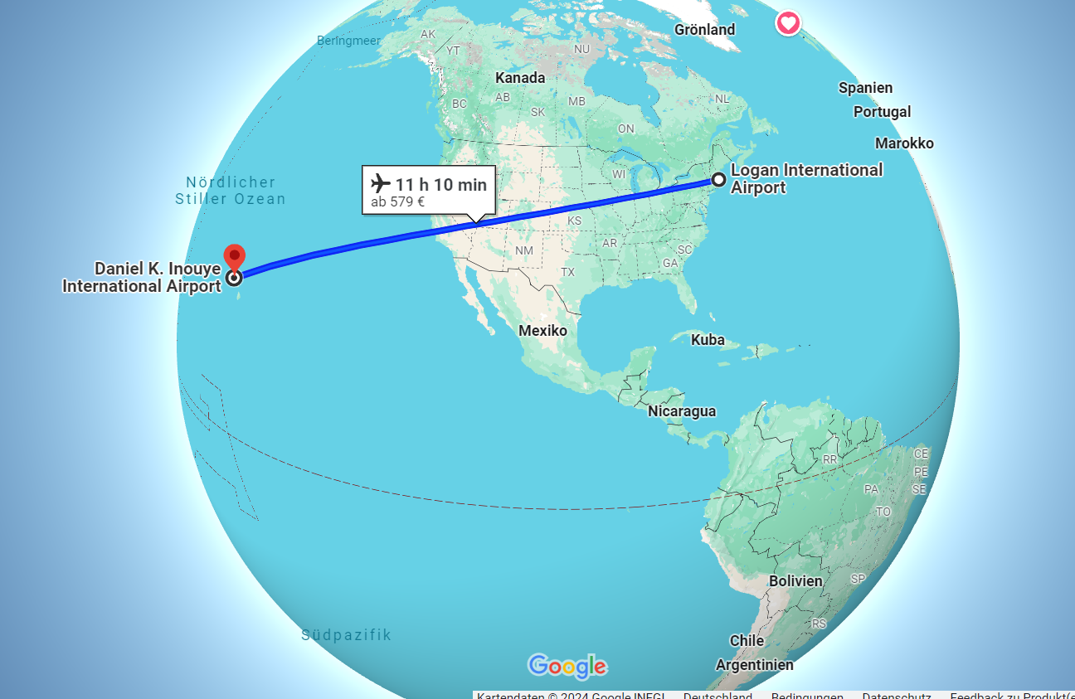

Slide 4
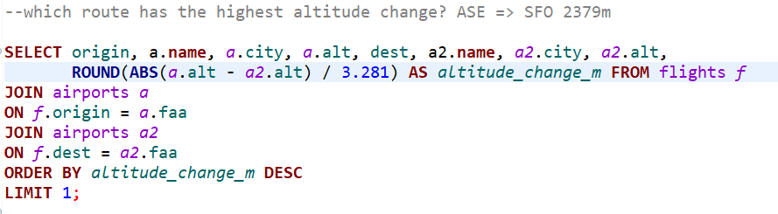
which route has the highest altitude change?
Aspen/Pitkin County Airport => San Francisco International Airport
2384m vs 3.96m

Slide 5
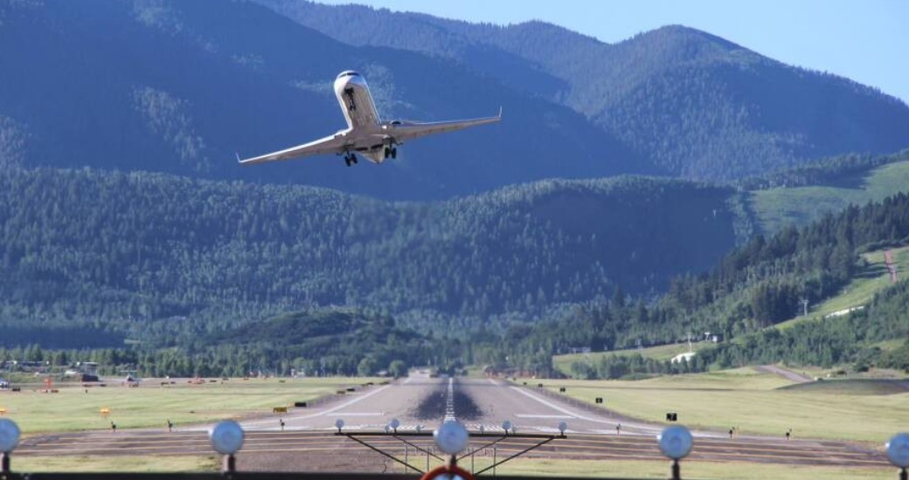
One of the World's Most Challenging Airport: Aspen-Pitkin County Airport (ASE)
in the Heart of the Rocky Mountains

Slide 6
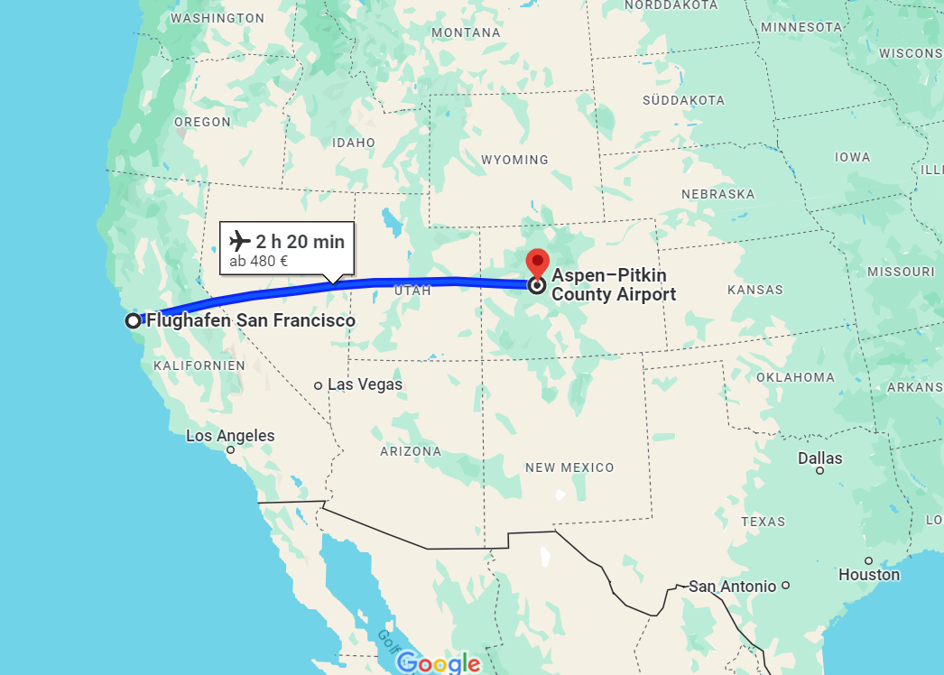

Slide 7
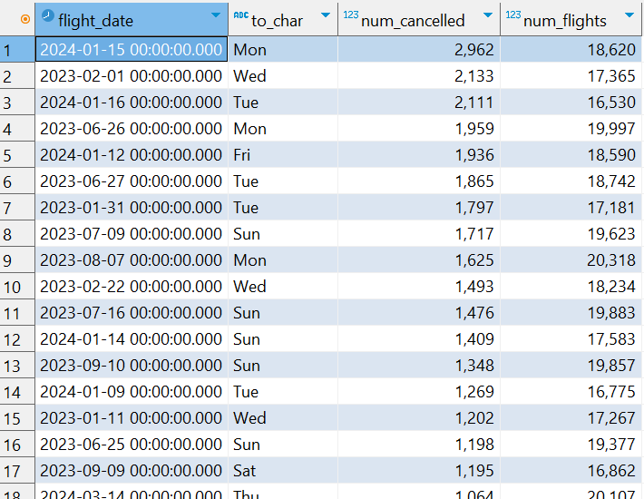
on which day has the highest number of cancelled flights?

Slide 8
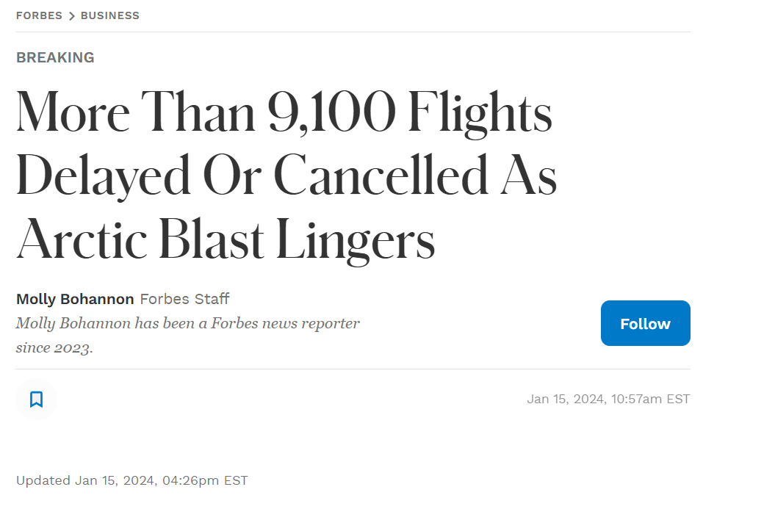
ON 2024-01-15 because of winter storm

Slide 9

ON 2023-02-01 because of ice storm

Slide 10
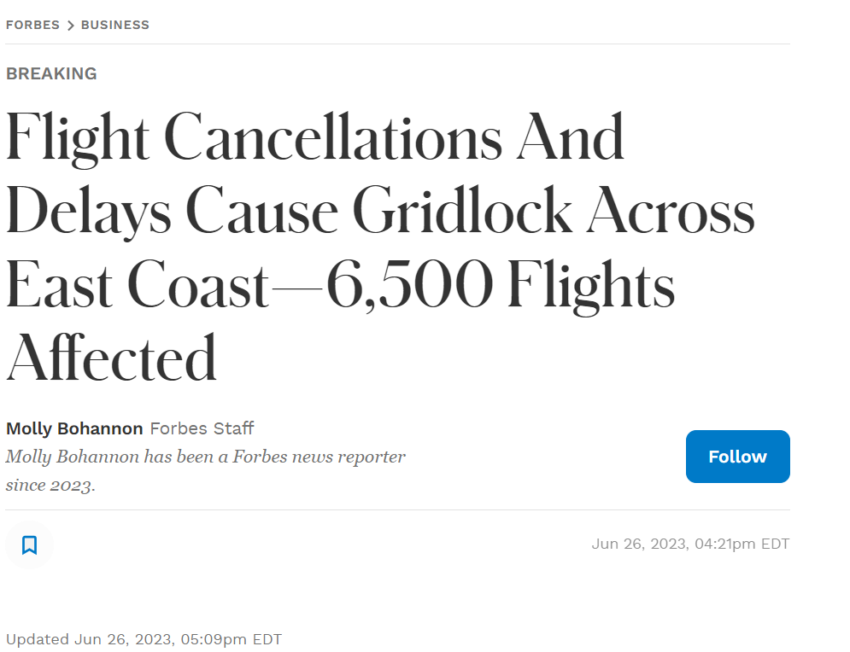
ON 2023-6-26 because of severe thunderstorm across East Coast

