Slide 1
Permutation test for adonis under reduced model
Terms added sequentially (first to last)
Blocks: strata
Permutation: free
Number of permutations: 1000
adonis2(formula = Wide_6 ~ as.factor(Year) * Treatment * SubTrt, data = Wide_6.env, permutations = 1000, by = "terms", parallel = 16, strata = Wide_6.env$Plot)
Df SumOfSqs R2 F Pr(>F)
as.factor(Year) 3 19.235 0.42647 99.6738 0.000999 ***
Treatment 2 0.678 0.01503 5.2687 0.000999 ***
SubTrt 3 3.089 0.06848 16.0056 0.000999 ***
as.factor(Year):Treatment 6 0.587 0.01302 1.5218 0.020979 *
as.factor(Year):SubTrt 9 2.706 0.05999 4.6733 0.000999 ***
Treatment:SubTrt 2 0.124 0.00275 0.9637 0.327672
as.factor(Year):Treatment:SubTrt 6 0.158 0.00351 0.4096 0.993007
Residual 288 18.526 0.41075
Total 319 45.102 1.00000

Slide 2
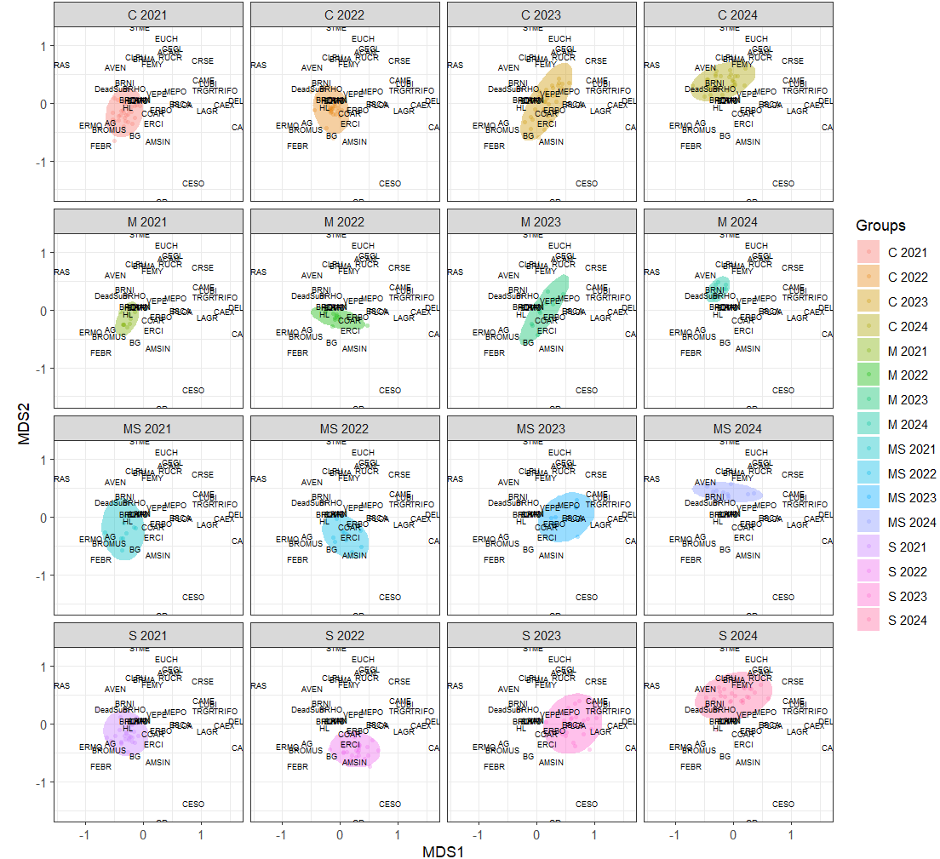

Slide 3
No interactions, including 2021

Slide 4
Pre-post by subtreatments – poor fit

