Slide 1
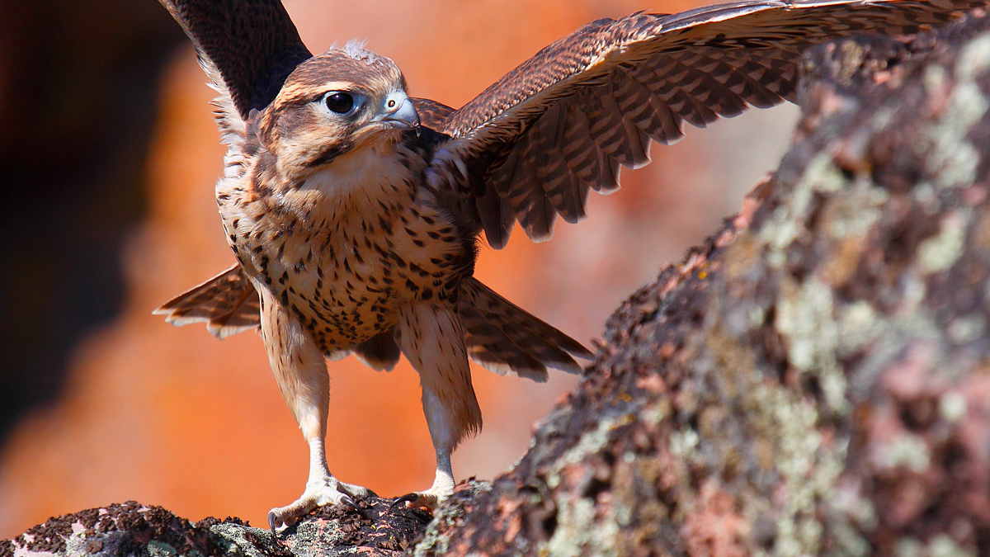
Falcon Occupancy Analysis….Help!
June 2020
Sarah Wakamiya
Photo by Gavin Emmons

Slide 2
Goals for this meeting
Give a brief overview of analysis thus far
Discuss goals for consultation
Consider logistics: approach, timeline, required materials

Slide 3
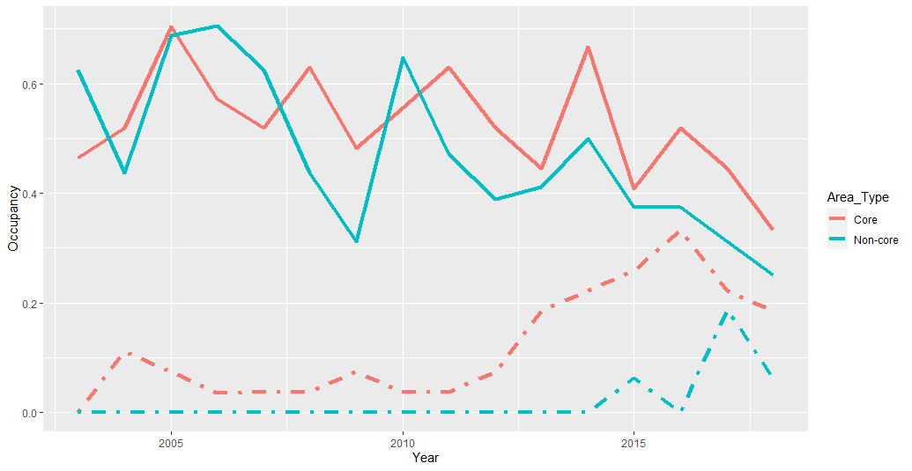
Analysis Objective(s)
Primary: Evaluate trend in number of sites occupied and fecundity of prairie falcons
Protocol/SOP and Starcevich (2013) – Occupancy estimates on presence/absence, trend analysis on number of hatchlings and fledglings detected in occupied sites.
Extension: Use multi-state occupancy modeling to:
Investigate trend in breeding success
Identify patterns in breeding state transitions
Understand rate of imperfect detection of breeding states (e.g. how good are we at truly detecting breeding status)
Investigate the influence of peregrine falcons on occupancy and breeding state transitions

Slide 4
Multistate Framework
States
0 = Unoccupied (no detection)
1 = Occupied without successful reproduction (detection of adult)
2 = Occupied, with successful reproduction (detection of nestling/fledglings – did not include eggs)
Parameters Estimating:
Phi0 = initial occupancy probabilities in each state
psi = probability of site being occupied in year t+1, given the site’s state (not occupied, occupied not breeding, or occupied breeding) the prior year
R =probability of successful reproduction at a site in year t+1, given the site’s state (not occupied, occupied not breeding, or occupied breeding) the prior year
p = probability of detection presence given it’s true state
Delta = probability of observing successful reproduction given that successful reproduction occurred

Slide 5
Covariates
Year Specific
Peregrine falcon presence
Site Specific
Area Type (core vs. non-core)
Time
Time – seasonal trend (time as a continuous variable)
time – seasonal variation (time as a factor level)
Session – variation across years (annual variation: year as a factor level)

Slide 6
Work completed
SFAN_Falcon_Analysis_MultiState_20190910.R
Data gymnastics → rMark
Create prairie falcon detection history (PRFADetectHistory)
Converted peregrine data to a covariate list per year (PEFACov)
Also created a “late season” covariate to try to reduce “time” parameters (LateCov) – this didn’t really work
Combined PRFADetectHistory, PEFACov, and LateCov ->final file for rMark
Created a Time_Interval list to show number of visits/year by territory for the process.data step

Slide 7
Work completed
SFAN_Falcon_Analysis_MultiState_20190910.R
Prep Analysis
Import mark file and set field types
Made PEFA and Late covariates time-varying
Process mark file using the robust design multiple-state occupancy estimation conditional binomal model (RDMSOccRepro)

Slide 8

Work completed
SFAN_Falcon_Analysis_MultiState_20190910.R
Began stepwise approach to comparing/testing models:
Model for detection probability (p) holding all else constant
Best fit: p(stratum*session)
Model for reproductive success (Delta) using best fit for p and all else constant
Best fit: Delta(session*Time)
Model for probability of occupancy (psi) using best fit for p, Delta, and Phi0 constant

Slide 9
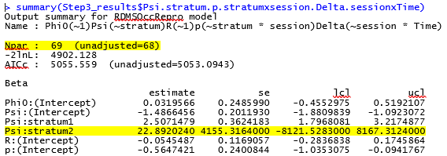
Problem:
Number of parameters incorrect for models with stratum (breeding state) as effect on Psi
 | model | npar | AICc | DeltaAICc | weight | Deviance
 | Phi0(~1)Psi(~stratum + time)R(~1)p(~stratum * session)Delta(~session * Time) | 83 | 540.183 | 0 | 9.99E-01 | 4851.399
12 | Phi0(~1)Psi(~stratum * Time)R(~1)p(~stratum * session)Delta(~session * Time) | 72 | 5055.173 | 14.99018 | 5.55E-04 | 4894.3
8 | Phi0(~1)Psi(~stratum)R(~1)p(~stratum * session)Delta(~session * Time) | 69 | 5055.559 | 15.3762 | 4.58E-04 | 4902.128
10 | Phi0(~1)Psi(~stratum + Time)R(~1)p(~stratum * session)Delta(~session * Time) | 70 | 5058.135 | 17.95229 | 1.26E-04 | 4902.231
11 | Phi0(~1)Psi(~stratum * time)R(~1)p(~stratum * session)Delta(~session * Time) | 111 | 5094.548 | 54.36463 | 1.56E-12 | 4829.972
7 | Phi0(~1)Psi(~PEFA1 * Time)R(~1)p(~stratum * session)Delta(~session * Time) | 70 | 5295.595 | 255.41249 | 0.00E+00 | 5139.691
2 | Phi0(~1)Psi(~1)R(~1)p(~stratum * session)Delta(~session * Time) | 67 | 5296.043 | 255.85994 | 0.00E+00 | 5147.533
1 | Phi0(~1)Psi(~Area_Type)R(~1)p(~stratum * session)Delta(~session * Time) | 68 | 5297.74 | 257.55749 | 0.00E+00 | 5146.774
3 | Phi0(~1)Psi(~PEFA1)R(~1)p(~stratum * session)Delta(~session * Time) | 68 | 5298.462 | 258.27899 | 0.00E+00 | 5147.495
14 | Phi0(~1)Psi(~Time)R(~1)p(~stratum * session)Delta(~session * Time) | 68 | 5298.505 | 258.32189 | 0.00E+00 | 5147.538
5 | Phi0(~1)Psi(~PEFA1 + Time)R(~1)p(~stratum * session)Delta(~session * Time) | 69 | 5300.707 | 260.5243 | 0.00E+00 | 5147.276
13 | Phi0(~1)Psi(~time)R(~1)p(~stratum * session)Delta(~session * Time) | 81 | 5308.896 | 268.71307 | 0.00E+00 | 5125.261
4 | Phi0(~1)Psi(~PEFA1 + time)R(~1)p(~stratum * session)Delta(~session * Time) | 82 | 5311.46 | 271.27683 | 0.00E+00 | 5125.254
6 | Phi0(~1)Psi(~PEFA1 * time)R(~1)p(~stratum * session)Delta(~session * Time) | 96 | 5330.64 | 290.45691 | 0.00E+00 | 5107.548

Slide 10
Possible Reasons?
Something wrong with code/data?
“Non-identifiability” – problems with data/parameter is confounded?
Models not converging/bad model?
Not enough data?
???

Slide 11
Point Blue to the Rescue!
Point Blue review data and code
Goal
Determine if should continue with multi-state model or should scrap and just do simple analysis
If continue with multi-state model assist with figuring out why model isn’t converging and how to move forward

Slide 12
What’s next?
Best approach?
Determine timeline
Send data/code to point blue

