Slide 1
River hydrology visualizations

Slide 2
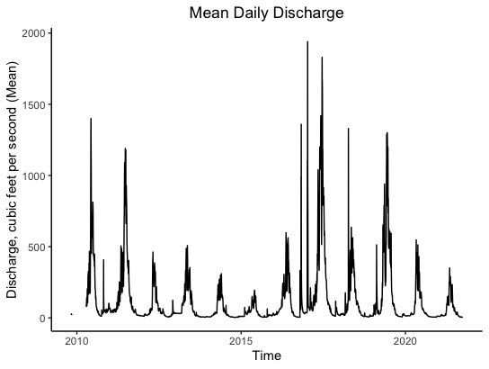

Slide 3
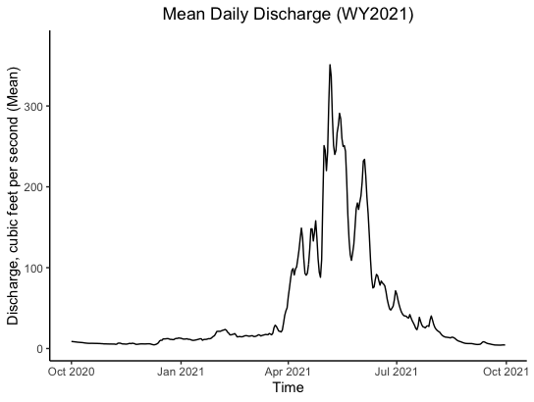

Slide 4
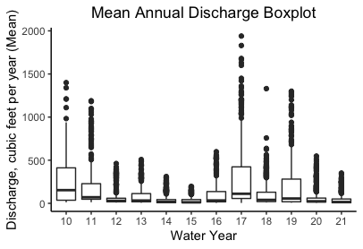
Notes:
- Changed to water year

Slide 5
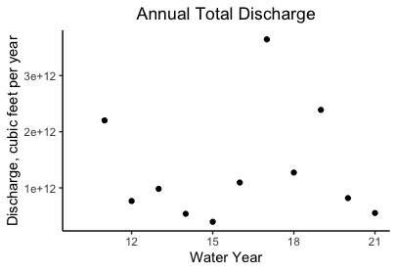
Notes:
Scatter
- Changed to water year

Slide 6
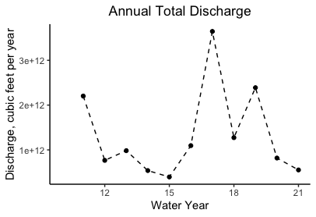
Notes:
Scatter + dashed line
- Changed to water year

Slide 7
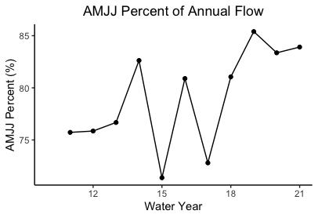
Notes:
Row 8 graph

Slide 8
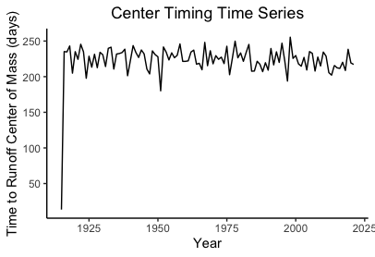
Notes:
Row 9 graph
Note: MRHQ_snwmlt output does not have month (just 1 row per year), so can’t plot by water year

Slide 9
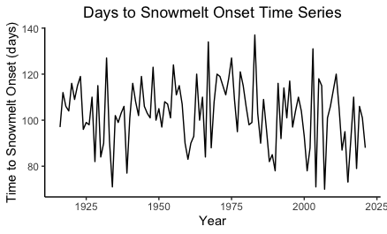
Notes:
Row 10 graph
Note: MRHqsnoset output does not have month (just 1 row per year), so can’t plot by water year
Also MRHqsnoset has two column names I don’t know

Slide 10
Rows 11-12 → not sure which output file to use/what column headers are
Rows 13-14 I think first need ^

Slide 11
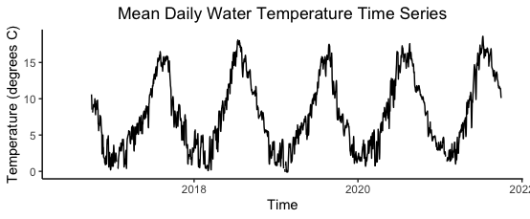
Notes:
Row 16 graph
Complete period of record

