Slide 1
River hydrology visualizations

Slide 2
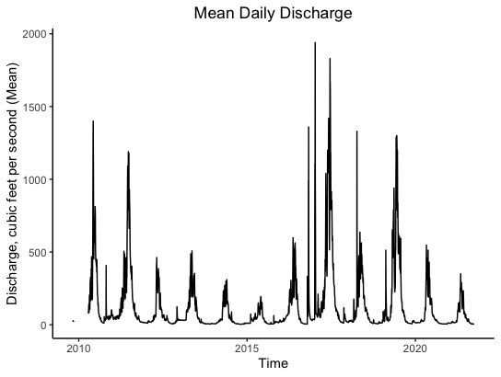

Slide 3
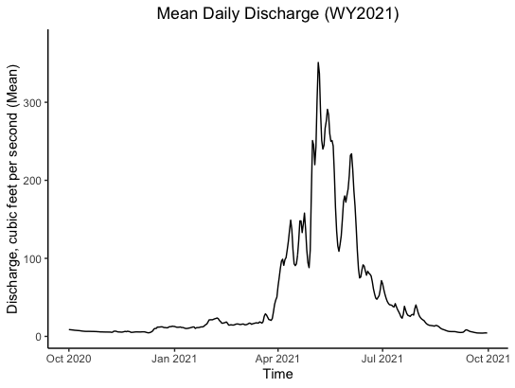

Slide 4
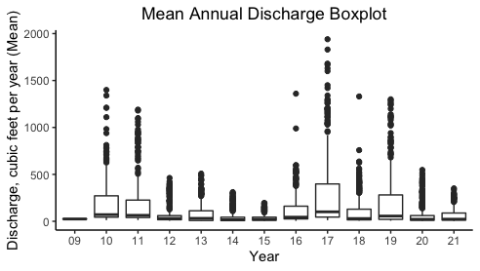
Notes:
- Re did this plot on daily mean value – group boxplots by year (not flat lines anymore)

Slide 5
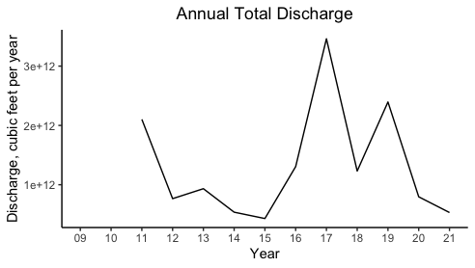

Slide 6
Row 8 – value or time series?

