Slide 1

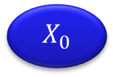









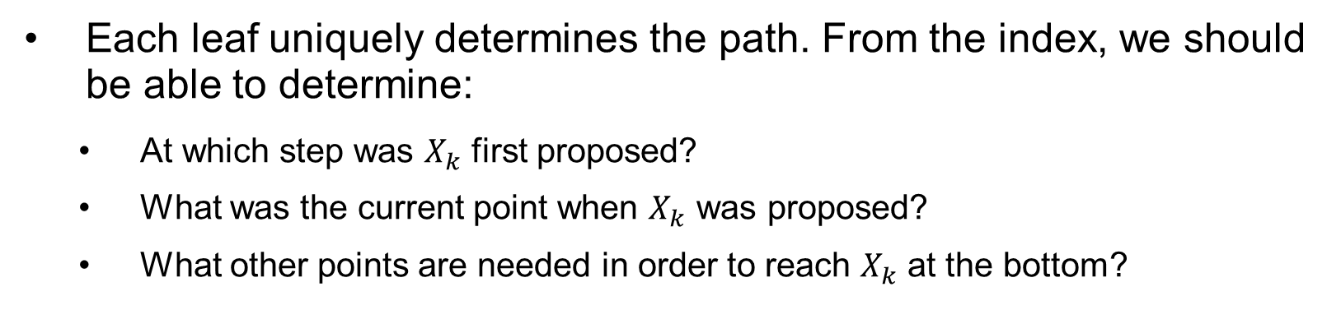




















Implementation Remarks
$$X_{0}→X_{1}$$
$$X_{0}→X_{2}$$
Reject
Accept
$$X_{1}→X_{3}$$
$$X_{0}→X_{4}$$
$$X_{2}→X_{6}$$
$$X_{1}→X_{5}$$
$$X_{3}→X_{7}$$
$$X_{0}$$
$$X_{4}$$
$$X_{2}$$
$$X_{6}$$
$$X_{1}$$
$$X_{5}$$
$$X_{3}$$
$$X_{7}$$
$$X_{0}$$
$$X_{8}$$
$$X_{4}$$
$$X_{9}$$
$$X_{2}$$
$$X_{10}$$
$$X_{5}$$
$$X_{11}$$
$$X_{1}$$
$$X_{12}$$
$$X_{6}$$
$$X_{13}$$
$$X_{3}$$
$$X_{14}$$
$$X_{7}$$
$$X_{15}$$
Each leaf uniquely determines the path. From the index, we should be able to determine:
At which step was $X_{k}$ first proposed?
What was the current point when $X_{k}$ was proposed?
What other points are needed in order to reach $X_{k}$ at the bottom?

