Slide 1
Parallel Metropolis-Hastings
Boyan Bejanov
bbejanov@bankofcanada.ca
Data and Statistics Office, Bank of Canada
School of Computer Science, Carleton University

Slide 2
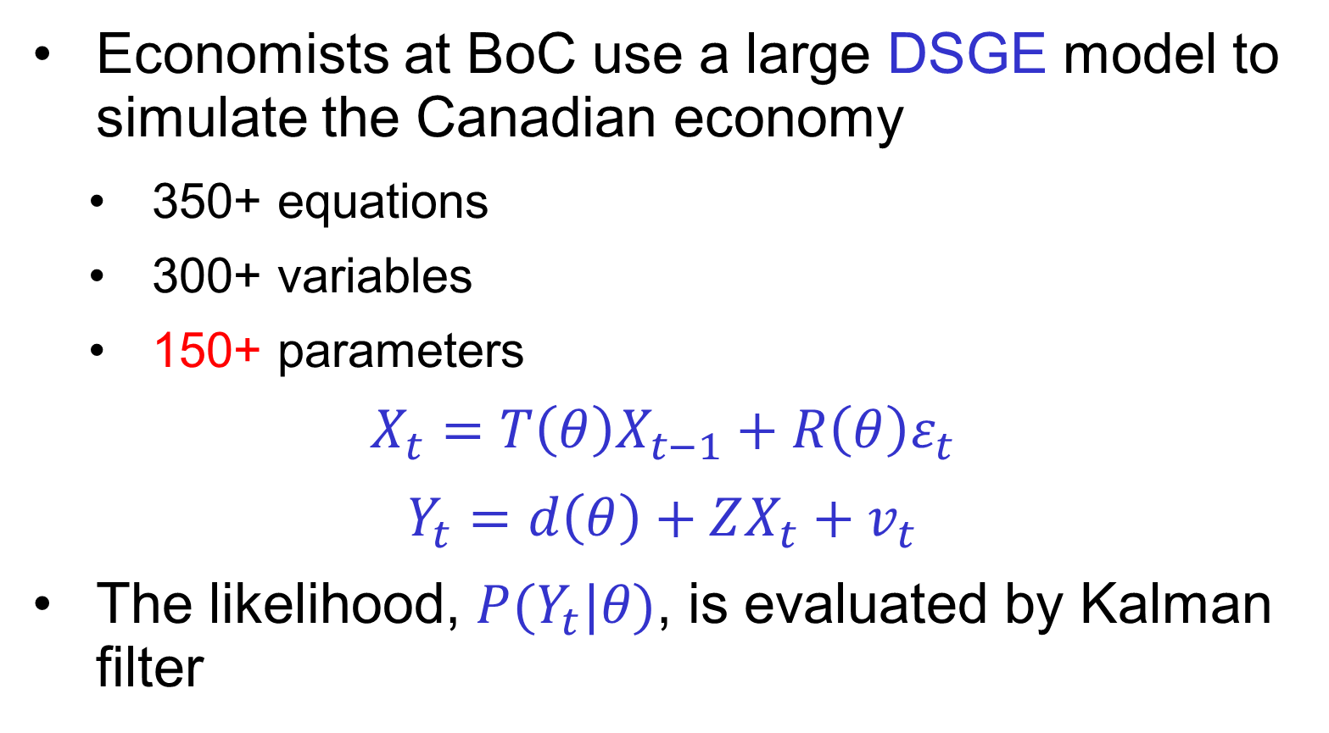
Motivation
Economists at BoC use a large DSGE model to simulate the Canadian economy
350+ equations
300+ variables
150+ parameters
$$X_{t}=T\left(θ\right)X_{t−1}+R\left(θ\right)ε_{t}$$
$$Y_{t}=d\left(θ\right)+ZX_{t}+v_{t}$$
The likelihood, $P(Y_{t}|θ)$, is evaluated by Kalman filter
Notes:
Xt is a vector of variables describing the state of the econoly
Yt is a vector of observed variables
Eps_t is innovation
Vt is observation error
Theta is a vector of parameters

Slide 3
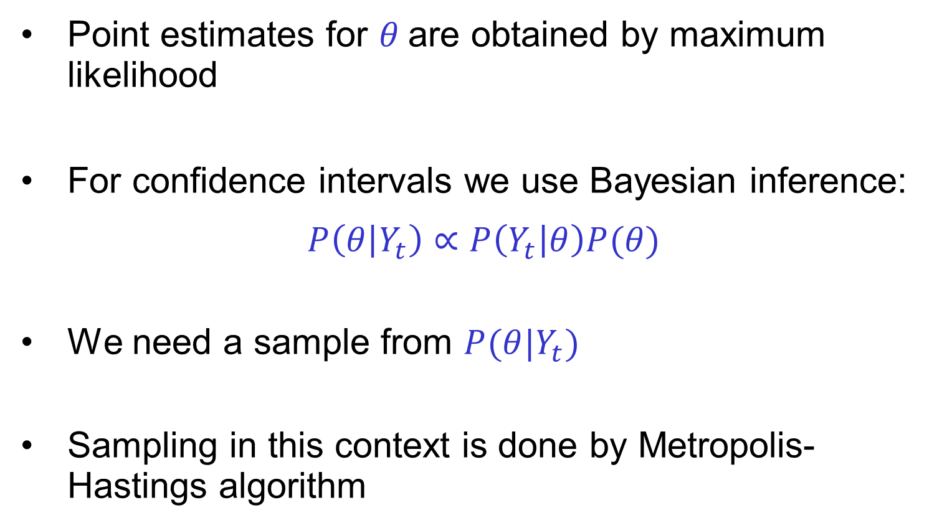
Motivation
Point estimates for $θ$are obtained by maximum likelihood
For confidence intervals we use Bayesian inference:
$$P\left(θ | Y_{t}\right)∝P\left(Y_{t} | θ\right)P(θ)$$
We need a sample from $P(θ|Y_{t})$
Sampling in this context is done by Metropolis-Hastings algorithm
Notes:
P(theta) is the prior distribution of theta
P(Yt|theta) is the sampling distribution (when seen as function of Yt), or likelihood (when seen as function of theta)
P(theta|Yt) is posterior distribution

Slide 4
Outline
Brief introduction to Markov Chains
Metropolis-Hastings Algorithm
Overview of parallelization approaches
Prefetching algorithm
Analysis
Implementation details
Computational experiments
Conclusions

Slide 5
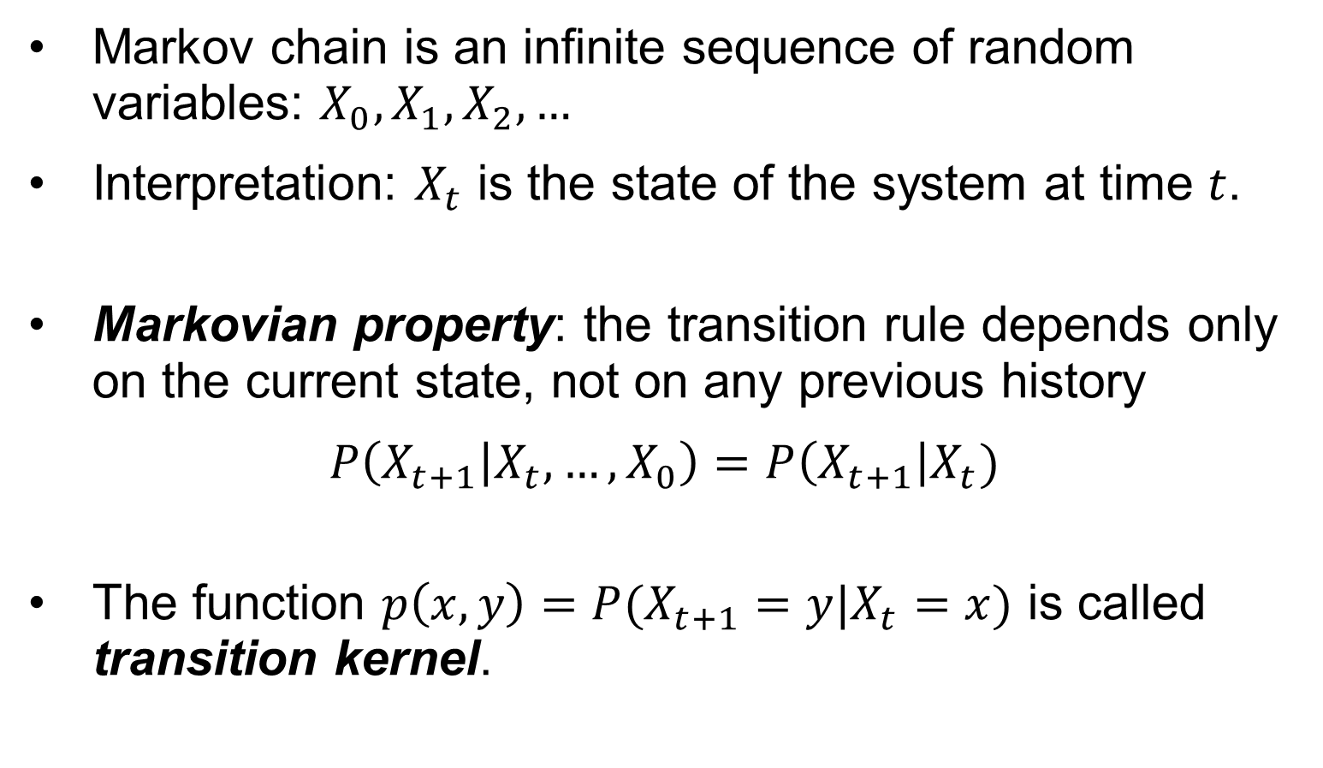
Markov Chains - definition
Markov chain is an infinite sequence of random variables: $X_{0}, X_{1}, X_{2},…$
Interpretation: $X_{t}$ is the state of the system at time $t$.
Markovian property: the transition rule depends only on the current state, not on any previous history
$$P\left(X_{t+1} | X_{t},…,X_{0}\right)=P\left(X_{t+1}\right|X_{t})$$
The function $p\left(x,y\right)=P(X_{t+1}=y|X_{t}=x)$ is called transition kernel.

Slide 6
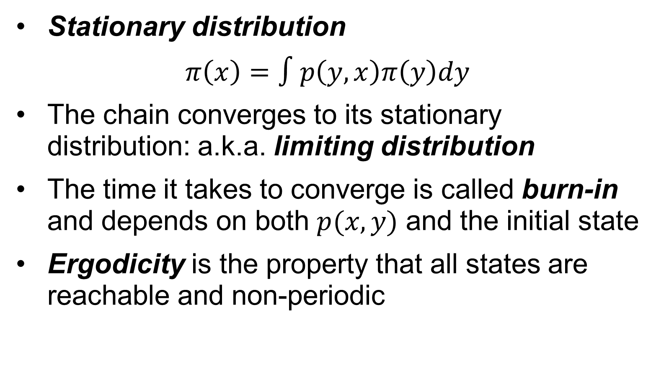
Markov Chains - properties
Stationary distribution
$$π\left(x\right)=∫p\left(y,x\right)π\left(y\right)dy$$
The chain converges to its stationary distribution: a.k.a. limiting distribution
The time it takes to converge is called burn-in and depends on both $p(x,y)$ and the initial state
Ergodicity is the property that all states are reachable and non-periodic
Notes:
Ergodic chains are guaranteed to have limiting distributions

Slide 7
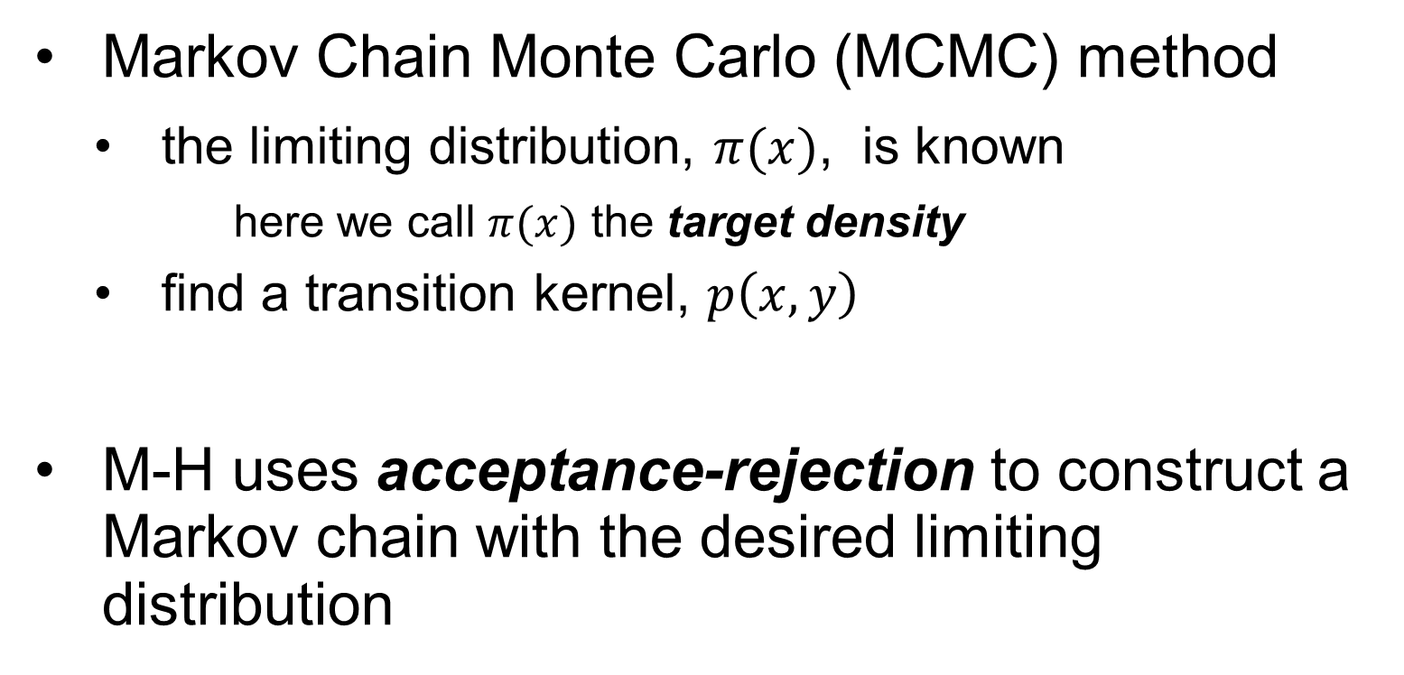
Metropolis-Hastings Algorithm
Markov Chain Monte Carlo (MCMC) method
the limiting distribution, $π(x)$, is known
here we call $π(x)$ the target density
find a transition kernel, $p\left(x,y\right)$
M-H uses acceptance-rejection to construct a Markov chain with the desired limiting distribution

Slide 8
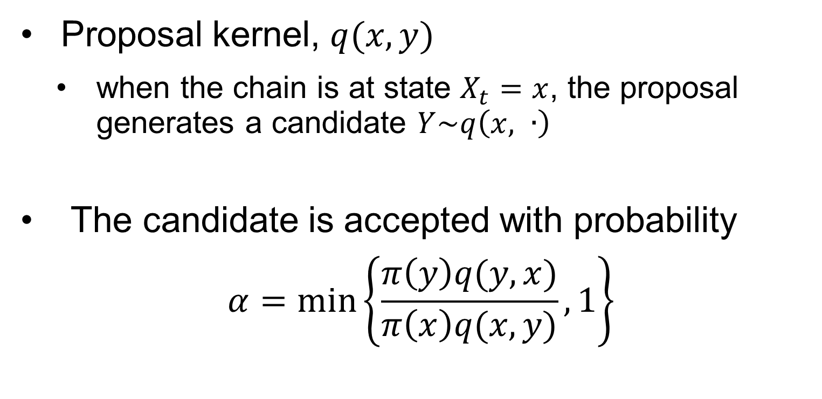
Metropolis-Hastings Idea
Proposal kernel, $q(x,y)$
when the chain is at state $X_{t}=x$, the proposal generates a candidate $Y\sim q\left(x, ∙\right)$
The candidate is accepted with probability
$$α=\min_{ }\left\{\frac{π\left(y\right)q(y,x)}{π\left(x\right)q(x,y)}, 1\right\}$$

Slide 9
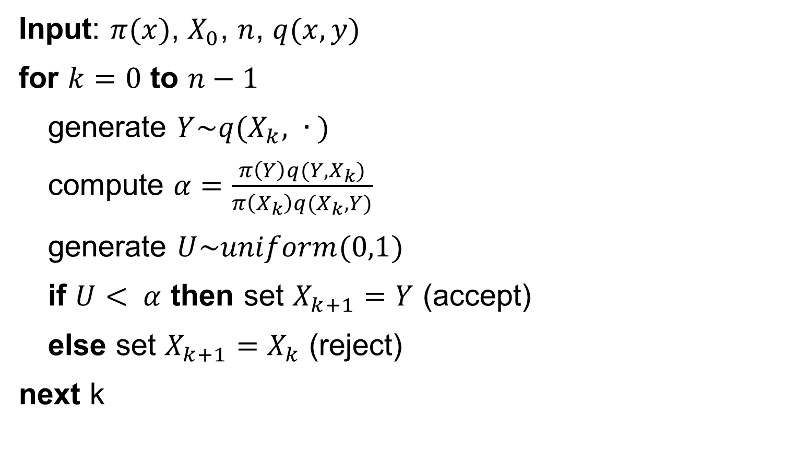
Metropolis-Hastings Algorithm
Input: $π(x)$, $X_{0}$, $n$, $q(x,y)$
for $k=0$ to $n−1$
generate $Y\sim q(X_{k}, ∙ )$
compute $α=\frac{π\left(Y\right)q(Y,X_{k})}{π\left(X_{k}\right)q(X_{k},Y)}$
generate $U\sim uniform(0,1)$
if $U< α$ then set $X_{k+1}=Y$ (accept)
else set $X_{k+1}=X_{k}$ (reject)
next k

Slide 10
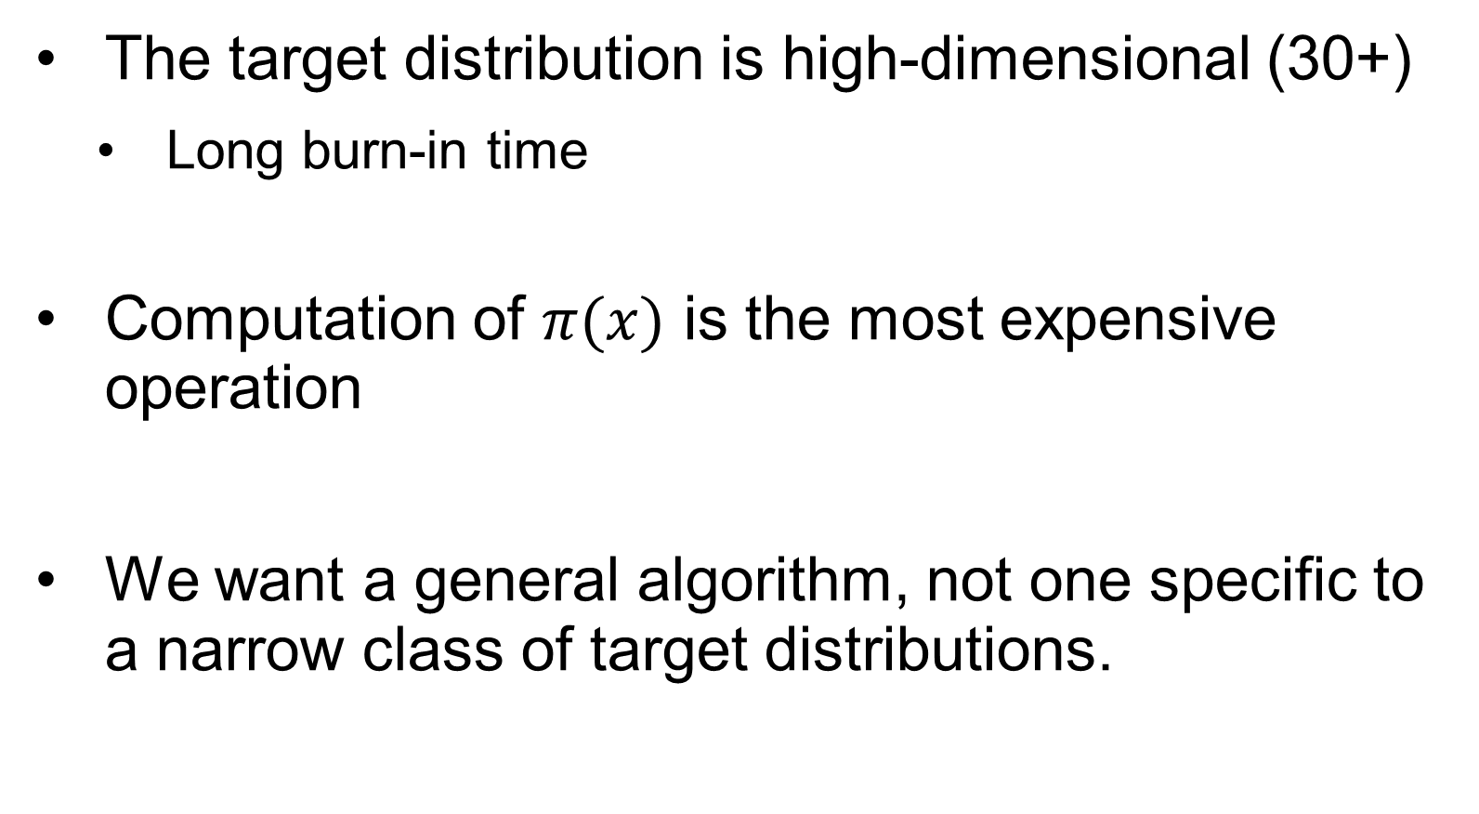
Assumptions and Goals
The target distribution is high-dimensional (30+)
Long burn-in time
Computation of $π(x)$ is the most expensive operation
We want a general algorithm, not one specific to a narrow class of target distributions.

Slide 11
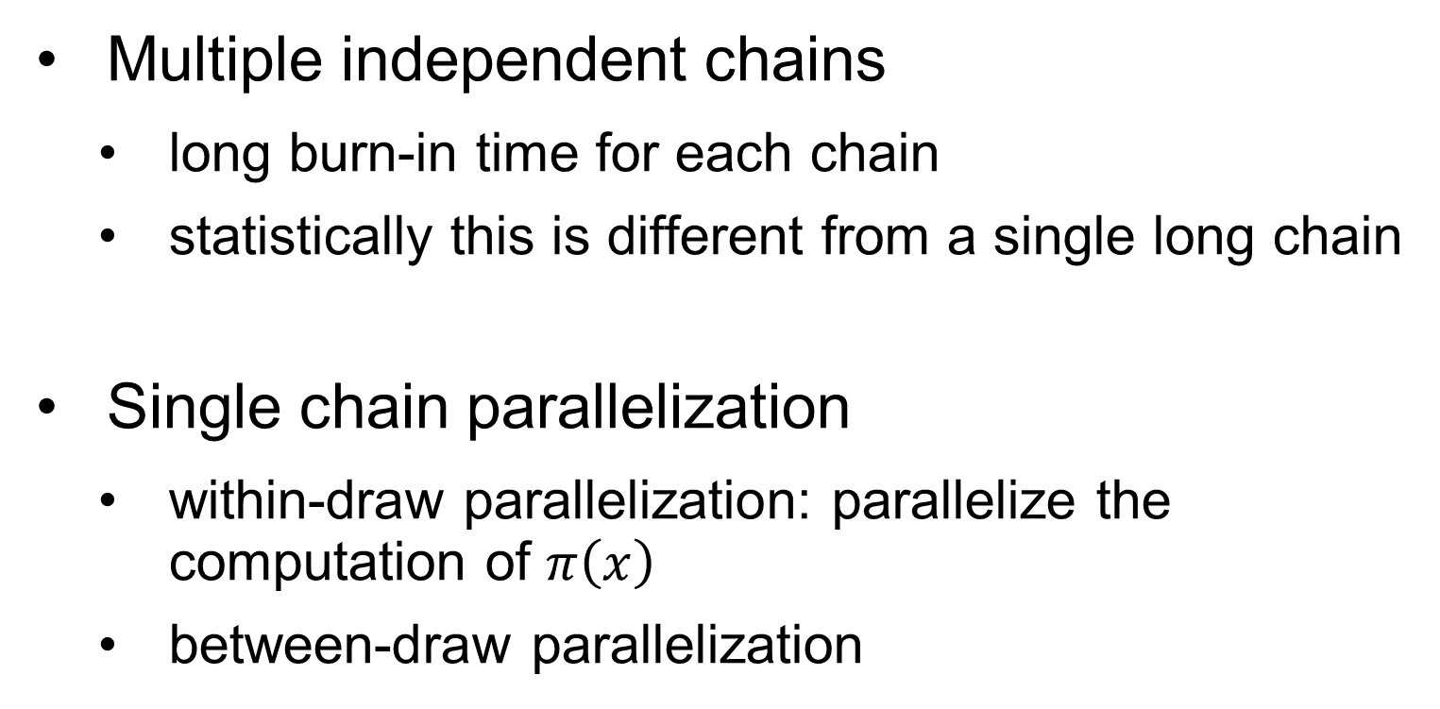
Parallel M-H approaches
Multiple independent chains
long burn-in time for each chain
statistically this is different from a single long chain
Single chain parallelization
within-draw parallelization: parallelize the computation of $π\left(x\right)$
between-draw parallelization

Slide 12
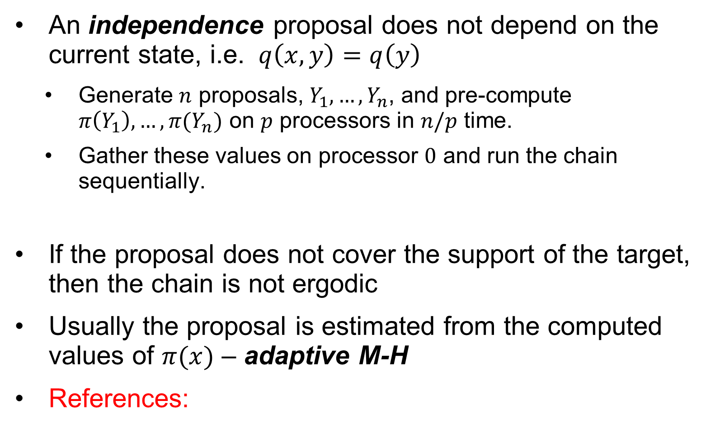
Parallel M-H approaches
An independence proposal does not depend on the current state, i.e. $q\left(x,y\right)=q\left(y\right)$
Generate $n$ proposals, $Y_{1},…,Y_{n}$, and pre-compute $π\left(Y_{1}\right),…, π(Y_{n})$ on $p$ processors in $n/p$ time.
Gather these values on processor $0$ and run the chain sequentially.
If the proposal does not cover the support of the target, then the chain is not ergodic
Usually the proposal is estimated from the computed values of $π(x)$ – adaptive M-H
References:

Slide 13
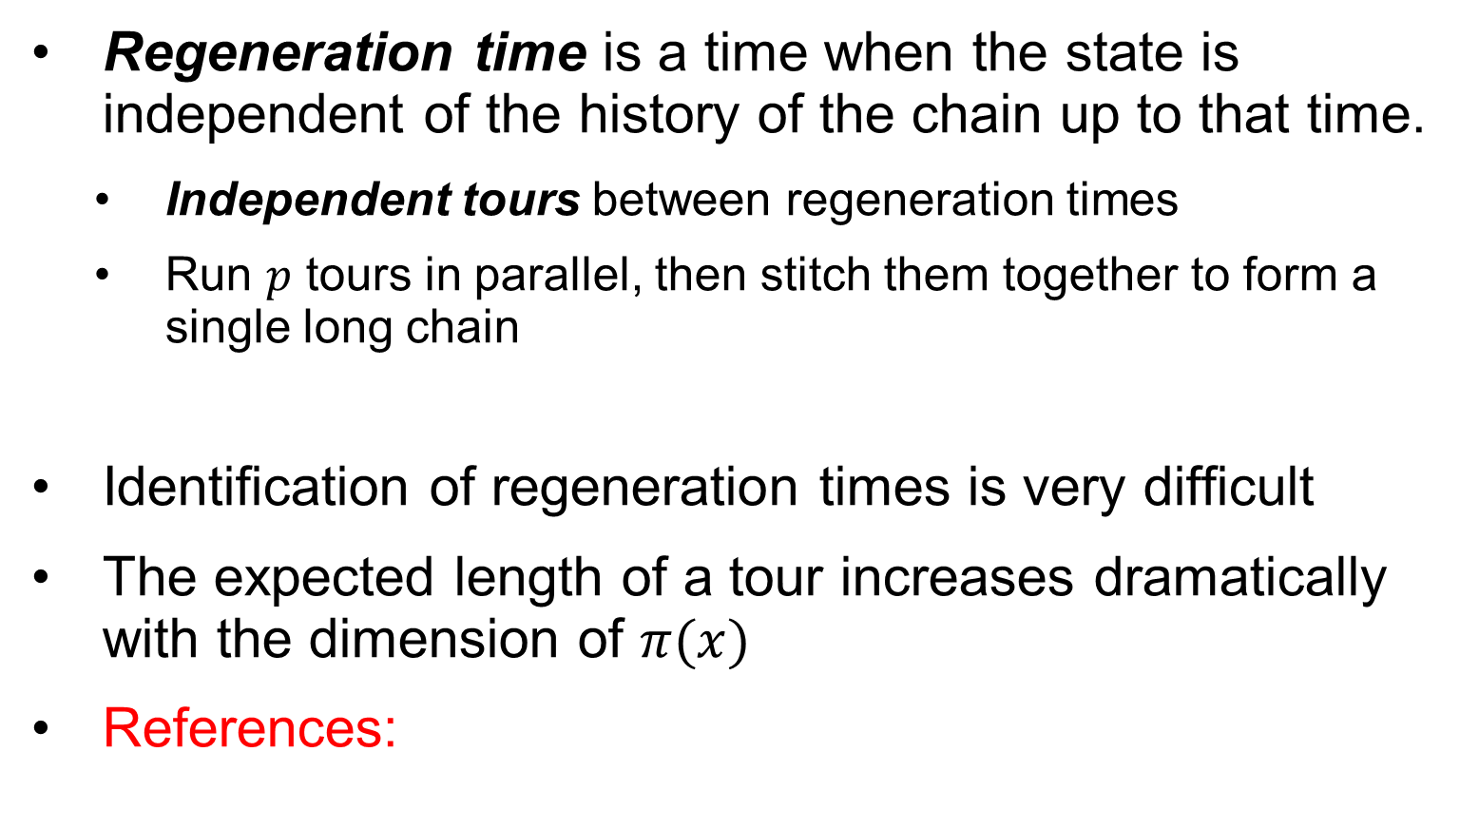
Parallel M-H approaches
Regeneration time is a time when the state is independent of the history of the chain up to that time.
Independent tours between regeneration times
Run $p$ tours in parallel, then stitch them together to form a single long chain
Identification of regeneration times is very difficult
The expected length of a tour increases dramatically with the dimension of $π(x)$
References:

Slide 14
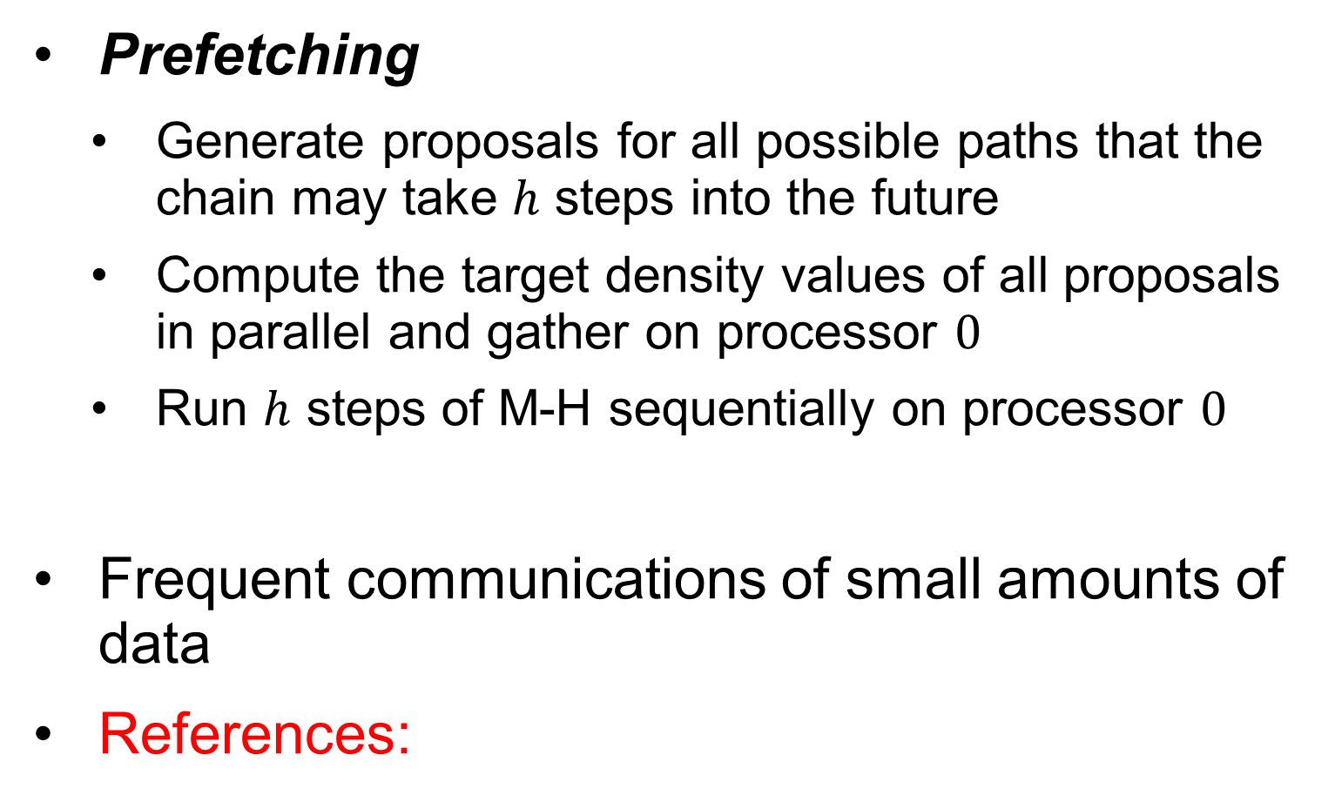
Parallel M-H approaches
Prefetching
Generate proposals for all possible paths that the chain may take $h$ steps into the future
Compute the target density values of all proposals in parallel and gather on processor $0$
Run $h$ steps of M-H sequentially on processor $0$
Frequent communications of small amounts of data
References:

Slide 15
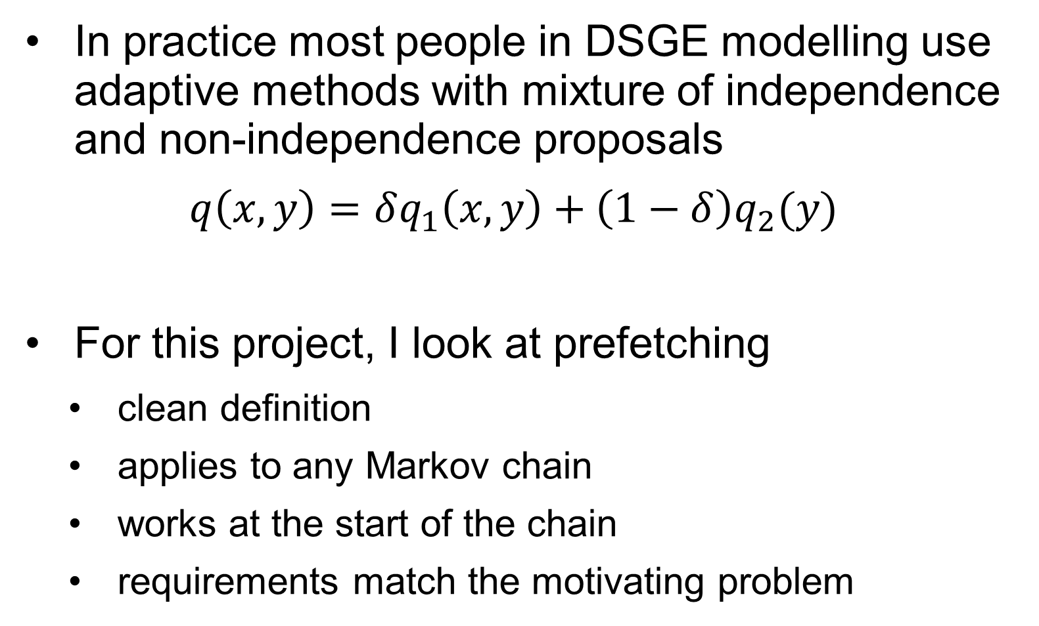
Method of choice
In practice most people in DSGE modelling use adaptive methods with mixture of independence and non-independence proposals
$$q\left(x,y\right)=δq_{1}\left(x,y\right)+\left(1−δ\right)q_{2}(y)$$
For this project, I look at prefetching
clean definition
applies to any Markov chain
works at the start of the chain
requirements match the motivating problem

Slide 16
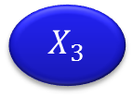
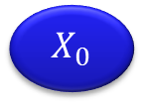
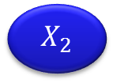
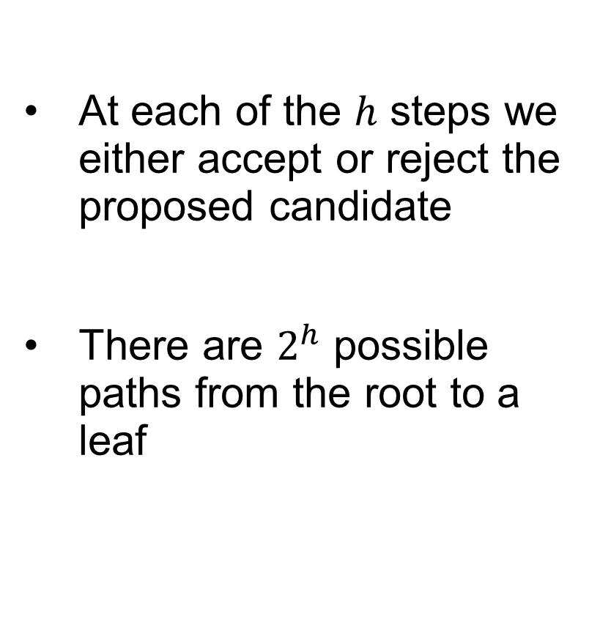
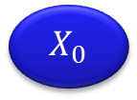

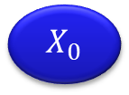

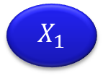

Prefetching
At each of the $h$ steps we either accept or reject the proposed candidate
There are $2^{h}$ possible paths from the root to a leaf
$$X_{0}$$
$$h=0$$
R
A
$$X_{0}$$
$$X_{1}$$
$$h=1$$
R
A
R
A
$$X_{0}$$
$$X_{2}$$
$$X_{1}$$
$$X_{3}$$
$$h=2$$

Slide 17
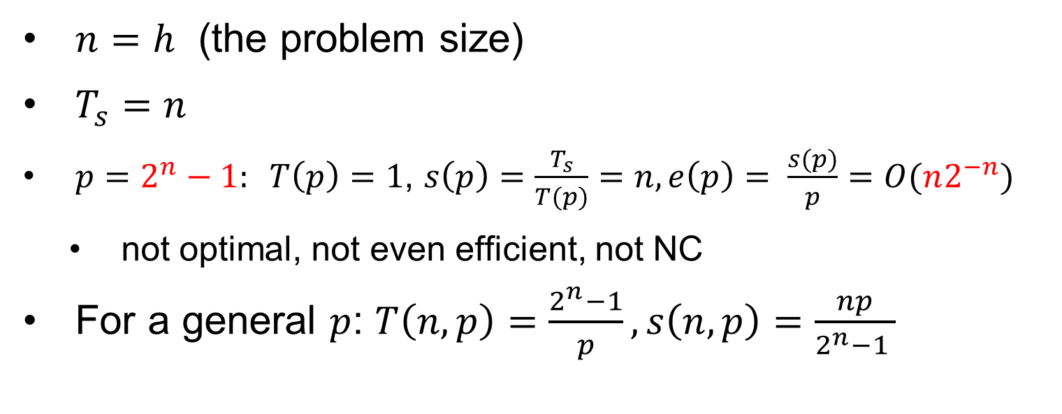
Complexity Math
$n=h$ (the problem size)
$T_{s}=n$
$p=2^{n}−1: T\left(p\right)=1$, $s\left(p\right)=\frac{T_{s}}{T(p)}=n, e\left(p\right)= \frac{s(p)}{p}=O(n2^{−n})$
not optimal, not even efficient, not NC
For a general $p$: $T\left(n,p\right)=\frac{2^{n}−1}{p}, s\left(n,p\right)=\frac{np}{2^{n}−1 }$

Slide 18
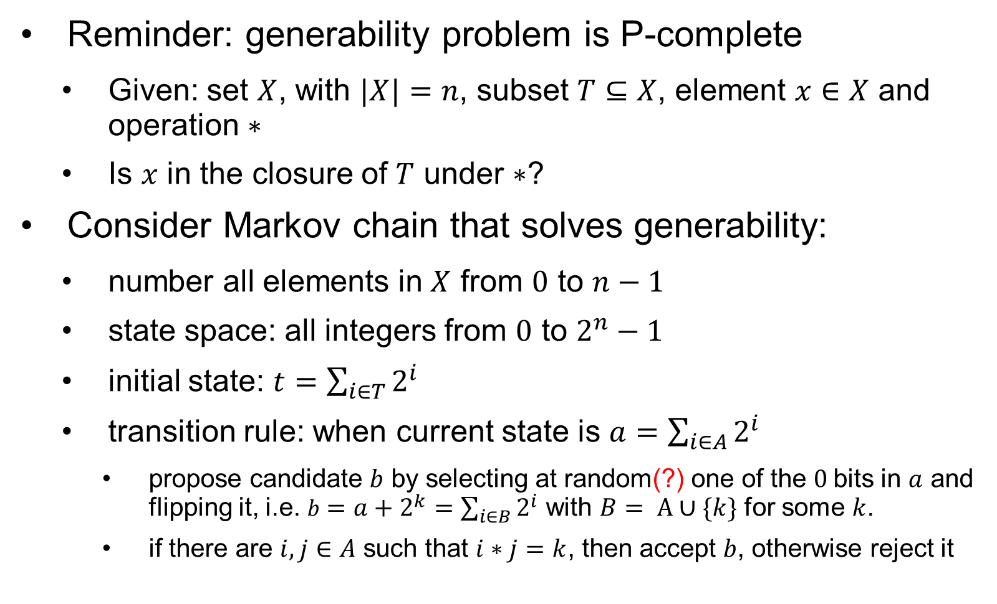
P-Completeness
Reminder: generability problem is P-complete
Given: set $X$, with $|X|=n$, subset $T⊆X$, element $x∈X$ and operation $∗$
Is $x$ in the closure of $T$ under $∗$?
Consider Markov chain that solves generability:
number all elements in $X$ from $0$ to $n−1$
state space: all integers from $0$ to $2^{n}−1$
initial state: $t=\sum_{i∈T}{2^{i}}$
transition rule: when current state is $a$ $=\sum_{i∈A}{2^{i}}$
propose candidate $b$ by selecting at random(?) one of the $0$bits in $a$ and flipping it, i.e. $b=a+2^{k}=\sum_{i∈B}{2^{i}}$ with $B= A∪\{k\}$ for some $k$.
if there are $i,j∈A$ such that $i∗j=k$, then accept $b$, otherwise reject it

Slide 19
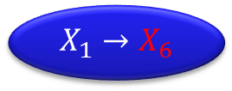
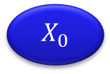


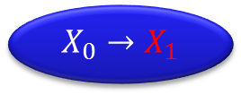

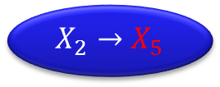
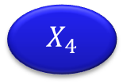
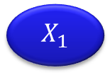


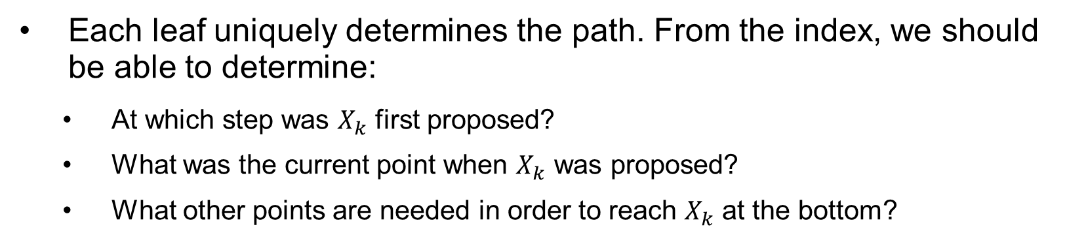
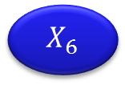


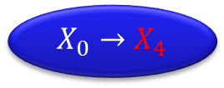
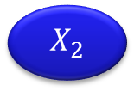



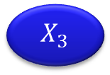





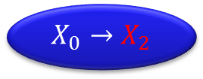
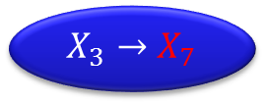
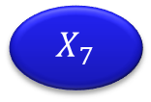



Implementation Remarks
$$X_{0}→X_{1}$$
$$X_{0}→X_{2}$$
R
A
$$X_{1}→X_{3}$$
$$X_{0}→X_{4}$$
$$X_{2}→X_{5}$$
$$X_{1}→X_{6}$$
$$X_{3}→X_{7}$$
$$X_{0}$$
$$X_{4}$$
$$X_{2}$$
$$X_{5}$$
$$X_{1}$$
$$X_{6}$$
$$X_{3}$$
$$X_{7}$$
$$X_{0}$$
$$X_{8}$$
$$X_{4}$$
$$X_{9}$$
$$X_{2}$$
$$X_{10}$$
$$X_{5}$$
$$X_{11}$$
$$X_{1}$$
$$X_{12}$$
$$X_{6}$$
$$X_{13}$$
$$X_{3}$$
$$X_{14}$$
$$X_{7}$$
$$X_{15}$$
Each leaf uniquely determines the path. From the index, we should be able to determine:
At which step was $X_{k}$ first proposed?
What was the current point when $X_{k}$ was proposed?
What other points are needed in order to reach $X_{k}$ at the bottom?

Slide 20








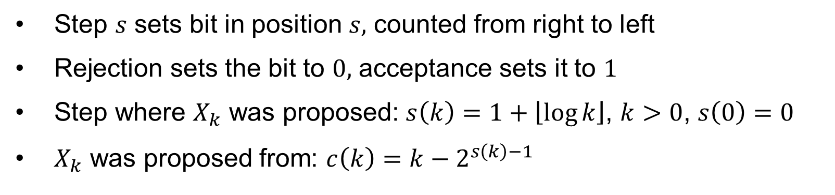











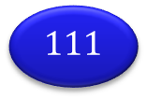

Implementation Remarks
$$/$$
$$0$$
R
A
$$1$$
$$00$$
$$10$$
$$01$$
$$11$$
$$000$$
$$100$$
$$010$$
$$110$$
$$001$$
$$101$$
$$011$$
$$111$$
$$X_{0}$$
$$X_{8}$$
$$X_{4}$$
$$X_{12}$$
$$X_{2}$$
$$X_{10}$$
$$X_{6}$$
$$X_{14}$$
$$X_{1}$$
$$X_{9}$$
$$X_{5}$$
$$X_{13}$$
$$X_{3}$$
$$X_{11}$$
$$X_{7}$$
$$X_{15}$$
Step $s$ sets bit in position $s,$ counted from right to left
Rejection sets the bit to $0,$ acceptance sets it to $1$
Step where $X_{k}$ was proposed: $s\left(k\right)=1+\left\lfloor \log{k}\right\rfloor$, $k>0$, $s\left(0\right)=0$
$X_{k}$ was proposed from: $c\left(k\right)=k−2^{s\left(k\right)−1}$

Slide 21
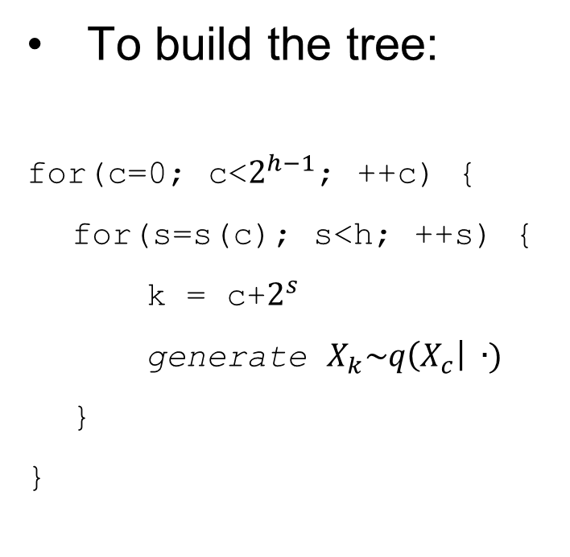
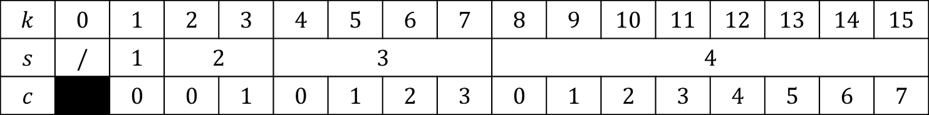

Implementation Remarks
$$k$$ | $$0$$ | $$1$$ | $$2$$ | $$3$$ | $$4$$ | $$5$$ | $$6$$ | $$7$$ | $$8$$ | $$9$$ | $$10$$ | $$11$$ | $$12$$ | $$13$$ | $$14$$ | $$15$$
$$s$$ | $$/$$ | $$1$$ | $$2$$ |  | $$3$$ |  |  |  | $$4$$
$$c$$ |  | $$0$$ | $$0$$ | $$1$$ | $$0$$ | $$1$$ | $$2$$ | $$3$$ | $$0$$ | $$1$$ | $$2$$ | $$3$$ | $$4$$ | $$5$$ | $$6$$ | $$7$$
To build the tree:
for(c=0; c<$2^{h−1}$; ++c) {
for(s=s(c); s<h; ++s) {
k = c+$2^{s}$
generate $X_{k}\sim q\left(X_{c}\right| ∙)$
}
}
The M-H algorithm
c=0;
for(s=1; s<h; ++s) {
p = c + $2^{s−1}$;
if (accept $X_{p}$) c = p;
State[s] = $X_{c}$;
}

Slide 22
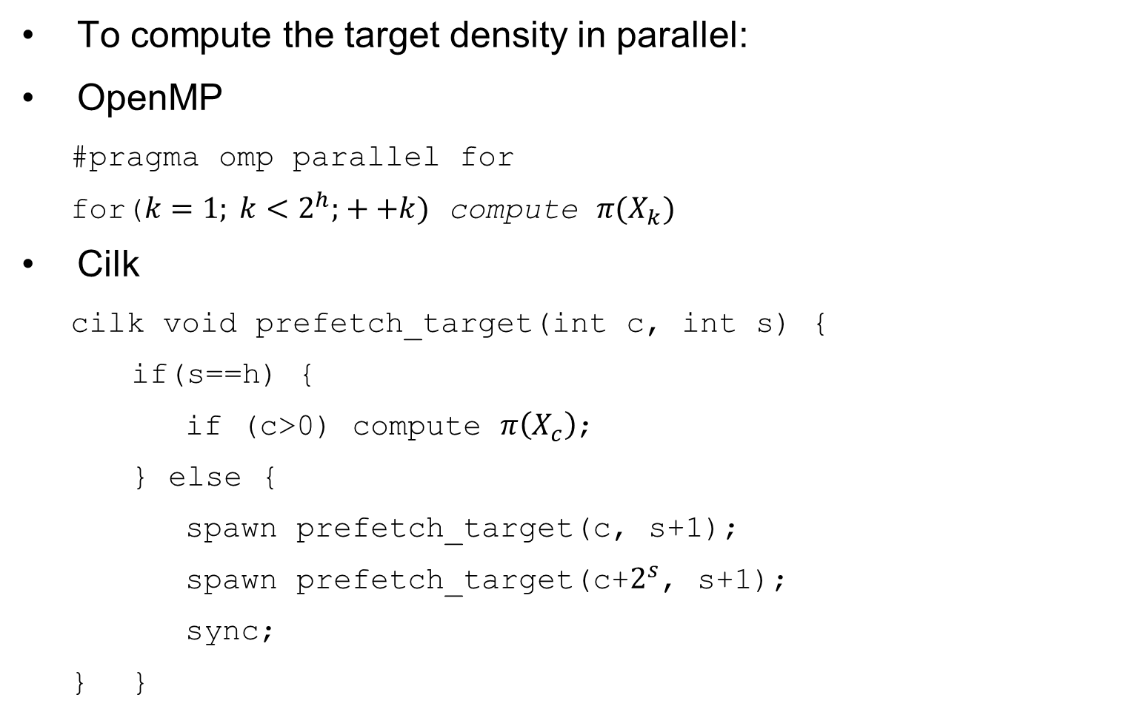
Implementation Remarks
To compute the target density in parallel:
OpenMP
#pragma omp parallel for
for($k=1; k<2^{h}; ++k)$ compute $π(X_{k})$
Cilk
cilk void prefetch_target(int c, int s) {
if(s==h) {
if (c>0) compute $π\left(X_{c}\right)$;
} else {
spawn prefetch_target(c, s+1);
spawn prefetch_target(c+$2^{s}$, s+1);
sync;
} }

Slide 23
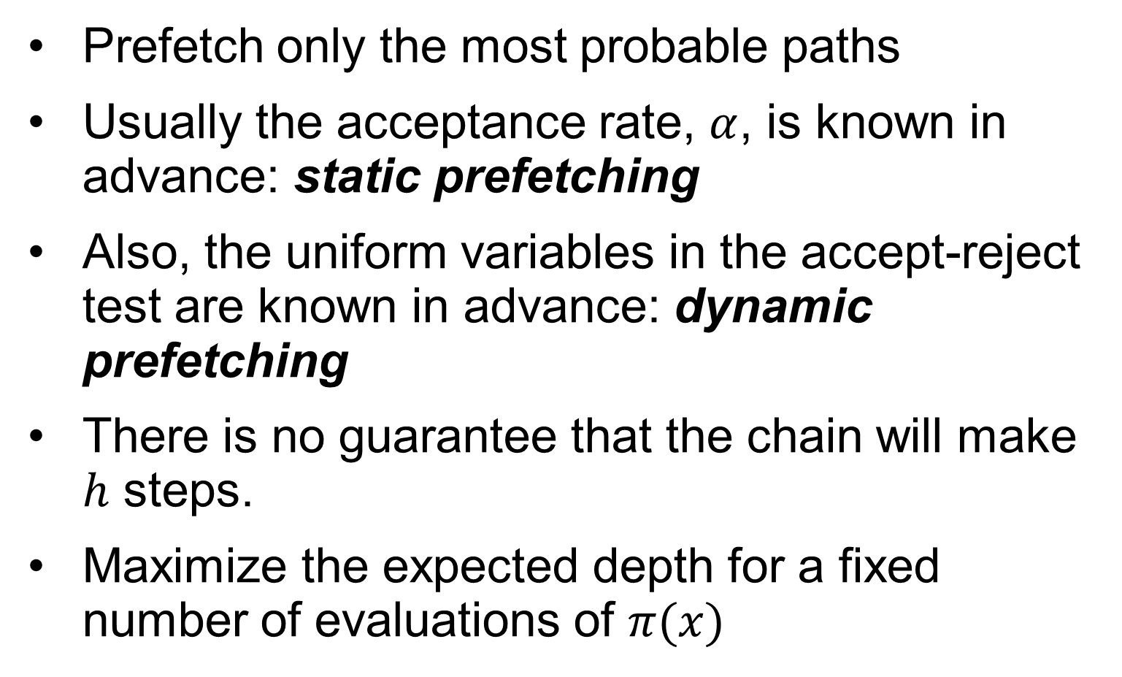
Incomplete Prefetching
Prefetch only the most probable paths
Usually the acceptance rate, $α$, is known in advance: static prefetching
Also, the uniform variables in the accept-reject test are known in advance: dynamic prefetching
There is no guarantee that the chain will make $h$ steps.
Maximize the expected depth for a fixed number of evaluations of $π(x)$

Slide 24

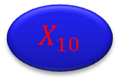
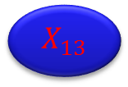





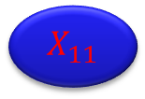


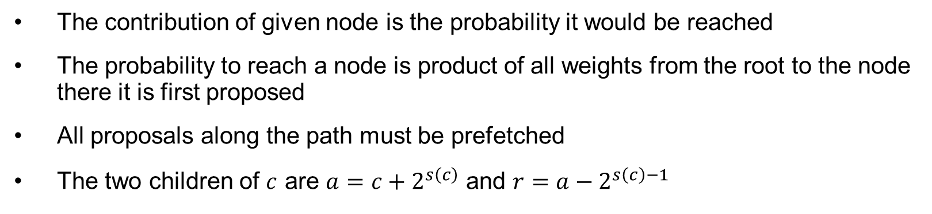
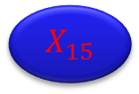







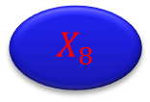


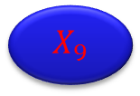





Incomplete Prefetching
$$X_{1}$$
$$X_{2}$$
$${1−α}_{1}$$
$α_{1}$
$$X_{3}$$
$${1−α}_{2}$$
$α_{2}$
$${1−α}_{2}$$
$α_{2}$
$$X_{4}$$
$$X_{6}$$
$$X_{5}$$
$$X_{7}$$
$${1−α}_{3}$$
$α_{3}$
$${1−α}_{3}$$
$α_{3}$
$${1−α}_{3}$$
$α_{3}$
$${1−α}_{3}$$
$α_{3}$
$$X_{8}$$
$$X_{12}$$
$$X_{10}$$
$$X_{14}$$
$$X_{9}$$
$$X_{13}$$
$$X_{11}$$
$$X_{15}$$
$$X_{0}$$
$$X_{8}$$
$$X_{4}$$
$$X_{12}$$
$$X_{2}$$
$$X_{10}$$
$$X_{6}$$
$$X_{14}$$
$$X_{1}$$
$$X_{9}$$
$$X_{5}$$
$$X_{13}$$
$$X_{3}$$
$$X_{11}$$
$$X_{7}$$
$$X_{15}$$
The contribution of given node is the probability it would be reached
The probability to reach a node is product of all weights from the root to the node there it is first proposed
All proposals along the path must be prefetched
The two children of $c$ are $a=c+2^{s\left(c\right)}$ and $r=a−2^{s\left(c\right)−1}$

Slide 25


Incomplete Prefetching
$$p$$ | $$D(p)$$
$$1$$ | $$1$$
$$2$$ | $$1.77$$
$$3$$ | $$2.35$$
$$4$$ | $$2.80$$
$$5$$ | $$3.15$$
$$6$$ | $$3.41$$
$$7$$ | $$3.64$$
$$8$$ | $$3.84$$
$$9$$ | $$4.03$$
$$10$$ | $$4.20$$
$$11$$ | $$4.36$$
$$12$$ | $$4.49$$
$$13$$ | $$4.63$$
$$14$$ | $$4.77$$
$$15$$ | $$4.88$$
Complexity example with $α=0.234$
$T(p) = n / D(p)$, $s(p) = D(p)$
lower $α$ gives better speedup curve
these are expected rates, your mileage may vary

Slide 26

Run Times Full Prefetching
$$h$$ | $$p$$ | #threads | parallel method | total time | time per step
- | - | 1 | seq | 120.06 | 0.1017
2 | 3 | 3 | omp | 61.65 | 0.0514
2 | 3 | 3 | cilk | 62.06 | 0.0517
3 | 3 | 3 | cilk | 122.66 | 0.1022
3 | 5 | 5 | cilk | 82.81 | 0.0690
3 | 7 | 7 | cilk | 42.70 | 0.0356
3 | 7 | 7 | omp | 42.72 | 0.0356
4 | 15 | 15 | omp | 34.55 | 0.0288
4 | 15 | 15 | cilk | 33.93 | 0.0283
5 | 16 | 31 | cilk | 73.72 | 0.0614
5 | 16 | 16 | cilk | 67.08 | 0.0559

Slide 27
Run Times Full Prefetching

Slide 28

Run Times Partial Prefetching
$$p$$ | $$D$$ | $$h$$ | $$d$$ | total time cilk | total time omp | tree
2 | 1.766 | 2 | 1.66297 | 74.5942 | 74.7524 | 1 2
3 | 2.35276 | 3 | 2.06724 | 60.8497 | 60.6849 | 1 2 4
4 | 2.80221 | 4 | 3.36798 | 37.5026 | 37.1227 | 1 2 4 8
5 | 3.14649 | 5 | 2.71655 | 47.3608 | 46.9558 | 1 2 4 8 16
6 | 3.41021 | 6 | 2.90511 | 44.1376 | 43.7954 | 1 2 4 8 16 32
7 | 3.64421 | 6 | 3.54142 | 51.9093 | 58.3732 | 1 2 3 4 8 16 32
8 | 3.84622 | 7 | 3.45533 | 51.7107 | 60.1928 | 1 2 3 4 8 16 32 64
9 | 4.02547 | 7 | 3.44669 | 55.8634 | 59.8548 | 1 2 3 4 5 8 16 32 64
10 | 4.20471 | 7 | 3.82428 | 56.6887 | 54.4586 | 1 2 3 4 5 6 8 16 32 64
11 | 4.35945 | 8 | 3.85209 | 52.9827 | 54.1078 | 1 2 3 4 5 6 8 16 32 64 128
12 | 4.49675 | 8 | 4.5 | 43.9406 | 46.5858 | 1 2 3 4 5 6 8 12 16 32 64 128
13 | 4.63405 | 8 | 4.13495 | 49.1822 | 50.4384 | 1 2 3 4 5 6 8 9 12 16 32 64 128
14 | 4.77135 | 8 | 4.37226 | 46.3788 | 47.8808 | 1 2 3 4 5 6 8 9 10 12 16 32 64 128
15 | 4.88988 | 9 | 4.16725 | 49.4775 | 49.9524

Slide 29
Run Times Partial Prefetching

Slide 30

Conclusion
Prefetching is a viable parallel algorithm for multicore and small $h$
Partial prefetching seems promising, although the static acceptance probabilities don’t seem to work well
Next steps
integrate with Matlab and R
combine with adaptive IMH

Slide 31


Parallel Random Numbers

