Slide 1
Parallel Metropolis-Hastings
Boyan Bejanov
bbejanov@bankofcanada.ca
Data and Statistics Office, Bank of Canada
COMP5704
School of Computer Science, Carleton University
April 2014

Slide 2
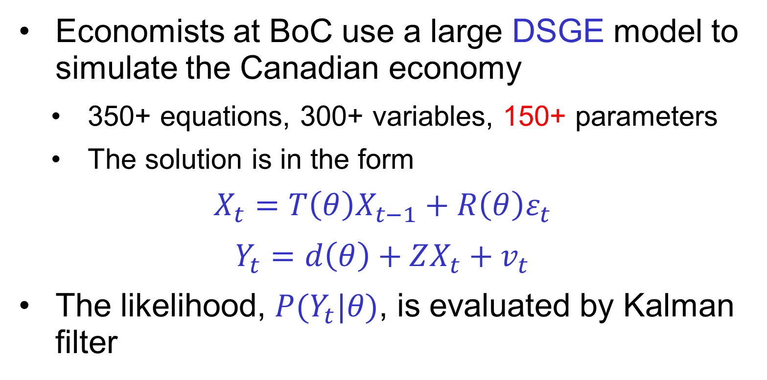
Motivation
Economists at BoC use a large DSGE model to simulate the Canadian economy
350+ equations, 300+ variables, 150+ parameters
The solution is in the form
$$X_{t}=T\left(θ\right)X_{t−1}+R\left(θ\right)ε_{t}$$
$$Y_{t}=d\left(θ\right)+ZX_{t}+v_{t}$$
The likelihood, $P(Y_{t}|θ)$, is evaluated by Kalman filter

Slide 3
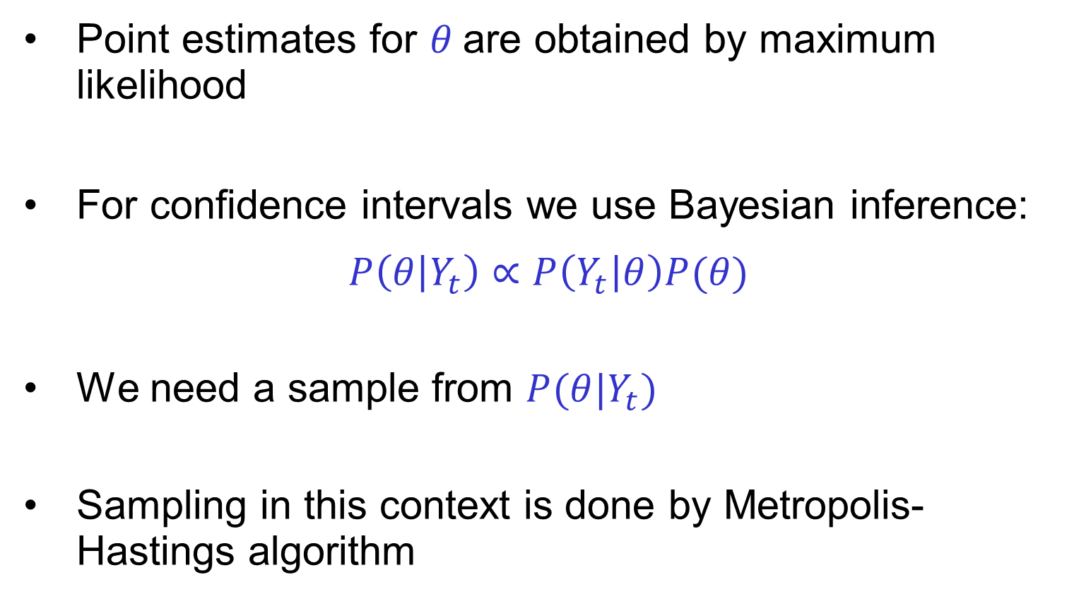
Motivation
Point estimates for $θ$are obtained by maximum likelihood
For confidence intervals we use Bayesian inference:
$$P\left(θ | Y_{t}\right)∝P\left(Y_{t} | θ\right)P(θ)$$
We need a sample from $P(θ|Y_{t})$
Sampling in this context is done by Metropolis-Hastings algorithm

Slide 4
Outline
Brief introduction to Markov Chains
Metropolis-Hastings Algorithm
Overview of parallelization approaches
Prefetching algorithm
Analysis
Implementation details
Computational experiments
Conclusions

Slide 5
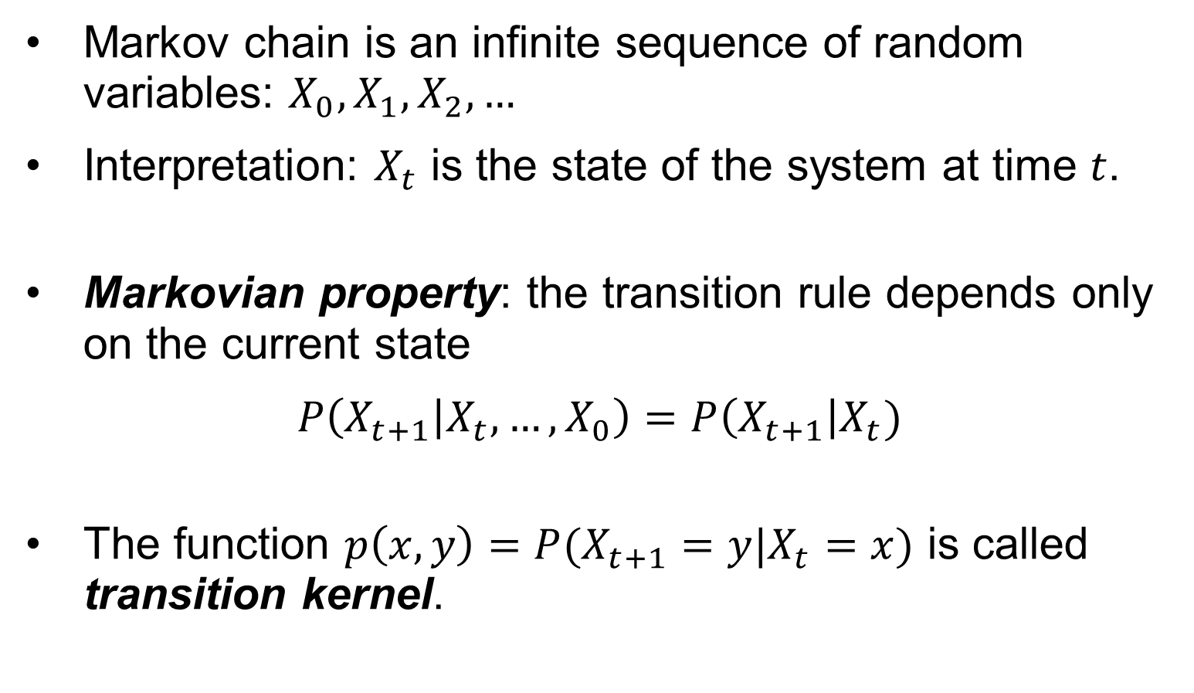
Markov Chains - definition
Markov chain is an infinite sequence of random variables: $X_{0}, X_{1}, X_{2},…$
Interpretation: $X_{t}$ is the state of the system at time $t$.
Markovian property: the transition rule depends only on the current state
$$P\left(X_{t+1} | X_{t},…,X_{0}\right)=P\left(X_{t+1}\right|X_{t})$$
The function $p\left(x,y\right)=P(X_{t+1}=y|X_{t}=x)$ is called transition kernel.

Slide 6
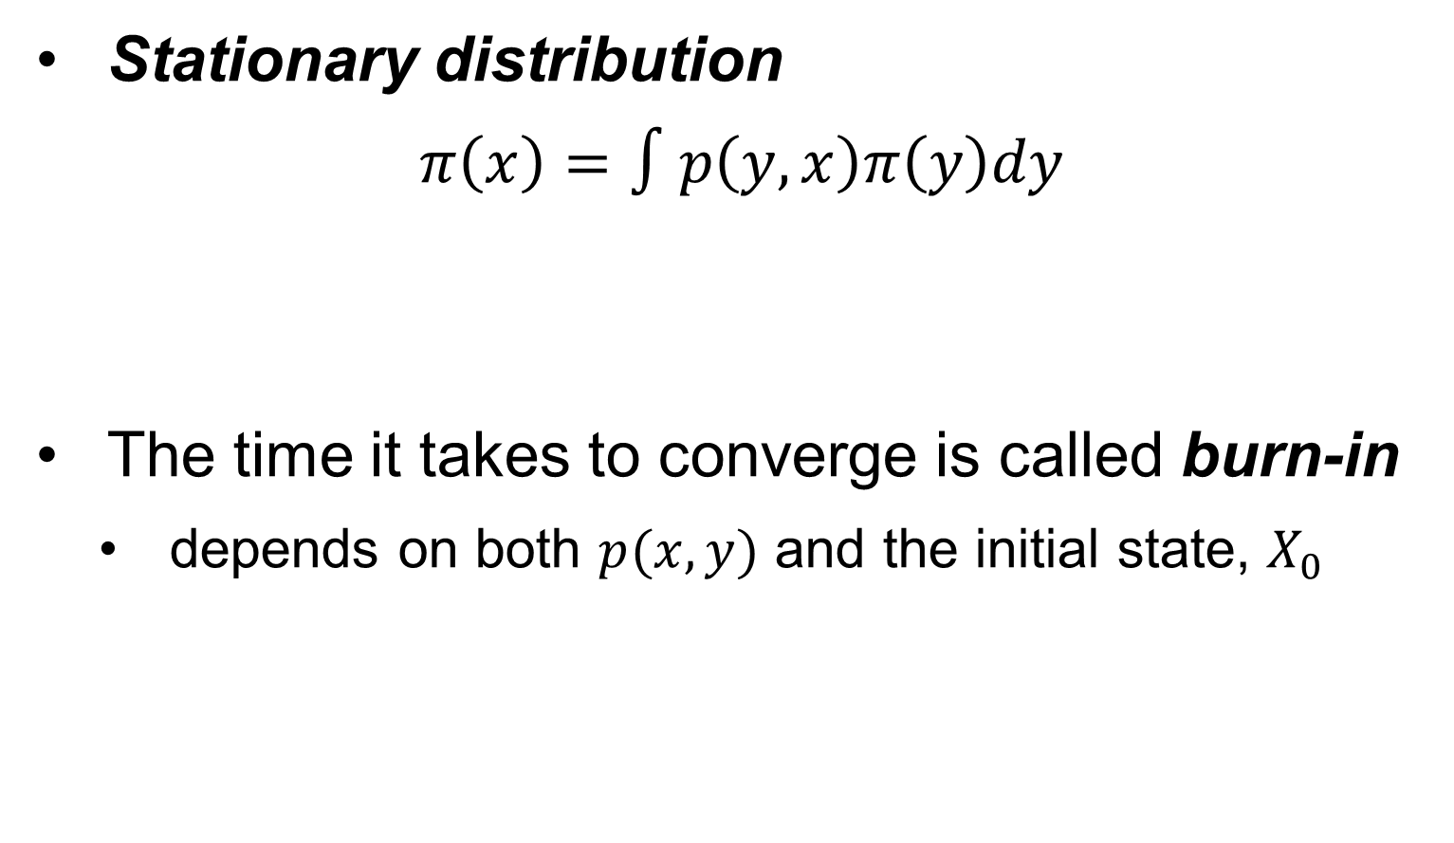
Markov Chains - properties
Stationary distribution
$$π\left(x\right)=∫p\left(y,x\right)π\left(y\right)dy$$
The time it takes to converge is called burn-in
depends on both $p(x,y)$ and the initial state, $X_{0}$

Slide 7
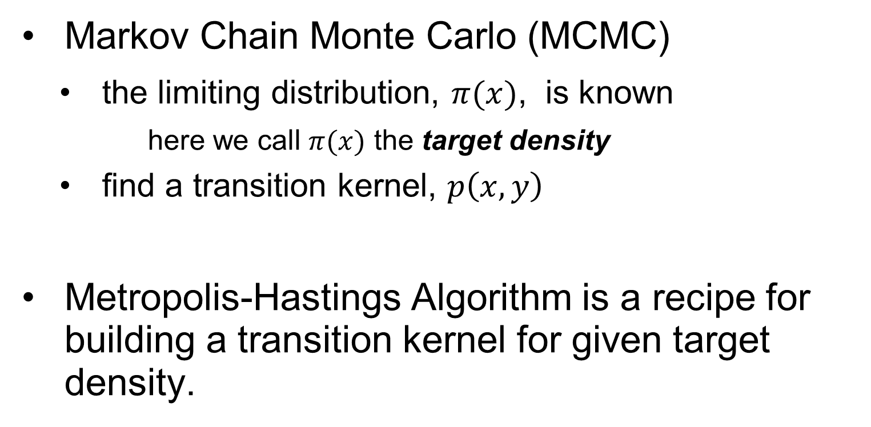
Metropolis-Hastings Algorithm
Markov Chain Monte Carlo (MCMC)
the limiting distribution, $π(x)$, is known
here we call $π(x)$ the target density
find a transition kernel, $p\left(x,y\right)$
Metropolis-Hastings Algorithm is a recipe for building a transition kernel for given target density.

Slide 8
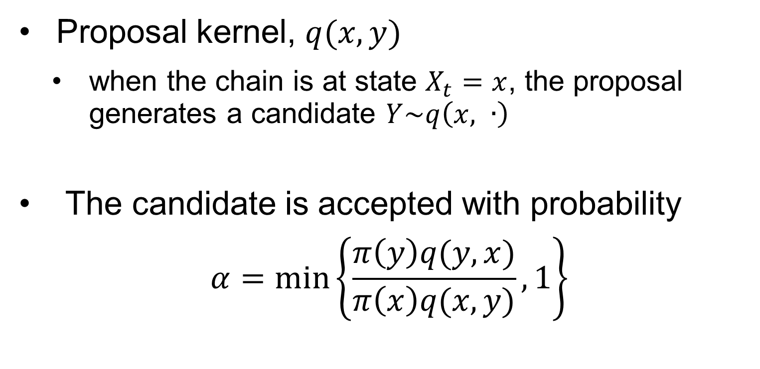
Metropolis-Hastings Algorithm
Proposal kernel, $q(x,y)$
when the chain is at state $X_{t}=x$, the proposal generates a candidate $Y\sim q\left(x, ∙\right)$
The candidate is accepted with probability
$$α=\min_{ }\left\{\frac{π\left(y\right)q(y,x)}{π\left(x\right)q(x,y)}, 1\right\}$$

Slide 9
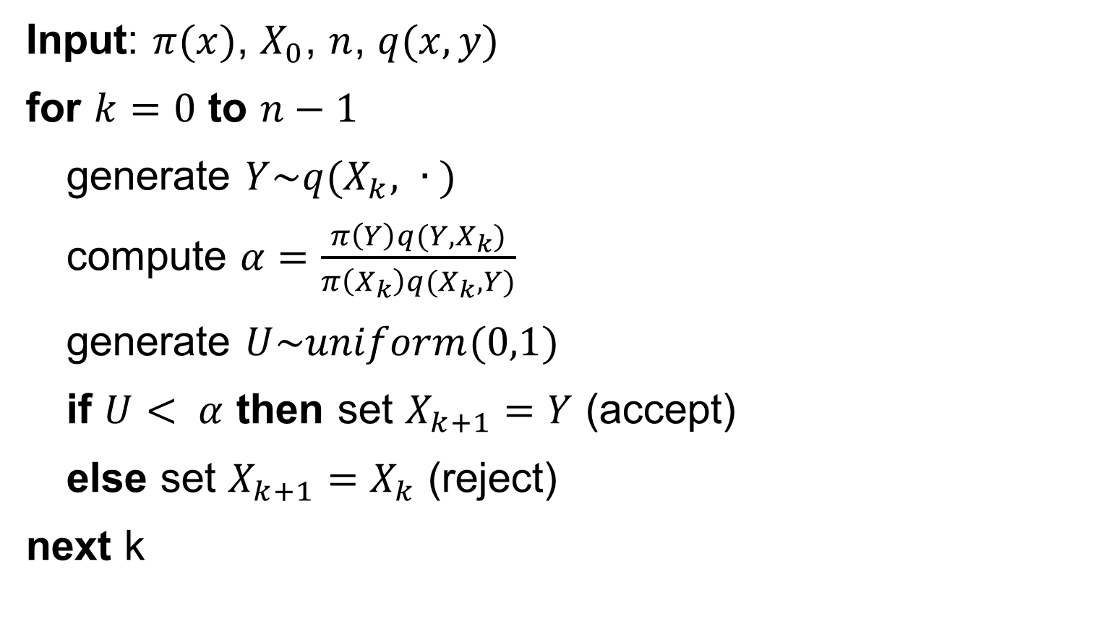
Metropolis-Hastings Algorithm
Input: $π(x)$, $X_{0}$, $n$, $q(x,y)$
for $k=0$ to $n−1$
generate $Y\sim q(X_{k}, ∙ )$
compute $α=\frac{π\left(Y\right)q(Y,X_{k})}{π\left(X_{k}\right)q(X_{k},Y)}$
generate $U\sim uniform(0,1)$
if $U< α$ then set $X_{k+1}=Y$ (accept)
else set $X_{k+1}=X_{k}$ (reject)
next k

Slide 10
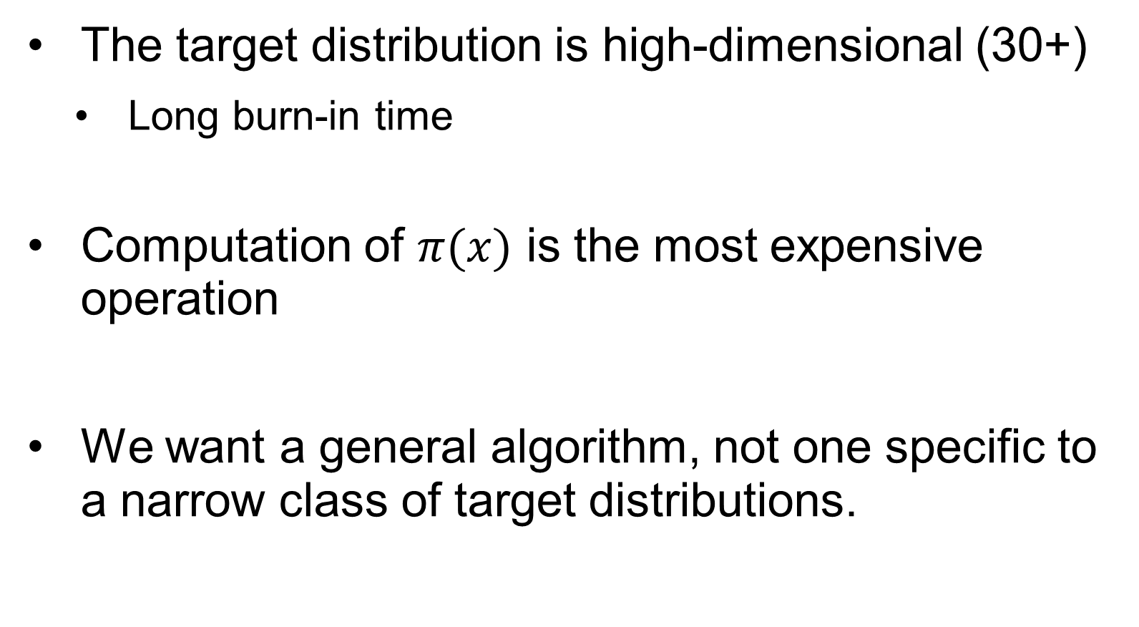
Assumptions and Goals
The target distribution is high-dimensional (30+)
Long burn-in time
Computation of $π(x)$ is the most expensive operation
We want a general algorithm, not one specific to a narrow class of target distributions.

Slide 11
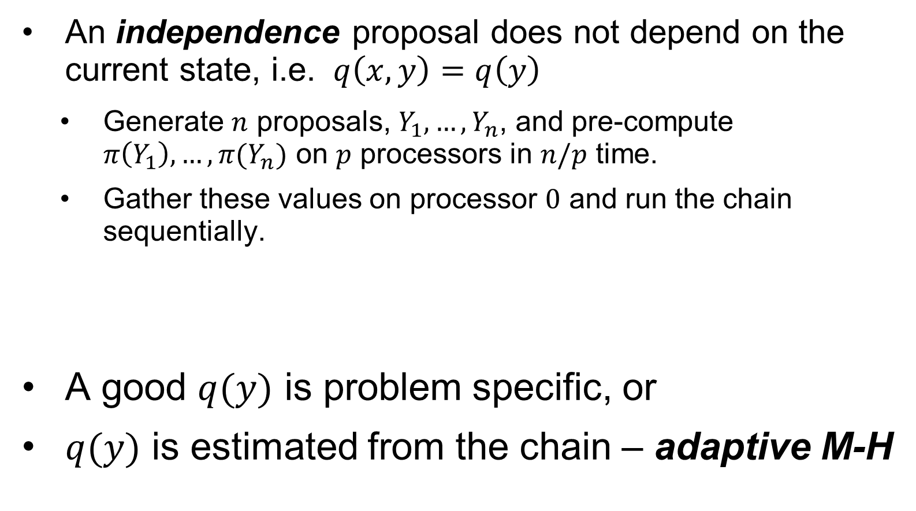
Parallel M-H approaches
An independence proposal does not depend on the current state, i.e. $q\left(x,y\right)=q\left(y\right)$
Generate $n$ proposals, $Y_{1},…,Y_{n}$, and pre-compute $π\left(Y_{1}\right),…, π(Y_{n})$ on $p$ processors in $n/p$ time.
Gather these values on processor $0$ and run the chain sequentially.
A good $q(y)$ is problem specific, or
$q(y)$ is estimated from the chain – adaptive M-H

Slide 12
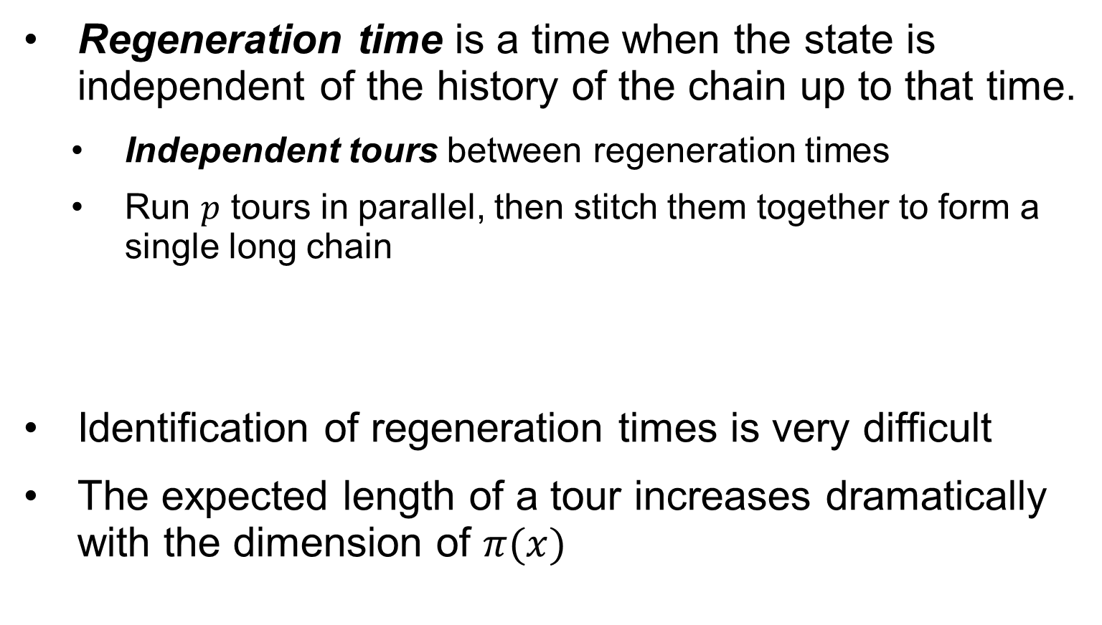
Parallel M-H approaches
Regeneration time is a time when the state is independent of the history of the chain up to that time.
Independent tours between regeneration times
Run $p$ tours in parallel, then stitch them together to form a single long chain
Identification of regeneration times is very difficult
The expected length of a tour increases dramatically with the dimension of $π(x)$

Slide 13
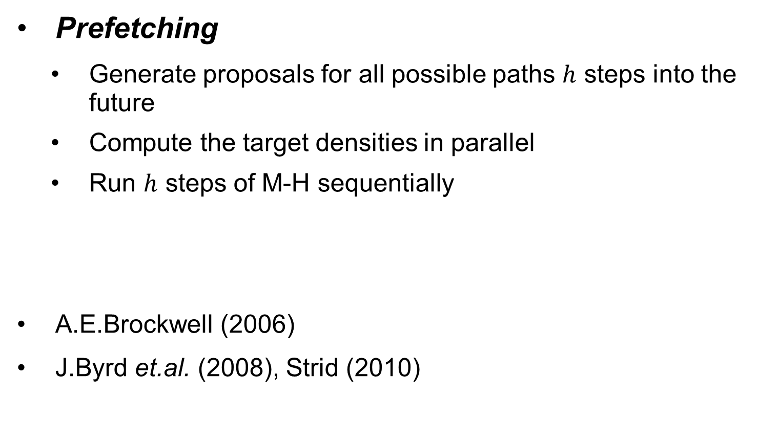
Parallel M-H approaches
Prefetching
Generate proposals for all possible paths $h$ steps into the future
Compute the target densities in parallel
Run $h$ steps of M-H sequentially
A.E.Brockwell (2006)
J.Byrd et.al. (2008), Strid (2010)

Slide 14
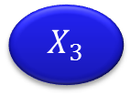
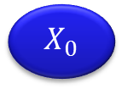
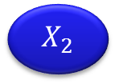
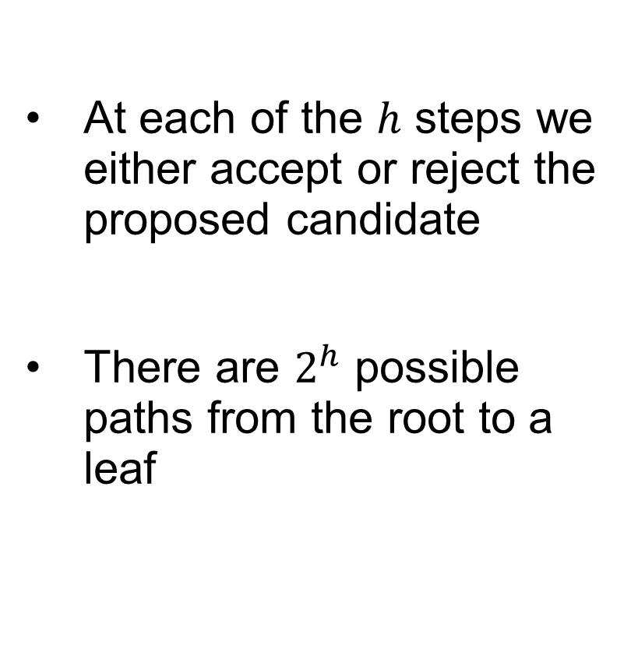
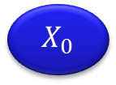

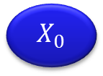

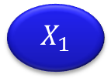

Prefetching
At each of the $h$ steps we either accept or reject the proposed candidate
There are $2^{h}$ possible paths from the root to a leaf
$$X_{0}$$
$$h=0$$
R
A
$$X_{0}$$
$$X_{1}$$
$$h=1$$
R
A
R
A
$$X_{0}$$
$$X_{2}$$
$$X_{1}$$
$$X_{3}$$
$$h=2$$

Slide 15
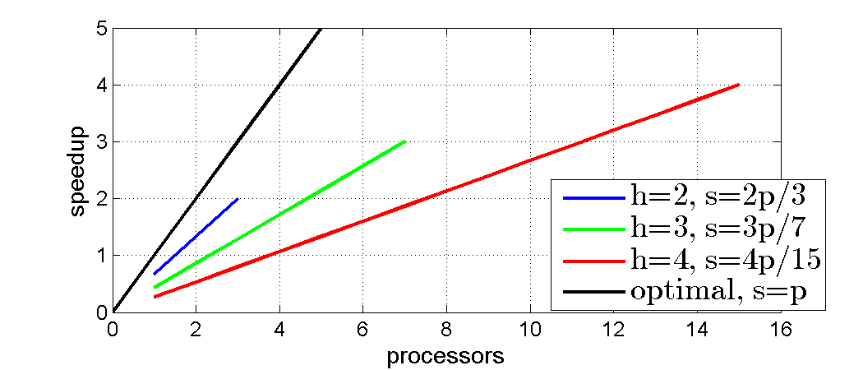
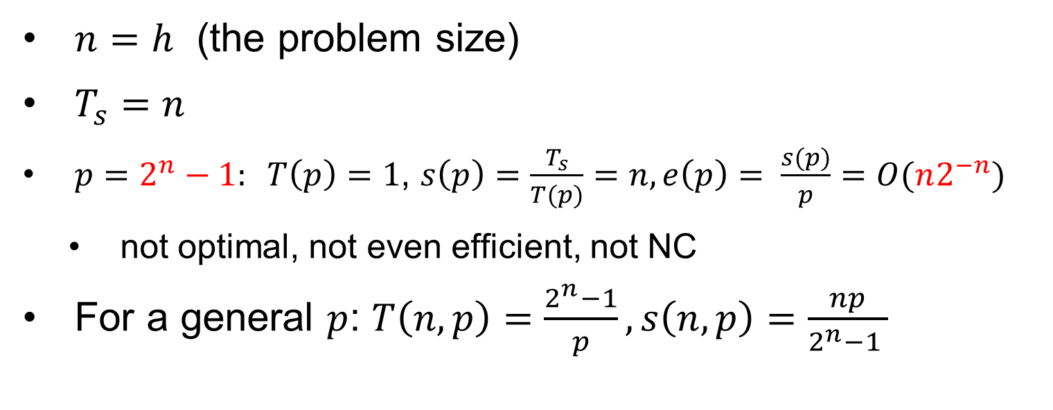
Complexity Math
$n=h$ (the problem size)
$T_{s}=n$
$p=2^{n}−1: T\left(p\right)=1$, $s\left(p\right)=\frac{T_{s}}{T(p)}=n, e\left(p\right)= \frac{s(p)}{p}=O(n2^{−n})$
not optimal, not even efficient, not NC
For a general $p$: $T\left(n,p\right)=\frac{2^{n}−1}{p}, s\left(n,p\right)=\frac{np}{2^{n}−1 }$

Slide 16
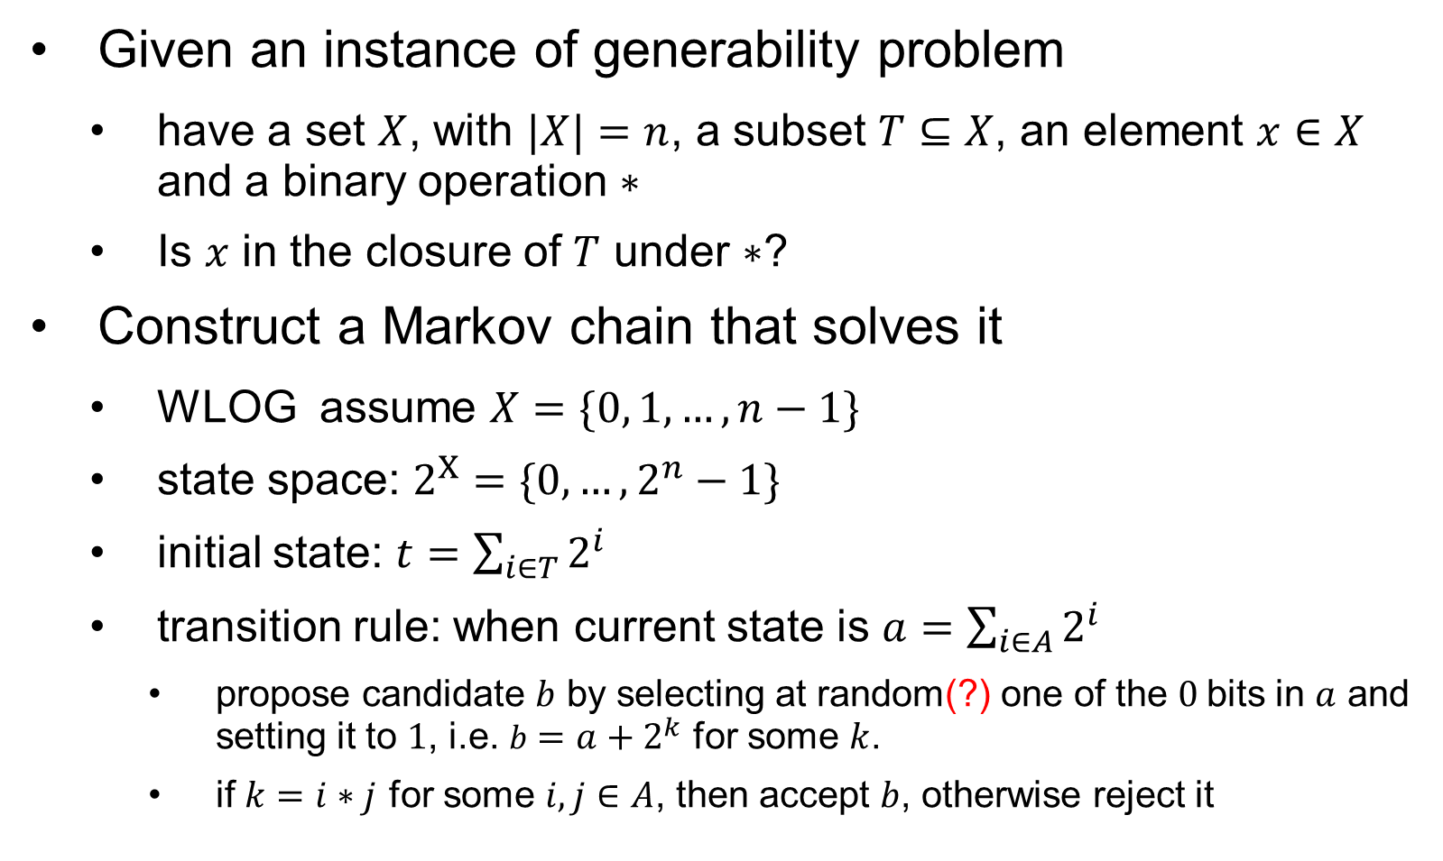
P-Completeness
Given an instance of generability problem
have a set $X$, with $|X|=n$, a subset $T⊆X$, an element $x∈X$ and a binary operation $∗$
Is $x$ in the closure of $T$ under $∗$?
Construct a Markov chain that solves it
WLOG assume $X=\{0, 1,…, n−1\}$
state space: $2^{X}=\{0,…,2^{n}−1\}$
initial state: $t=\sum_{i∈T}{2^{i}}$
transition rule: when current state is $a$ $=\sum_{i∈A}{2^{i}}$
propose candidate $b$ by selecting at random(?) one of the $0$bits in $a$ and setting it to $1$, i.e. $b=a+2^{k}$ for some $k$.
if $k=i∗j$ for some $i,j∈A$, then accept $b$, otherwise reject it

Slide 17
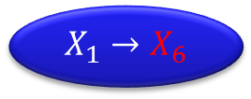
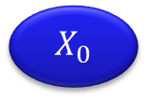


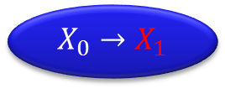

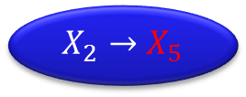
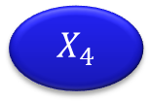
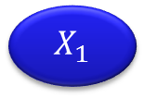


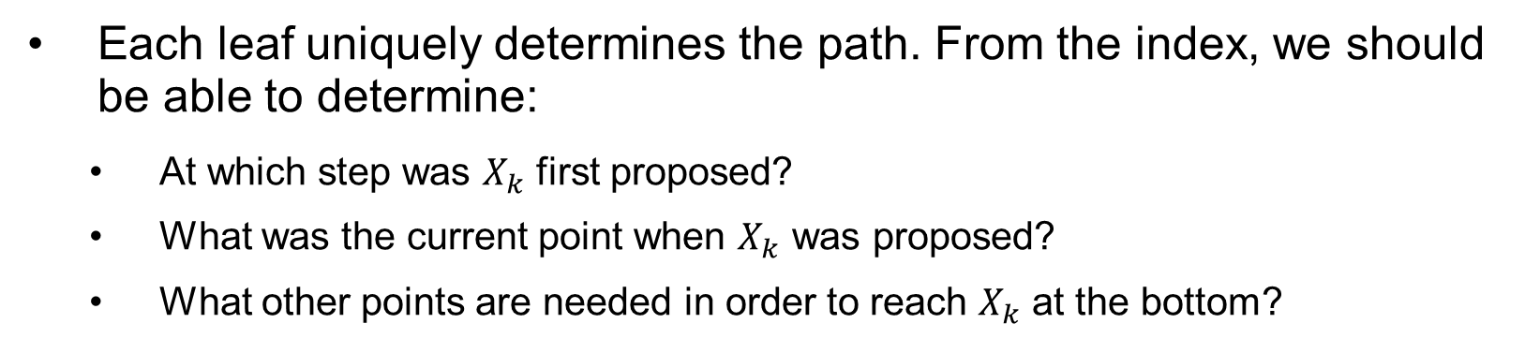
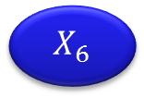


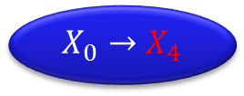
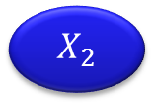



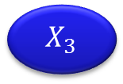





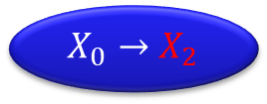
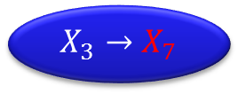
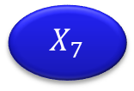



Implementation Remarks
$$X_{0}→X_{1}$$
$$X_{0}→X_{2}$$
R
A
$$X_{1}→X_{3}$$
$$X_{0}→X_{4}$$
$$X_{2}→X_{5}$$
$$X_{1}→X_{6}$$
$$X_{3}→X_{7}$$
$$X_{0}$$
$$X_{4}$$
$$X_{2}$$
$$X_{5}$$
$$X_{1}$$
$$X_{6}$$
$$X_{3}$$
$$X_{7}$$
$$X_{0}$$
$$X_{8}$$
$$X_{4}$$
$$X_{9}$$
$$X_{2}$$
$$X_{10}$$
$$X_{5}$$
$$X_{11}$$
$$X_{1}$$
$$X_{12}$$
$$X_{6}$$
$$X_{13}$$
$$X_{3}$$
$$X_{14}$$
$$X_{7}$$
$$X_{15}$$
Each leaf uniquely determines the path. From the index, we should be able to determine:
At which step was $X_{k}$ first proposed?
What was the current point when $X_{k}$ was proposed?
What other points are needed in order to reach $X_{k}$ at the bottom?

Slide 18








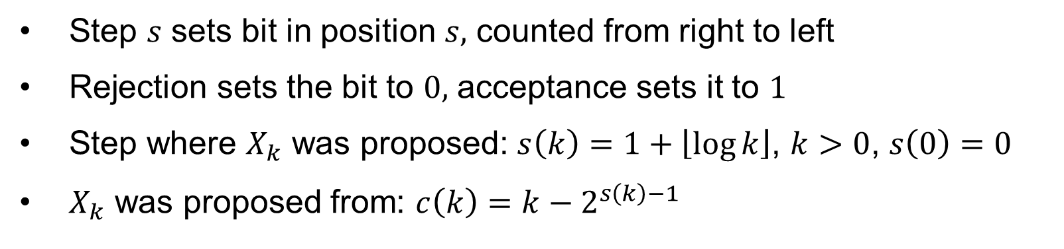











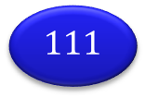

Implementation Remarks
$$/$$
$$0$$
R
A
$$1$$
$$00$$
$$10$$
$$01$$
$$11$$
$$000$$
$$100$$
$$010$$
$$110$$
$$001$$
$$101$$
$$011$$
$$111$$
$$X_{0}$$
$$X_{8}$$
$$X_{4}$$
$$X_{12}$$
$$X_{2}$$
$$X_{10}$$
$$X_{6}$$
$$X_{14}$$
$$X_{1}$$
$$X_{9}$$
$$X_{5}$$
$$X_{13}$$
$$X_{3}$$
$$X_{11}$$
$$X_{7}$$
$$X_{15}$$
Step $s$ sets bit in position $s,$ counted from right to left
Rejection sets the bit to $0,$ acceptance sets it to $1$
Step where $X_{k}$ was proposed: $s\left(k\right)=1+\left\lfloor \log{k}\right\rfloor$, $k>0$, $s\left(0\right)=0$
$X_{k}$ was proposed from: $c\left(k\right)=k−2^{s\left(k\right)−1}$

Slide 19
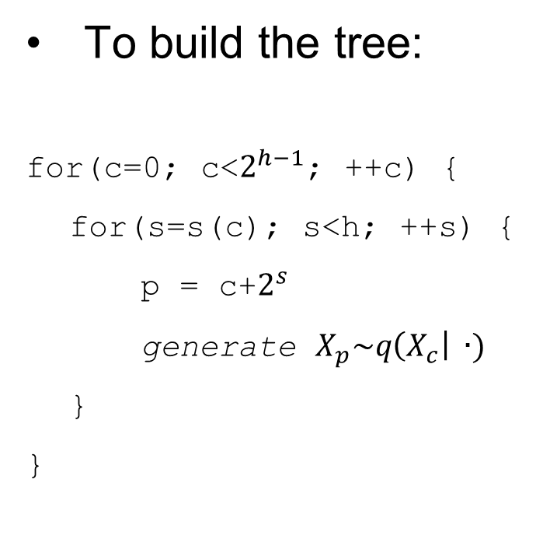
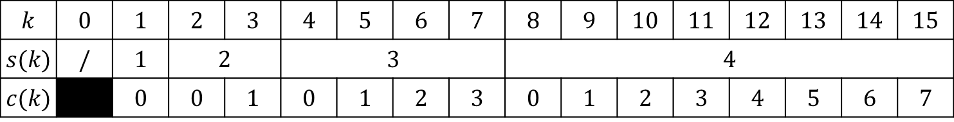

Implementation Remarks
$$k$$ | $$0$$ | $$1$$ | $$2$$ | $$3$$ | $$4$$ | $$5$$ | $$6$$ | $$7$$ | $$8$$ | $$9$$ | $$10$$ | $$11$$ | $$12$$ | $$13$$ | $$14$$ | $$15$$
$$s(k)$$ | $$/$$ | $$1$$ | $$2$$ |  | $$3$$ |  |  |  | $$4$$
$$c(k)$$ |  | $$0$$ | $$0$$ | $$1$$ | $$0$$ | $$1$$ | $$2$$ | $$3$$ | $$0$$ | $$1$$ | $$2$$ | $$3$$ | $$4$$ | $$5$$ | $$6$$ | $$7$$
To build the tree:
for(c=0; c<$2^{h−1}$; ++c) {
for(s=s(c); s<h; ++s) {
p = c+$2^{s}$
generate $X_{p}\sim q\left(X_{c}\right| ∙)$
}
}
The M-H algorithm
c=0;
for(s=1; s<h; ++s) {
p = c + $2^{s−1}$;
if (accept $X_{p}$) c = p;
State[s] = $X_{c}$;
}

Slide 20
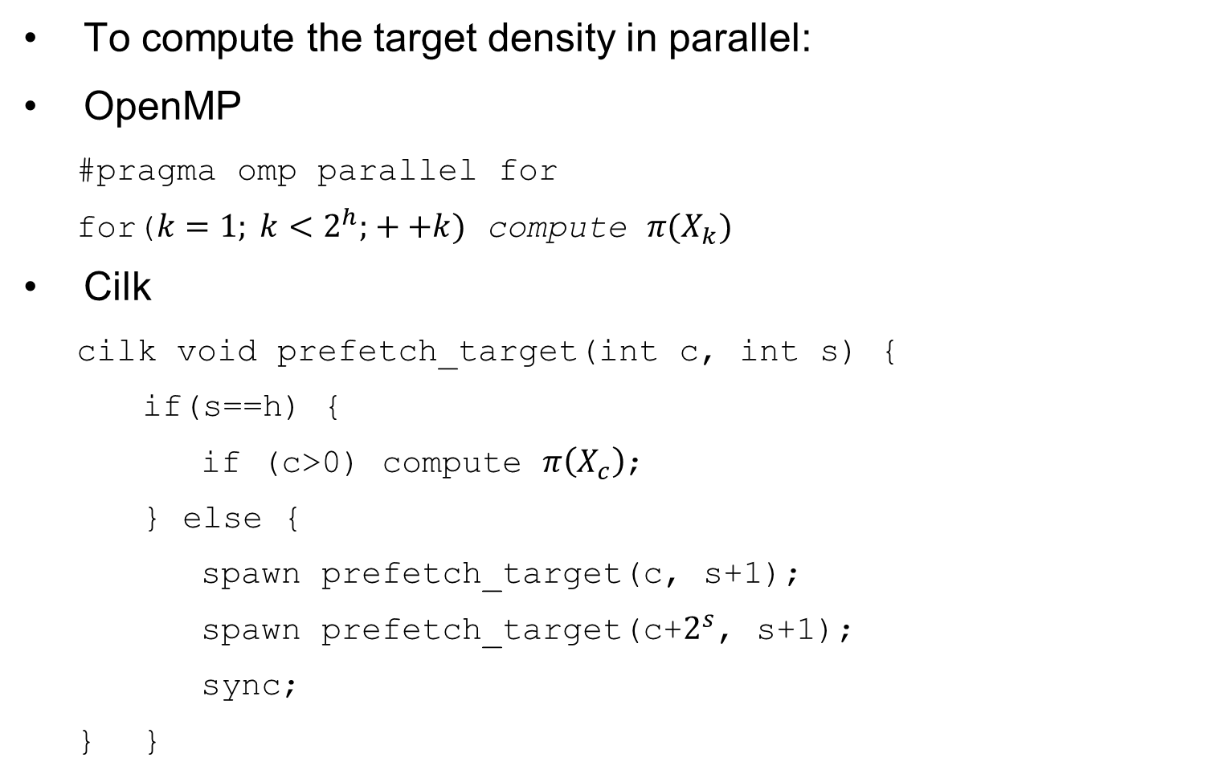
Implementation Remarks
To compute the target density in parallel:
OpenMP
#pragma omp parallel for
for($k=1; k<2^{h}; ++k)$ compute $π(X_{k})$
Cilk
cilk void prefetch_target(int c, int s) {
if(s==h) {
if (c>0) compute $π\left(X_{c}\right)$;
} else {
spawn prefetch_target(c, s+1);
spawn prefetch_target(c+$2^{s}$, s+1);
sync;
} }

Slide 21
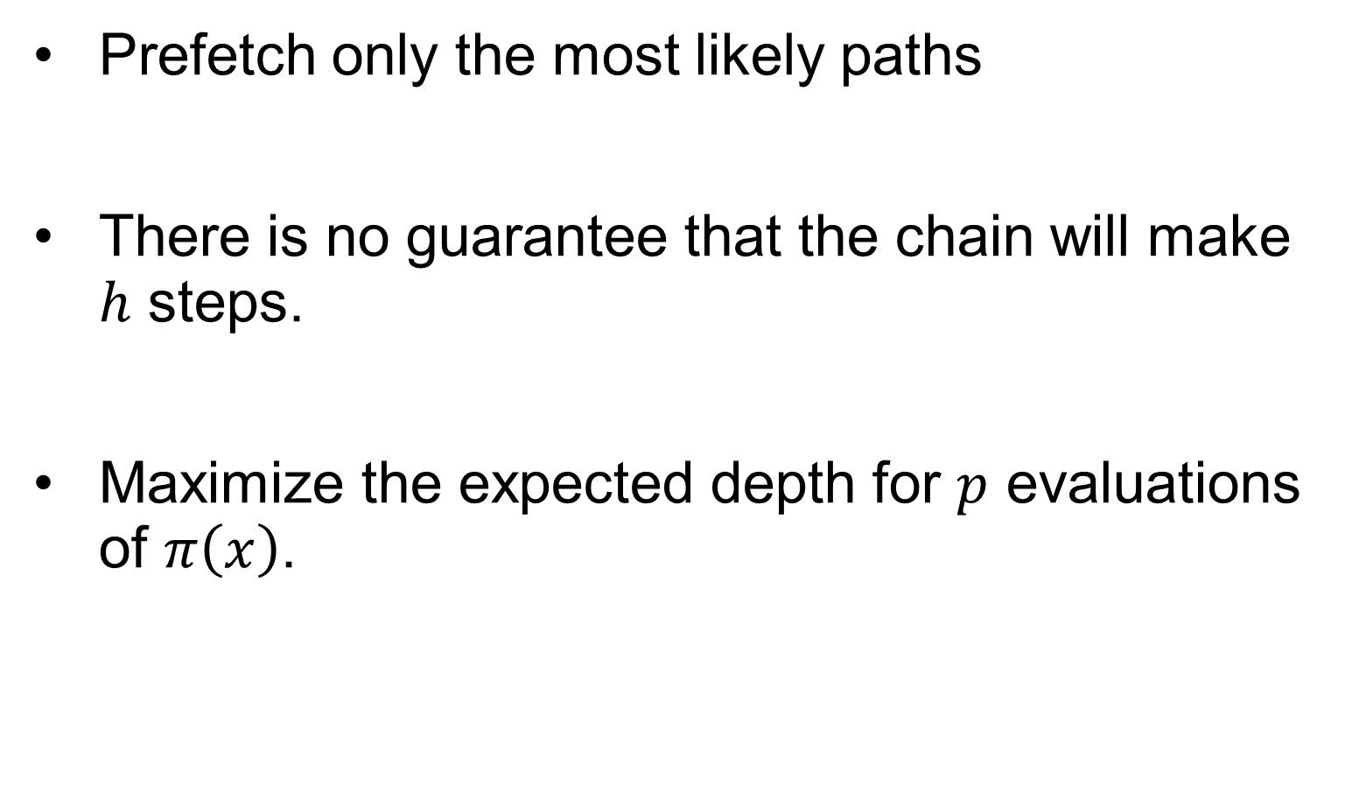
Incomplete Prefetching
Prefetch only the most likely paths
There is no guarantee that the chain will make $h$ steps.
Maximize the expected depth for $p$ evaluations of $π\left(x\right)$.

Slide 22

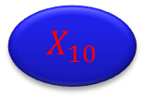
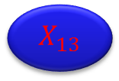





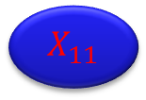


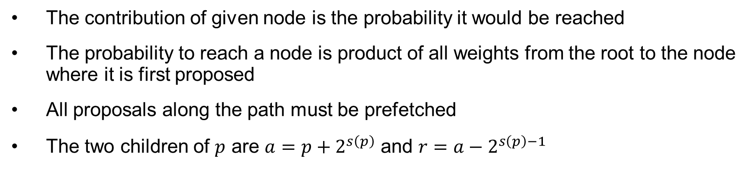
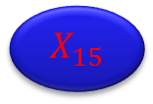







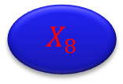


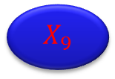



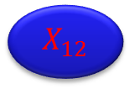

Incomplete Prefetching
$$X_{1}$$
$$X_{2}$$
$${1−α}_{1}$$
$α_{1}$
$$X_{3}$$
$${1−α}_{2}$$
$α_{2}$
$${1−α}_{2}$$
$α_{2}$
$$X_{4}$$
$$X_{6}$$
$$X_{5}$$
$$X_{7}$$
$${1−α}_{3}$$
$α_{3}$
$${1−α}_{3}$$
$α_{3}$
$${1−α}_{3}$$
$α_{3}$
$${1−α}_{3}$$
$α_{3}$
$$X_{8}$$
$$X_{12}$$
$$X_{10}$$
$$X_{14}$$
$$X_{9}$$
$$X_{13}$$
$$X_{11}$$
$$X_{15}$$
$$X_{0}$$
$$X_{8}$$
$$X_{4}$$
$$X_{12}$$
$$X_{2}$$
$$X_{10}$$
$$X_{6}$$
$$X_{14}$$
$$X_{1}$$
$$X_{9}$$
$$X_{5}$$
$$X_{13}$$
$$X_{3}$$
$$X_{11}$$
$$X_{7}$$
$$X_{15}$$
The contribution of given node is the probability it would be reached
The probability to reach a node is product of all weights from the root to the node where it is first proposed
All proposals along the path must be prefetched
The two children of $p$ are $a=p+2^{s\left(p\right)}$ and $r=a−2^{s\left(p\right)−1}$

Slide 23



Incomplete Prefetching
$$p$$ | $$D(p)$$
$$1$$ | $$1$$
$$2$$ | $$1.77$$
$$3$$ | $$2.35$$
$$4$$ | $$2.80$$
$$5$$ | $$3.15$$
$$6$$ | $$3.41$$
$$7$$ | $$3.64$$
$$8$$ | $$3.84$$
$$9$$ | $$4.03$$
$$10$$ | $$4.20$$
$$11$$ | $$4.36$$
$$12$$ | $$4.49$$
$$13$$ | $$4.63$$
$$14$$ | $$4.77$$
$$15$$ | $$4.88$$
Complexity: example with $α=0.234$
$T(p) = n / D(p)$, $s(p) = D(p)$
these are expected rates, your mileage may vary

Slide 24


Run Times Full Prefetching
Intel Xeon E5-2690 8 cores @ 2.90 GHz, dual socket (16 core total)
$n=1200$, $π\left(x\right)$ is $15$ dimensional with added work for delay
$$h$$ | $$p$$ | #threads | parallel method | total time | average time per step
baseline |  |  | seq | 120.06 | 0.1017
2 | 3 | 3 | omp | 61.65 | 0.0514
2 | 3 | 3 | cilk | 62.06 | 0.0517
3 | 3 | 3 | cilk | 122.66 | 0.1022
3 | 5 | 5 | cilk | 82.81 | 0.0690
3 | 7 | 7 | cilk | 42.70 | 0.0356
3 | 7 | 7 | omp | 42.72 | 0.0356
4 | 15 | 15 | omp | 34.55 | 0.0288
4 | 15 | 15 | cilk | 33.93 | 0.0283
5 | 16 | 31 | cilk | 73.72 | 0.0614
5 | 16 | 16 | cilk | 67.08 | 0.0559

Slide 25
Run Times Full Prefetching

Slide 26

Run Times Partial Prefetching
$$p$$ | $$D$$ | $$h$$ | $$d$$ | total time cilk | total time omp | tree
2 | 1.766 | 2 | 1.66297 | 74.5942 | 74.7524 | 1 2
3 | 2.35276 | 3 | 2.06724 | 60.8497 | 60.6849 | 1 2 4
4 | 2.80221 | 4 | 3.36798 | 37.5026 | 37.1227 | 1 2 4 8
5 | 3.14649 | 5 | 2.71655 | 47.3608 | 46.9558 | 1 2 4 8 16
6 | 3.41021 | 6 | 2.90511 | 44.1376 | 43.7954 | 1 2 4 8 16 32
7 | 3.64421 | 6 | 3.54142 | 51.9093 | 58.3732 | 1 2 3 4 8 16 32
8 | 3.84622 | 7 | 3.45533 | 51.7107 | 60.1928 | 1 2 3 4 8 16 32 64
9 | 4.02547 | 7 | 3.44669 | 55.8634 | 59.8548 | 1 2 3 4 5 8 16 32 64
10 | 4.20471 | 7 | 3.82428 | 56.6887 | 54.4586 | 1 2 3 4 5 6 8 16 32 64
11 | 4.35945 | 8 | 3.85209 | 52.9827 | 54.1078 | 1 2 3 4 5 6 8 16 32 64 128
12 | 4.49675 | 8 | 4.50000 | 43.9406 | 46.5858 | 1 2 3 4 5 6 8 12 16 32 64 128
13 | 4.63405 | 8 | 4.13495 | 49.1822 | 50.4384 | 1 2 3 4 5 6 8 9 12 16 32 64 128
14 | 4.77135 | 8 | 4.37226 | 46.3788 | 47.8808 | 1 2 3 4 5 6 8 9 10 12 16 32 64 128
15 | 4.88988 | 9 | 4.16725 | 49.4775 | 49.9524

Slide 27
Run Times Partial Prefetching

Slide 28

Conclusion
Prefetching is a viable parallel algorithm for multicore and small $h$
Partial prefetching seems promising, although the static acceptance probabilities don’t seem to work well
Next steps
integrate with Matlab and R
combine with adaptive IMH

Slide 29


Random Number Generators

