Slide 1


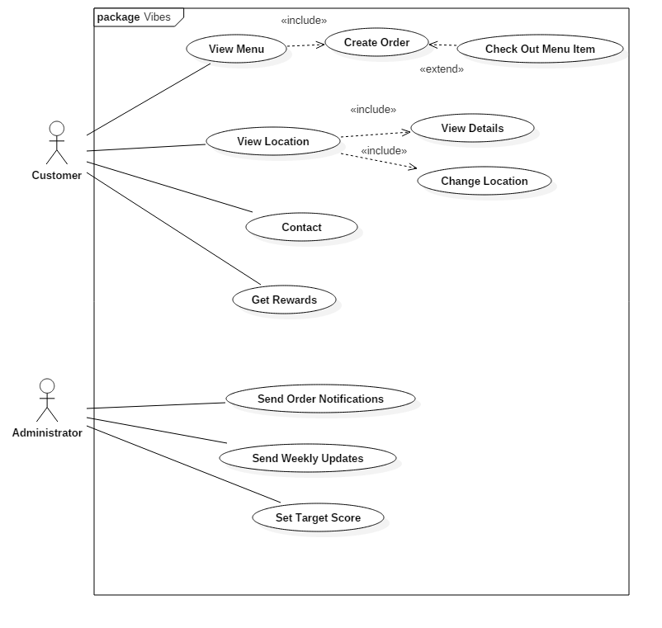
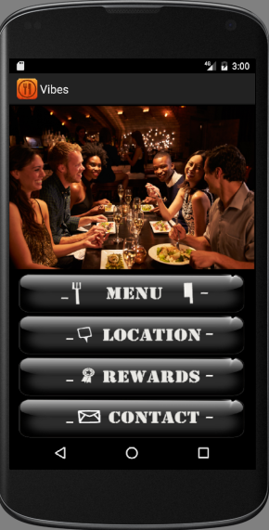
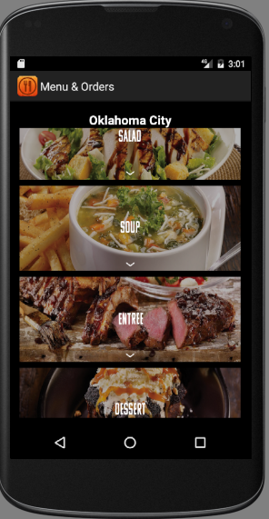
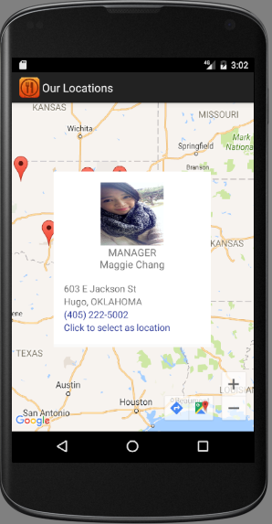
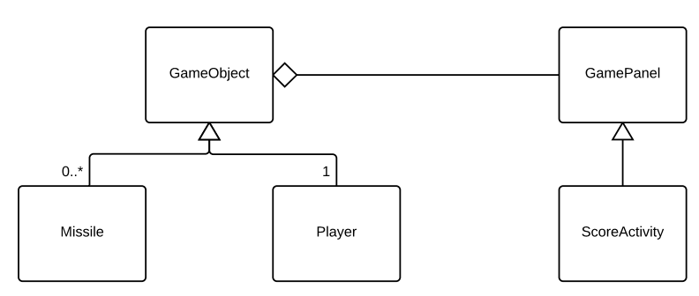
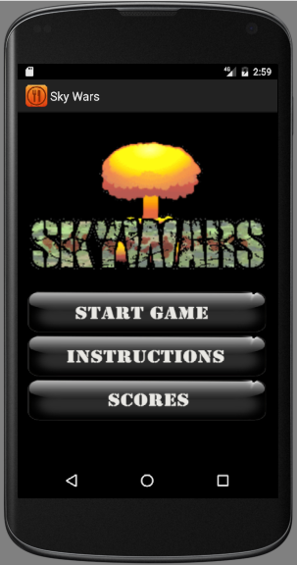
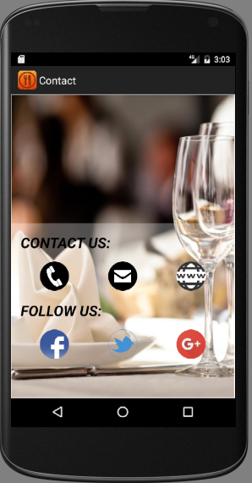
POSTER TITLE
Authors: STUDENT NAMES
(Faculty Advisor:)
1
PROBLEM AND MOTIVATION
3
METHODOLOGY
A number of restaurant apps incorporate a reward system through the number of purchases one has made. Much as this is a motivation for customers to make several orders, there is no concrete way to make them interested in the frequent use of the apps.
Google Maps Android API was used for the location functionality.
The observer design pattern was used to record game scores.
The Picasso library was used to handle image display rather than the traditional use of threads.
Android form edit text library from the maven central repository was used for data validation in forms.
The Material DateTime Picker library was used to display time and dates.
All libraries used for development were tested and compatible with Android versions 4.0 to 7.0.
2
BACKGROUND
Games with rewards incorporated in them have more people addicted to them because of the thrill of being rewarded after accomplishing a task. With this in mind, we designed an Android application that would provide the functions of a restaurant app but changed the reward system to be based on the points one made in the game incorporated within the app.
Fig 3: UML Use Case Diagrams showing general App functionality.
4
RESULT
The app could be used by customers to place orders, view restaurant locations with their details, contact restaurant managers and play games to acquire rewards.
Managers could use the app to send order notifications, restaurant updates and set weekly game target scores.
Fig 1: Observer Design Pattern.
Fig 2: App Screen Shots.

