Slide 1
MARIE vs x86 Calculator
Bibek Gupta
CMSC 3833
University of Central Oklahoma

Slide 2
Project Topic
a software for the MARIE architecture and x86 architecture (written in C then compiled to assembly)
Calculator with 4 ops (+,-,/,*)

Slide 3
Team Members
Bibek Gupta

Slide 4
Design
User friendly design
Accept any two integers
User input
Standard output

Slide 5
Implementation
Challenges
Creating new MULT instruction
Creating new DIV instruction
What I have done
Added new MULT instruction (MarieSim.java, Assembler.java)
Added new DIV instruction (MarieSim.java, Assembler.java)

Slide 6
Performance/Comparison
x86 assembly can do string manipulation with instructions which is not available MARIE.
In MARIE, it is difficult to print many user-friendly messages like printf function, we can print user-friendly messages through a printf like function in x86.
MARIE has very few instructions for basic calculator program which is not a case with x86. x86 has higher number of instructions compared to MARIE.

Slide 7
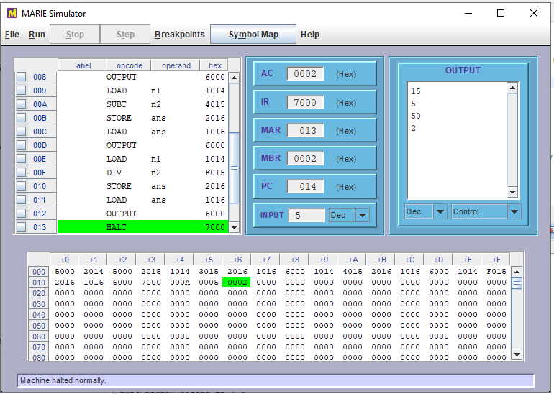
Demo

Slide 8
Conclusion
What I learned: implementation of calculator functions with the help of MARIE with some pre-defined instructions and by adding new instruction as well.
What I found: calculator execution at MARIE as well as x86 architecture

Slide 9
Thanks! Questions and Answers

