Slide 1
TRANSFORMING AMERICAN HEALTHCARE
A Six-Pillar Framework for System Transformation
Vermont as the National Template | April 2026
Health Transformation Review | htreview.com

Slide 2
PART I
THE FOUNDATION
Framework, Portrait, and Reader's Guide

Slide 3
CHAPTER 1
The Six-Pillar Framework
Health Transformation Review | Transforming American Healthcare

Slide 4
THE SIX-PILLAR TRANSFORMATION FRAMEWORK
1
POLICY
2
ECONOMICS
3
TECHNOLOGY
Mandatory architecture
for structural reform
Payment reform &
global budget design
Data infrastructure
for population health
4
CLINICAL
5
EQUITY
6
OPERATIONS
Care delivery redesign
for the transformed system
Closing gaps, not
just averaging them
Where strategy
becomes execution
All six must move together — single-pillar interventions consistently fail

Slide 5
WHY SINGLE-PILLAR INTERVENTIONS FAIL
SINGLE-PILLAR APPROACH → FAILS
SIX-PILLAR APPROACH → WORKS
Payment Reform Only
Policy enables Economics
Hospitals have no population health
infrastructure to respond
Mandatory RBP/global budgets remove voluntary opt-out by highest-cost actors
Clinical Redesign Only
Economics drives Clinical
Payment system penalizes utilization
reduction with lost revenue
Payment incentives align with population health model requirements
Technology Only
Technology enables all
Platforms deployed with no incentive
or capacity to use them
Data infrastructure makes population health management scalable
Equity Program Only
Equity monitors all
Structural drivers — access, payment,
SDOH — go unaddressed
Every pillar decision evaluated for equity implications — no blind spots
Chapter 1 — Source: CMMI evaluation literature; Oliver Wyman Act 167 Report

Slide 6
VERMONT'S SIX-PILLAR TRANSFORMATION MAP
Pillar | Primary Vermont Intervention | Act / Vehicle | Key Deadline
Policy | Acts 167 (2022), 51, 55, 68 (2025); AHEAD State Agreement | Vermont legislature + CMS | December 2028 Strategic Plan
Economics | Mandatory RBP (FY2027); Hospital global budgets (FY2028-2030); AHEAD TCOC | GMCB + DVHA | FY2027 / FY2028 / FY2030
Technology | VHCURES all-payer database; Vermont CIN; AHS-GMCB analytics vendor | GMCB + DVHA + AHS | Analytics vendor 2026
Clinical | Blueprint for Health (all-payer PCMH+CHT); CoCM; CCBHC expansion (7 entities) | DVHA + Blueprint + DMH | 5 new CCBHCs by July 2026
Equity | Geographic equity monitoring; SDOH integration; GLP-1 BALANCE decision | AHS + VDH + DVHA | BALANCE decision 2026
Operations | 14-hospital transformation plans; Vermont CIN shared services; PMO | AHS + 14 hospitals | Final plans early 2026
Chapter 1 — Source: Acts 167 & 68; AHEAD State Agreement; Vermont RHT Program Application

Slide 7
VERMONT'S LEGISLATIVE REFORM CASCADE 2022 – 2025
2022
Act 167
2023
Act 51
2025
(Spring)
Act 55
2025
(Summer)
Act 68
The Diagnosis Mandate
The Foundation
Drug Pricing Cap
The Mandate
Hospital systems analysis commissioned. Oliver Wyman engaged. Five goals established: reduce inefficiencies, lower costs, improve access, improve outcomes, reduce inequities.
Hospital sustainability assessments. CON process review. Framework for subsequent payment reform legislation.
$135M in annual drug savings. Hospital 340B reporting requirements. Act 55 drug cap: $104.3M in FY2026 savings.
Mandatory RBP (FY2027). Global budgets (FY2028-2030). Statewide Strategic Plan (December 2028). Health Care Delivery Advisory Committee.
Each Act builds on the institutional capacity and evidence created by its predecessor — the reform cascade structure
Chapter 1 / Chapter 4 — Source: Vermont Legislature; Act 167 (2022); Act 68 (2025)

Slide 8
CHAPTER 2
The Vermont System Portrait
Health Transformation Review | Transforming American Healthcare

Slide 9
VERMONT: THE DEMOGRAPHIC CRISIS IN DATA
647K
57%
−13%
Total population
Growth in 65+ population by 2040
Working-age population by 2040
2nd smallest US state by population
From 21.7% today to 30%+ of total
From 367K to ~318K — shrinking commercial base
97%
108%
9/14
Insured rate — one of the highest in US
Premium increase 2018–2024
Hospitals reporting losses (FY2023)
ACA + Medicaid expansion; yet still unaffordable
$456/month → $948/month; income grew only 22%
Worst performing: -8.9% operating margin
Chapter 2 — Source: Oliver Wyman Act 167 Report (2024); AHS January 2025 Legislative Presentation; Vermont RHT Application

Slide 10
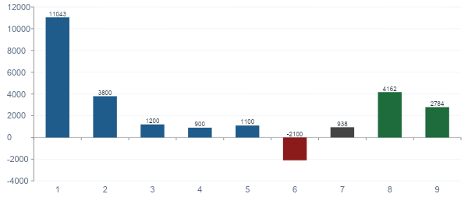
VERMONT HOSPITAL FINANCIAL POSITIONS: FY2023 vs. BENCHMARKS
Chapter 2 — Source: AHS Health Care System Transformation Report (November 2025); NASHP via CMS

Slide 11
VERMONT'S 14-HOSPITAL NETWORK: THREE-TIER STRUCTURE
Regional Specialty Centers (RSC)
TIER 1
UVMMC (16 COEs) | SW Vermont Medical | Brattleboro Memorial | Rutland Regional | Central VT Medical
Highest COE count. Accept referrals from the network for designated specialties. Financial sustainability strongest. Primary RSC role: UVMMC.
Community Hospitals — Focused Scope
TIER 2
NW Medical Center | NE VT Regional | Springfield | Copley | Mt. Ascutney | Porter Medical
2–4 COE designations. Maintain specific service lines. Transfer complex cases to RSCs. Actively engaged in Act 68 transformation planning.
Transition Assessment Required
TIER 3
Grace Cottage (19 beds) | Gifford Medical | North Country Hospital
Most financially vulnerable. REH conversion, CACC, or home-based care model under assessment. Act 68 transformation plans address transition path.
Chapter 2 / Chapter 8 — Source: Oliver Wyman Act 167 Report; AHS Transformation Reports 2025

Slide 12
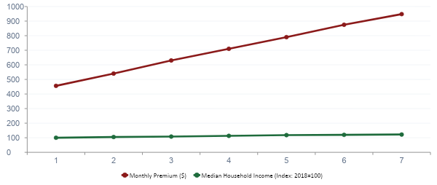
VERMONT PREMIUM vs. INCOME GROWTH 2018–2024: THE AFFORDABILITY GAP
108% premium increase vs. 22% income growth — the affordability crisis driving Vermont's transformation mandate
Chapter 2 — Source: AHS January 2025 Legislative Presentation; GMCB rate filings

Slide 13
PART II
THE SIX PILLARS IN DEPTH
Policy · Economics · Operations · Clinical · Equity · Technology

Slide 14
CHAPTER 4
The Policy Pillar — Legislative Architecture
Health Transformation Review | Transforming American Healthcare

Slide 15
OLIVER WYMAN'S THREE IMPERATIVES FOR VERMONT
230 community meetings · 14 hospital service areas · $1M analysis commissioned under Act 167
IMPERATIVE 1
IMPERATIVE 2
IMPERATIVE 3
BUILD HOUSING
AND FIX TRANSPORTATION
PAY WITH RBP AND
MOVE TO GLOBAL BUDGETS
MOVE CARE OUT
OF HOSPITALS
WHY:
WHY:
WHY:
Housing vacancy rate 3% (healthy = 5%). Half of renters cost-burdened. Provider recruitment impossible without housing. Transportation barriers = missed appointments = crisis presentations.
Commercial prices average 250-300% of Medicare. UVMMC outpatient: 417% of Medicare. Premium increased 108% in 6 years. Break-even: ~136% of Medicare.
32.3% of ED visits potentially avoidable. Hospital-centric model is financially unsustainable as demographics shift cost toward Medicare/Medicaid. Administrative overhead 91% above benchmark.
WHAT:
WHAT:
WHAT:
Advocacy for housing investment as healthcare policy. Transportation as a health equity intervention. Oliver Wyman's FIRST imperative — before payment reform.
Act 68 mandates RBP (FY2027) and hospital global budgets (FY2028-2030). AHEAD Model provides Medicare FFS global budget from January 2027.
Blueprint PCMH expansion. CCBHC network. CoCM behavioral health integration. RPM and telehealth for chronic disease management.
Chapter 4 — Source: Oliver Wyman Act 167 Community Engagement: Recommendations (August 2024)

Slide 16
ACT 68 OF 2025 — KEY PROVISIONS AND DEADLINES
Provision | Requirement | Deadline | Authority
FY2026 rate reduction | –1% commercial rate benchmark; $230.65M total regulatory reductions | FY2026 (ongoing) | GMCB
Transformation grants | $2M to hospitals for transformation plan development and implementation | September 2025 launch | AHS
Reference-Based Pricing | Mandatory maximum commercial rates for all Vermont hospitals | FY2027 (Oct 2026) | GMCB
Medicare global budgets | AHEAD Model Cohort 2; Medicare FFS global budgets for all hospitals | January 1, 2027 | AHS/CMS
Non-CAH global budgets | Prospective annual budgets for PPS hospitals | FY2028 (Oct 2027) | GMCB
All-hospital global budgets | CAHs included in mandatory global budget program | FY2030 (Oct 2029) | GMCB
Statewide Strategic Plan | Delivered to Legislature; updated every 3 years | December 1, 2028 | AHS + Advisory Committee
Chapter 4 — Source: Act 68 of 2025 (Vermont); GMCB Act 68 Update (February 2026)

Slide 17
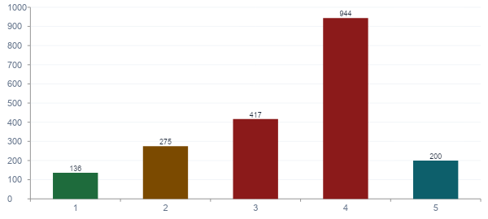
VERMONT HOSPITAL COMMERCIAL PRICES vs. MEDICARE (% of Medicare)
Act 68 RBP will set mandatory commercial maximum rates — ending the pricing that drives Vermont's 108% premium increase
Chapter 4 / Chapter 6 — Source: GMCB Act 68 RBP Update (February 2026); RAND Hospital Transparency; GMCB FY2026 data

Slide 18
THE AHEAD MODEL — VERMONT'S FEDERAL PARTNERSHIP (COHORT 2)
Hospital Global Budgets
Primary Care AHEAD
All Vermont hospitals receive prospective Medicare FFS global budgets from Jan 2027. Hospitals receive fixed revenue regardless of volume — incentive shifts to population health management.
Voluntary enhanced Medicare payments for PCMHs. Four payment pathways including fully prospective models. Replaces expiring Blueprint Medicare PMPM demonstration.
EAST Fund
Total Cost of Care Accountability
Up to $150M/year in additional Medicare funds for Vermont to invest in primary care, behavioral health, home health, long-term care, and SDOH programs — the transformation capital engine.
Vermont responsible for all-payer TCOC targets. State-level accountability with meaningful consequences after Year 3. 9-year model: January 2027 through December 2035.
KEY AGREEMENT TERMS: Signed January 17, 2025 · Vermont: Cohort 2 · Starts January 1, 2027 · 9-year model · Vermont may withdraw with 30-day notice (pre-launch) or 6-month notice (post-launch)
Chapter 4 — Source: AHEAD State Agreement (January 17, 2025); CMS AHEAD Model documentation

Slide 19
CHAPTER 5
The Policy Pillar in Practice — CMMI, Waivers, H.R.1
Health Transformation Review | Transforming American Healthcare

Slide 20
H.R. 1 — THE ONE BIG BEAUTIFUL BILL ACT: HEALTHCARE IMPACT
$911B
10M
$137B
$50B
Federal Medicaid spending cuts
over 10 years (CBO estimate)
Additional uninsured Americans
by 2034 (CBO)
Rural Medicaid spending reduction
over 10 years (KFF)
Rural Health Transformation
Program (5 years, 2026-2030)
THE FISCAL CLIFF PROBLEM
The RHT Program is FRONT-LOADED (2026-2030) while Medicaid cuts are BACK-LOADED — 64% of 10-year Medicaid reductions occur AFTER 2030 when the RHT fund expires. Vermont must use RHT capital to build structural efficiency by 2030, or face the Medicaid revenue cliff without the cost structure to absorb it.
Chapter 5 / Chapter 17 — Source: CBO; KFF H.R.1 Rural Health Analysis; Chartis 2026 State of Rural Health

Slide 21
CMMI MODEL SUCCESS FACTORS: WHY MOST FAIL AND SOME WORK
Factor | Successful Models | Failed Models
Mandatory participation | AHEAD, Maryland HSCRC, Vermont Act 68 — all providers must participate | Most CMMI ACOs, BPCI-A, bundled payments — highest-cost actors opt out
Two-sided risk (real) | ACO REACH full risk, AHEAD global budgets — meaningful downside | MSSP Track 1 (upside only), many bundles with minimal downside exposure
State regulatory alignment | AHEAD (designed with state agencies), Maryland HSCRC (built on existing authority) | Federal models imposed without coordinating with state Medicaid, insurance regulators
Implementation support | AHEAD cooperative agreement funds, Vermont RHRC engagement, pre-launch period | Models launched with insufficient runway — providers cannot redesign care before accountability begins
Chapter 5 — Source: HTR analysis of CMMI evaluation literature; CMS model documentation; 2023 independent CMMI evaluation

Slide 22
SECTION 1115 WAIVERS — THE STATE'S PRIMARY FEDERAL POLICY TOOL
Coverage Expansions
National: Extending Medicaid to populations not otherwise eligible; non-traditional benefit structures
Vermont: Vermont Global Commitment to Health: expanded coverage beyond standard state plan requirements
Payment Reform
National: Global budgets, ACO arrangements, APMs for Medicaid not permitted under standard rules
Vermont: Vermont's Medicaid hospital global budgets under AHEAD alignment operate via Global Commitment demonstration
SDOH Investments
National: Housing supports, food assistance, transportation for high-risk Medicaid enrollees
Vermont: Vermont HRSN amendment authorizes Medicaid-funded social services connected to Blueprint HRSN screening
Budget Neutrality Constraint
National: Federal spending cannot exceed what it would have been without the waiver — negotiated baseline
Vermont: AHEAD methodology for Vermont's Medicaid global budget baseline is a critical negotiated parameter with major financial consequences
Chapter 5 — Source: CMS 1115 waiver framework; Vermont Global Commitment to Health demonstration; Act 68 of 2025

Slide 23
“The RHT funding is a tool that lets us put affordability plans into action. This is not our health care reform plan. This is an opportunity that we’ll use to support all of the health care reform work that we’re already doing in the state.”
— Jenney Samuelson, Vermont AHS Secretary | January 2026
CHAPTERS 4, 5, 11, 17 — The Transformation Imperative

Slide 24
CHAPTER 6
The Economics Pillar — Global Budgets & RBP
Health Transformation Review | Transforming American Healthcare

Slide 25
FEE-FOR-SERVICE vs. GLOBAL BUDGET: THE INCENTIVE REVOLUTION
FEE-FOR-SERVICE
GLOBAL BUDGET
Revenue per discharge — MAXIMIZE
Cost per discharge — MINIMIZE UNNECESSARY COST
Admission volume — MORE = MORE REVENUE
Avoidable admission rate — LOWER IS BETTER
Length of stay — LONGER = MORE REVENUE
Efficient LOS — UNNECESSARY DAYS = COST
Service line volume — GROW PROFITABLE LINES
PMPM population health cost — STAY IN BUDGET
Payer mix — MORE COMMERCIAL = BETTER
Quality performance — DETERMINES ADJUSTMENTS
Denials management — RECOVER DENIED CLAIMS
Potentially avoidable utilization — PREVENT THEM
Case mix index — CAPTURE HIGHER ACUITY
Community investment ROI — SDOH PROGRAMS SAVE MONEY
Chapter 6 / Chapter 7 — Source: HTR Economics Pillar framework; Maryland HSCRC experience

Slide 26
MARYLAND'S GLOBAL BUDGET PROOF OF CONCEPT
Maryland Health Services Cost Review Commission — results after 10+ years of all-payer global hospital budgets
$1.4B
−7%
30yr
#1
Medicare savings generated
Hospital admission rate reduction
Duration of global budget model
Medicare per-capita spending rank
Cumulative savings vs. national trend
Compared to national average trajectory
Longest-running all-payer hospital budget system
Maryland moved from high-cost to lowest-cost state
WHAT MARYLAND PROVES FOR VERMONT
Global budgets can produce documented Medicare savings and utilization reduction. The model requires: (1) Mandatory participation — no opt-out. (2) All-payer design — Medicare, Medicaid, and commercial aligned. (3) State regulatory authority — Maryland's HSCRC has 30 years of institutional capacity. Vermont's GMCB is building this capacity now.
Chapter 6 — Source: Maryland HSCRC; CMMI AHEAD Model documentation

Slide 27
VERMONT'S TOTAL COST OF CARE ACCOUNTABILITY ARCHITECTURE
FEDERAL LAYER
AHEAD Model TCOC Target
CMS sets state-level total cost of care benchmark for Vermont Medicare FFS. Vermont accountable for staying below benchmark. Consequences after Year 3. Up to $150M/year EAST Fund.
STATE LAYER
GMCB Global Hospital Budgets
Each Vermont hospital receives a prospective annual budget for Medicare FFS. Fixed revenue regardless of volume. Incentive: efficient population health management. Mandatory from FY2028.
PRIMARY CARE LAYER
Primary Care AHEAD Enhanced Payments
Vermont PCMH practices receive enhanced prospective Medicare payments under PC AHEAD pathways. Replaces expiring Blueprint Medicare PMPM demonstration. Voluntary — encourages expansion.
INVESTMENT LAYER
EAST Fund — Transformation Capital
Vermont receives up to $150M/year in additional Medicare funds for primary care, behavioral health, SDOH, home health, long-term care investments that the payment reform requires.
Chapter 6 — Source: AHEAD State Agreement (January 2025); Act 68 of 2025; GMCB RBP Update (February 2026)

Slide 28
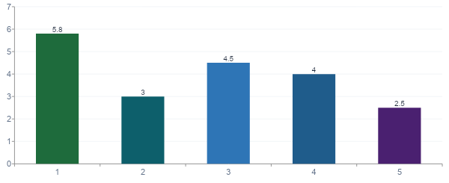
THE FINANCIAL RETURN ON PREVENTION UNDER GLOBAL BUDGETS
Under FFS, prevention costs money. Under global budgets, prevention saves money. Vermont's Blueprint proves the ROI — $5.8M reduction in medical expenditure per $1M invested (Population Health Management journal).
Chapters 6 & 7 — Source: Population Health Management (Blueprint ROI study); HTR Economics Pillar framework

Slide 29
CHAPTER 8
The Operations Pillar — Hospital System Transformation
Health Transformation Review | Transforming American Healthcare

Slide 30
VERMONT HOSPITAL PERFORMANCE vs. NATIONAL BENCHMARKS (2023)
Measure | Vermont | Benchmark | Gap | Status
30-Day Readmission Rate | 14.8% | 14.5% | +0.3% | OK
Potentially Avoidable ED Visits | 32.3% | No national benchmark yet | Major opportunity | ACTION
Operating Profit / Adj. Discharge (PPS) | $5,345 | $4,162 | +$1,183 above benchmark | OK
Operating Profit / Adj. Discharge (CAH) | $938 | $2,784 | −$1,846 BELOW benchmark | CRITICAL
Mgmt & Admin Cost / Adj. Discharge (PPS) | $2,730 | $1,427 | +$1,303 excess (91% above) | CRITICAL
Vermonters with Personal Health Provider | 91% | 87% national avg | +4% above benchmark | STRONG
PCPs Accepting New Medicaid Patients | 59% | Not set | Access gap for Medicaid patients | ACTION
ED Visits for MH/SIH per 10K ED visits | 245.5 | Not set nationally | High in Rutland, Windham counties | ACTION
Chapter 8 — Source: AHS Health Care System Transformation Report (November 2025); NASHP via CMS; VDH

Slide 31
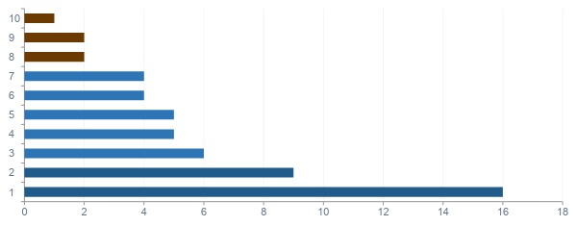
VERMONT CIN: COE SPECIALTY CONCENTRATION BY HOSPITAL
Tier 1 — Regional Specialty Centers (RSCs)
Tier 2 — Focused Scope Community Hospitals
Tier 3 — Transition Assessment Required
Chapter 8 — Source: Oliver Wyman Act 167 Report (2024); AHS Hospital Transformation Plans

Slide 32
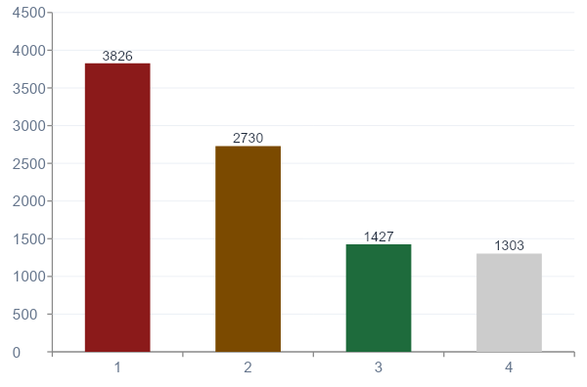
THE ADMINISTRATIVE COST PREMIUM — VERMONT'S $1,303 PER-DISCHARGE GAP
WHAT THIS MEANS
• Vermont PPS hospitals spend 91% MORE on administration than efficient peers
• This $1,303/discharge gap = primary operational inefficiency target
• Shared services through Vermont CIN can close this gap
• Oliver Wyman: administrative reduction contributes >$100M of $400M+ transformation savings target
• AI scribes + credentialing automation + group purchasing = the operations playbook
Chapter 8 — Source: AHS November 2025 Transformation Report; NASHP via CMS; Oliver Wyman Act 167 Report

Slide 33
THE RHRC METHODOLOGY — TECHNICAL ASSISTANCE FOR 14 HOSPITALS
Rural Health Redesign Center engagement — May through October 2025
Financial & Operational Baseline
Priority Identification
1
Hospital-specific cost data from GMCB financial records and CMS cost reports. Position vs. Vermont average and national benchmark on key efficiency metrics.
2
Working with hospital leadership to identify highest-leverage short-term cost reduction opportunities and medium-term transformation priorities.
Transformation Plan Development
Regional Coordination
3
Structured plans mapping specific actions to timelines, costs, and Act 167 outcome objectives. Hospital sustainability and cost analysis through service line review.
4
Connecting hospital-level planning to the statewide regional work. Ensuring individual plans are compatible with neighboring hospital plans. Identifying shared service opportunities.
Chapter 8 — Source: AHS November 2025 Transformation Report; AHS Health Care Transformation website

Slide 34
CHAPTER 10
The Clinical Pillar — Redesigning Care Delivery
Health Transformation Review | Transforming American Healthcare

Slide 35
VERMONT BLUEPRINT FOR HEALTH — 15 YEARS OF RESULTS
$5.8M
100%
Reduction in medical expenditure
Vermont PCMHs recognized by NCQA
Per $1M invested in Blueprint — documented 5.8:1 ROI (Population Health Management journal)
All participating practices meet NCQA Patient-Centered Medical Home standards
77%
91%
Hypertension controlled in PCMH patients
Vermonters with a personal provider
Blueprint quality metric; 4 points above national benchmark
4 points above the 87% national benchmark — Blueprint's access foundation
Chapter 10 — Source: Population Health Management (2016 Blueprint ROI study); AHS November 2025 Transformation Report

Slide 36
COLLABORATIVE CARE MODEL (CoCM) — THE BEHAVIORAL HEALTH INTEGRATION STANDARD
The only integrated care model with 90+ randomized controlled trials and designated Medicare billing codes (CPT 99492, 99493, 99494)
Primary Care Provider
(PCP)
Behavioral Health Care
Manager (BHCM)
Psychiatric
Consultant
Treating & billing provider
Day-to-day care coordinator
Clinical supervision
Identifies patients via validated screening (PHQ-9, GAD-7). Provides warm handoffs. Bills CoCM codes monthly. Retains clinical ownership.
Maintains patient registry. Provides brief interventions. Monitors treatment response with validated scales. Escalates to psychiatric consultant as needed.
Regular case review with BHCM. Consultation on treatment recommendations. Direct care for highest-acuity cases only — one psychiatrist supports an entire practice.
Vermont application: Blueprint MHI pilot — 80% of administrative entities increased CHT staffing | BHCM positions the natural CHT deployment
Chapter 10 — Source: SAMHSA CoCM Program; CMS Behavioral Health Integration Services (January 2026); Vermont Blueprint MHI Evaluation (2025)

Slide 37
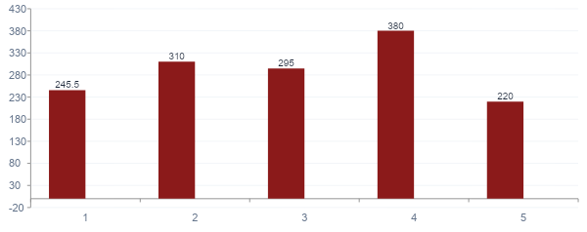
VERMONT BEHAVIORAL HEALTH CRISIS: ED PRESENTATIONS BY COUNTY
245.5 ED visits per 10,000 for suicide ideation/self-harm — the clearest evidence of behavioral health access failure. 5 new CCBHCs by July 2026 and permanent CoCM funding through AHEAD EAST Fund are the operational response.
Chapter 10 — Source: AHS November 2025 Transformation Report; VDH ED surveillance data

Slide 38
VERMONT'S THREE-LAYER BEHAVIORAL HEALTH ARCHITECTURE
Layer 1
Mental Health Integration in Primary Care
CoCM + Blueprint MHI pilot: behavioral health care managers embedded in PCMH practices. PHQ-9/GAD-7 screening. Brief intervention. 80% of Blueprint administrative entities increased CHT staffing in MHI pilot.
Funding vehicle: AHEAD EAST Fund (permanent MHI funding) + Blueprint PCMH
Layer 2
Certified Community-Based integrated Health Centers (CCBHCs)
Vermont CCBHC Demonstration State since 2024. 2 operational as of 2025. 5 new entities by July 2026 (RHT Program). Serve all patients regardless of insurance status. Comprehensive behavioral health including crisis intervention, SUD treatment, care coordination.
Funding vehicle: CCBHC Demonstration enhanced Medicaid + RHT Program grants
Layer 3
Crisis System and Acute Behavioral Health
Mobile crisis (operational January 2024). 988 Suicide and Crisis Lifeline centralized dispatch. 6 Designated Hospitals with inpatient psychiatric units. Brattleboro Retreat: primary psychiatric hospital. Hospital-level youth MH beds added under Act 167 actions.
Funding vehicle: State funding + Medicaid + Act 167 mandatory actions
Chapter 10 — Source: Vermont DMH CCBHC Program; Vermont Blueprint MHI Evaluation; AHS Transformation Reports

Slide 39
CHAPTER 11
The AHS Restructuring Roadmap
Health Transformation Review | Transforming American Healthcare

Slide 40
THE FOUR AHS ORGANIZATIONAL GAPS OLIVER WYMAN IDENTIFIED
Gap 1: Program-Silo Structure
Gap 2: No Planning & Effectiveness Function
Problem: Organized around program types (Medicaid, mental health, SUD, aging), not geographic service areas. A hospital working on housing + MH + primary care must navigate 4+ AHS programs.
Problem: No analytical unit to model financial/access impact of service changes, evaluate hospital proposals, or monitor whether transformation investments are producing results.
Fix: Designate HSA-level AHS Coordinators who convene all relevant programs around each hospital's transformation plan.
Fix: Establish Division of Planning and Effectiveness. Joint AHS-GMCB analytics vendor (procurement underway 2025-2026).
Gap 3: Under-Resourced Transformation Mgmt
Gap 4: Fragmented SDOH Integration
Problem: AHS must simultaneously manage AHEAD, 14 hospital plans, RHT Program ($195M), GMCB coordination, and monthly legislative reporting. Insufficient staff for this portfolio.
Problem: Housing, transportation, food assistance programs are separate from healthcare transformation goals. Cannot demonstrate SDOH → healthcare utilization reduction link.
Fix: Hire dedicated transformation staff using RHT Program funds (explicitly authorized). Establish Project Management Office.
Fix: Cross-program SDOH integration protocols. HSA Coordinator model links health and social services. VHCURES linkage to social service data.
Chapter 11 — Source: Oliver Wyman Act 167 Report (2024); AHS November 2025 Transformation Report

Slide 41
THE REDESIGNED AHS: THREE-LEVEL POPULATION HEALTH OPERATING MODEL
Level 1
Strategic direction and six-pillar framework • Payment reform trajectory (with GMCB) • Capital allocation: RHT, EAST Fund, Act 68 grants
STATEWIDE SYSTEM ARCHITECT
Federal relationship management (CMS, HRSA, CMMI) • Accountability framework and monthly reporting • Statewide Strategic Plan development (Dec 2028)
Level 2
HSA Coordinator for each of 14 Hospital Service Areas • Cross-program coordination: DVHA, DMH, Blueprint, ADS, DAIL • Hospital transformation plan integration and support
REGIONAL NETWORK CONVENER (14 HSAs)
Regional analytics using CIN analytics platform • Community engagement: hospitals, FQHCs, CBOs, SDOH programs
Level 3
Medicaid (DVHA): AHEAD alignment, global budget Medicaid component • Blueprint for Health: PCMH expansion, MHI, CHT network • DMH: CCBHC development, crisis system, SUD continuum
PROGRAM DELIVERY OPERATOR
SDOH programs: cross-program integration via HSA Coordinator layer
Chapter 11 — Source: Oliver Wyman Act 167 Report; Act 68 of 2025; AHS Health Care Delivery Advisory Committee mandate

Slide 42
VERMONT 2028 STATEWIDE STRATEGIC PLAN — PROPOSED STRUCTURE
Plan Section | Key Commitment Required
Executive Summary — Vermont's crisis, progress, central commitments | Quantified 2031/2035/2040 trajectory — specific, not aspirational
Section 1: System Context — Updated diagnosis as of 2028 baseline | Hospital financial positions updated with post-RBP/global budget data
Section 2: Payment Reform Architecture — RBP status, global budgets, AHEAD | RBP and global budget dollar savings documented by payer and HSA
Section 3: Primary Care & Behavioral Health — Blueprint, CCBHC, CoCM | AHEAD primary care investment % target vs. baseline
Section 4: Hospital Network & Regionalization — Tier designations, COE status | Confirmed tier designations — all 14 hospitals
Section 5: Data & Technology Infrastructure — VHCURES, HIE, analytics | VHCURES-VHIE integration status; statewide EHR decision
Section 6: Health Equity Strategy — Geographic, racial, SDOH equity | Disparity metrics by county — Northeast Kingdom as priority
Section 7: Workforce Strategy — Supply, deployment, retention | 370 FTE gap plan with RHT workforce investment tracking
Section 8: AHS Organizational Architecture — HSA Coordinators, PMO | HSA Coordinator deployments confirmed; PMO operational
Section 9: Accountability Framework — 17+ Act 167/68 metrics | Performance targets for 2028-2031 on all 17+ measures
Section 10: Financial Plan — RHT balance, EAST Fund, projected savings | Capital allocation plan; projected system savings vs. Oliver Wyman baseline
Chapter 11 — Source: Act 68 of 2025; HTR six-pillar framework; Health Care Delivery Advisory Committee mandate

Slide 43
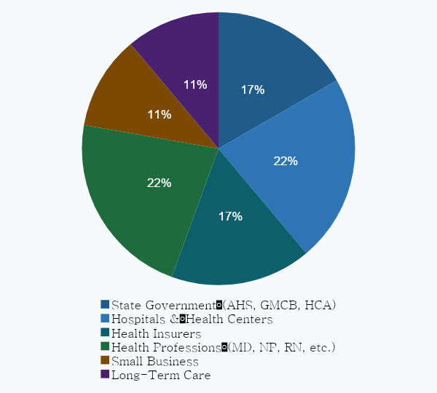
HEALTH CARE DELIVERY ADVISORY COMMITTEE — ACT 68 MANDATE
PRIMARY RESPONSIBILITIES:
• Set affordability benchmarks
• Monitor system performance
• Develop Statewide Strategic Plan (with AHS)
• Incorporate Comprehensive Primary Health Care Steering Committee recommendations
• Advise GMCB on continuous evaluation process
• Provide coordinated recommendations to General Assembly
• Consult with Health Equity Advisory Commission
Chapter 11 — Source: Act 68 of 2025; healthcarereform.vermont.gov/health-care-reform-delivery-advisory-committee

Slide 44
CHAPTER 12
The Equity Pillar — Closing Gaps
Health Transformation Review | Transforming American Healthcare

Slide 45
VERMONT'S GEOGRAPHIC EQUITY DISPARITIES — KEY COUNTY DATA
County / Region | Uninsured Rate | Key Disparity | Priority
Vermont statewide | ~3% | Baseline | Reference
Essex County (NE Kingdom) | ~8% — nearly 3× statewide | Highest uninsurance, most rural, highest poverty | CRITICAL
Orleans County (NE Kingdom) | 6-7% | Limited provider access; North Country Hospital vulnerable | HIGH
Caledonia County (NE Kingdom) | 5-6% | NE VT Regional Hospital serves area; financial fragility | HIGH
Rutland County | ~3.5% | Higher opioid overdose rates; above-avg MH crisis ED presentations | ELEVATED
Windham County | ~4% | Higher suicide/SH and opioid rates; SUD corridor with Springfield Hospital | ELEVATED
Chittenden County (Burlington) | ~2.5% | Best-served county; UVMMC anchor | BASELINE
Black adults (statewide) | ~18% uninsured (vs. 6% white adults) | 82% have insurance vs. 94% statewide; 80% have personal provider vs. 91% | SIGNIFICANT
Chapter 12 — Source: Vermont Department of Health Health Equity Report (January 2025); Vermont RHT Application; AHS November 2025 Report

Slide 46
HEALTH DISPARITY ROOT CAUSE TAXONOMY — MATCHING INTERVENTIONS TO CAUSES
1
2
3
4
5
Geographic
Access Barriers
Social Needs
Barriers
Clinical Practice
Variation
Coverage & Cost
Barriers
Trust &
Engagement Barriers
MECHANISMS:
MECHANISMS:
MECHANISMS:
MECHANISMS:
MECHANISMS:
Distance; transportation; provider shortage; broadband gaps; limited hours
Housing instability; food insecurity; transportation; economic stress
Weight bias; racial bias in treatment; cultural incompetence; language barriers
High deductibles; copays causing care avoidance; coverage gaps (GLP-1s for obesity)
Discrimination in care; stigma; historical mistreatment; lack of culturally competent providers
INTERVENTIONS:
INTERVENTIONS:
INTERVENTIONS:
INTERVENTIONS:
INTERVENTIONS:
COE regionalization + EMS; telehealth (RHT); broadband investment; Blueprint expansion
AHEAD EAST Fund SDOH; Blueprint HRSN screening; AHS HSA Coordinators; CHW deployment
Provider diversity recruitment; implicit bias training; standardized protocols; patient advisory councils
Act 68 affordability benchmarks; RBP premium passthrough; BALANCE Model GLP-1 decision
CHWs from served communities; HEART program (LGBTQ+); BIPOC community partnerships; CCBHCs
Chapter 12 — Source: HTR Equity Pillar framework; Vermont Department of Health; Oliver Wyman Act 167 Report

Slide 47
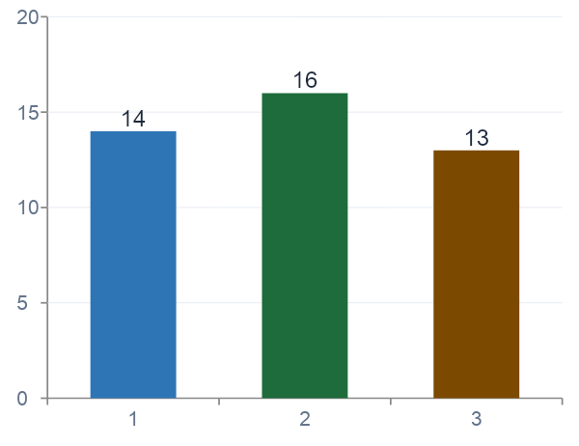
THE GLP-1 ACCESS EQUITY CRISIS — WHO GETS TRANSFORMATIVE OBESITY DRUGS
CMS BALANCE Model (Dec 2025)
Voluntary model for Medicaid agencies to cover GLP-1s for obesity at negotiated prices. Launch: May 2026. Vermont DVHA must opt in.
Drug Costs After Negotiation
IRA negotiated price: $274/month (effective 2027) vs. $1,000+ list price. Still out of reach without Medicaid coverage for Vermont's lowest-income patients.
Vermont's Equity Decision
Vermont Medicaid covers GLP-1s for diabetes but NOT obesity. BALANCE opt-in is an equity policy choice: Medicaid patients have higher obesity, diabetes, and cardiovascular disease rates.
Chapter 12 — Source: KFF GLP-1 Medicaid Coverage Analysis (January 2026); CMS BALANCE Model (December 2025)

Slide 48
VERMONT EQUITY ACCOUNTABILITY FRAMEWORK — 2028 STRATEGIC PLAN TARGETS
Equity Indicator | Stratification | Current Status | Target Direction
Uninsured rate | By county (focus: Essex, Orleans, Caledonia) | Essex: ~8% vs. 3% statewide | Reduce NE Kingdom gap toward statewide 3% by 2030
Primary care access rate | By race/ethnicity (BIPOC vs. white) | BIPOC adults: 79-81% vs. 91% statewide | Reduce gap — target 87%+ for all race/ethnicity groups
Potentially avoidable ED visits | By county; by income quintile | 32.3% statewide — higher in rural counties | Track NE Kingdom rate; reduce toward statewide average
30-day MH/SUD follow-up | By county; by race/ethnicity | 76% MH / 68% SUD — gaps in Rutland, Windham | Increase toward 85%+ in all counties
GLP-1 access for Medicaid enrollees | By income; by county | Not covered for obesity indication | BALANCE Model opt-in decision 2026
SDOH screening completion | By HSA; by patient demographics | Operational in Blueprint PCMHs; not uniform | Universal completion in all Blueprint PCMHs by 2027
Emergency response time | By county (focus: NE Kingdom) | No current baseline | Establish baseline; track improvement via EMS regionalization
Chapter 12 — Source: Act 167; Act 68; VDH Health Equity Data Report (January 2025); AHS November 2025 Transformation Report

Slide 49
CHAPTER 14
The Technology Pillar — Data Infrastructure
Health Transformation Review | Transforming American Healthcare

Slide 50
VERMONT'S TARGET TECHNOLOGY ARCHITECTURE — FIVE LAYERS
Layer 5
Advanced Analytics & AI Applications
Population health analytics platform (AHS-GMCB) · AI scribe grants (RHT) · Diagnostic AI (CIN) · RPM · Price transparency
Layer 4
Population Health Management
Blueprint clinical data registry · Attribution management · SDOH screening data · CHT care coordination registry
Layer 3
Integrated Health Record (Target State)
VHCURES-VHIE integration · MH and SUD data (42 CFR Part 2 compliant) · SDOH data · Single patient identity
Layer 2
Data Exchange Infrastructure
Vermont VHIE/VITL · FHIR R4 APIs · Vermont CIN data standards · CommonWell/Carequality national connectivity
Layer 1
Core Data Assets (Foundation)
VHCURES (100% Medicare/Medicaid; 60% commercial) · VUHDDS (14 hospitals) · 4 EHR platforms · Blueprint clinical registry · GMCB regulatory data
Chapter 14 — Source: GMCB VHCURES documentation; Vermont HIE Strategic Plan; Oliver Wyman Report; Vermont RHT Application

Slide 51
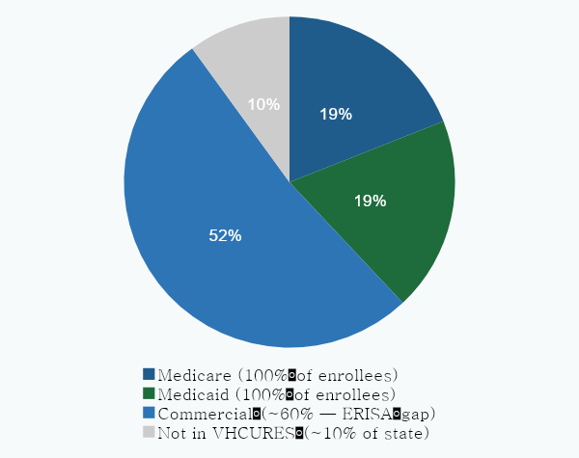
VHCURES — VERMONT'S ALL-PAYER CLAIMS DATABASE: COVERAGE AND GAPS
ERISA Gap (~40% of commercial)
Self-insured employers cannot be required by states to submit data (federal law). Many large Vermont employers excluded.
Impact: Total cost of care calculations systematically undercount commercially insured population.
12-18 Month Data Lag
Most VHCURES data reflects conditions 12-18 months prior. November 2025 AHS report acknowledged most measures reflect 2023 or earlier.
Impact: Cannot manage global budgets in real-time. AHS-GMCB analytics vendor procurement addresses this.
No Behavioral Health / SDOH Data
MH/SUD records governed by 42 CFR Part 2. Social service utilization not in VHCURES.
Impact: Cannot link housing/transportation/food programs to healthcare outcomes — breaks SDOH → utilization analysis.
Chapter 14 — Source: GMCB VHCURES documentation; Oliver Wyman Act 167 Report; AHS November 2025 Transformation Report

Slide 52
VERMONT'S THREE PRIORITY FHIR USE CASES — FROM STANDARD TO WORKING SYSTEM
Patient Access API — §170.315(g)(10) compliance
1
Enables: Patients access their health records through third-party apps. Required by CMS for hospitals and clinicians receiving Medicare/Medicaid payments.
Vermont: All Vermont hospitals must be compliant. Monitor smaller CAHs without robust IT departments.
Provider Access API — Care coordination across CIN
2
Enables: Care coordinators at one organization can query clinical records from another for shared patients. Enables real-time cross-facility care coordination.
Vermont: Priority RHT IT investment. Enables inter-hospital care coordination that regionalization blueprint requires.
Payer-to-Provider API — Electronic prior authorization
3
Enables: FHIR-based prior authorization eliminates manual PA. Formulary exchange reduces prescription errors. Uses Da Vinci CRD and DTR implementation guides.
Vermont: Accelerates Vermont's PA reform agenda. GMCB should require payer FHIR API compliance as condition of rate approval.
Chapter 14 / Chapter 15 — Source: CMS Interoperability Rule; ONC 21st Century Cures Rule; Vermont RHT Application; HTR Technology framework

Slide 53
AI SCRIBE TECHNOLOGY — WORKFORCE MULTIPLIER FOR VERMONT'S RURAL PRACTICES
2+ hrs
370 FTE
Daily documentation time saved per provider
Vermont primary care shortage by 2030
AI scribe automates transcription of clinical encounters
AI scribe = equivalent capacity gain without hiring
>25%
$195M
Effective capacity gain per provider
RHT Program — includes AI scribe grants
At 8 patients/day, 2 hours saved = 4+ additional appointments
Explicitly for rural/independent practices that can't afford enterprise pricing
Chapter 14 — Source: Vermont RHT Application; JAMA Network Open ambient scribe study (2024); National Consortium Telehealth (2026)

Slide 54
CHAPTER 17
The Future — 2026 and Beyond
Health Transformation Review | Transforming American Healthcare

Slide 55
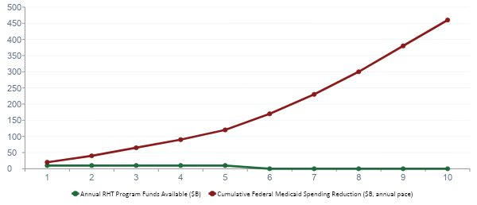
THE RURAL HEALTH FISCAL CLIFF: RHT FUNDS vs. MEDICAID CUT TIMELINE
64% of Medicaid cuts hit AFTER 2030 when RHT funds expire. Vermont must achieve structural efficiency by 2030 to survive the back-loaded cuts.
Chapter 17 — Source: KFF 'A Closer Look at the $50B Rural Health Fund' (September 2025); CBO H.R.1 estimate; HTR analysis

Slide 56
VERMONT 2026–2030: TWO SCENARIOS
TRANSFORMATION SUCCESS SCENARIO
PARTIAL TRANSFORMATION SCENARIO
FY2027: RBP implemented. First premium growth slowdown in a decade.
FY2027: RBP contested — UVMMC seeks legislative relief. Modified glide path.
FY2028: Non-CAH global budgets operational. AHEAD delivers population health improvements.
FY2028: Global budget methodology not finalized. Deadline extended.
2028: AHS delivers Strategic Plan with specific quantified commitments.
2028: Strategic Plan descriptive, not prescriptive — identifies questions, avoids commitments.
2030: RHT capital fully deployed. Medicaid cuts absorbed through efficiency gains.
2030: RHT capital partially for operations support, not structural transformation.
2031-35: Vermont as national template. AHEAD expands nationally using Vermont evidence.
2031-35: Transformation real but incomplete. Second reform wave required.
Chapter 17 — Source: HTR analysis; Oliver Wyman Act 167 Report; Vermont AHEAD State Agreement; Act 68 of 2025

Slide 57
SIX-PILLAR FORECAST 2026–2035: HEADWINDS AND TAILWINDS
Pillar | Primary Headwind | Primary Tailwind | 2035 Outlook
Policy | H.R.1 Medicaid cuts; federal policy instability; work requirements | AHEAD expanding; mandatory RBP/global budgets; price transparency momentum | Moderate national progress; Vermont high if execution holds
Economics | Medicaid revenue reductions; GLP-1 spending wave | RBP producing savings; IRA drug negotiation; ACO REACH maturing | VBC reaches 70-75% commercial by 2030; global budgets beyond Vermont/MD limited
Technology | Data lag; AI governance absent; FHIR incomplete at smaller facilities | CIN analytics; RHT IT grants; ambient AI reducing burden; FHIR maturing | Fastest-improving pillar nationally; AI governance the critical risk
Clinical | Primary care workforce shortage; MHI sustainability; PACE gap | Blueprint + AHEAD primary care investment; CCBHC expansion; CoCM billing | Steady improvement nationally; Vermont has country's strongest primary care infrastructure
Equity | H.R.1 coverage losses hitting most vulnerable; federal equity funding cuts | BALANCE GLP-1; CCBHC access policy; HRSN screening; Act 68 equity requirements | Highest-risk pillar nationally; explicit equity targets in Vermont Strategic Plan essential
Operations | Hospital transformation pace; AHS capacity gaps; administrative complexity | $195M RHT; all 14 hospitals engaged; GMCB capacity added; CIN shared services | Vermont: transformation underway; question is whether execution matches deadlines
Chapter 17 — Source: HTR analysis; KFF; Chartis 2026; Oliver Wyman; Vermont AHEAD Agreement; Act 68 of 2025

Slide 58
VERMONT IS NOT JUST VERMONT.
It is every state,
ten to twenty years from now.
The forces producing Vermont's crisis — demographic aging, hospital financial fragility,
commercial cross-subsidy collapse, voluntary reform failure — are present nationally.
Health Transformation Review | Transforming American Healthcare | April 2026 | htreview.com

