Slide 1
1. What type of galaxy is the Milky Way? How far away is the Solar System from the center of the Milky Way? How fast is the Sun orbiting the Milky Way?
2. What is Proxima b (and c!) and why is it an exciting discovery?
3. What are the mission goals of the spacecraft Juno?
4. What problems exist in sending people to Mars or any space travel?
5. Where else besides Earth is liquid water thought to exist?
6. What are the mission goals of the spacecraft New Horizons?

Slide 2
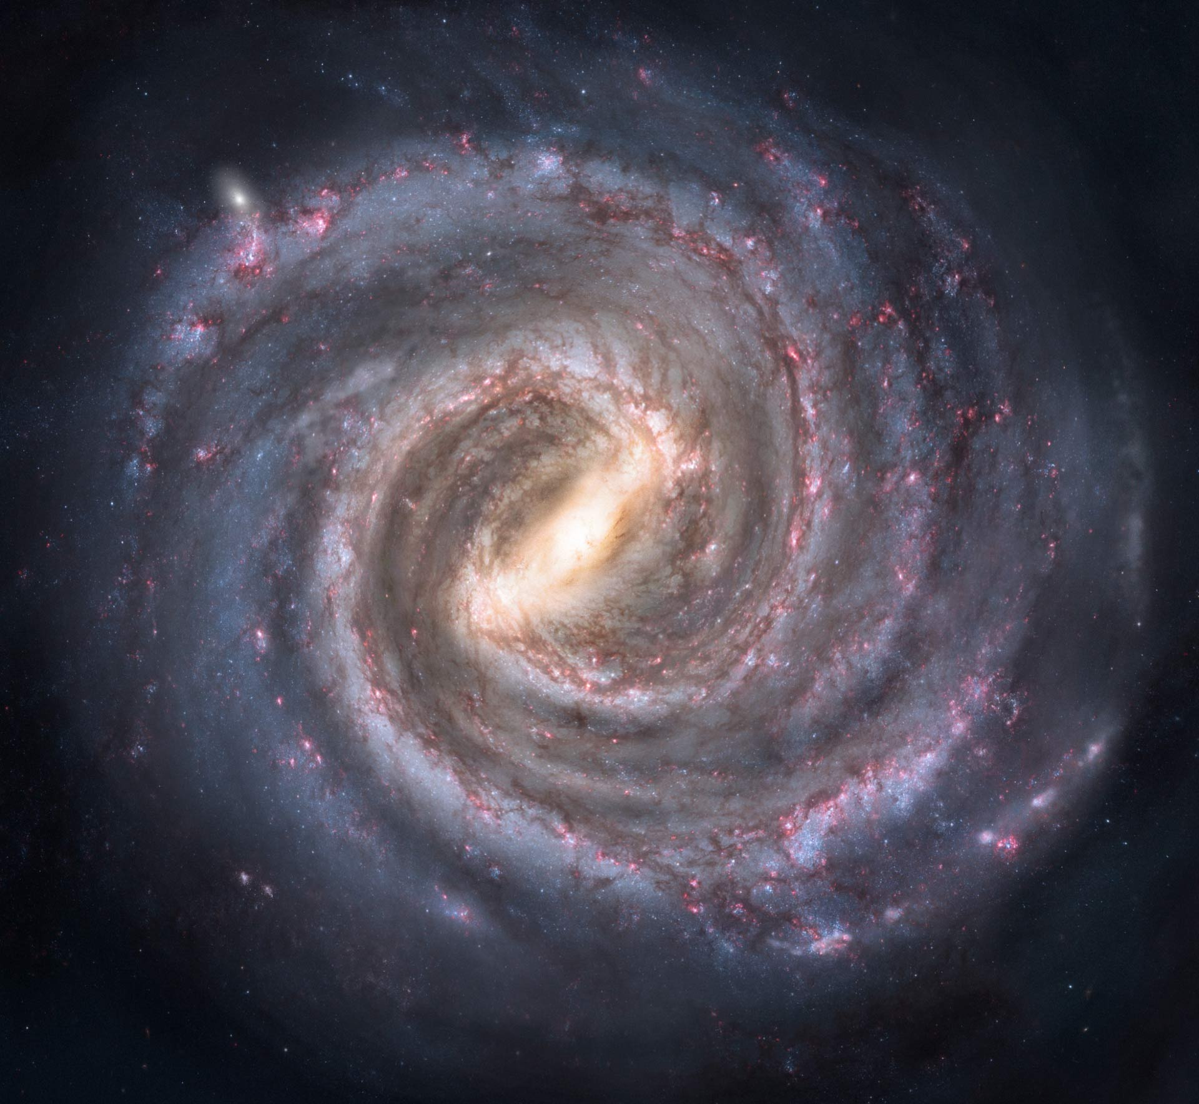
Solar System

Slide 3


Slide 4
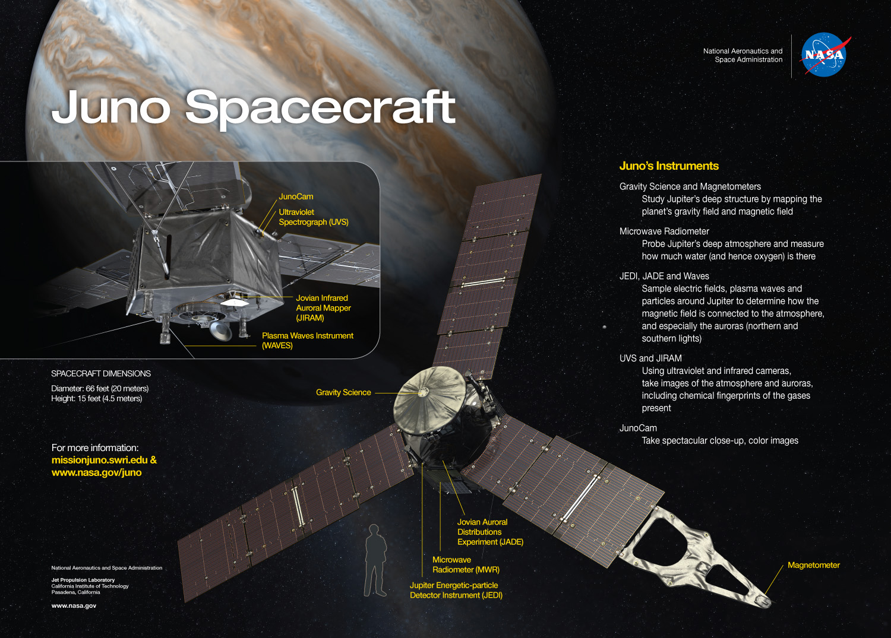

Slide 5
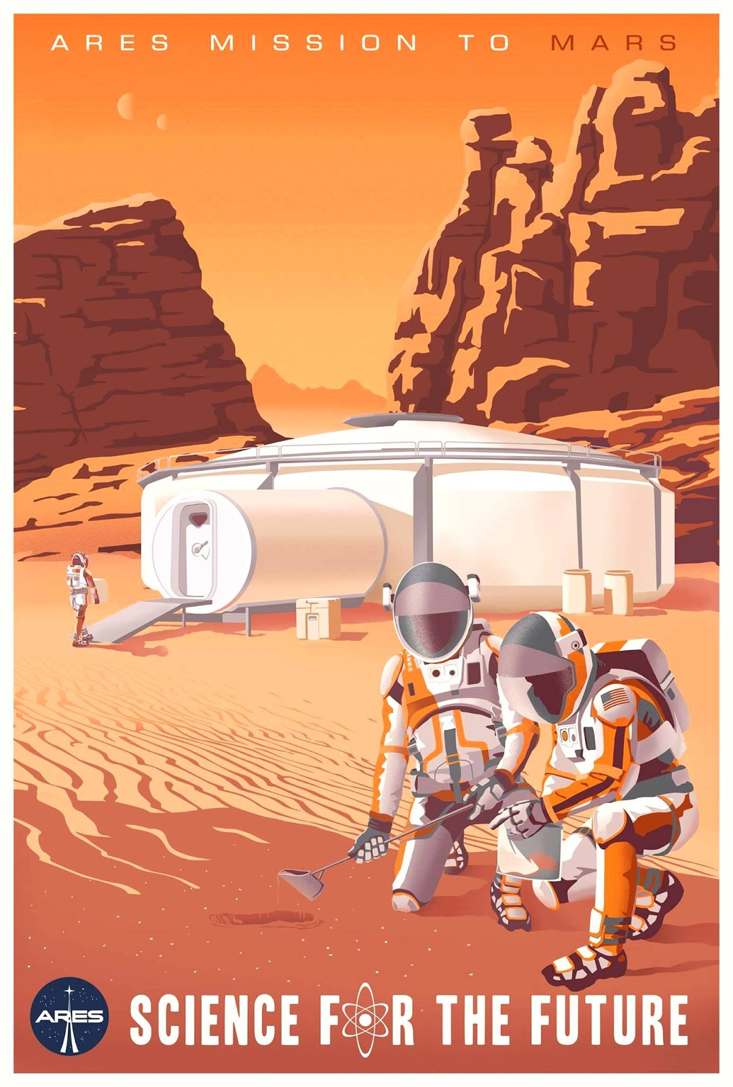

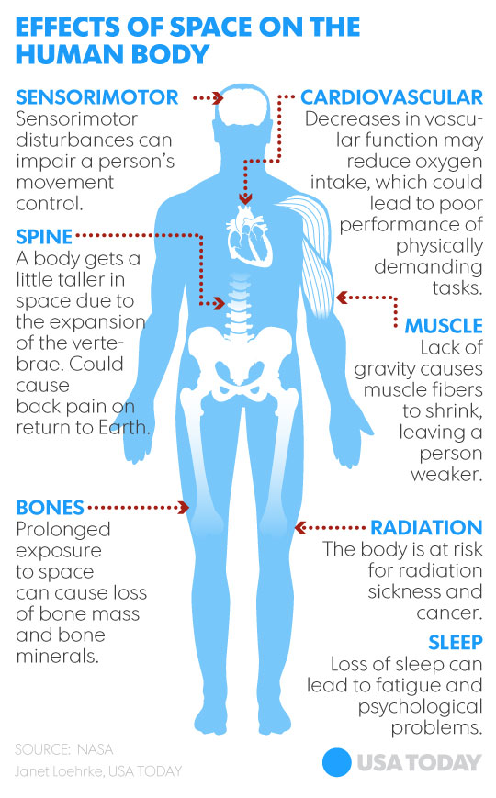

Slide 6
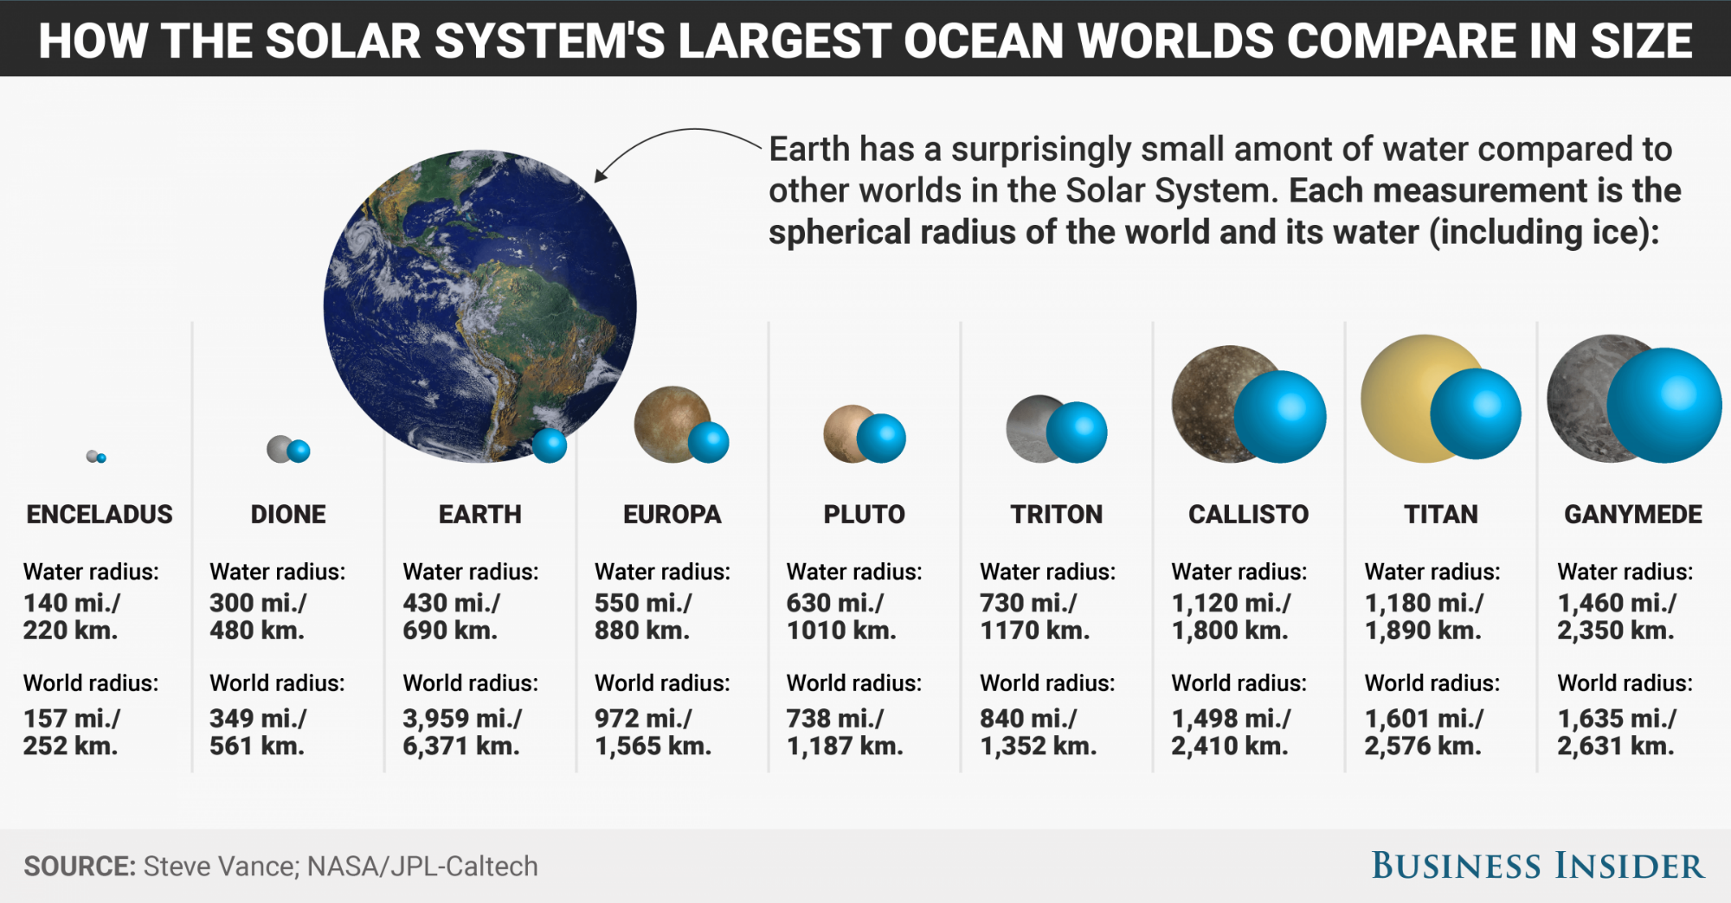

Slide 7
