Slide 1
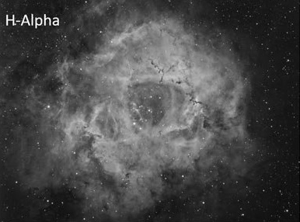
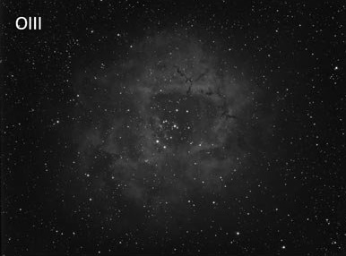
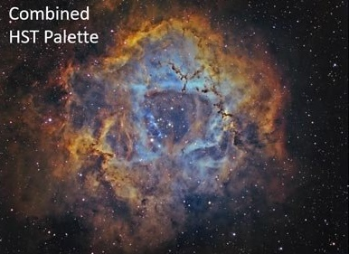
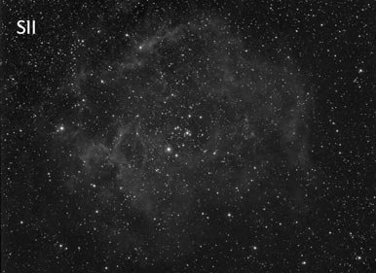
Filters
&
Imaging

Slide 2
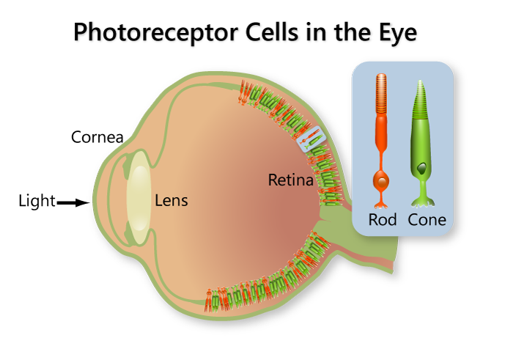
Rods & Cones
Rods
More sensitive
Used at night
Can’t perceive color
Cones
Three types:
S (short)
M (medium)
L (long)
Observe at different wavelengths
Combine to create color

Slide 3
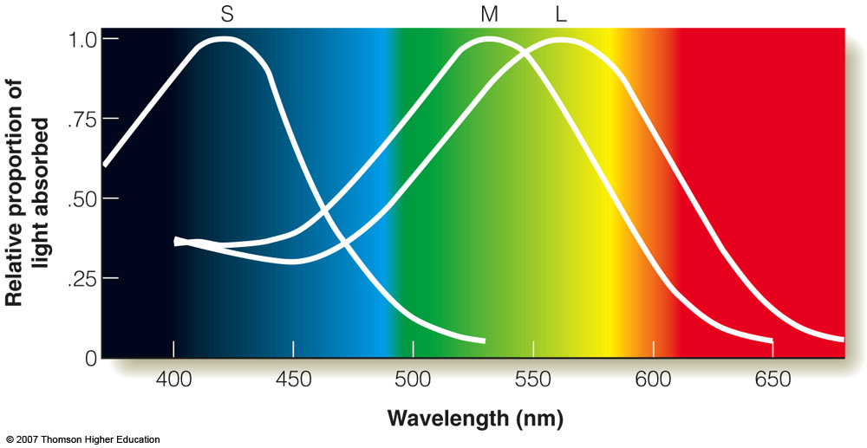
Rods & Cones
Rods
More sensitive
Used at night
Can’t perceive color
Cones
Three types:
S (short)
M (medium)
L (long)
Observe at different wavelengths
Combine to create color

Slide 4
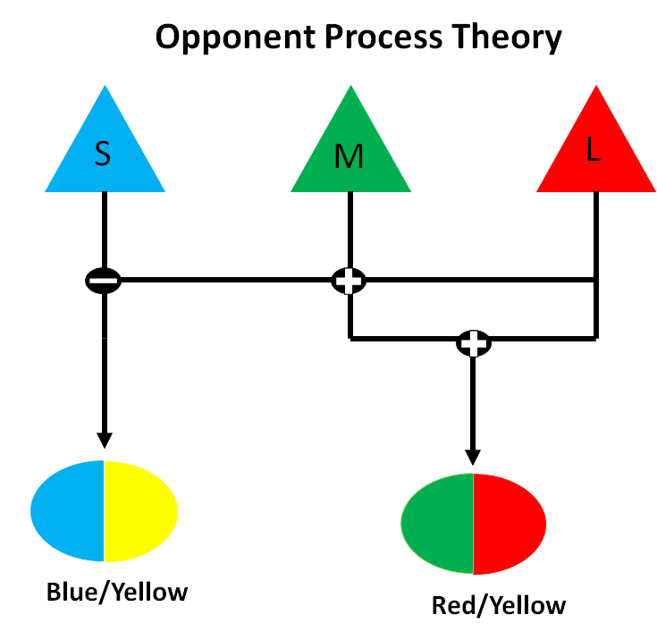
Rods & Cones
Rods
More sensitive
Used at night
Can’t perceive color
Cones
Three types:
S (short)
M (medium)
L (long)
Observe at different wavelengths
Combine to create color

Slide 5




Normal Vision
No Green Cones
No Blue Cones
Colorblind

Slide 6
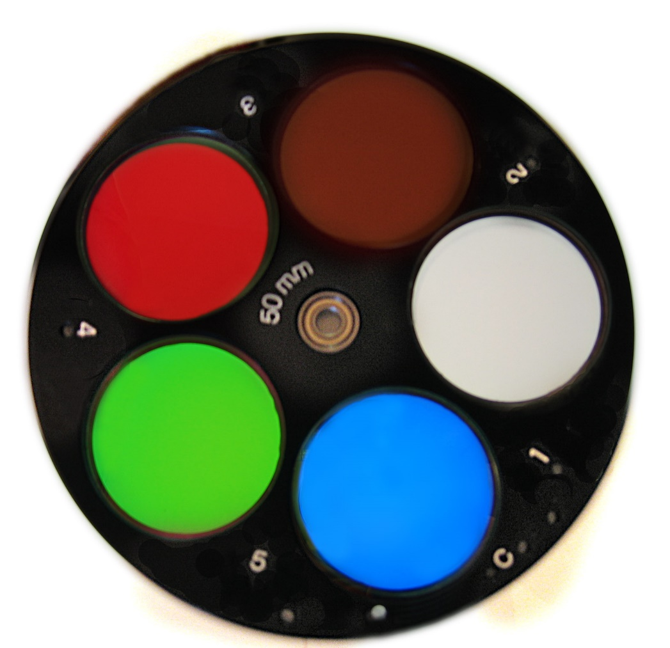
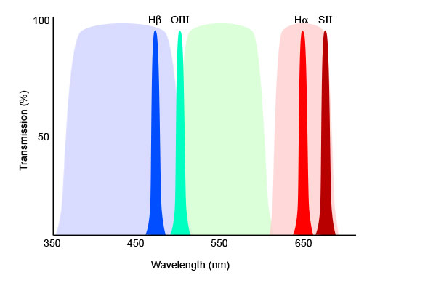
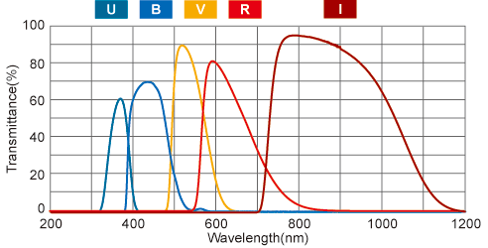
Filters
Transmit light over a certain wavelength range
Broadband
Continuous Emission
e.g. R, G/V, B
Narrowband
Emission Lines
e.g. Hα, Hβ, O III, S II

Slide 8
