Slide 1
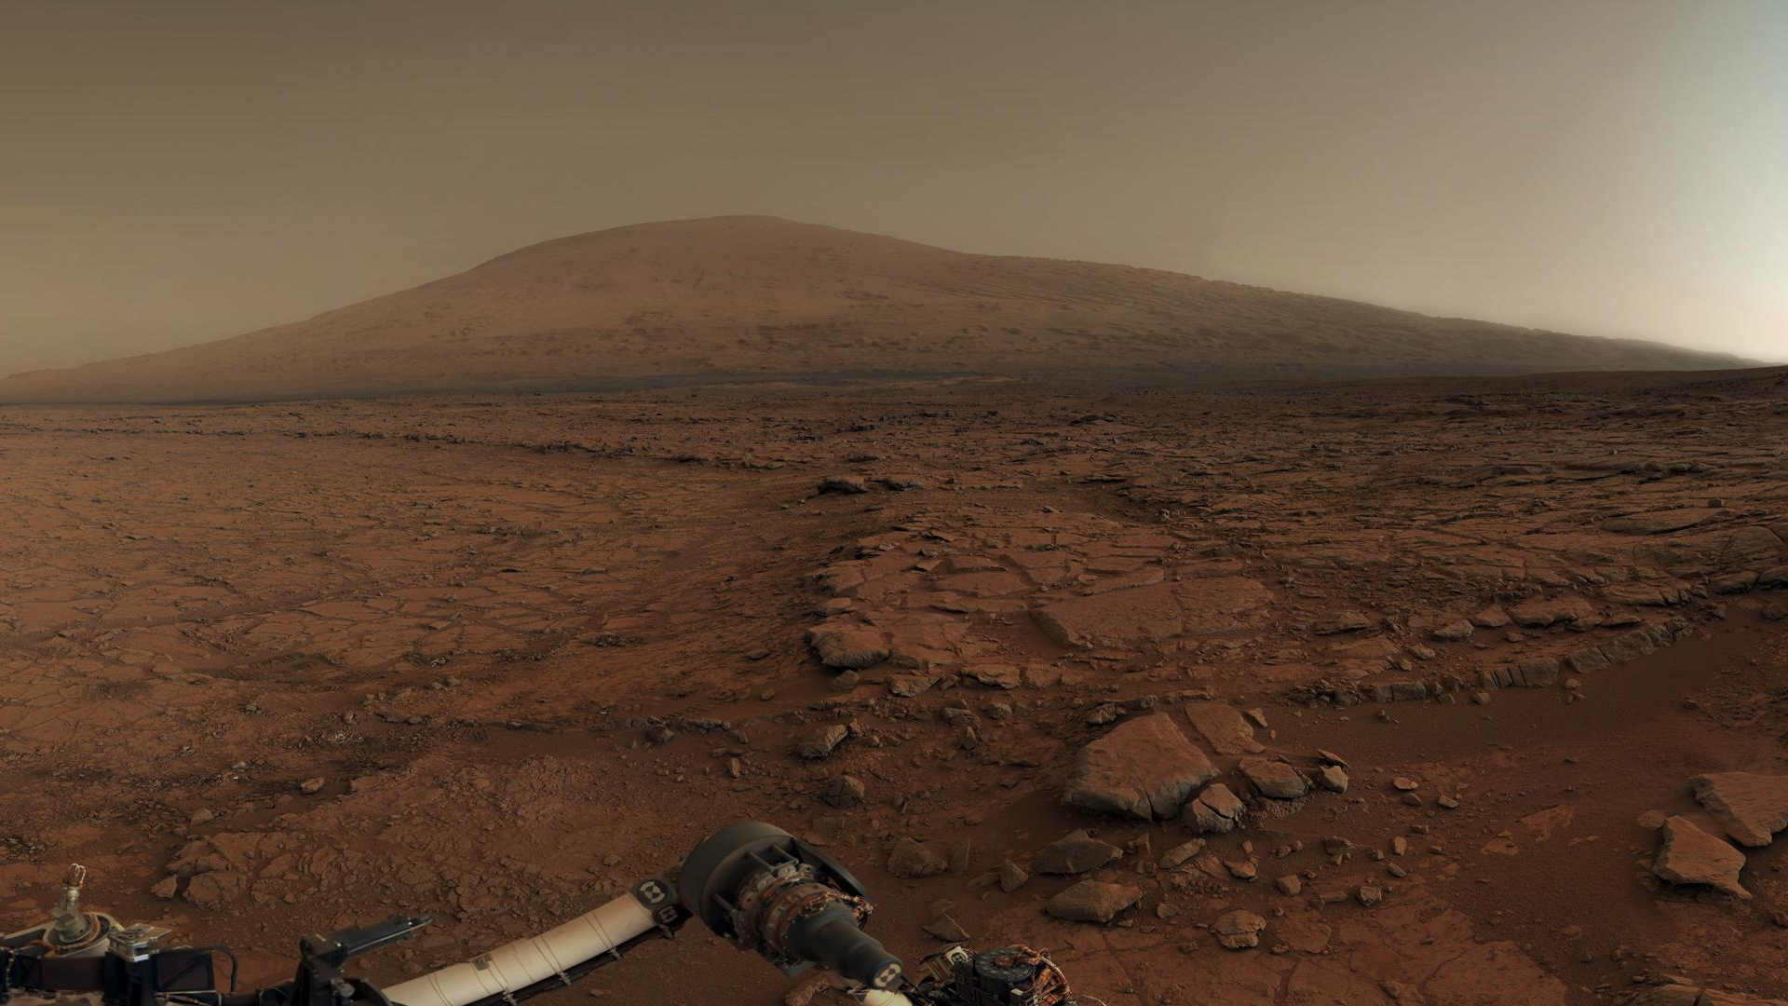
Introduction to Image Analysis

Slide 2
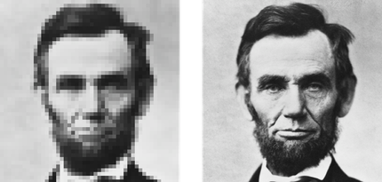
Which of the following about the images is true?
The image on the left is higher resolution.
The image on the left is more zoomed in.
The image on the right has fewer arcseconds per pixel.
The image on the right covers a larger area.

Slide 3




Which of the following about the images is true?
$$θ_{left}$$
The image on the left is higher resolution.
The image on the left is more zoomed in.
The image on the right has fewer arcseconds per pixel.
The image on the right covers a larger area.
$$θ_{right}$$
$$1°={60}^{′}=3600′′$$

Slide 4
Which of the following about the images is true?
The image on the left is higher resolution.
The image on the left is more zoomed in.
The image on the right has fewer arcseconds per pixel.
The image on the right covers a larger area.

Slide 5
Abe Lincoln's forehead measured approximately 12cm across. Which is closest to the size of the pixels in the left-hand image?
2 cm/pixel
0.5 cm/pixel
0.2 cm/pixel
0.05 cm/pixel

Slide 6

Abe Lincoln's forehead measured approximately 12cm across. Which is closest to the size of the pixels in the left-hand image?
~24 pixels
0.5 cm/pixel
$$\frac{12 cm}{24 pixels}=0.5\frac{cm}{pixel}$$

Slide 7
If the photographer moved farther away, how would the pixel size in the image change?
There would be more centimeters per pixel.
There would be fewer centimeters per pixel.
The pixels would have a larger angular size.
The pixels would have a smaller angular size.

Slide 8

If the photographer moved farther away, how would the pixel size in the image change?
There would be more centimeters per pixel.
E.g., If twice as far away:
$$\frac{12 cm}{12 pixels}=1\frac{cm}{pixel}$$

Slide 9
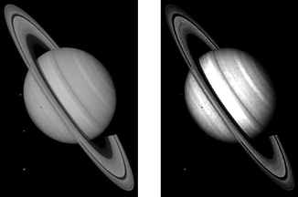
Which is TRUE about the images of Saturn?
The image on the right shows more of Saturn's rings
The image on the left is darker
The image on the right shows higher contrast
The image on the left is higher resolution

Slide 10
Which is TRUE about the images of Saturn?
The image on the right shows more of Saturn's rings
The image on the left is darker
The image on the right shows higher contrast
The image on the left is higher resolution

Slide 11
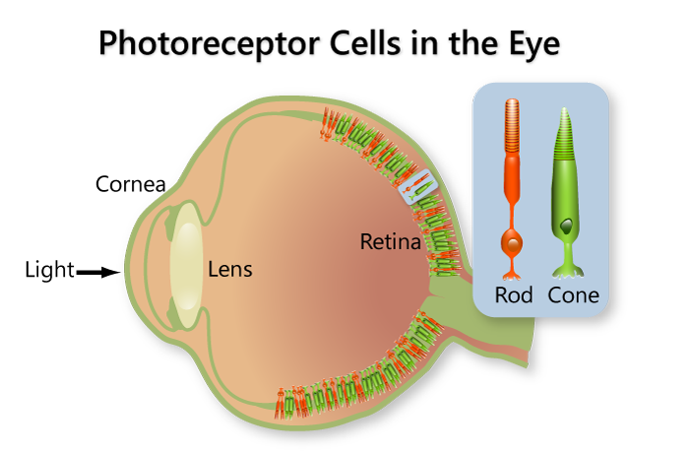
Rods & Cones
Rods
More sensitive
Used at night
Can’t perceive color
Cones
Three types:
S (short)
M (medium)
L (long)
Observe at different wavelengths (filters)
Combine to create color

Slide 12
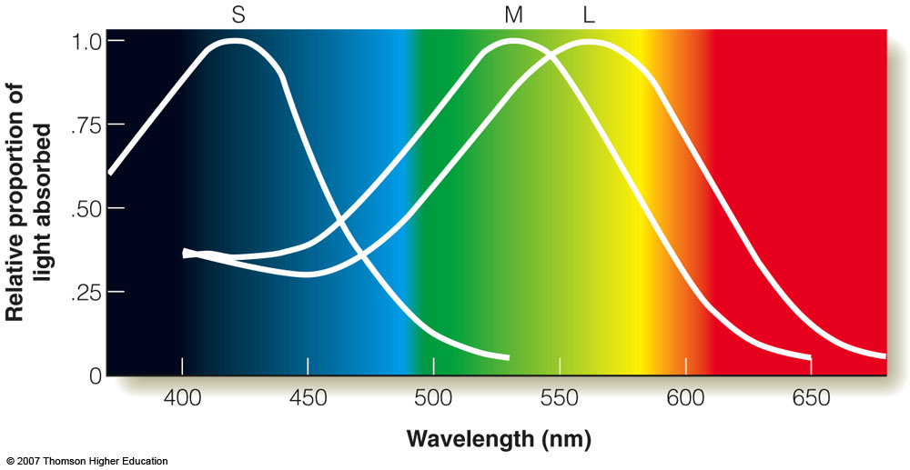
Rods & Cones
Rods
More sensitive
Used at night
Can’t perceive color
Cones
Three types:
S (short)
M (medium)
L (long)
Observe at different wavelengths (filters)
Combine to create color

Slide 13
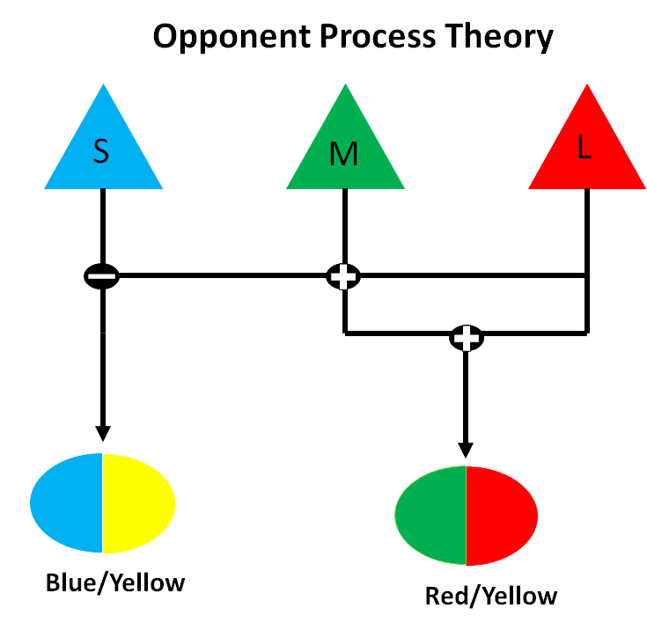
Rods & Cones
Rods
More sensitive
Used at night
Can’t perceive color
Cones
Three types:
S (short)
M (medium)
L (long)
Observe at different wavelengths (filters)
Combine to create color

Slide 14
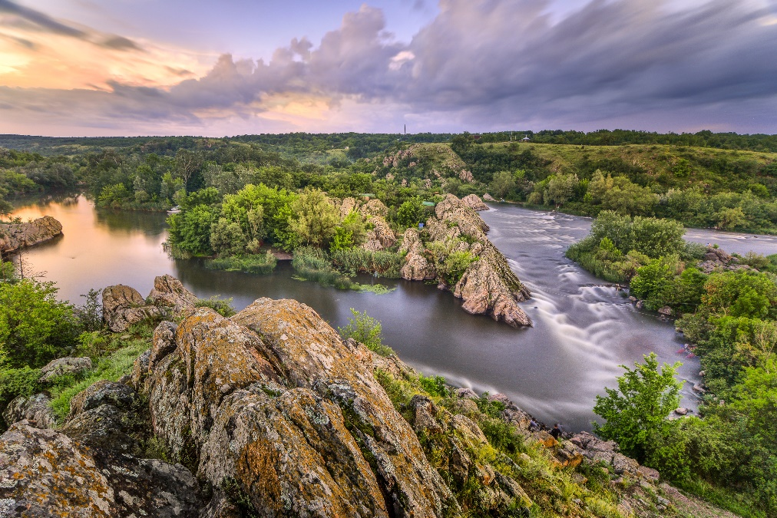
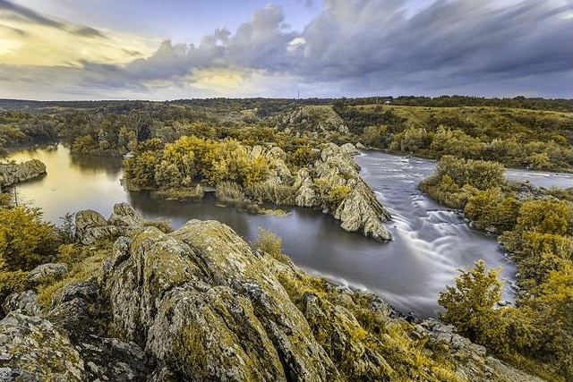
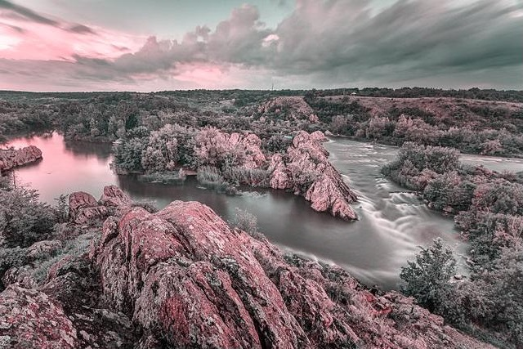
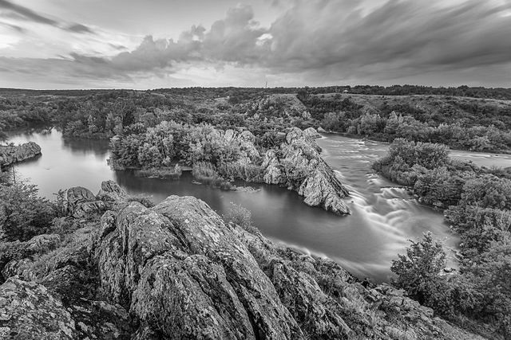
Normal Vision
No Green Cones
No Blue Cones
Colorblind

Slide 15
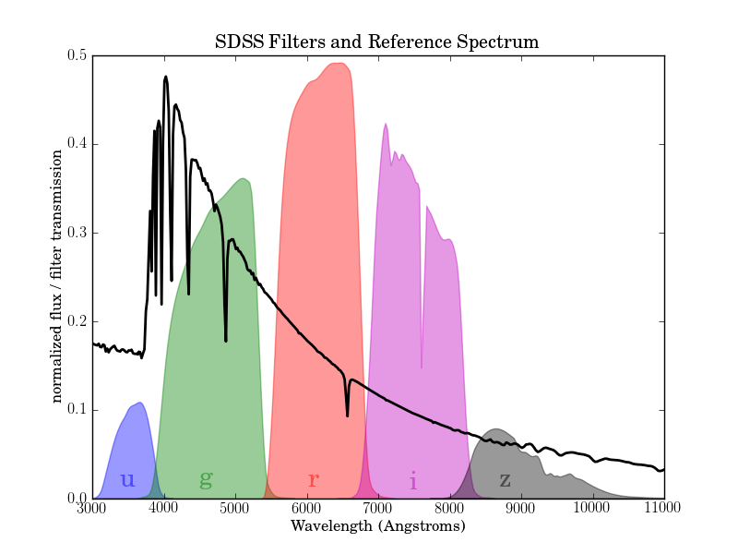
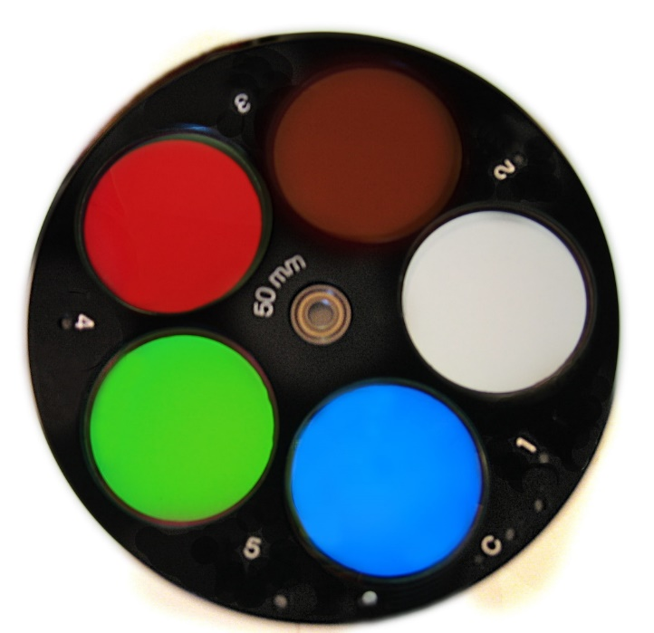
Filters
Transmit light within a certain wavelength range
Broadband
Continuous Emission
e.g. R, G/V, B
Narrowband
Emission Lines
e.g. O III, S II

Slide 16
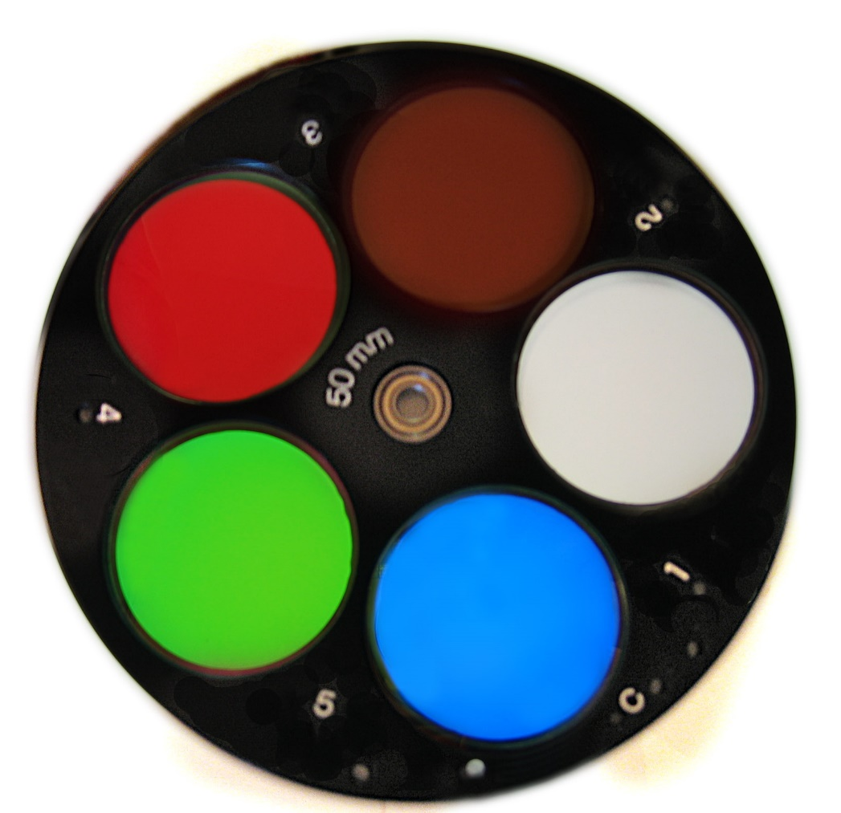
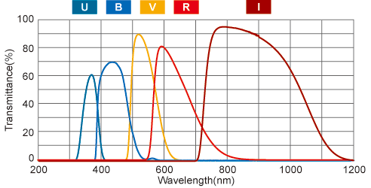
Filters
Transmit light within a certain wavelength range
Narrowband
Emission Lines
e.g. O III, S II
Broadband
Continuous Emission
e.g. R, G/V, B

Slide 17
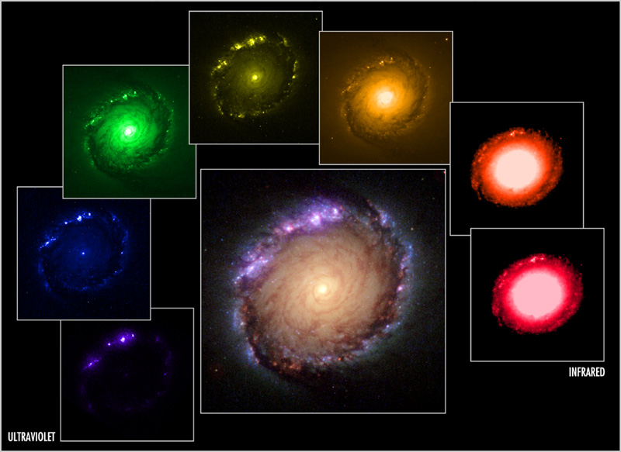

Slide 18
