Slide 1
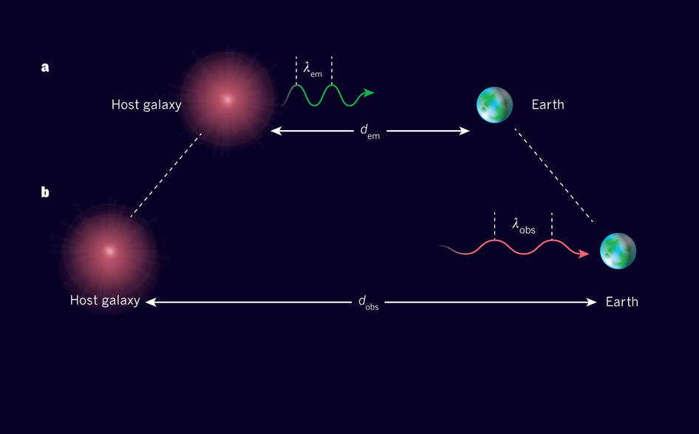
Astronomical Redshift

Slide 2
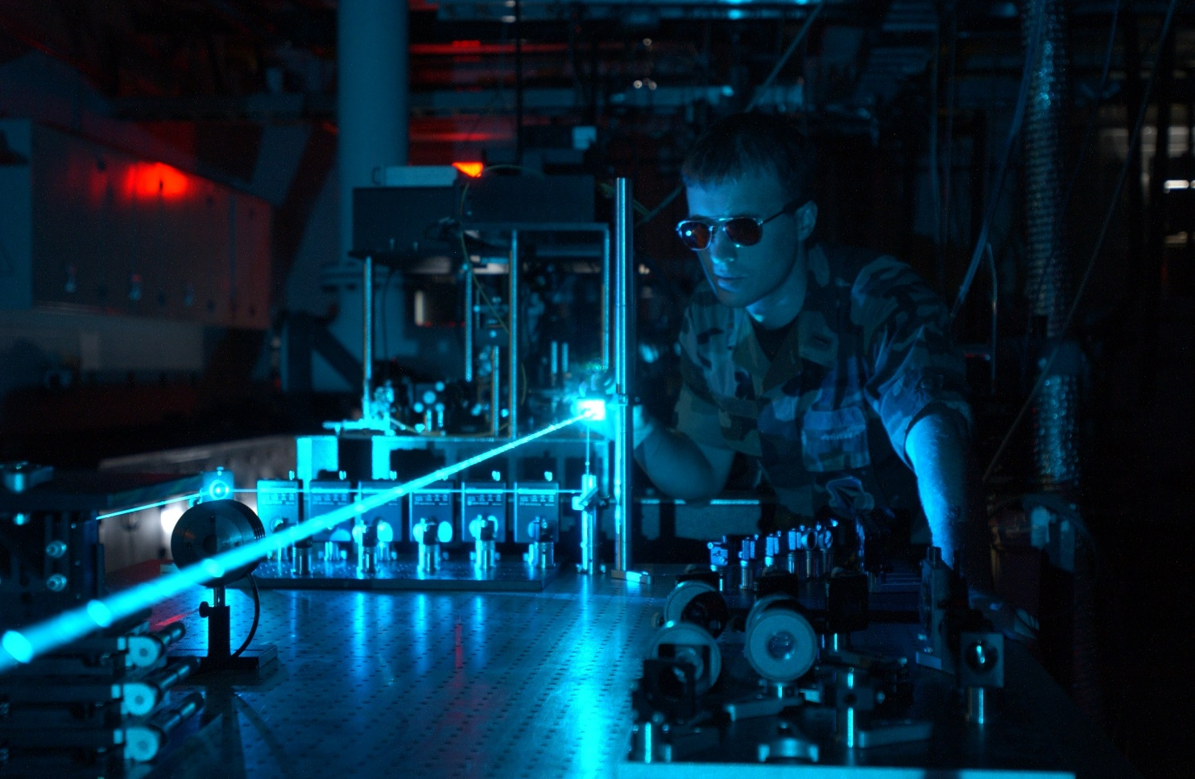
Which of the following can affect the apparent wavelength of light?
The velocity of the source
The velocity of the observer
The medium the light travels through
Gravity

Slide 3
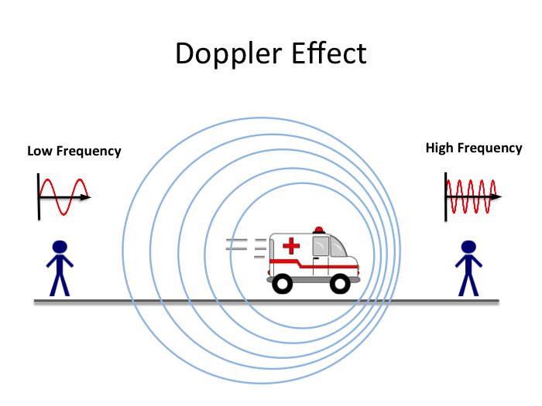
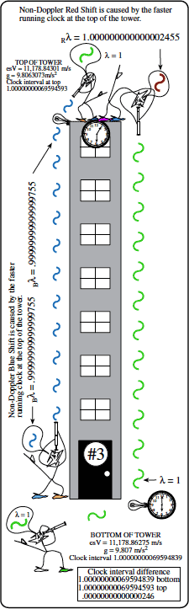
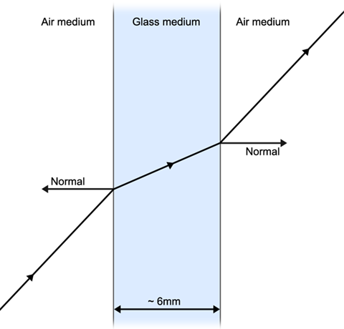
Which of the following can affect the apparent wavelength of light?
The velocity of the source
The velocity of the observer
The medium the light travels through
Gravity

Slide 4
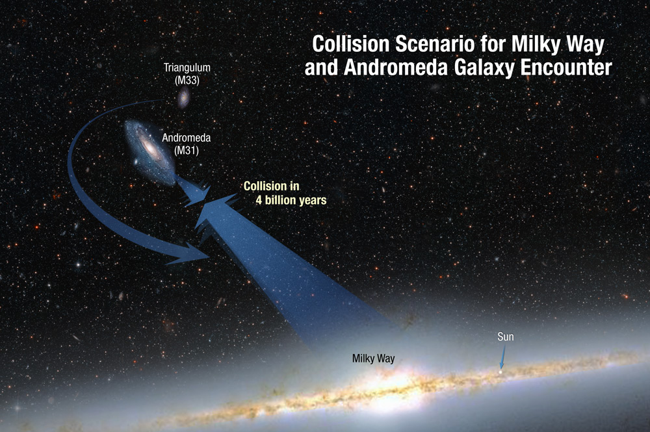
As an object moves towards an observer
The wavelength of the light will increase and the frequency will decrease
The wavelength of the light will decrease and the frequency will increase
The wavelength and frequency will both increase
The wavelength and frequency will both decrease
The wavelength and frequency will stay the same

Slide 5
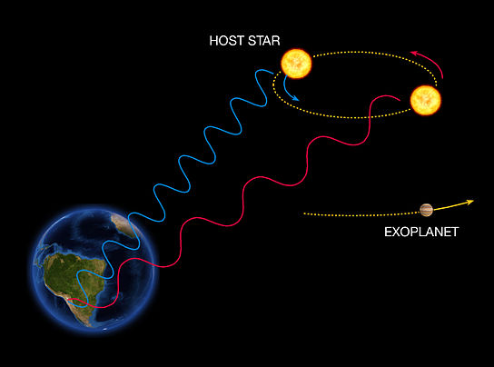
As an object moves towards an observer
The wavelength of the light will increase and the frequency will decrease
The wavelength of the light will decrease and the frequency will increase
The wavelength and frequency will both increase
The wavelength and
both decrease
The wavelength
d

Slide 6
The phenomenon described above is known as The
Black Drop Effect
Yarkovsky Effect
Doppler Effect
Greenhouse Effect
Holtzman Effect

Slide 7
The phenomenon described above is known as The
Black Drop Effect
Yarkovsky Effect
Doppler Effect
Greenhouse Effect
Holtzman Effect

Slide 8
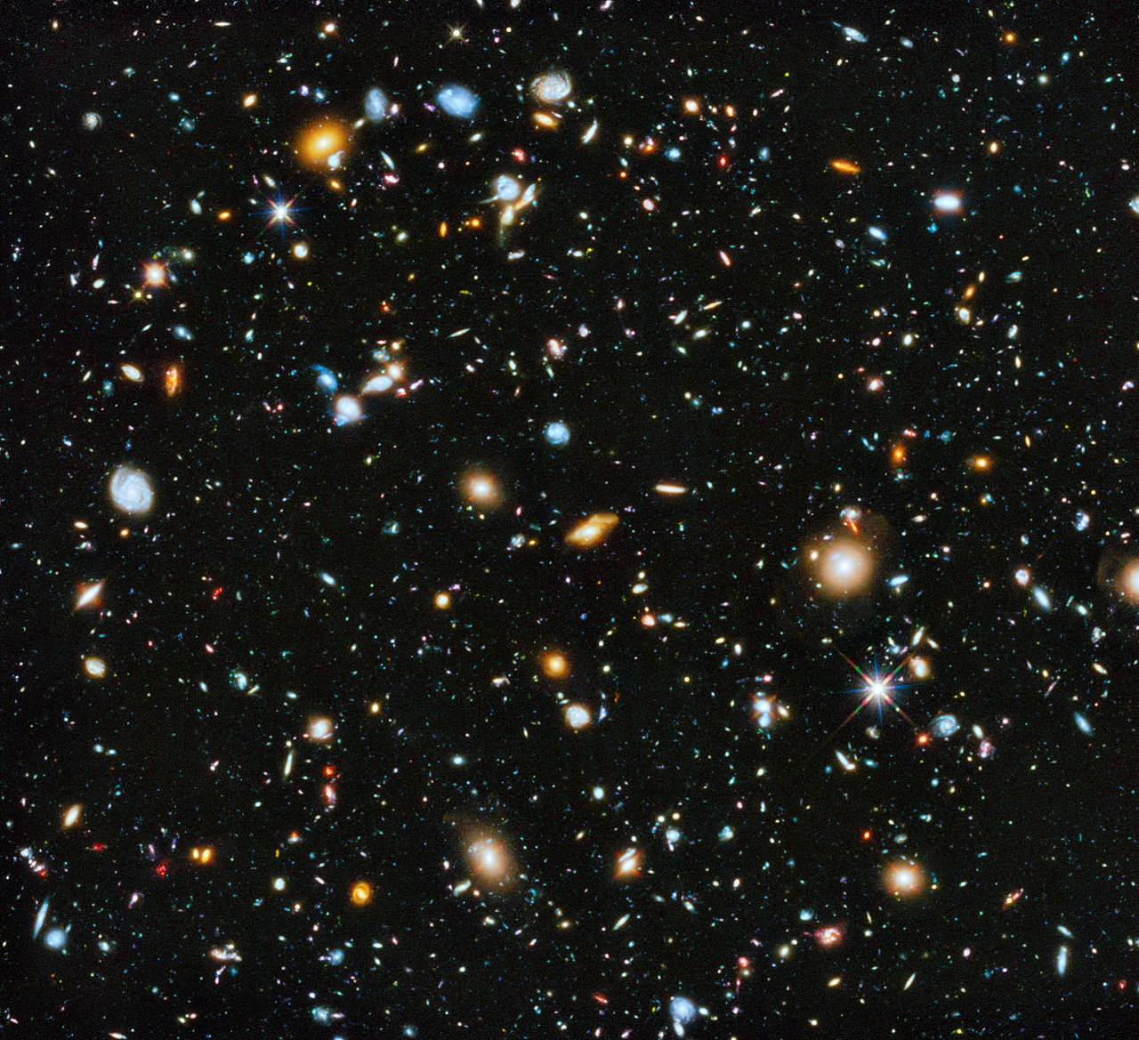
Observations of the cosmos suggest that the Universe is
Static
Collapsing
Expanding at a constant rate
Expanding at an increasing rate
Banana-shaped

Slide 9
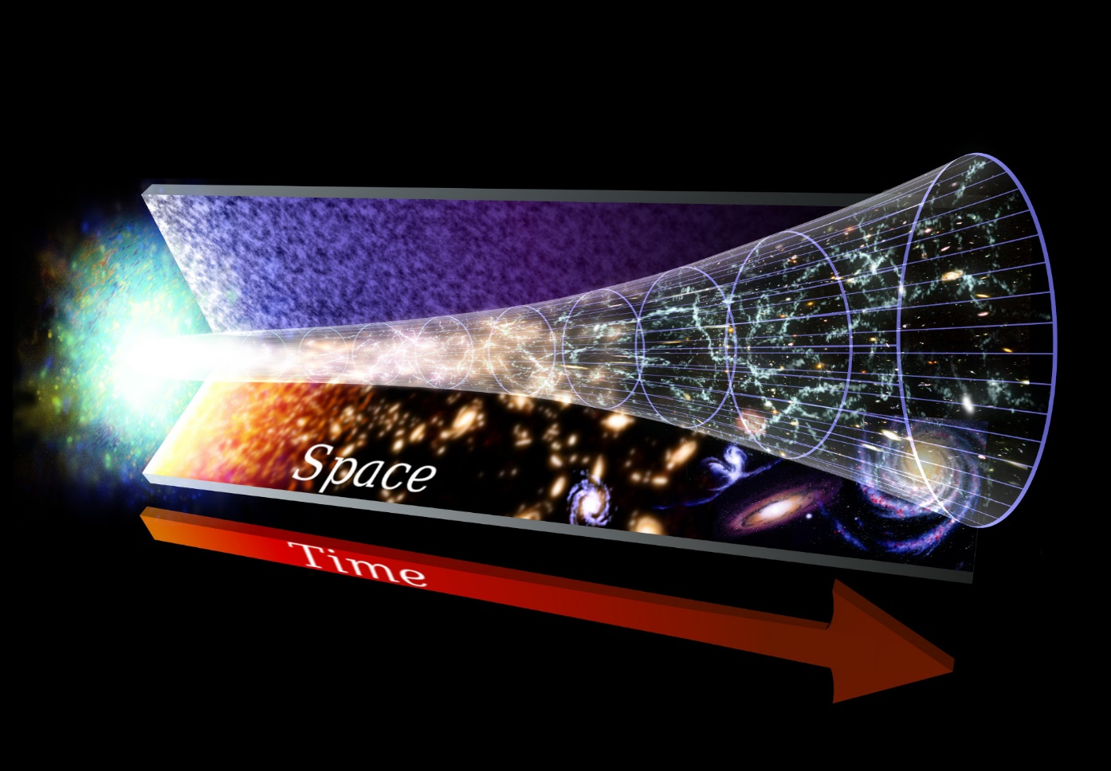
Observations of the cosmos suggest that the Universe is
Static
Collapsing
Expanding at a constant rate
Expanding at an increasing rate
Banana-shaped

Slide 10
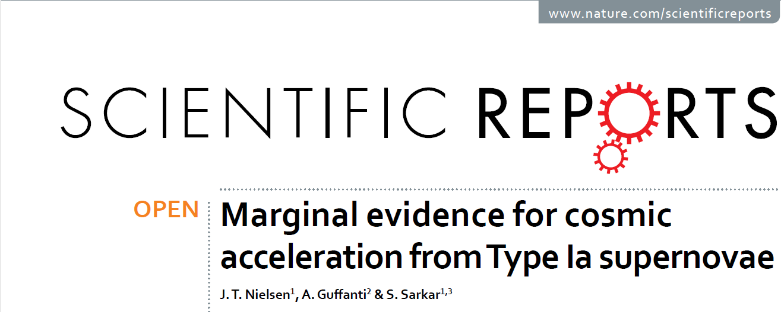
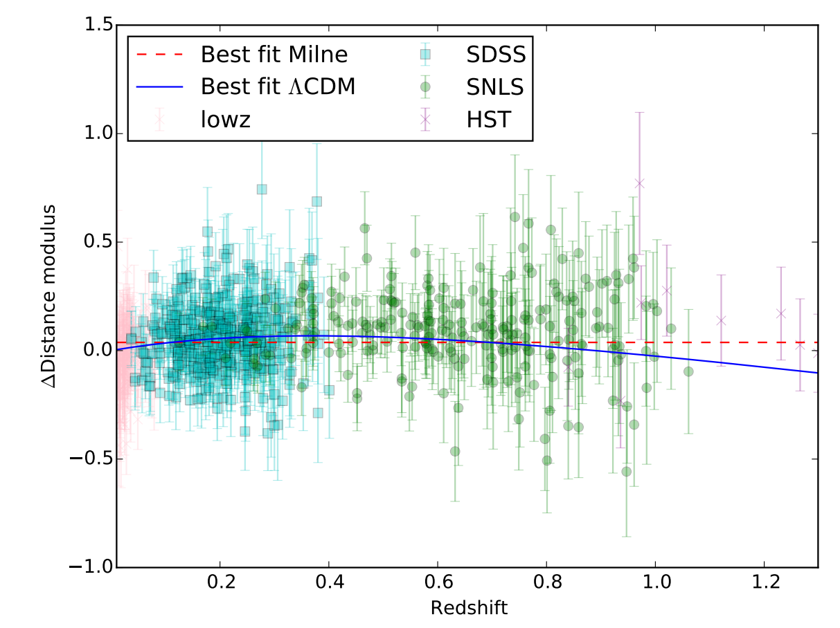
Constant Expansion
Accelerating Expansion

Slide 11
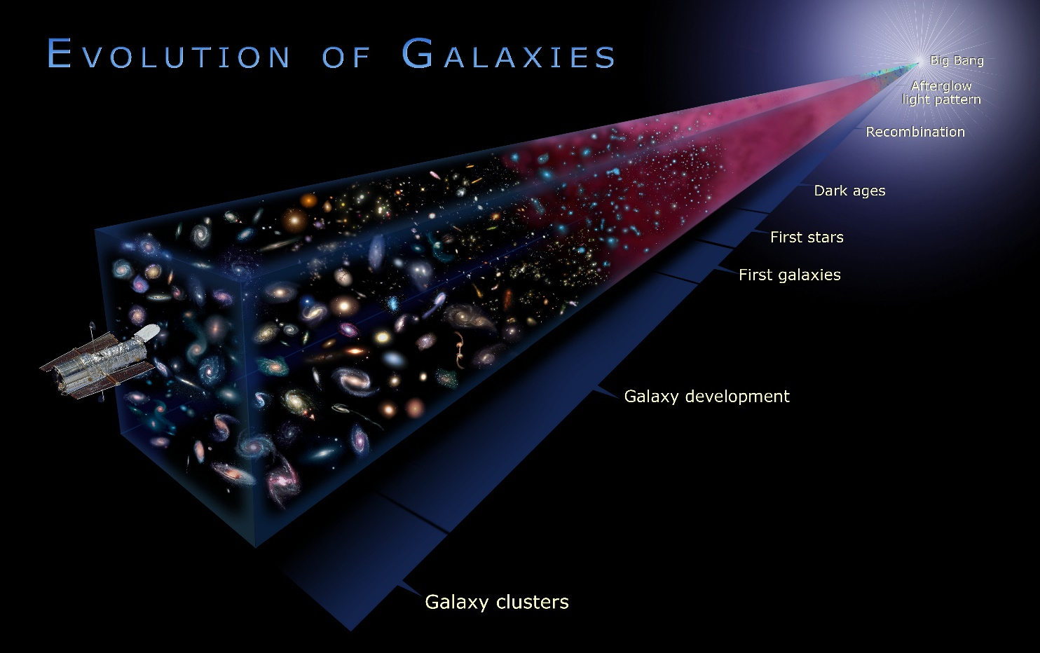
The estimated age of the Universe is
Less than 10 thousand years
Between 10,000 and 10 million years
Between 10 and 100 million years
Between 100 million and 10 billion years
Between 10 billion years and 100 billion years
More than 100 billion years

Slide 12
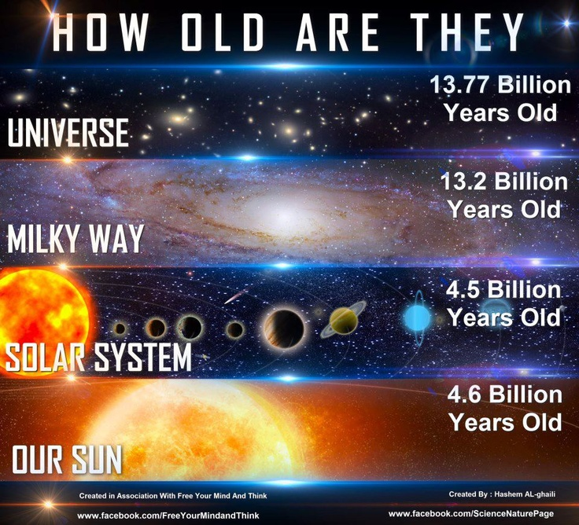
The estimated age of the Universe is
Less than 10 thousand years
Between 10,000 and 10 million years
Between 10 and 100 million years
Between 100 million and 10 billion years
Between 10 billion years and 100 billion years
More than 100 billion years

Slide 13
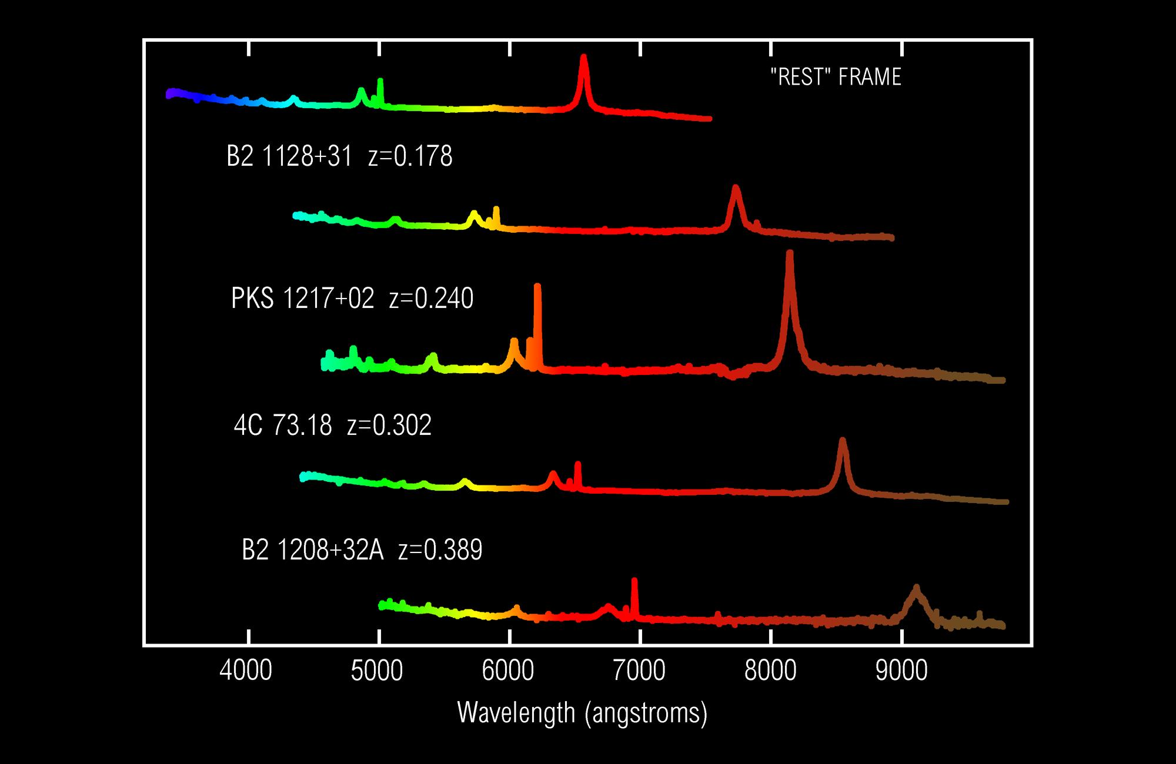
Quasars
Quasi-Stellar Radio Sources
High Redshift Values (z)
Not a doppler effect
Expansion of Space
Center of Galaxy
AGNs (Active Galactic Nuclei)
Much brighter than host galaxy
> 10¹² L_{SUN}
Brightness can vary dramatically on the order of a few minutes
~ size of Solar System

Slide 14
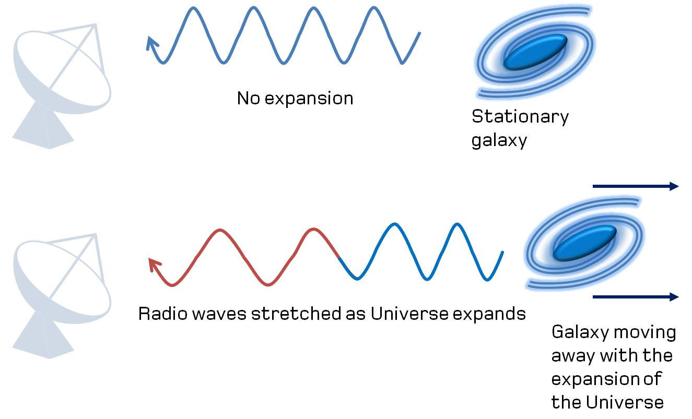
Quasars
Quasi-Stellar Radio Sources
High Redshift Values (z)
Not a doppler effect
Expansion of Space
Center of Galaxy
AGNs (Active Galactic Nuclei)
Much brighter than host galaxy
> 10¹² L_{SUN}
Brightness can vary dramatically on the order of a few minutes
~ size of Solar System

Slide 15
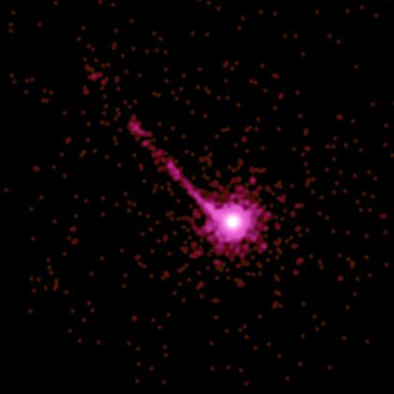
Quasars
Quasi-Stellar Radio Sources
High Redshift Values (z)
Not a doppler effect
Expansion of Space
Center of Galaxy
AGNs (Active Galactic Nuclei)
Much brighter than host galaxy
> 10¹² L_{SUN}
Brightness can vary dramatically on the order of a few minutes
~ size of Solar System

Slide 16
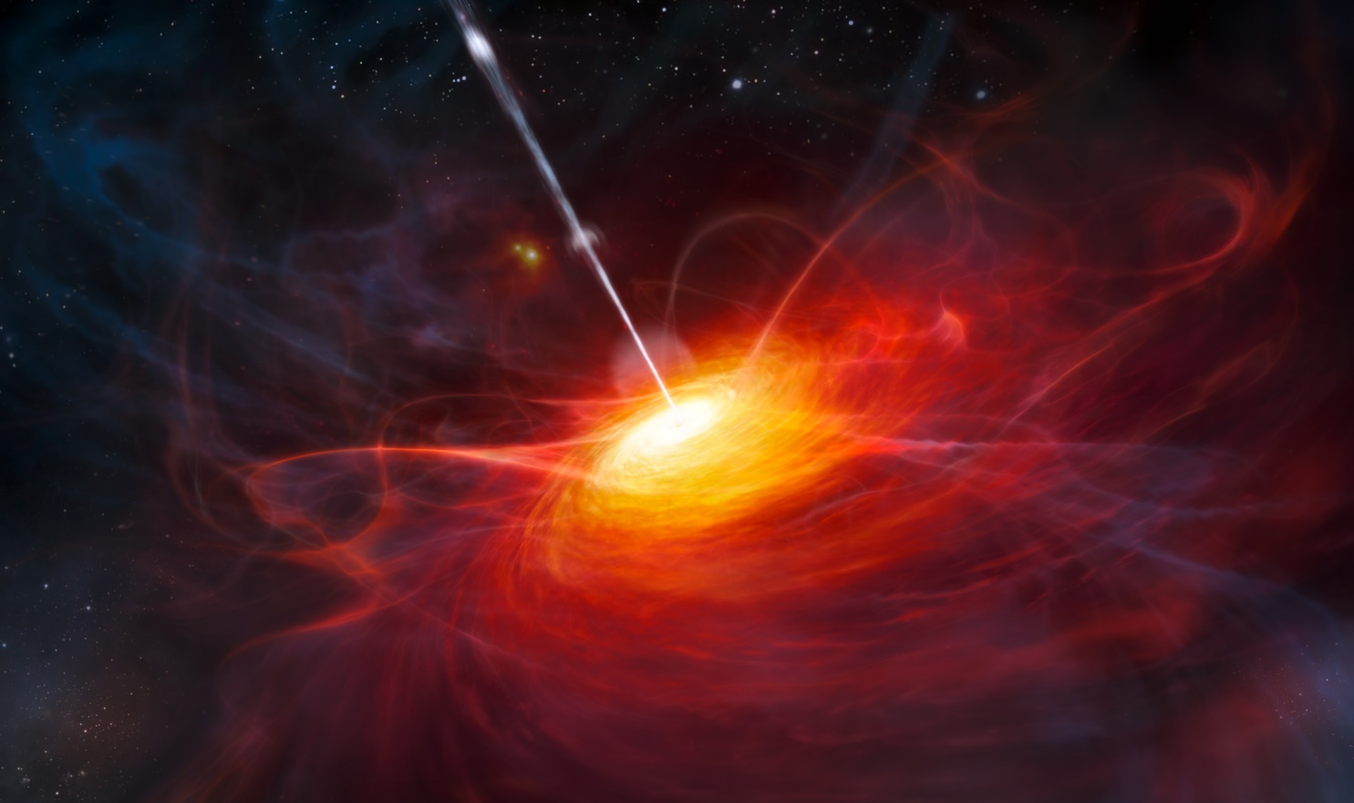
Quasars
Supermassive Black Hole
+
Accretion Disk
+
Jet (Radio Emission)

Slide 17
