Slide 1
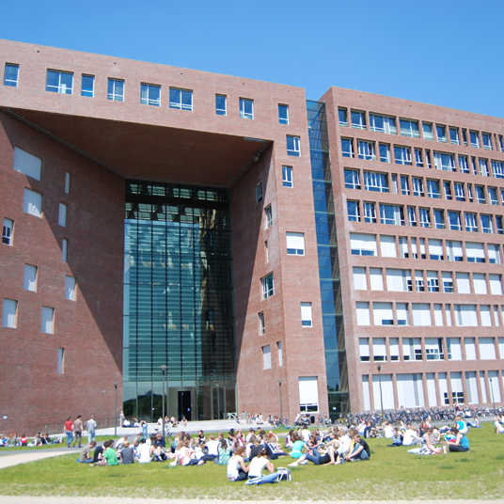



Acoustic profiler study

Slide 2
Aim of the project
Test the use of AZFP for monitoring marine life in OWFs
Monitor change in biomass over the course of 1 month, accross 3 different OWFs
Indication on the effect of seismics and pile driving sounds on marine communities

Slide 3
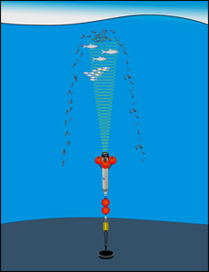
Principles
Upward looking devices
Long time monitoring
Multi-frequency ability
Initially designed for zooplankton monitoring

Slide 4
Frames
transducers

Slide 5
Recording plan
3 deployments
Belwind (seismic survey) – 15/07 to 11/08
C-Power (pile driving) – 22/08 to 20/09
Pair design (in and out the OWF)
2 AZFP units
38, 125, 200, 455 kHz – deployed in the OWF
125, 200, 455, 769 kHz – deployed outside the OWF

Slide 6
Processing
Data
Removal of bottom and surface bubbles
Integration with different methods

Slide 7
Processing outputs
Raw integration
Integration over thresholded data
63 dB
70 dB
“School” detection

