Slide 1
EDP Data Pipeline Engineering Merging Data from Bronze Delta to Silver Delta Tables
February 24, 2023

Slide 2
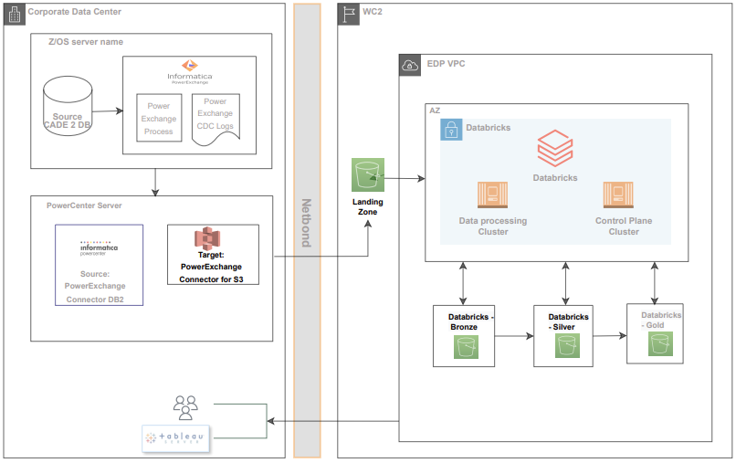
Presentation Overview
The Databricks Medallion architecture consists of Bronze, Silver, and Gold layers that correspond to different data quality levels. Last Sprint, development work showed data movement from Informatica to landing zone, and then to Bronze delta table.

Slide 3
Demo Overview
The objective for today’s presentation is to show the end-to-end data journey, progressively improving the structure and quality of data, upon reaching the Silver delta table.
Today’s Demonstration
Silver Layer
2
Informatica
S3 Landing Zone
Bronze Layer
The source where a set number of tables will be ingested into the AWS S3 Landing Zone desired folders
Multiple files of various sizes for CADE 2 table are configured across many partitions where each file accommodates multiple partitions (max 32)
Lambda function moves the files to separate folders. There is a one-to-one correspondence between each folder and table
Desired folders are pre-created using AWS Lambda Function
Informatica workflows load CADE 2 table data into AWS S3 Landing Zone folders
1
Databricks workflows pick the incremental data from Bronze layer using Autoloader
A generic script is created, which takes table name as a parameter and merge the data to each table
Data types are converted according to the target table definition
Utility script is built to have generic functions, such as metadata, append, preparing statements for merge, and data type conversion
After loading the files to AWS S3 Landing Zone, Databricks workflows pick the files and move them to Bronze Layer using Autoloader
A script is created, which takes table name as a parameter and move the data to each table
A live demo will follow to show how data is merged from Bronze delta to Silver delta table.

Slide 4
Demo

Slide 5
Next Steps
Continue to develop the pipeline for the remaining tables
Build process tables and config tables for Gold layer and data validation
Start using Great Expectations tool for data validation

Slide 6
Appendix

Slide 7
Sprint 2 Demonstration (2/10/2023)

Slide 8
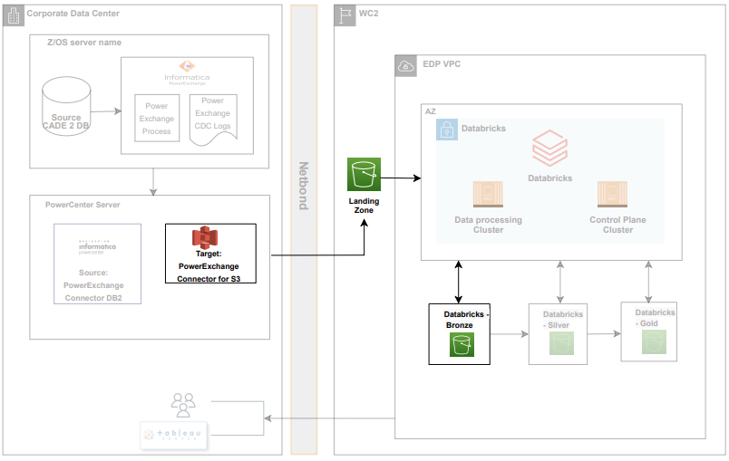
Demo Overview
This demo is designed to showcase the data pipeline starting from Informatica S3 Connector based extraction and ingestion into AWS S3 Landing Zone, and then into Databricks Bronze Layer using the Autoloader.
AWS S3 Landing Zone
Desired folders are pre-created using AWS Lambda Function
Informatica workflows load CADE 2 table data into AWS S3 Landing Zone folders
Informatica
Informatica PowerCenter S3 Connector will be used to ingest data to AWS S3 Landing zone
The source where a set number of tables will be ingested into the AWS S3 Landing Zone desired folders
Multiple files of various sizes for CADE 2 table are configured across many partitions where each file accommodates multiple partitions (max 32)
Databricks Bronze Layer
After loading the files to AWS S3 Landing Zone, Databricks workflows pick the files and move to Bronze Layer using Autoloader.
Script is created, which takes table name as a parameter and move the data to each table

Slide 9
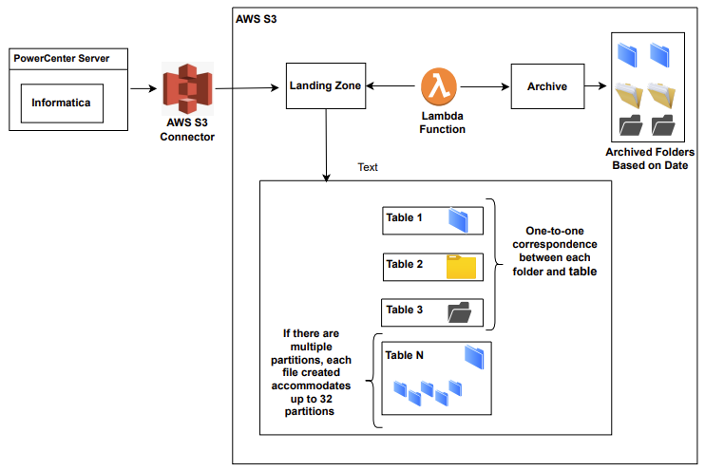
Folder / Subfolder Creation
When folders are loaded into the AWS S3 Landing Zone, if there are multiple partitions, a single file is created to accommodate up to 32 partitions.
A live demo will follow to show the step-by-step process of copying data from Informatica PowerCenter to Bronze Layer.

Slide 10
Next Steps
Copy data from Bronze Layer to Silver Layer and then to Gold Layer
Build a script for data validation (Incremental / Full Load)

Slide 11
Sprint 1 Demonstration (1/27/2023)

Slide 12
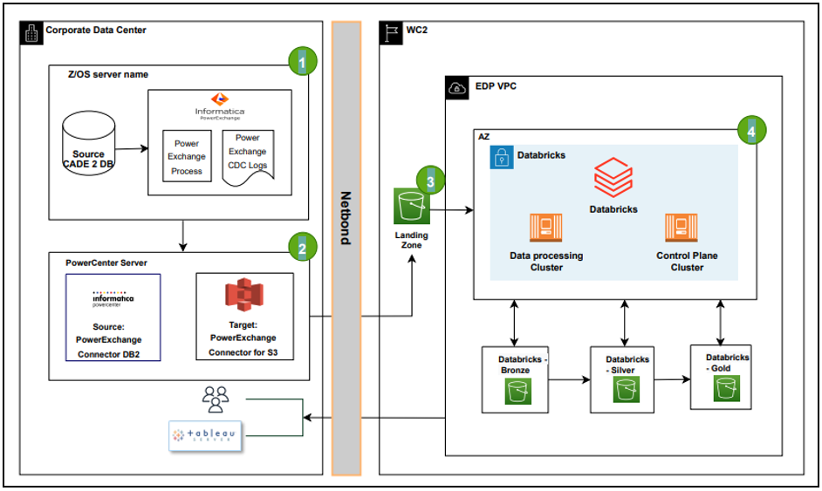
Demo Overview
One of the components for the Data Synchronization Solution is moving files from AWS S3 Landing Zone to Databricks Landing Zone using the Lambda Function.
AWS S3 Landing Zone
Data from informatica will be copied to CADE 2 ODS Folder in the AWS S3 bucket using S3 connector
File Format: Delimiter
Databricks Landing Zone
Files in AWS S3 Landing Zone will be overwritten each time data is copied
The Lambda function moves the files to separate folders. There is a one-to-one correspondence between each folder and table
Autoloader will be used to copy the data from Databricks Landing Zone in AWS S3 to Bronze Layer
File Format: Parquet
Archive
Data is copied from AWS S3 Landing Zone to Archive folder using the Lambda function
For compliance purpose, data is kept per the Retention Policy
File Format: Delimiter

Slide 13
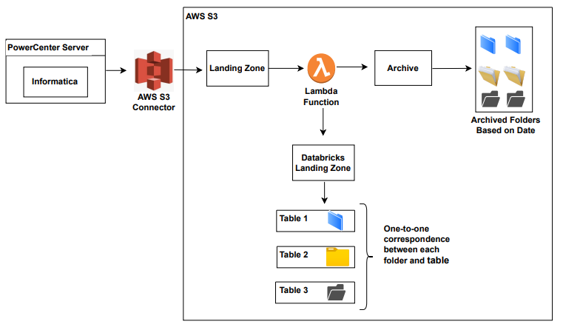
File Transfer Flow Diagram
The high-level diagram below captures how the Lambda Function is used to create two separate folders in parallel with different purposes.
A live demo will follow to show how Databricks processing scripts are used to move / format files.

Slide 14
Next Steps
Continue to build Databricks processing scripts for Silver Layer and Gold Layer
Validate the incremental data in Databricks Landing Zone against Source
Build metadata in audit trails / data movement

Slide 15
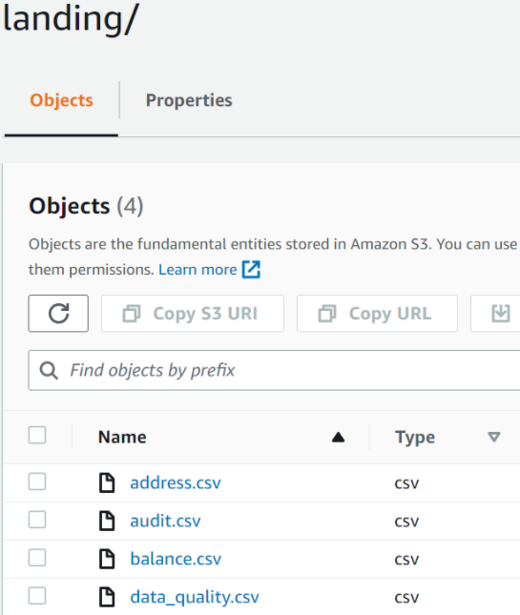
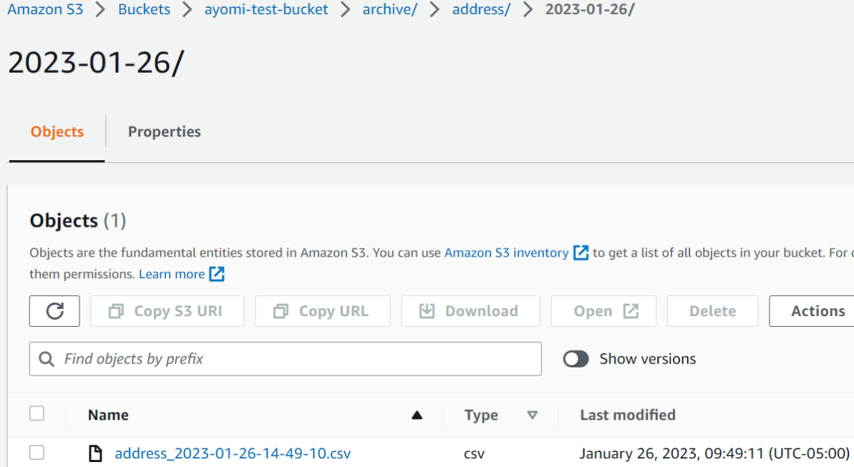
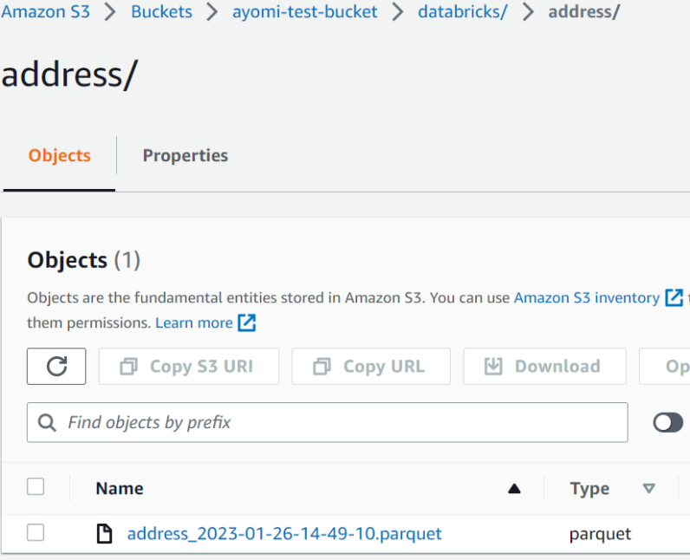
Sample Screenshots
Below are sample screenshots of the AWS S3 Landing Zone, Archive, and Databricks Landing Zone views, which are included in the demo.
AWS S3 Landing Zone
Archive
Databricks Landing Zone

