Slide 1


Audio Classification: Spectrograms, CNNs, and Python implementation
Bridget Bertoni
Delivery Data Scientist @ Microsoft
Essential Educate Training
8/7/19

Slide 2

Humans are great at classifying audio signals!
File #1
File #2

Slide 3
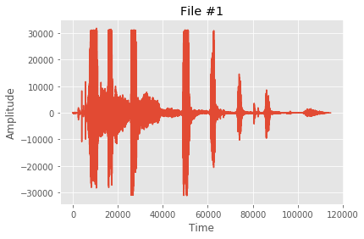
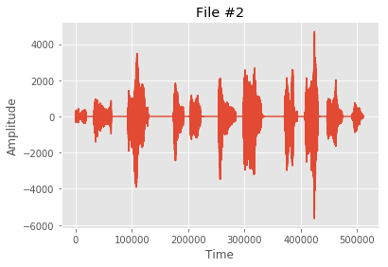
Unfortunately the computer sees this:

Slide 4
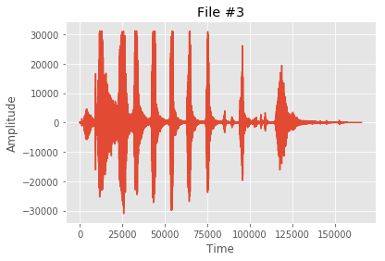
Unfortunately the computer sees this:
???

Slide 5
Machine Learning Solution
Solution based on how humans distinguish sounds
Pitch/frequency
Loudness
Traditional approach is to first do feature engineering based on human perception
Mel frequency spectrogram
Can also input raw audio data into a 1D convolutional neural network (CNN)
Convolution theorem → the 1D CCN can learn the important frequencies

Slide 6
Machine Learning Solution
Solution based on how humans distinguish sounds
Pitch/frequency
Loudness
Traditional approach is to first do feature engineering based on human perception
Mel frequency spectrogram
Can also input raw audio data into a 1D convolutional neural network (CNN)
Convolution theorem → the 1D CCN can learn the important frequencies

Slide 7
Mel Frequency Spectrogram
Basic idea is to mimic how humans hear
Slice up time signal and compute power spectrum
(We Distinguish sounds based on frequency)
Bin results using Mel filterbank
(We can distinguish lower frequencies better)
Take the log
(Loudness is not linear in power)

Slide 8
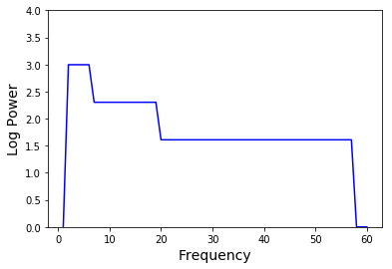
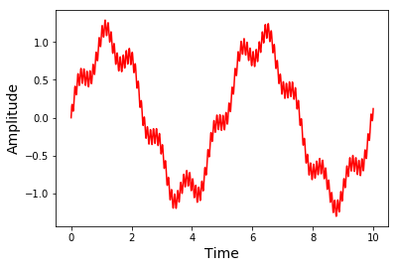
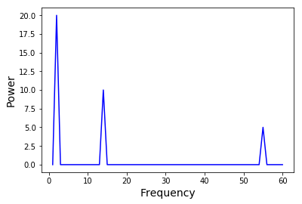
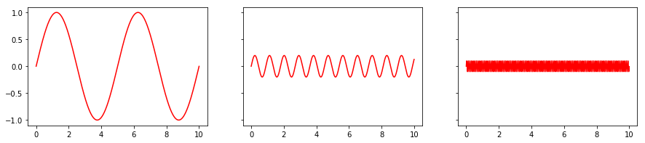
Bin using
Mel filterbank
and take log
Δt₁
Compute
power
spectrum

Slide 9
Bin using
Mel filterbank
and take log
Δt₁
Compute
power
spectrum

Slide 10
Represent as image
Bin using
Mel filterbank
and take log
Frequency
Δt₁
Δt₁
Compute
power
spectrum
Frequency
Δt₁ Δt₂ Δt₃ …

Slide 11
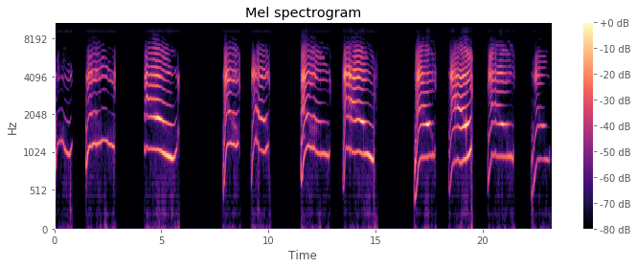
Final Mel Frequency
Spectrogram!
Overtones/harmonics
appear above the
fundamental frequency

Slide 12

Demo Python Script in Jupyter Notebook
Demo Problem: Simplified version of Kaggle’s Freesound General-Purpose
Audio Tagging Challenge
Load data from blob storage
Initial data preprocessing
Compute Mel frequency spectrograms
Train 2D CNN using keras
Investigate mystery File #3

Slide 13
Conclusions
CNNs can be used to classify audio signals
Mel frequency spectrograms can aid in featurization
Librosa and keras libraries make it easy to build these models in Python

