Slide 1
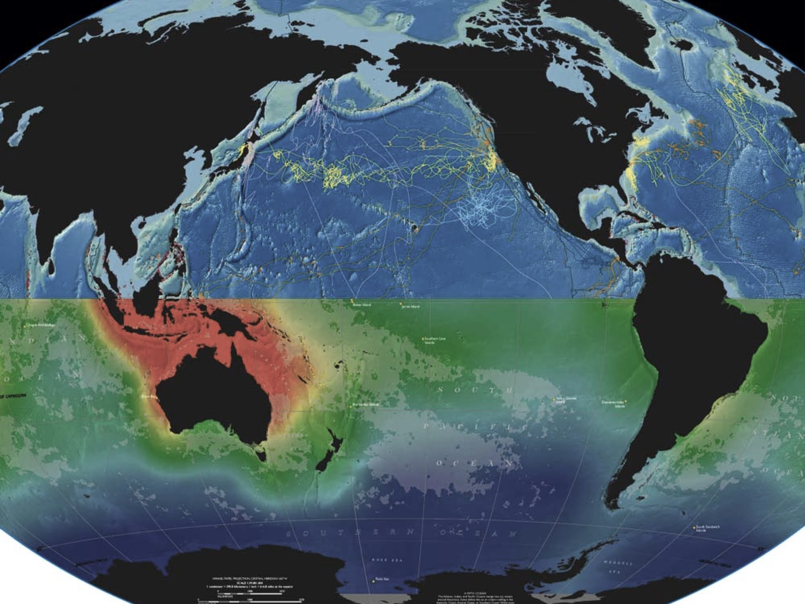


Oceans of Data:
Reproducible Marine Science
bit.y
Ben Best, PhD (EcoQuants)
2017-01-25 at UCSB Library’s Collaboratory
Reproducible Data Research: It’s Complicated
Notes:
http://www.library.ucsb.edu/events-exhibitions/reproducible-data-research

Slide 2
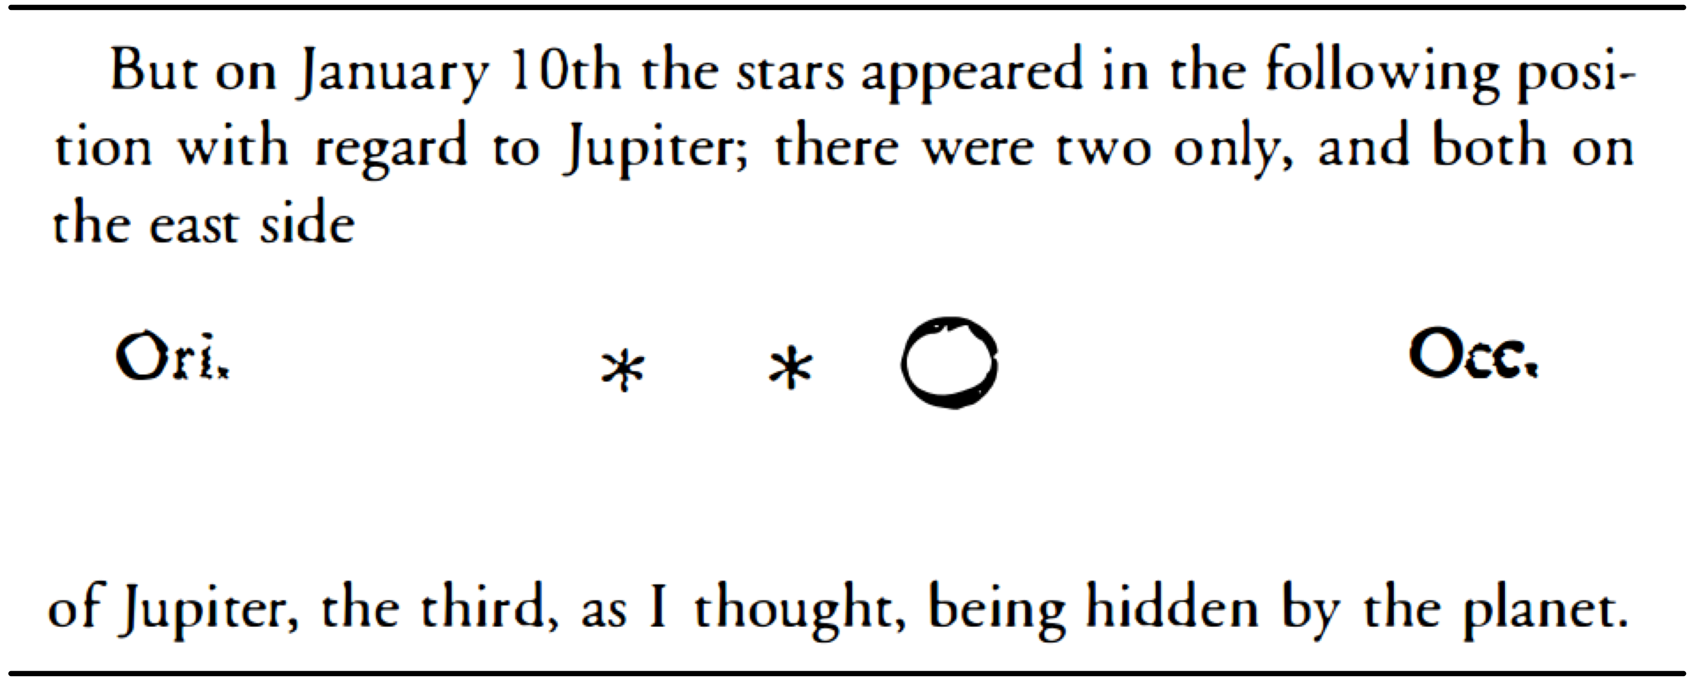
Reproducible Research
- Galileo Galilei (1610) Sidereus nuncius
Science was always meant to be open | Authorea
authorea.com/users/3/articles/6316/_show_article
Notes:
[Science was always meant to be open | Authorea](https://www.authorea.com/users/3/articles/6316/_show_article)
Sidereus nuncius = Starry Messenger
Data: drawings
Metadata: timing (Jan 10)
Text: interpretation
1662 Philosophical Transactions

Slide 3

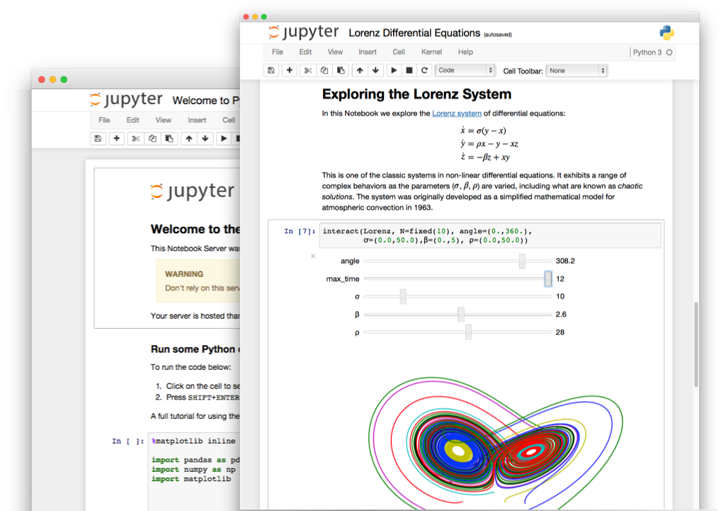

Slide 4
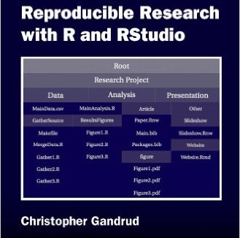
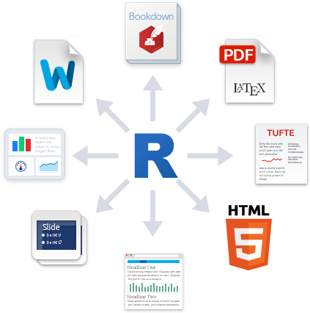
Reproducible Research with R and RStudio
markdown
christophergandrud.github.io/RepResR-RStudio
rmarkdown.rstudio.com
What is R Markdown? on Vimeo (1 min) vimeo.com/178485416

Slide 5
