Slide 1
Overview of the project
Targeted to Drexel's student who are actively looking for a job
Provides help if the student is looking for a job outside of Drexel System
Save student time and easy to navigate

Slide 2


Technologies Used
HTML
CSS
JavaScript
JQuery
Ajax
Node.js
MySQL database
Github

Slide 3
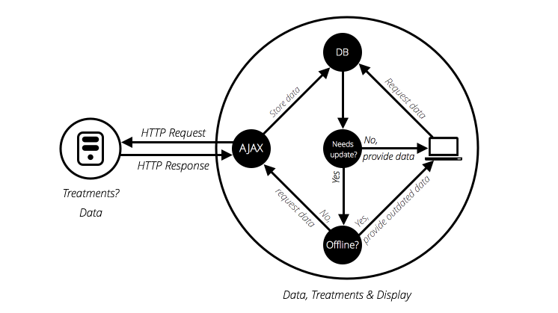
DataFlow
Client
BackEnd

Slide 4
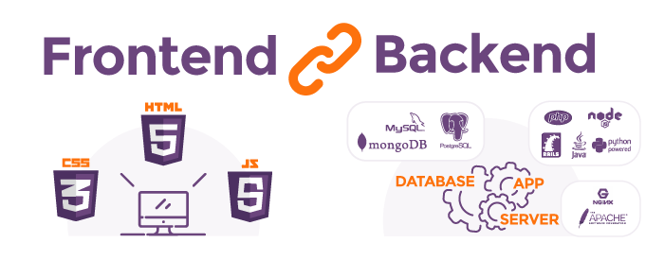
What we learned?

Slide 5
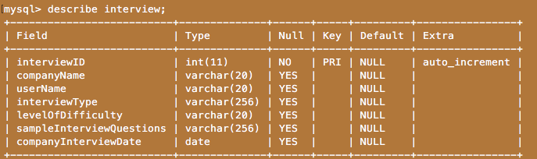
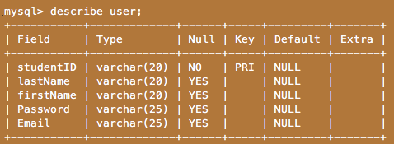
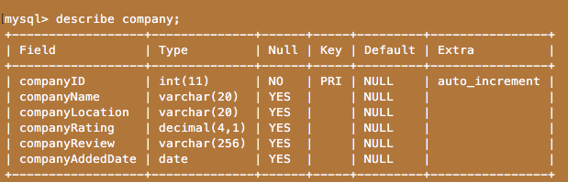
SQL Schema

Slide 6
Challenges Faced
Log In Handle
Jquery Classes
Emitter
SQL Injection

