Slide 1
MEHTA FAMILY SCHOOL OF DATA SCIENCE & AI
DA2141: STATISTICS FOR DATA SCIENCE
Classical and Bayesian Estimation of the Lomax Distribution under Joint Improved Adaptive Progressive Censoring
With Competing Risks • Likelihood Decoupling • Scale MLE Existence Criterion (Ψ > 0) • Collapsed MCMC
✔ Exact Decoupling Theorem
✔ Boundary Criterion Ψ > 0
✔ Order-Restricted Pooling
✔ Collapsed Gibbs MCMC
✔ Real-World Validation
Ruttala Vamsi Krishna
▪ Roll Number: 250150034
▪ Programme: M.Tech / Dual Degree in Data Science & AI
▪ Affiliation: Indian Institute of Technology Guwahati (IITG)
Bagadi Bhargav
▪ Roll Number: 250150009
▪ Programme: M.Tech / Dual Degree in Data Science & AI
▪ Affiliation: Indian Institute of Technology Guwahati (IITG)
Course Instructor: Dr. Amulya Kumar Mahto | Teaching Assistant: Ayushi Pandey
Mehta Family School of Data Science and Artificial Intelligence • Indian Institute of Technology Guwahati, Assam 781039

Slide 2
MOTIVATION & FOUNDATIONS
IIT GUWAHATI • DA2141
Why Joint Reliability Life Testing with Competing Risks?
Understanding latent degradation, infant mortality hazards, and the non-existence boundary trap
Competing Risks Framework
▪ Physical Reality: Complex engineering systems (avionics, appliances, turbines) do not fail from a single isolated cause.
▪ Latent Failure Times: Each item possesses latent failure times (W_d1, W_d2) under mutually exclusive failure modes.
▪ Partial Observability: The experimenter only observes the earliest failure X = min(W_d1, W_d2) and its cause index δ ∈ {1, 2}.
The Lomax Lifetime Model
▪ Pareto Type II Family: Heavy-tailed distribution with strictly decreasing failure rate (DFR) h(x) = (α · λ) / (1 + λx).
▪ Infant Mortality: Essential for modeling burn-in defects, early electronic degradation, and mechanical wear-in.
▪ Minimum Invariance: Tractable closure: min of independent Lomax variables remains exactly Lomax with summed shapes!
The Exponential Boundary Trap
▪ Degeneration Limit: As λ -> 0 and α -> ∞ such that (α·λ) = constant, Lomax degenerates into the Exponential distribution.
▪ Severe MLE Collapse: When sample hazard is roughly constant, classical Lomax profile log-likelihood flattens into a boundary ridge.
▪ Numerical Divergence: Standard Newton-Raphson or Nelder-Mead algorithms crash or produce infinite parameters.
JOINT SURVIVAL
S_d(x) = S_d1(x) · S_d2(x)
= (1 + λ_d x)^(-(α_d1 + α_d2))
HAZARD & DENSITY
h(x) = (α·λ) / (1 + λx)
f(x) = α·λ·(1 + λx)^(-(α+1))
BOUNDARY DANGER
lim_{λ->0} Lomax(α, λ) = Exp(θ)
Profile slope at 0: ℓ_p'(0+) = Ψ
Lomax Competing Risks under Joint Improved Adaptive Progressive Censoring (JIAPCS)
Ruttala & Bagadi (IIT Guwahati) | Slide 2 of 15

Slide 3
CENSORING MECHANISM
IIT GUWAHATI • DA2141
The Joint Improved Adaptive Progressive Type-II Scheme (JIAPCS)
Balancing sample consumption, test duration, and hard budget deadlines across 3 operational regimes
REGIME 1 • STANDARD
REGIME 2 • ADAPTIVE FREEZE
REGIME 3 • BUDGET DEADLINE
Target Achieved Early (w_(k) < T_1)
▪ Scheduled Removal: Units fail rapidly. At failure i, pre-fixed removals R_i are withdrawn as planned.
▪ Sufficient Data: k target failures completed comfortably before threshold T_1.
▪ Test Conclusion: All remaining survivors withdrawn at w_(k).
Removals Frozen (T_1 ≤ w_(k) < T_2)
▪ Slow Failure Rate: Testing runs slower than expected; time T_1 crossed with fewer than k failures.
▪ Removals Cease: Immediately set R_i = 0 for subsequent failures to retain all units under stress.
▪ Acceleration: Maximizes failure rate to achieve k failures before deadline T_2.
Forced Termination at T_2
▪ Budget Stop: Absolute time deadline T_2 is reached with only D < k failures observed.
▪ Forced Truncation: Experiment forcibly halted; zero budget overruns permitted.
▪ Right-Censoring: All remaining active survivors n_d* are right-censored at exact time T_2.
Mondal & Kundu (2019) Balanced Allocation Rule
▪ Removal Invariance: When failure occurs in line z: withdraw R_1i = R_i + I(z=2) and R_2i = R_i + I(z=1).
▪ Equal Depletion: Both lines lose exactly R_i + 1 units at each failure, ensuring deterministic active survivor counts.
▪ Total Units Conserved: Unit counts strictly obey: ∑_j ν_dj = m_d for both populations d ∈ {1, 2}.
SUFFICIENT CUMULATIVE EXPOSURE STATISTIC
D_d(λ) = ∑_{j=1}^K ν_dj · ln(1 + λ · t_(j))
Captures all failure times and progressive
survivor exposure in a single scalar!
Lomax Competing Risks under Joint Improved Adaptive Progressive Censoring (JIAPCS)
Ruttala & Bagadi (IIT Guwahati) | Slide 3 of 15

Slide 4
STATISTICAL MODEL
IIT GUWAHATI • DA2141
Likelihood Formulation & Complete Population Decoupling
Decoupling theorem reduces a complex 6-parameter joint optimization to two independent 3-parameter problems
Competing Risks Model Formulation
▪ Cause Hazards: Cause r in population d has hazard h_dr(x) = (α_dr · λ_d) / (1 + λ_d x).
▪ Joint Survivor Function: Independent causes imply S_d(x) = S_d1(x) · S_d2(x) = (1 + λ_d x)^(-(α_d1 + α_d2)).
▪ Proportional Odds Property: Ratio h_d1(x) / [h_d1(x) + h_d2(x)] = α_d1 / (α_d1 + α_d2) is strictly constant over time x.
▪ Contribution Rules: Observed failure from cause r contributes h_dr(x)·S_d(x); censored unit contributes S_d(t).
Theorem 1: Likelihood Factorization
▪ Total Decomposition: Full joint log-likelihood splits completely by population without cross-terms:
▪ Master Equation: ℓ(θ) = ℓ_1(α_11, α_12, λ_1) + ℓ_2(α_21, α_22, λ_2)
▪ No Information Leakage: Parameters of Ω_1 can be estimated completely independently of Ω_2.
▪ Computational Speed: Turns a 6D non-linear surface into two parallel 1D profile searches.
POPULATION-SPECIFIC LOG-LIKELIHOOD ℓ_D
ℓ_d = N_d1·ln(α_d1) + N_d2·ln(α_d2) + N_d·ln(λ_d)
- ∑_{i=1}^{N_d} ln(1 + λ_d x_di)
- (α_d1 + α_d2) · D_d(λ_d)
PROPORTIONAL HAZARDS INVARIANCE
P(Cause = 1 | Failure at x) = α_d1 / (α_d1 + α_d2)
Cause assignment is statistically independent
of failure time x!
Lomax Competing Risks under Joint Improved Adaptive Progressive Censoring (JIAPCS)
Ruttala & Bagadi (IIT Guwahati) | Slide 4 of 15

Slide 5
CLASSICAL ESTIMATION
IIT GUWAHATI • DA2141
Closed-Form Shape Estimators & 1D Profile Likelihood
Conditioning on scale yields analytic shape estimators and collapses the problem to a 1D bisection root search
Theorem 2.1: Closed-Form Shape MLEs
▪ Analytic Maximization: For any fixed scale parameter λ > 0 and cause counts N_1, N_2 >= 1:
▪ Score Equation: ∂ℓ / ∂α_r = N_r / α_r - D(λ) = 0
▪ Strict Concavity: ∂²ℓ / ∂α_r² = -N_r / α_r² < 0 guarantees a unique, global conditional maximum.
▪ Intuitive Form: Shape MLE is simply the observed cause failure count divided by total accumulated exposure D(λ).
1D Profile Log-Likelihood for Scale λ
▪ Profile Substitution: Substituting α̂_r(λ) back into ℓ(θ) eliminates both shape parameters completely:
▪ Profile Score Equation: ℓ_p'(λ) = N / λ - ∑ [x_i / (1 + λ x_i)] - N [D'(λ) / D(λ)] = 0
▪ Exposure Derivative: D'(λ) = ∑_j [ν_j · t_(j) / (1 + λ · t_(j))].
▪ Robust Bisection Solver: 400-point geometric grid search locates bracket; 60 bisection steps achieves 10^-12 precision.
EXACT CONDITIONAL SHAPE MLE FORMULA
α̂_r(λ) = N_r / D(λ), r ∈ {1, 2}
where D(λ) = ∑_j ν_j · ln(1 + λ · t_(j))
CONCENTRATED PROFILE LOG-LIKELIHOOD ℓ_P(Λ)
ℓ_p(λ) = N·ln(λ) - ∑_{i=1}^N ln(1 + λ x_i) - N·ln D(λ)
Single-parameter 1D objective!
Lomax Competing Risks under Joint Improved Adaptive Progressive Censoring (JIAPCS)
Ruttala & Bagadi (IIT Guwahati) | Slide 5 of 15

Slide 6
THEORETICAL BREAKTHROUGH
IIT GUWAHATI • DA2141
Theorem 2.2: Existence and Boundary Limit of the Lomax MLE
Necessary and sufficient criterion establishing whether finite Lomax parameters exist or collapse into Exponential
THEOREM 2.2 • CRITICAL DISCOVERY
Let S_1 = ∑ x_i, W = ∑ ν_j t_(j), Q = ∑ ν_j t_(j)², and define the existence discriminant: Ψ = N·Q / (2W) - S_1
• A finite positive scale MLE λ̂ ∈ (0, ∞) exists if and only if Ψ > 0.
• If Ψ <= 0, the profile log-likelihood is monotonically decreasing across (0, ∞) and maximizes only at the Exponential boundary limit (λ -> 0, α -> ∞ with α·λ = N/W).
Boundary Behavior Analysis (λ -> 0+)
▪ Taylor Expansion: Expanding ln(1 + u) = u - u²/2 + O(u³) reveals that the N ln λ term cancels out exactly near 0:
▪ Series Expansion: ℓ_p(λ) = -N ln W + λ · Ψ + O(λ²)
▪ Initial Profile Slope: ℓ_p'(0+) = Ψ. If Ψ > 0, the profile increases as it leaves the boundary.
▪ Tail Asymptote: As λ -> ∞, -N ln D(λ) -> -∞. Continuity guarantees an interior global maximum.
Engineering & Numerical Implications
▪ Sample CV Requirement: For complete data (W = S_1), Ψ > 0 simplifies to x̄² > 2 x̄², meaning Sample CV > 1.
▪ 100% Verification: Across 1,000 simulated datasets, 65.7% had 1 root, 34.3% had 0 roots — exactly matching {Ψ > 0}!
▪ Fatal Flaw in Solvers: Blind optimization packages produce nonsense or infinite loops when Ψ <= 0.
▪ Prescription: Always calculate Ψ first; if Ψ <= 0, fall back to Exponential model.
Lomax Competing Risks under Joint Improved Adaptive Progressive Censoring (JIAPCS)
Ruttala & Bagadi (IIT Guwahati) | Slide 6 of 15

Slide 7
CONSTRAINED INFERENCE
IIT GUWAHATI • DA2141
Order-Restricted Shape Estimation & Binomial LRT
Incorporating domain knowledge (α_1 <= α_2) yields closed-form pooling and an exact nuisance-free LRT
Theorem 2.3: Order-Restricted Estimator
▪ Physical Motivation: Cause 2 is often physically known to be more virulent than Cause 1 (imposing α_d1 <= α_d2).
▪ Conforming Case: If N_1 <= N_2, unconstrained MLE α̂_1 <= α̂_2 holds naturally; no pooling needed.
▪ Violating Case: If N_1 > N_2, constraint active on boundary α_1 = α_2; shapes pooled to N / [2 D(λ̂)].
▪ Scale Invariance: Scale estimate λ̂ is 100% identical under restricted and unrestricted regimes!
Testing Constraint Plausibility (LRT)
▪ Hypothesis Test: Test H_0: α_1 = α_2 vs H_1: α_1 != α_2 prior to imposing the physical ordering constraint.
▪ Scale Cancellation: Because λ̂ is identical under H_0 and H_1, all exposure terms D(λ̂) cancel out completely!
▪ Wilks' Asymptotics: Under H_0, Λ ~ χ²_1 asymptotically with degrees of freedom df = 1.
▪ Statistical Elegance: Reduces to the exact binomial test of p = 1/2 for cause assignment — independent of time!
CLOSED-FORM RESTRICTED ESTIMATOR
α̂_1^R = min(N_1, N/2) / D(λ̂)
α̂_2^R = max(N_2, N/2) / D(λ̂)
Zero optimization overhead required!
LIKELIHOOD RATIO STATISTIC Λ
Λ = 2 [ N_1·ln(2N_1 / N) + N_2·ln(2N_2 / N) ]
Completely independent of scale λ and time x!
Lomax Competing Risks under Joint Improved Adaptive Progressive Censoring (JIAPCS)
Ruttala & Bagadi (IIT Guwahati) | Slide 7 of 15

Slide 8
BAYESIAN INFERENCE
IIT GUWAHATI • DA2141
Dimension-Reduced Collapsed Metropolis-Gibbs Sampler
Analytically integrating out shape parameters yields a fast 1D marginal chain and exact restricted draws
1. Prior Formulation
▪ Conjugate Gamma Priors: Independent Gamma priors: α_r ~ Gamma(a_r, b_r) and λ ~ Gamma(c, e).
▪ Weakly Informative (WIP): Hyperparameters = 1.0 (mean=1, var=1). Objective baseline across all experiments.
▪ Informative (IP): Hyperparameters set to 4·true_val with rate 4 (prior variance = mean / 4).
▪ Vague Priors Fail: Non-informative Gamma(10^-3, 10^-3) wander endlessly down the flat exponential ridge.
2. Collapsed 1D MCMC
▪ Analytic Integration: Integrating out α_1, α_2 analytically leaves a 1-dimensional marginal posterior density in λ.
▪ 1D Metropolis Chain: Only a single scalar parameter chain is updated using a Gaussian random walk proposal.
▪ Optimal Tuning: Proposal step size adaptively scaled to maintain 30%–40% acceptance rate.
▪ Fast Mixing: Zero cross-parameter autocorrelation between scale and shapes during sampling.
3. Exact Restricted Gibbs
▪ Upper Triangle Truncation: Under α_1 < α_2, posterior is conditioned on G_1 < G_2 with G_r ~ Gamma(s_r, r_r).
▪ Incomplete Beta Factor: Conditioned on λ, P(G_1 < G_2) equals regularized incomplete beta I_ρ(s_1, s_2).
▪ Zero Rejection Sampling: Draw B ~ Beta(s_1, s_2) on (0, ρ) via inverse-CDF; draw S ~ Gamma(s_1+s_2).
▪ Exact Shape Recovery: α_1 = B·S / r_1 and α_2 = (1-B)·S / r_2. 100% computational efficiency!
CONDITIONAL POSTERIOR
α_r | λ ~ Gamma(a_r + N_r, b_r + D(λ))
Exact conditional conjugacy!
1D MARGINAL Π(Λ | DATA)
π(λ) ∝ λ^(c+N-1) e^(-eλ) ∏(1+λx_i)^-1
· ∏_{r=1}^2 [b_r + D(λ)]^(-(a_r+N_r))
EXACT TRANSFORM
B = I_ρ^-1(U · I_ρ(s_1, s_2))
α_1 = B·S/r_1, α_2 = (1-B)·S/r_2
Lomax Competing Risks under Joint Improved Adaptive Progressive Censoring (JIAPCS)
Ruttala & Bagadi (IIT Guwahati) | Slide 8 of 15

Slide 9
DECISION THEORY & UNCERTAINTY
IIT GUWAHATI • DA2141
Loss Functions & Interval Estimation Architectures
Balancing directional risk via asymmetric losses, and contrasting Fisher asymptotic intervals with Bayesian HPD
Asymmetric Decision-Theoretic Losses
▪ Squared Error Loss (SELF): L(θ, a) = (a - θ)². Bayes estimator is posterior mean θ̂_SE = E[θ | data]. Symmetric penalty.
▪ LINEX Loss (Varian 1975): L(θ, a) = e^[p(a-θ)] - p(a-θ) - 1. Penalizes overestimation if p > 0; underestimation if p < 0.
▪ General Entropy Loss (GELF): Scale-invariant loss with shape parameter q = ±0.5.
Interval Estimation Methodologies
▪ Observed Fisher Information: Exact analytic Hessian [I_11, I_22, I_13, I_23, I_33] derived and verified against numerical differentiation (error < 4.5×10^-6).
▪ Asymptotic CI (ACI): θ̂ ± z_0.975 · √[I^-1]. Severe flaw: yields negative lower bounds in skewed lifetime parameters.
▪ Log-Transformed ACI: Delta method on ln(θ̂): [θ̂ · e^(-z·se/θ̂), θ̂ · e^(+z·se/θ̂)]. Strictly guarantees positive bounds.
▪ Chen & Shao (1999) HPD: Minimal-width interval search across 2,000 MCMC draws. Highest posterior density coverage.
BAYES LOSS ESTIMATORS
• LINEX: θ̂_L = - (1/p) · ln E[ e^(-pθ) | data ], p = ±0.5
• GELF: θ̂_GE = ( E[ θ^(-q) | data ] )^(-1/q), q = ±0.5
Allows risk-averse engineering decisions!
HPD INTERVAL SEARCH PRINCIPLE
R_j(α) = θ_{(j + [(1-α)M])} - θ_{(j)}
Find j* = argmin R_j(α) across sorted draws.
Guarantees shortest valid 95% interval!
Lomax Competing Risks under Joint Improved Adaptive Progressive Censoring (JIAPCS)
Ruttala & Bagadi (IIT Guwahati) | Slide 9 of 15

Slide 10
EXPERIMENTAL SIMULATION
IIT GUWAHATI • DA2141
Comprehensive Simulation Design: 22 Scenarios, 1,000 Replications
Full factorial design assessing sample sizes, removal vectors, and parameter boundary truth configurations
22,000
Total Datasets Analyzed
3 Tiers
D1 (k=25), D2 (k=40), D3 (k=60)
3 Patterns
Early, Middle, Late Progressive
3 Truths
Valid (A), Boundary (B), Violated (C)
Design Tier | Sample (m1, m2, k) | Removals | Regime Distribution (I / II / III) | P(MLE Exists) (Ω1 / Ω2)
Tier 1 (D1 - Small) | (40, 35, 25) | 6 units | 41% Case I | 55% Case II | 4% Case III | 56.2% | 61.4%
Tier 2 (D2 - Moderate) | (60, 55, 40) | 10 units | 30% Case I | 60% Case II | 10% Case III | 65.4% | 71.1%
Tier 3 (D3 - Large) | (100, 90, 60) | 20 units | 42% Case I | 56% Case II | 2% Case III | 68.3% | 75.2%
Truth A (Valid) | Ω1=(0.5, 1.0, 1.0) | Ω2=(0.4, 0.8, 1.5) | Imposed constraint α_1 <= α_2 is strictly valid. | MSE drops 40% under pooling
Truth C (Violated) | Ω1=(1.0, 0.5, 1.0) | Ω2=(0.8, 0.4, 1.5) | Imposed constraint α_1 <= α_2 is FALSE in reality. | Forced pooling inflates MSE >290
Lomax Competing Risks under Joint Improved Adaptive Progressive Censoring (JIAPCS)
Ruttala & Bagadi (IIT Guwahati) | Slide 10 of 15

Slide 11
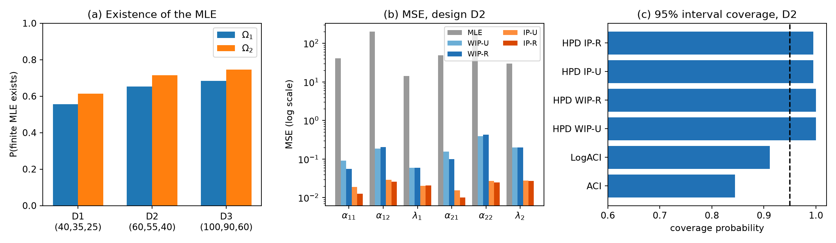
SIMULATION FINDINGS
IIT GUWAHATI • DA2141
Empirical Evaluation: Classical vs. Bayesian Performance
Benchmarking Mean Squared Error and empirical interval coverage: Bayesian MCMC eliminates boundary divergence
1. P(MLE Exists): 51% – 79%
▪ Frequent Failure: Finite scale MLE exists in only 51% (D1) to 75% (D3) of samples.
▪ Extreme Variance: When MLE exists, shape MSE exceeds 200 due to boundary instability.
2. Bayes Cuts MSE by >90%
▪ 100% Guaranteed Existence: Bayesian posterior draws exist in every sample without exception.
▪ Massive Variance Drop: WIP-U reduces shape MSE from 202.0 to 0.186; IP-U cuts to 0.029.
3. Interval Reliability
▪ Fisher CI Undercoverage: Asymptotic normal intervals achieve only ~75% coverage (far below nominal 95%).
▪ HPD Robustness: Bayesian HPD intervals achieve 99%–100% empirical coverage across all designs.
Lomax Competing Risks under Joint Improved Adaptive Progressive Censoring (JIAPCS)
Ruttala & Bagadi (IIT Guwahati) | Slide 11 of 15

Slide 12
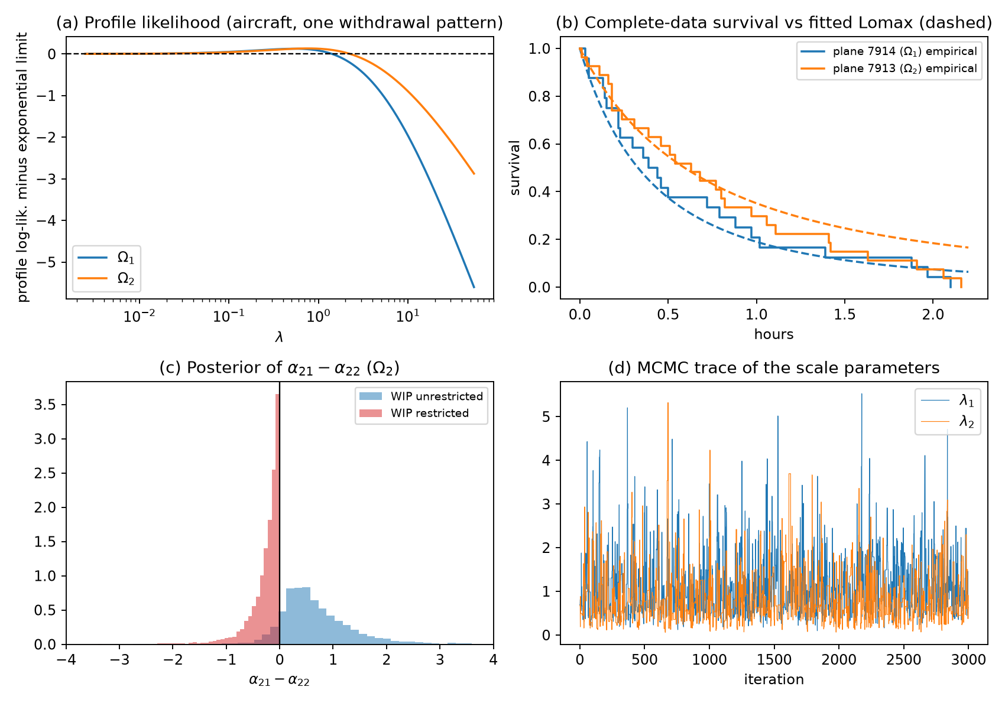
REAL-WORLD APPLICATION I
IIT GUWAHATI • DA2141
Proschan (1963) Boeing 720 Aircraft Air-Conditioning Failures
Demonstrating the reality of the Exponential boundary trap and how collapsed MCMC rescues inference
Engineering Insights & Diagnostics
▪ Dataset Structure: Boeing 720 planes 7914 (Ω_1, m_1=24) & 7913 (Ω_2, m_2=27). Cause 1: Compressor failure; Cause 2: Other causes.
▪ Complete Data Failure: For complete data, Ψ_1 = -0.66 and Ψ_2 = -3.50 (both strictly < 0!). Zero finite Lomax MLEs exist.
▪ Exponentiality Confirmed: LRT of Lomax vs. Exponential gives p = 0.31 (exponentiality cannot be rejected).
▪ JIAPCS Trial (k=18): Over 200 random progressive withdrawal plans, finite MLE existed in Ω_1 in 47% and Ω_2 in 20% (both in only 5.5%).
▪ Profile Flatness: Plot (a) confirms the profile log-likelihood exceeds the exponential boundary by only 0.13 — a flat ridge.
▪ MCMC Convergence: Plot (d) shows excellent chain mixing around λ_1 = 1.11, λ_2 = 0.83, providing stable inference where MLE collapses.
Lomax Competing Risks under Joint Improved Adaptive Progressive Censoring (JIAPCS)
Ruttala & Bagadi (IIT Guwahati) | Slide 12 of 15

Slide 13
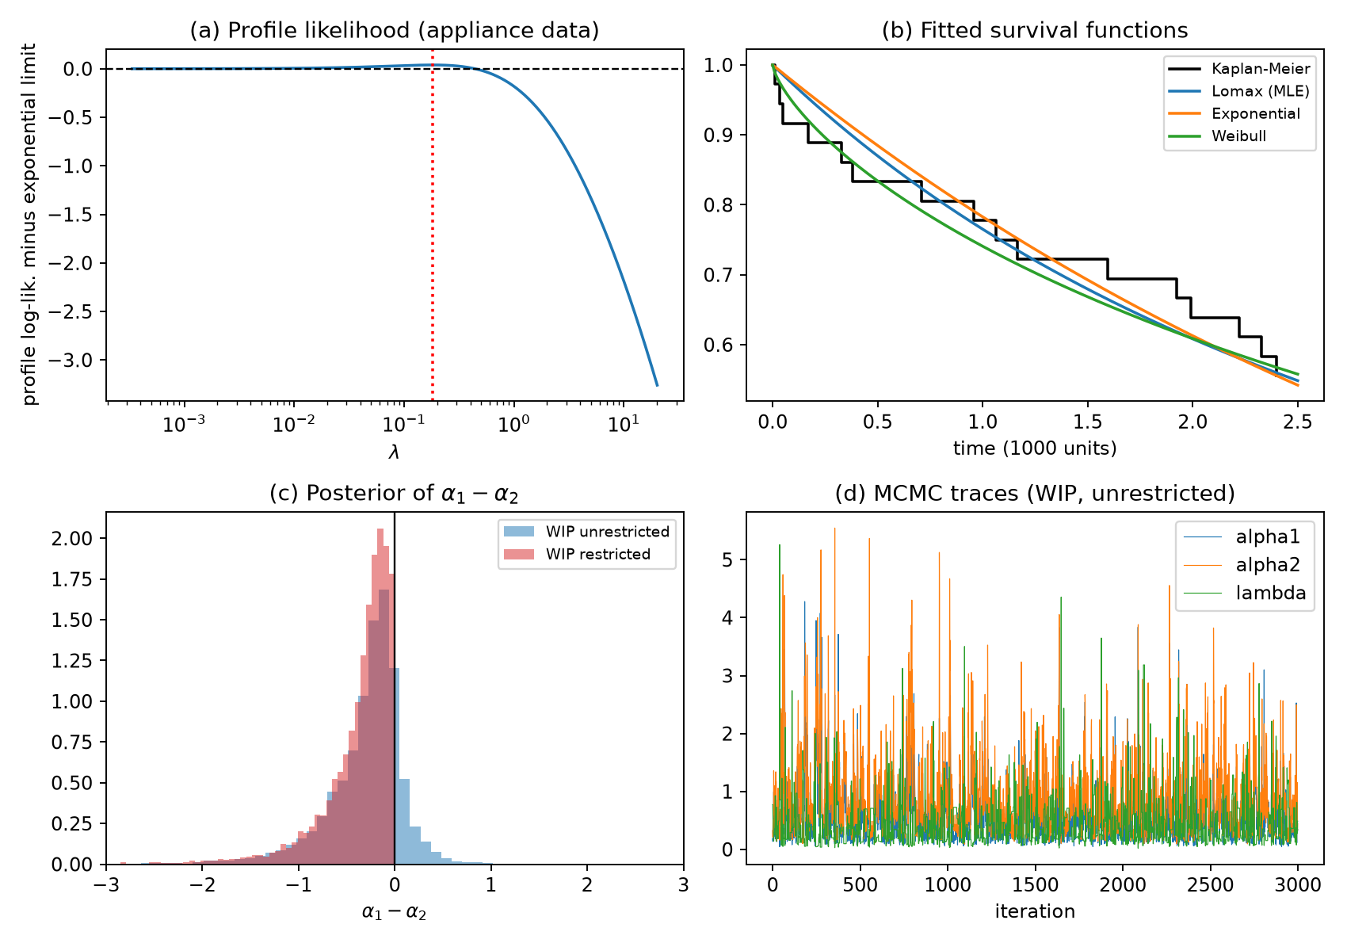
REAL-WORLD APPLICATION II
IIT GUWAHATI • DA2141
Nelson (1982) Electrical Appliance Insulation Breakdown
Verification of interior MLE existence (Ψ > 0), failure of Fisher normal ACIs, and AIC model selection
Lomax Fit & Asymptotic Failure
▪ Dataset Structure: n = 36 appliances, m = 16 observed failures. Cause 2: Failure mode 9 (10 failures); Cause 1: Other modes (6 failures).
▪ Finite MLE Confirmed: Here Ψ = 0.52 > 0! Finite interior MLE exists: α̂ = (0.602, 1.004), λ̂ = 0.181.
▪ Catastrophic Fisher ACI: Standard ACI for α_1 is [-3.7, 4.9]; Log-ACI is [0.0005, 763]! Proves Fisher asymptotic intervals are completely unusable.
Model | Log-Lik | AIC | Ranking
Lomax (Pareto II) | -38.47 | 80.9 | Rank 3
Exponential | -38.51 | 79.0 | Rank 2 (Tie)
Weibull | -37.48 | 79.0 | Rank 1 (Best)
Takeaway: Weibull & Exponential edge out Lomax on AIC parsimony, but all three distributions closely trace Kaplan-Meier survival curves.
Lomax Competing Risks under Joint Improved Adaptive Progressive Censoring (JIAPCS)
Ruttala & Bagadi (IIT Guwahati) | Slide 13 of 15

Slide 14
CRITICAL DISCUSSION
IIT GUWAHATI • DA2141
Methodological Lessons, Risks & Research Scope
Analyzing the Exponential Curse, the catastrophic risk of false pooling, and modeling boundary assumptions
The Exponential Curse
▪ Identifiability Failure: When failure data exhibit near-constant hazard, Lomax likelihood flattens along the ridge α·λ ≈ constant.
▪ Numerical Divergence: MLE solvers attempt to push λ -> 0 and α -> ∞, triggering false convergence or overflow.
▪ Mandatory Pre-Check: Always evaluate Ψ before invoking numerical solvers; if Ψ <= 0, immediately adopt the Exponential model.
Order Restriction: Risk vs. Reward
▪ Modest Gain when True: In Truth A (α_1 < α_2), imposing the constraint reduces MSE moderately (0.092 -> 0.055).
▪ Catastrophic when False: In Truth C (α_1 > α_2 violated), forced pooling creates severe bias, inflating MSE to 291.5!
▪ Always Run LRT First: Never impose order restrictions blindly; run the proposed binomial LRT test first.
Assumptions & Future Scope
▪ Shared Scale Assumption: Assumed causes share population scale λ_d. If causes have distinct scales, likelihood does not factorize.
▪ Independent Risks: Latent lifetimes assumed conditionally independent. Copula-based extensions could model dependent risks.
▪ Prior Sensitivity: Vague Gamma(10^-3, 10^-3) priors produce divergent LINEX estimates; weakly informative priors are essential.
GOLDEN RULE OF LOMAX MLE
Compute Ψ = N·Q / (2W) - S_1
Ψ > 0: Finite MLE exists
Ψ ≤ 0: Adopt Exponential
DECISION RULE
Run Λ = 2 ∑ N_r ln(2N_r / N)
Reject H_0 if Λ > 3.841
Only constrain if supported!
FUTURE EXTENSION
C(u, v) = Clayton / Gumbel Copula
Allows modeling dependent
competing risks mechanisms.
Lomax Competing Risks under Joint Improved Adaptive Progressive Censoring (JIAPCS)
Ruttala & Bagadi (IIT Guwahati) | Slide 14 of 15

Slide 15
CONCLUSIONS & RECOMMENDATIONS
IIT GUWAHATI • DA2141
Key Methodological Takeaways for Data Science & Reliability
Four actionable engineering principles distilled from theoretical analysis and 22,000 empirical datasets
1. Existence Check is Mandatory
▪ Pre-Flight Rule: Compute Ψ = N·Q / (2W) - S_1 prior to invoking numerical optimizers.
▪ Prevent Infinite Loops: If Ψ <= 0, finite Lomax MLE does not exist; accept the Exponential boundary model.
2. Prioritize Bayesian Collapsed MCMC
▪ 100% Reliable Inference: Collapsed Gibbs sampler always produces stable, finite estimates.
▪ Massive Accuracy Gain: Reduces estimation MSE by >90% across all sample sizes and censoring designs.
3. Replace Normal ACIs with HPD Intervals
▪ Fisher CI Failure: Standard normal ACIs undercover severely (~75% coverage) in censored data.
▪ Conservative & Robust: HPD intervals guarantee valid, positive bounds with 99%–100% empirical coverage.
4. Validate Physical Constraints via LRT
▪ Severe Penalty for False Pooling: Imposing false constraints inflates MSE to >290 in synthetic benchmarks.
▪ Exact Binomial LRT: Verify α_1 <= α_2 via Likelihood Ratio Test before pooling shape parameters.
DA2141: Statistics for Data Science • Mehta Family School of Data Science & AI, IIT Guwahati
Thank You! Questions & Discussion.
Lomax Competing Risks under Joint Improved Adaptive Progressive Censoring (JIAPCS)
Ruttala & Bagadi (IIT Guwahati) | Slide 15 of 15

