Slide 1

TERM 1 PROJECT
EDA OF MATCHES.CSV
Submitted By: Bhaskar Bharat
INSAID Batch: January 2019

Slide 2
Which Teams are the Winners, 1st Runners-Up & 2nd Runners-Up in each season?

Slide 3
Season | Winner | RunrsUp1 | RunrsUp2
2008 | Rajasthan Royals | Chennai Super Kings | Kings XI Punjab
2009 | Deccan Chargers | Royal Challengers Bangalore | Chennai Super Kings
2010 | Chennai Super Kings | Mumbai Indians | Royal Challengers Bangalore
2011 | Chennai Super Kings | Royal Challengers Bangalore | Mumbai Indians
2012 | Kolkata Knight Riders | Chennai Super Kings | Delhi Daredevils
2013 | Mumbai Indians | Chennai Super Kings | Rajasthan Royals
2014 | Kolkata Knight Riders | Kings XI Punjab | Chennai Super Kings
2015 | Mumbai Indians | Chennai Super Kings | Royal Challengers Bangalore
2016 | Sunrisers Hyderabad | Royal Challengers Bangalore | Gujarat Lions
2017 | Mumbai Indians | Rising Pune Supergiant | Kolkata Knight Riders
2018 | Chennai Super Kings | Sunrisers Hyderabad | Kolkata Knight Riders
We can see that both Mumbai Indians and Chennai Super Kings have won the tournament 3 times.
While Kolkata Knight Riders has won it for 2 times.

Slide 4
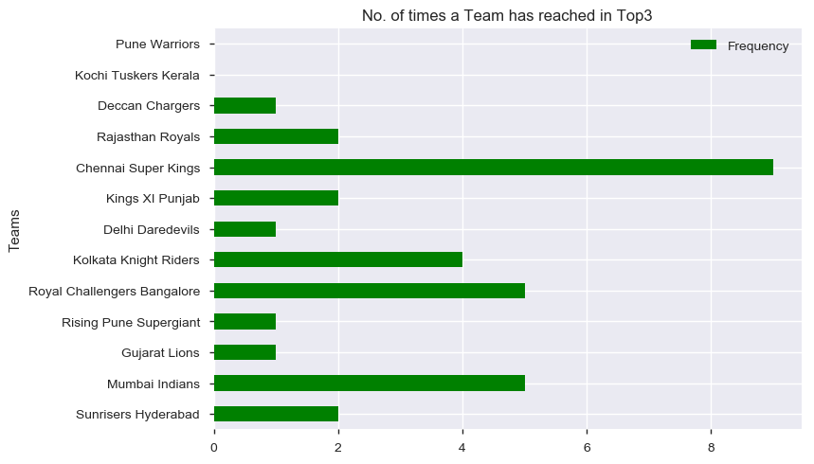
The figure shows that Chennai Super Kings has reached in the top 3 spots 9 times in the last 11 seasons, that is, 81% success rate.
After that Mumbai Indians and Royal Challengers Bangalore are there. They have reached 5 times in the last 11 seasons, that is, 45% success rate.
Kolkata Knight Riders is just behind Mumbai Indians and Royal Challengers Bangalore by securing their place in the top 3 spots 4 times in the last 11 seasons, that is, 36% success rate.

Slide 5
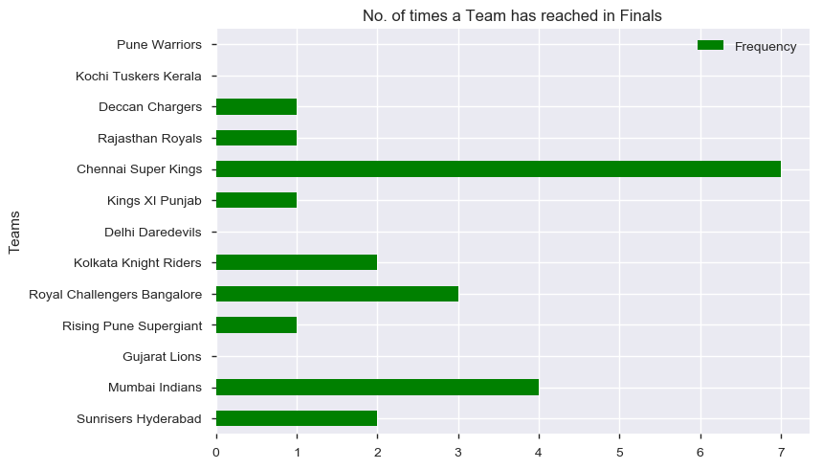
The figure shows that Chennai Super Kings has reached in the finals 7 times out of the 9 times it has reached in the Top 3, that is, 78% conversion rate.
After that Mumbai Indians is there. It has reached 4 times in the finals out of the 5 times it has reached in the Top 3, that is, 80% conversion rate.
Behind Mumbai Indians, Royal Challengers Bangalore has reached in the finals 3 times out of the 5 times it has reached in the Top 3, that is, 60% conversion rate.
Kolkata Knight Riders has reached in the finals 2 times out of the 4 times it has reached in the Top 3, that is, 50% conversion rate.

Slide 6
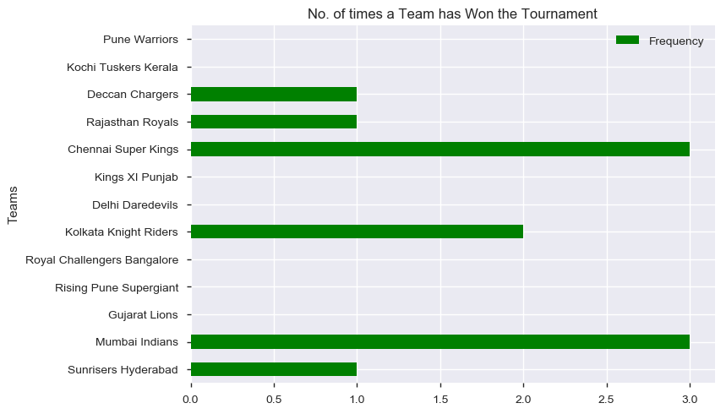
The figure shows that Chennai Super Kings has won the tournament 3 times out of the 7 times it has reached in the finals, that is, 43% conversion rate.
Mumbai Indians has also won the tournament 3 times out of the 4 times it has reached in the finals, that is, 75% conversion rate.
Kolkata Knight Riders has won the tournament 2 times out of the 2 times it has reached in the finals, that is, 100% conversion rate.

Slide 7
What is the Match Winning Percentage of each Team?

Slide 8
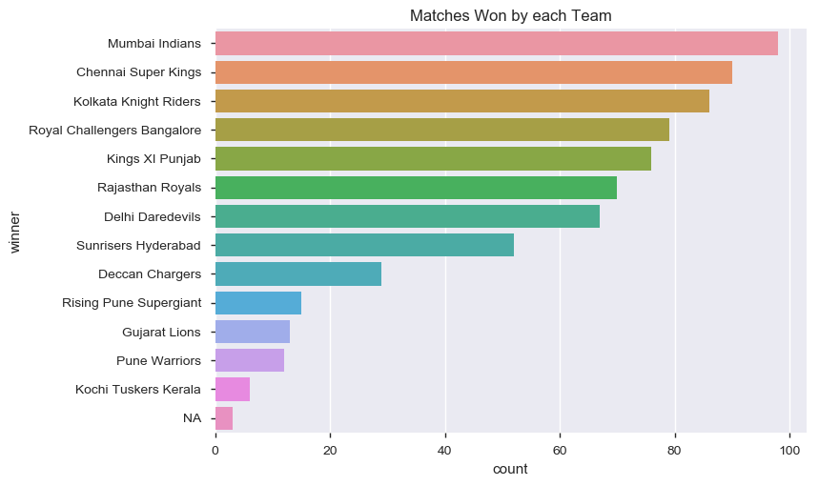
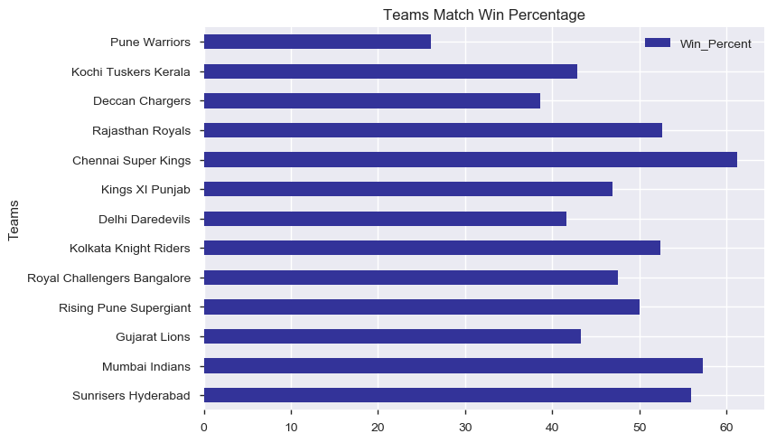
From the 2 observations we can see that:
Although Mumbai Indians has won the maximum number of matches in the 11 seasons that it has played, its match winning percentage is 57% (approx.) second highest after Chennai Super Kings' 62% (approx.).
Also, Sunrisers Hyderabad has a better match winning percentage than Kolkata Knight Riders & Rajasthan Royals.

Slide 9
What is the Impact of Toss on the Match Winning Percentage of each Team?

Slide 10
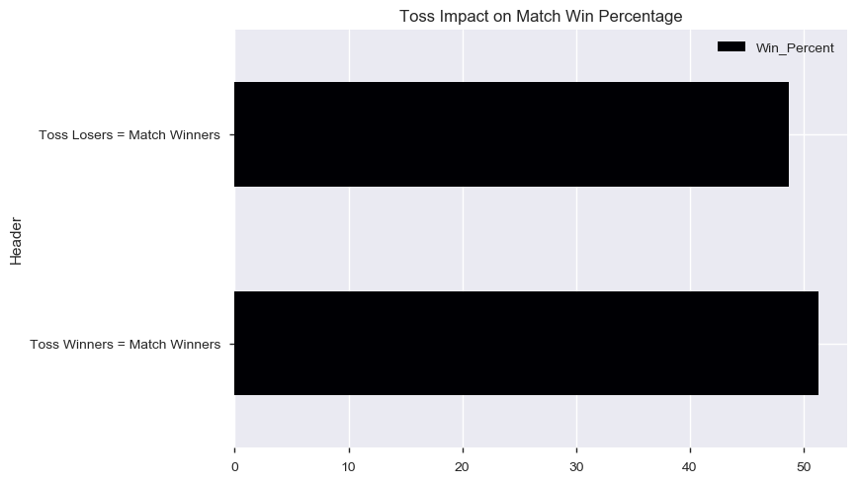
We can see that there is a slight advantage to the Toss Winning Team as far as Winning a Match is concerned.
52% (approx.) of the time Toss Winning Team is the Match Winning Team.

Slide 11
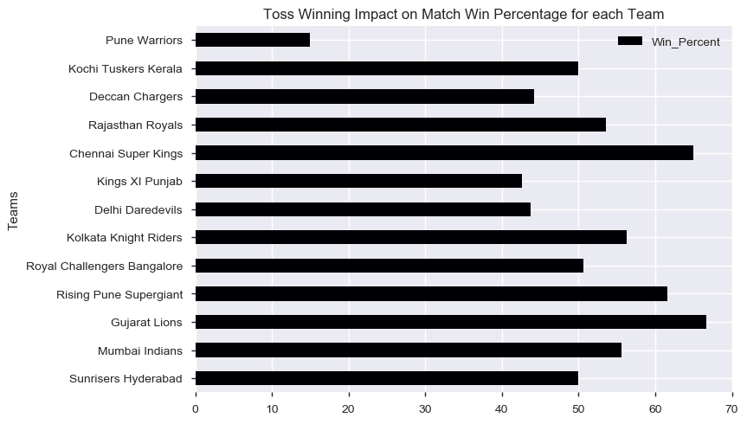
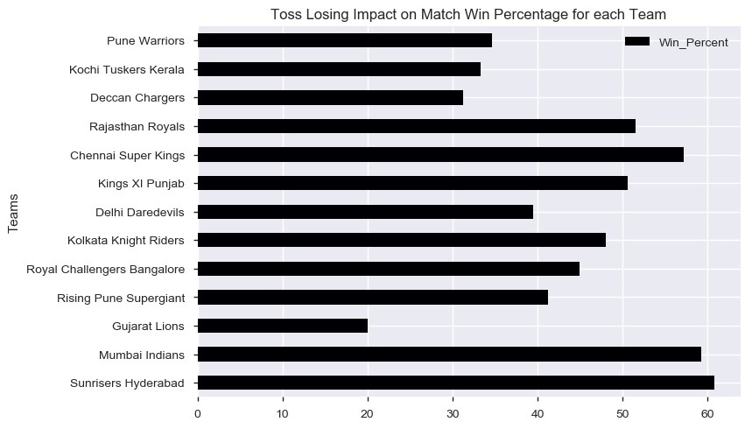
From the observations we can conclude that:
Mumbai Indians needs to capitalise more after winning the toss as compared to its close competitors Chennai Super Kings and Kolkata Knight Riders. Mumbai Indians needs to improve this figure by atleast 10%.
Although, after losing the toss Mumbai Indians has a slightly better track record of winning the matches with respect to its competitors Chennai Super Kings and Kolkata Knight Riders, but still it needs to further improve this figure by atleast 6%.

Slide 12
What is the Impact of Bat/Field First on the Match Winning Percentage of each Team?

Slide 13
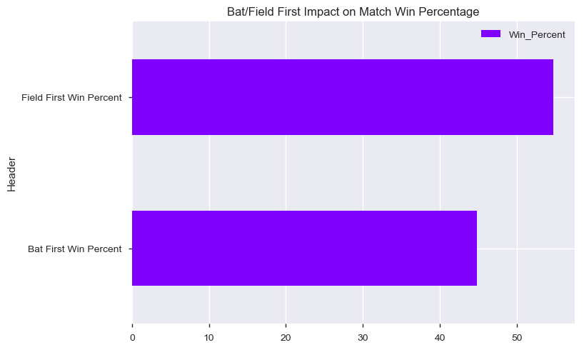
We can see that there is advantage to the Chasing Team as far as Winning a Match is concerned.
55% (approx.) of the time Fielding First Team is the Match Winning Team.

Slide 14
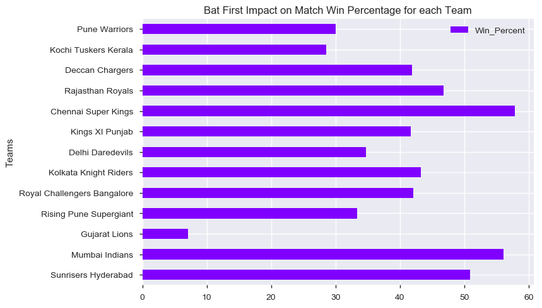
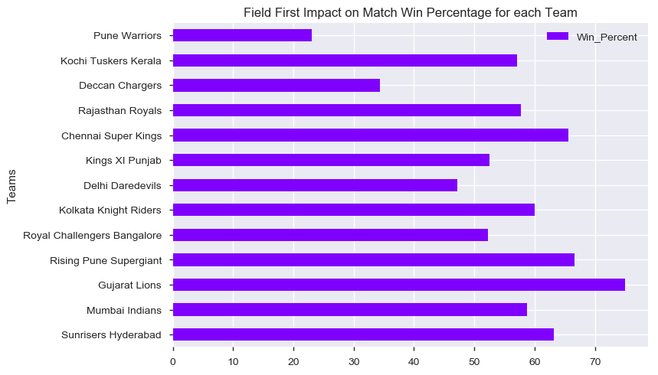
From the observations we can conclude that:
Mumbai Indians has a decent record while batting first as compared to its close competitor Chennai Super Kings. Mumbai Indians can improve this figure by around 10% to balance out with fielding first record.
Mumbai Indians is lagging behind in the fielding first statistic. It ranks 6th in this aspect. With respect to its competitors Chennai Super Kings and Kolkata Knight Riders it is short of 6% & 1% respectively. But from the winner of this category it is well short of 16%. So, Mumbai Indians needs to improve in this area by atleast 6% to put forth a strong challenge for other teams.

Slide 15
What is the Impact of Playing at Home Venue & at Away Locations on the Match Winning Percentage of each Team?

Slide 16
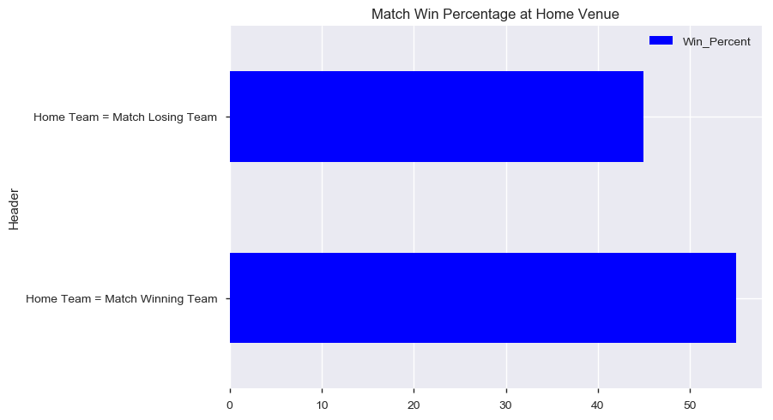
We can see that there is advantage to the Home Team as far as Winning a Match is concerned.
55% (approx.) of the time Home Team is the Match Winning Team.

Slide 17
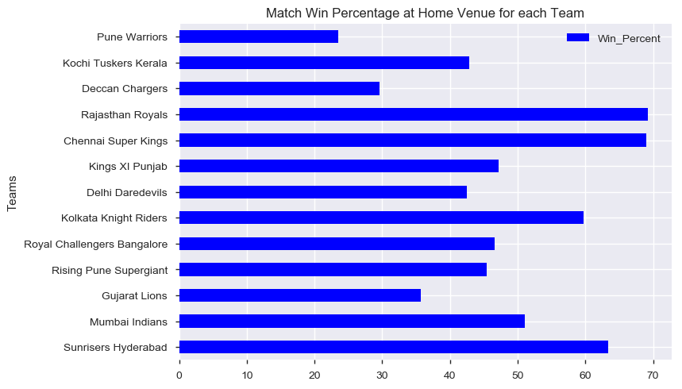
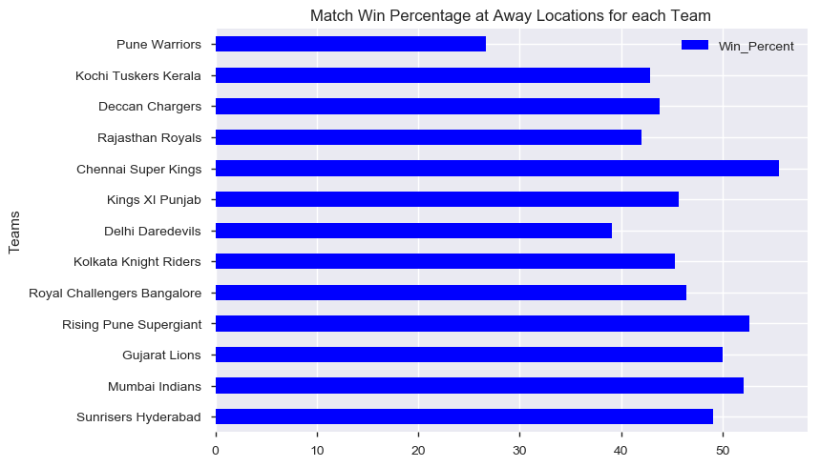
From the observations we can conclude that:
Chennai Super Kings has an excellent record both at home venue and away from home venue as well.
Kolkata Knight Riders has better record at home venue but is struggling a bit at away from home venues.
Mumbai Indians needs to improve its performance at home venue by atleast 10%. Away from home it has performed better but can further improve by 5% - 7%.

Slide 18
How each Team has Performed Season-Wise?

Slide 19
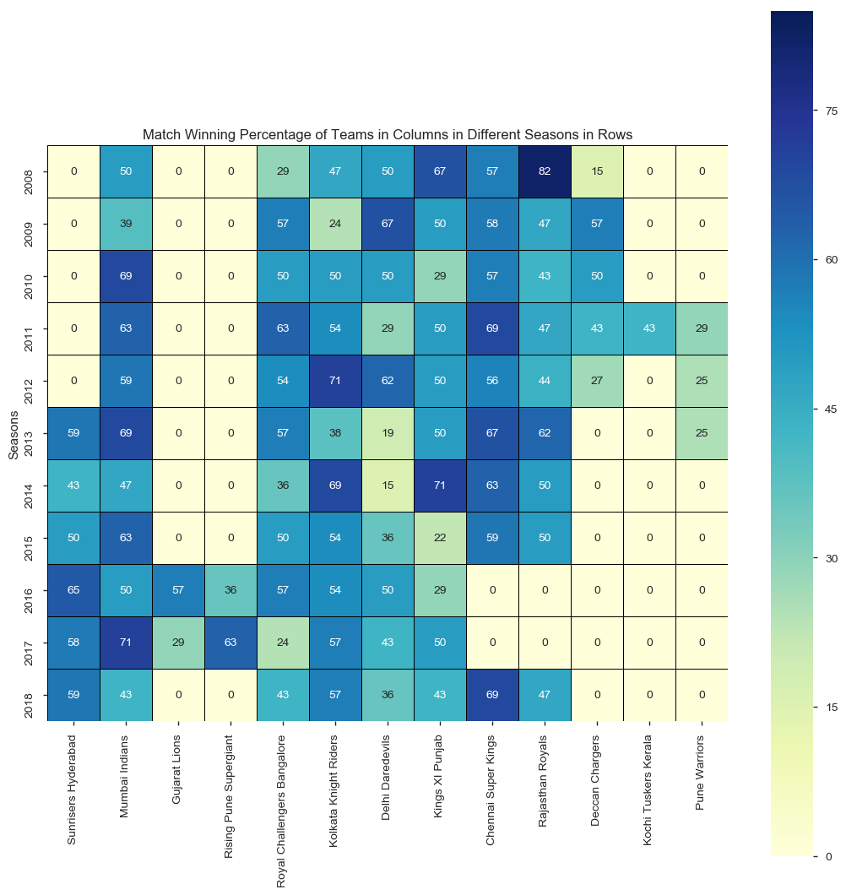
From the figure we can observe that:
Overall, the highest Match Winning Percentage 82% is registered by Rajasthan Royals in 2008.
Mumbai Indians has had 5 good seasons with Match Winning Percentage over 60% and 3 peak seasons with Match Winning Percentage close to 70%.
Chennai Super Kings has had 4 good seasons with Match Winning Percentage over 60% and 3 peak seasons with Match Winning Percentage close to 70%. Also, it has not played in 2 seasons.
Kolkata Knight Riders has had 2 good seasons with Match Winning Percentage over 60% and 1 peak season with Match Winning Percentage over 70%.
Also, we can observe that out of 13 Teams only 5 Teams have played all the 11 Seasons. Out of these 5 Teams, Delhi Daredevils has the weakest performance with Match Winning Percentage less than 50% 6 times.

Slide 20
Which Team has Won their Matches Comprehensively?

Slide 21
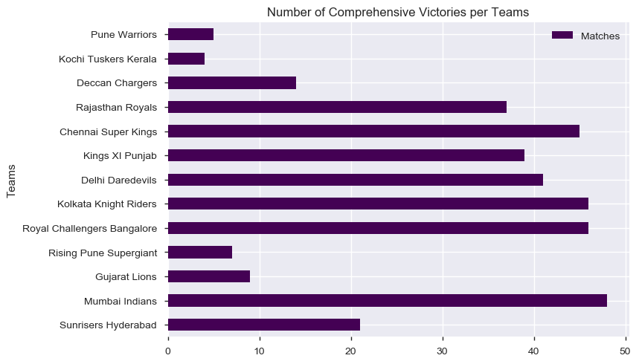
From the figure we can observe that:
Mumbai Indians has won the maximum number of matches comprehensively, 47 matches (approx.).
Kolkata Knight Riders and Royal Challengers Bangalore have won 45 matches each comprehensively.
Chennai Super Kings has won 44 matches comprehensively.

Slide 22
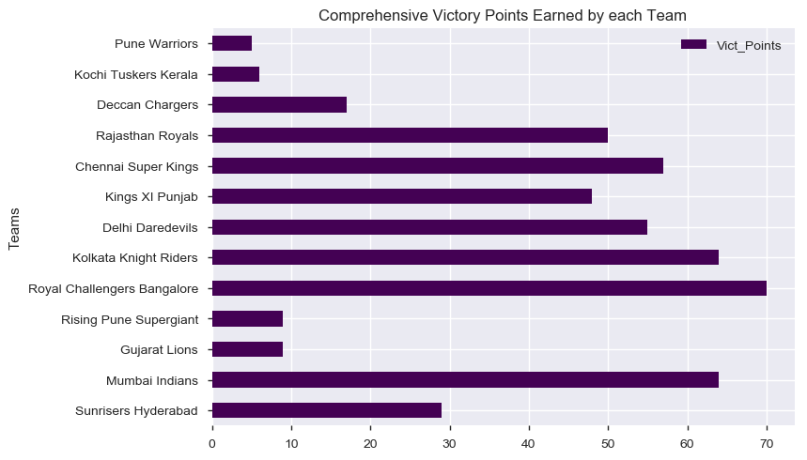
From the figure we can observe that:
Although Mumbai Indians has won the maximum number of matches comprehensively (47 matches (approx.)), Royal Challengers Bangalore has the highest Comprehensive Victory Points (70) which implies that Royal Challengers Bangalore has won their matches by greater margin than Mumbai Indians.
Kolkata Knight Riders and Mumbai Indians have 64 Comprehensive Victory Points each.
Chennai Super Kings has 57 Comprehensive Victory Points.

Slide 23
How the Teams have Performed when they have Played against each other?

Slide 24
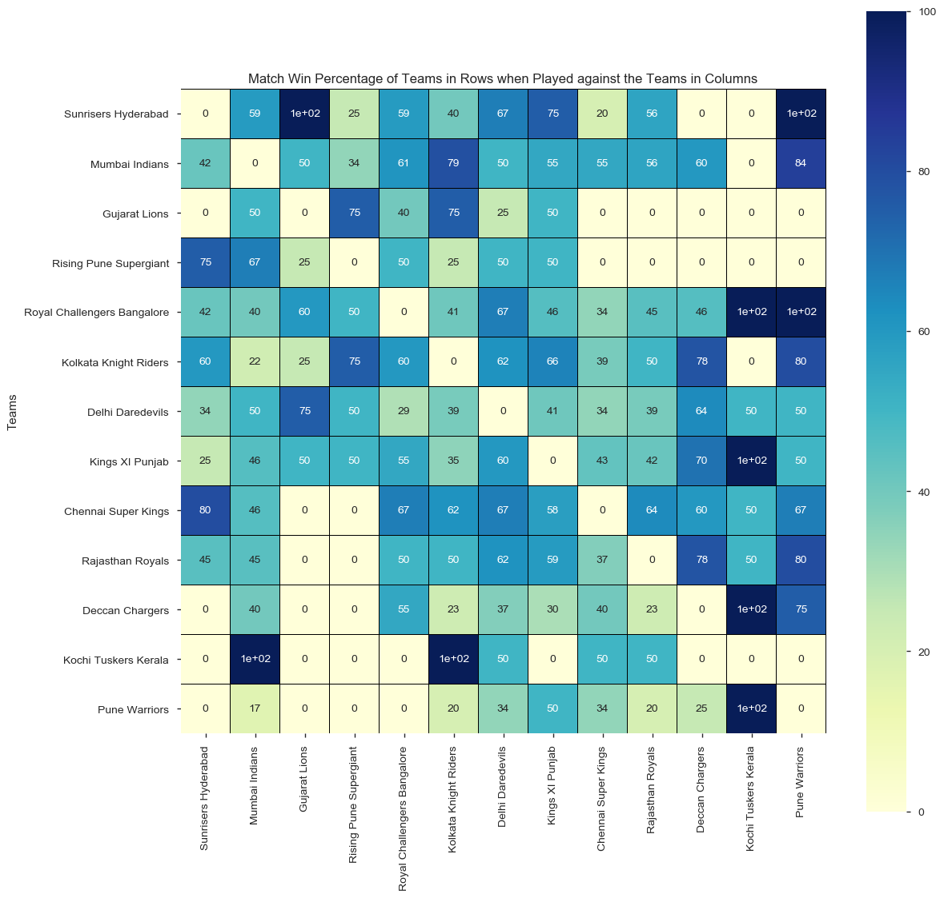
From the figure we can observe that:
Chennai Super Kings has more balanced performance (Match Win Percentage around 60%) against each and every team except against Mumbai Indians & Kochi Tuskers Kerala(Match Win Percentage less than 50%).
Mumbai Indians has Match Win Percentage more than 60% only against 4 teams. Against Sunrisers Hyderabad the Match Win Percentage is only 42% and against Kochi Tuskers Kerala not even won a single match.
Kolkata Knight Riders also has a balanced performance (Match Win Percentage around 60%) against most of the teams but struggles against Mumbai Indians, Chennai Super Kings, Gujarat Lions & Kochi Tuskers Kerala.
Few teams have 100% Match Win Percentage against few other teams. Ex.: Royal Challengers Bangalore has not lost a single match against Kochi Tuskers Kerala & Pune Warriors.

Slide 25
What is the Match Winning Percentage of Teams on each Day of the Week?

Slide 26
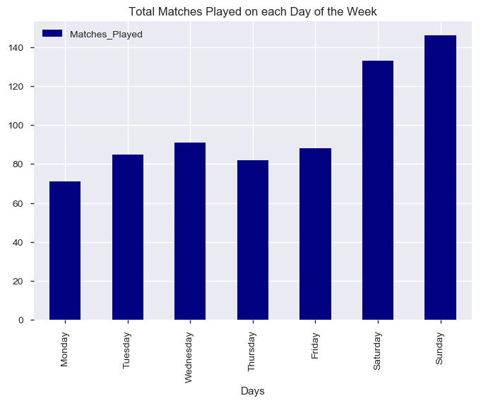
From the figure we can observe that:
Maximum number of matches have been played on the weekends and that too on Sundays.
On weekdays, maximum number of matches have been played on Wednesdays.

Slide 27
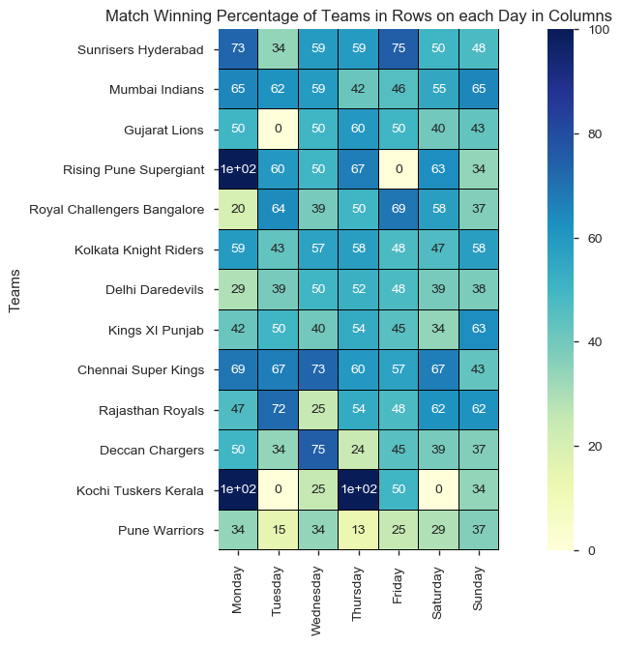
From the figure we can observe that:
Chennai Super Kings has a very balanced Match Win Percentage around 60% on each day of the week except on Sundays.
Mumbai Indians has won less than 50% of the matches on Thursdays & Fridays.
Kolkata Knight Riders has lost more than 50% of the matches on Tuesdays, Fridays & Saturdays.
Rising Pune Supergiant has never lost a match on Mondays and never won a match on Fridays.
Similarly, Kochi Tuskers Kerala has never lost a match on Mondays & Thursdays and never won a match on Tuesdays & Saturdays.

Slide 28
What is the Match Winning Percentage of Teams in each City?

Slide 29
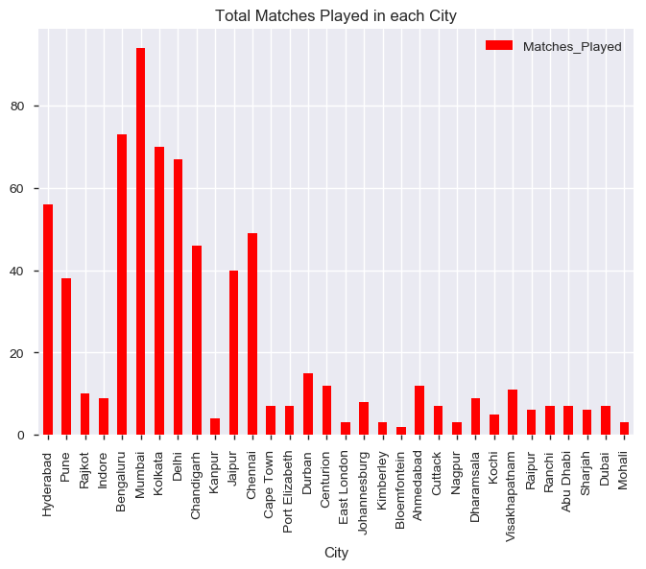
We can see that only 9 cities have hosted more than 20 matches in the 11 seasons, so we will be focussing on the winning percentage of each team in these 9 cities.

Slide 30
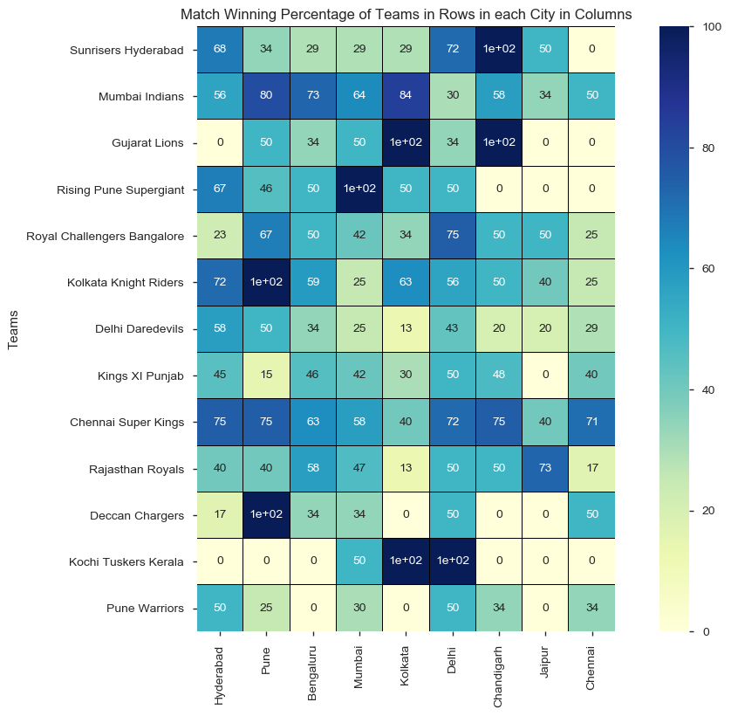
From the figure we can observe that:
Chennai Super Kings again has a very balanced Match Win Percentage around 60% in each of the cities except in Kolkata & Jaipur.
Mumbai Indians has won less than 50% of the matches in Delhi, Jaipur & Chennai.
Kolkata Knight Riders has lost more than 50% of the matches in Mumbai, Chandigarh, Jaipur & Chennai.
Few teams have not lost a single match in few of the cities. Ex.: Kochi Tuskers Kerala has never lost a match in Kolkata & Delhi.

Slide 31
Conclusions

Slide 32
Mumbai Indians needs to capitalise more after winning the toss as compared to its close competitors Chennai Super Kings and Kolkata Knight Riders. Mumbai Indians needs to improve this figure by atleast 10%.
Although, after losing the toss Mumbai Indians has a slightly better track record of winning the matches with respect to its competitors Chennai Super Kings and Kolkata Knight Riders, but still it needs to further improve this figure by atleast 6%.
Mumbai Indians has a decent record while batting first as compared to its close competitor Chennai Super Kings. Mumbai Indians can improve this figure by around 10% to balance out with fielding first record.
Mumbai Indians is lagging behind in the fielding first statistic. It ranks 6th in this aspect. With respect to its competitors Chennai Super Kings and Kolkata Knight Riders it is short of 6% & 1% respectively. But from the winner of this category it is well short of 16%. So, Mumbai Indians needs to improve in this area by atleast 6% to put forth a strong challenge for other teams.
Mumbai Indians needs to improve its performance at home venue by atleast 10%. Away from home it has performed better but can further improve by 5% - 7%.
Mumbai Indians has had 5 good seasons with Match Winning Percentage over 60% and 3 peak seasons with Match Winning Percentage close to 70%.
Mumbai Indians needs to improve their Match Win Percentage in Delhi, Jaipur & Chennai.
Mumbai Indians needs to improve their Match Win Percentage against Sunrisers Hyderabad, Rising Pune Supergiant & Delhi Daredevils.

