Slide 1
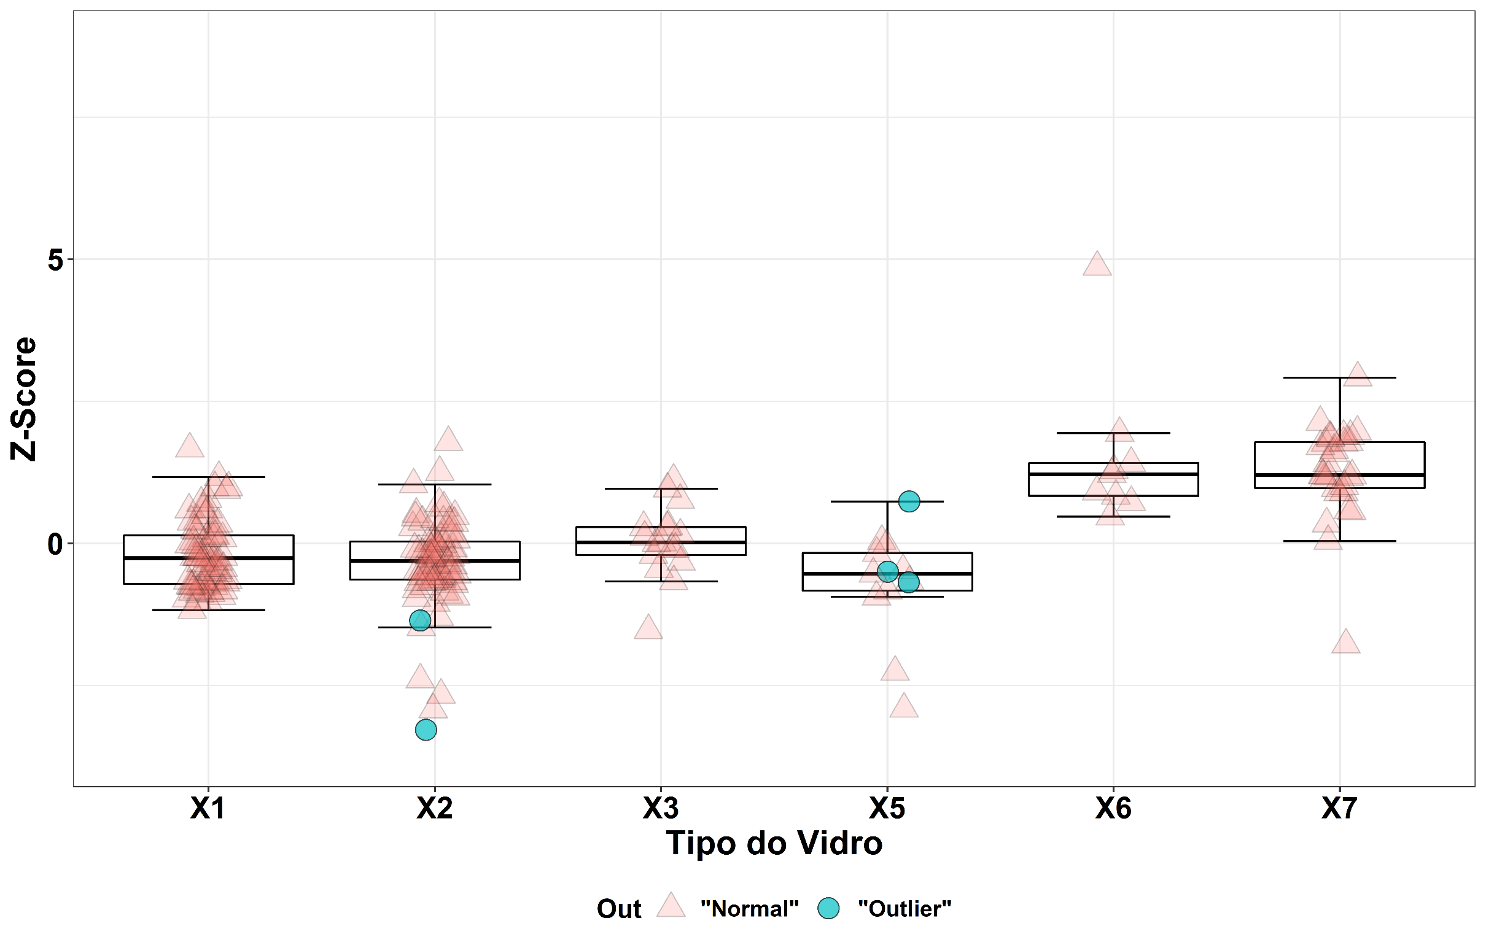
“Outliers mantidos”

