Slide 1
Bloom Filter
ADVANCED ALGORITHMS Brian Bippert, Emily Rothrock, Livvy Yurish Student Presentations

Slide 2
Bloom Filter
In this deck we will look at:
Bloom Filter structure
Hashing
Methods
Non-determinism
Applications

Slide 3
INTRODUCTION: Bloom Filters

Slide 4



Definitions and Math
Important values:
k - number of hashing functions
m - size of binary array
n - number of elements expected to be added to the structure
P - probability of a false positive
Associated math:
→ guarantees probability P false positive
→ calculates size of array based on size of input and probability
→ calculates optimal number of hashing function
Given n and an acceptable probability P, k and n can be calculated!

Slide 5
Format
Calculated values:
k - 2
m - 17
n - 5
P - 0.2 (20%)
On initialization, an array of size k hashing functions will be generated
seeds =
some hashing function | some other hashing function
These values were chosen so the arrays fit on the screen. Common values for P are < 0.01 (1%)
bit =
0 | 0 | 0 | 0 | 0 | 0 | 0 | 0 | 0 | 0 | 0 | 0 | 0 | 0 | 0 | 0 | 0
This is the binary array that will be used to store the data. In a traditional bloom filter, these values are 1 or 0, but other implementations allow for different values at the expense of space

Slide 6
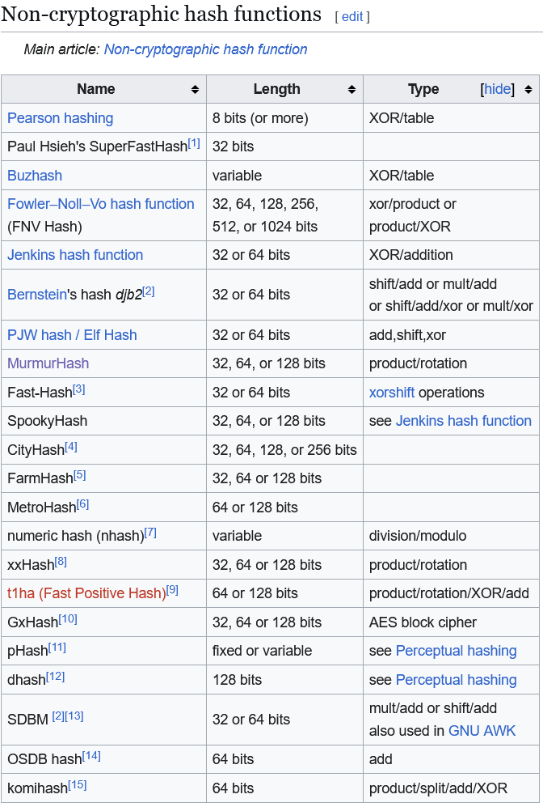
Aside on Hashing
Bloom filters are dependent on fast collision resistant hashing
Our implementation uses MurmurHash3
However, any of these are suitable
NOTE: These are not cryptographically secure and prioritize speed. Most use XOR/shifting/rotation, which are fast but reversible
Taken from https://en.wikipedia.org/wiki/List_of_hash_functions

Slide 7
Aside on Hashing
These are just a few examples
Some functions like Zobrist hashing have applications for Chess solvers
You CAN make Bloom filters more secure by using SHA-1 or MD5
Bloom filters are only as fast as their hashing functions

Slide 8
Back to Bloom Filters - Insert
O(k) runtime and can be parallelized
Remember k = 2 and m = 17!
In our implementation, this array stores seed values for MurmurHash3, which are used by the algorithm.
Values to add:
123
3433333
5
43843
Floryan
void insert(var add) {
for (int i = 0; i < k; i++) {
int h = mmh3(add, seeds[i]);
bit[h % m] = 1;
}
}
seeds =
12345678 | 4395494
Adapted from our Java solution
bit =
0 | 0 | 0 | 0 | 0 | 0 | 0 | 0 | 0 | 0 | 0 | 0 | 0 | 0 | 0 | 0 | 0
0 | 1 | 2 | 3 | 4 | 5 | 6 | 7 | 8 | 9 | 10 | 11 | 12 | 13 | 14 | 15 | 16

Slide 9
Insert
VALUE | FIRST HASH | SECOND HASH | INDICES
123 | 3745691713 | 2789295015 | [11, 6]
3433333 | 3403737752 | 3907732286 | [13, 1]
5 | 3583103607 | 1711168676 | [7, 16]
43843 | 2699127394 | 3469492224 | [11, 15]
Floryan | 2174324956 | 885440771 | [0, 4]
Indices are computed by i = hash % m
seeds =
12345678 | 4395494
bit =
1 | 1 | 0 | 0 | 1 | 0 | 1 | 1 | 0 | 0 | 0 | 1 | 0 | 1 | 0 | 1 | 1
0 | 1 | 2 | 3 | 4 | 5 | 6 | 7 | 8 | 9 | 10 | 11 | 12 | 13 | 14 | 15 | 16

Slide 10
Contains
VALUE | FIRST HASH | SECOND HASH | INDICES
Algorithm | 3043067305 | 269599843 | [2, 5]
bad | 106033911 | 3595602067 | [15, 16]
Floryan | 2174324956 | 885440771 | [0, 4]
Same code as insert, just checks if the index is true rather than setting it!
seeds =
12345678 | 4395494
Is a member!
Not a member!
Is this a member?
bit =
1 | 1 | 0 | 0 | 1 | 0 | 1 | 1 | 0 | 0 | 0 | 1 | 0 | 1 | 0 | 1 | 1
0 | 1 | 2 | 3 | 4 | 5 | 6 | 7 | 8 | 9 | 10 | 11 | 12 | 13 | 14 | 15 | 16

Slide 11
Delete?
***This is a modification of a Bloom Filter that allows for deletions***
VALUE | INDICES
123 | [11, 6]
43843 | [11, 15]
delete(123)
How do we deal with this?
bit =
1 | 1 | 0 | 0 | 1 | 0 | 1 | 1 | 0 | 0 | 0 | 1 | 0 | 1 | 0 | 1 | 1
0 | 1 | 2 | 3 | 4 | 5 | 6 | 7 | 8 | 9 | 10 | 11 | 12 | 13 | 14 | 15 | 16
bit’ =
1 | 1 | 0 | 0 | 1 | 0 | 1 | 1 | 0 | 0 | 0 | 2 | 0 | 1 | 0 | 1 | 1
del =
0 | 0 | 0 | 0 | 0 | 0 | 1 | 0 | 0 | 0 | 0 | 1 | 0 | 0 | 0 | 0 | 0
Two different ways to solve delete, both with clear drawbacks

Slide 12
Non-determinism and False Positives
Seed values are random (unless they aren’t)
One execution may result in more collisions
Will never be able to guarantee set membership, only exclusion
On large sets, a low P results in a very large binary array

Slide 13
Applications
URL safety → can be shipped with a browser
Username validation → no reason to check against a database
Faster database queries → store if data exists before execution
Alternative to HashSet/HashMap → faster and smaller

Slide 14
CONCLUSION

Slide 15
CONCLUSIONS
Bloom Filters
Fast and more scalable version of a hashing data structure
Takes advantage of boolean size in memory to store large amounts of data
Generalizable to any data as long as it can be hashed

