Slide 1
Bloom Filter
ADVANCED ALGORITHMS Brian Bippert, Emily Rothrock, Livvy Yurish Student Presentations

Slide 2



Definitions and Math
Important values:
k - number of hashing functions
m - size of binary array
n - number of elements expected to be added to the structure
P - probability of a false positive
Associated math:
→ guarantees probability P false positive
→ calculates size of array based on size of input and probability
→ calculates optimal number of hashing function
Given n and an acceptable probability P, k and n can be calculated!
WHY?:
URL safety → can be shipped with a browser
Username validation → no reason to check against a database
Faster database queries → store if data exists before execution
Alternative to HashSet/HashMap → faster and smaller
Notes:
Brian

Slide 3
Format
Calculated values:
k - 2
m - 17
n - 5
P - 0.2 (20%)
On initialization, an array of size k hashing functions will be generated
seeds =
some hashing function | some other hashing function
These values were chosen so the arrays fit on the screen. Common values for P are < 0.01 (1%)
bit =
0 | 0 | 0 | 0 | 0 | 0 | 0 | 0 | 0 | 0 | 0 | 0 | 0 | 0 | 0 | 0 | 0
This is the binary array that will be used to store the data. In a traditional bloom filter, these values are 1 or 0, but other implementations allow for different values at the expense of space
Notes:
Emily

Slide 4
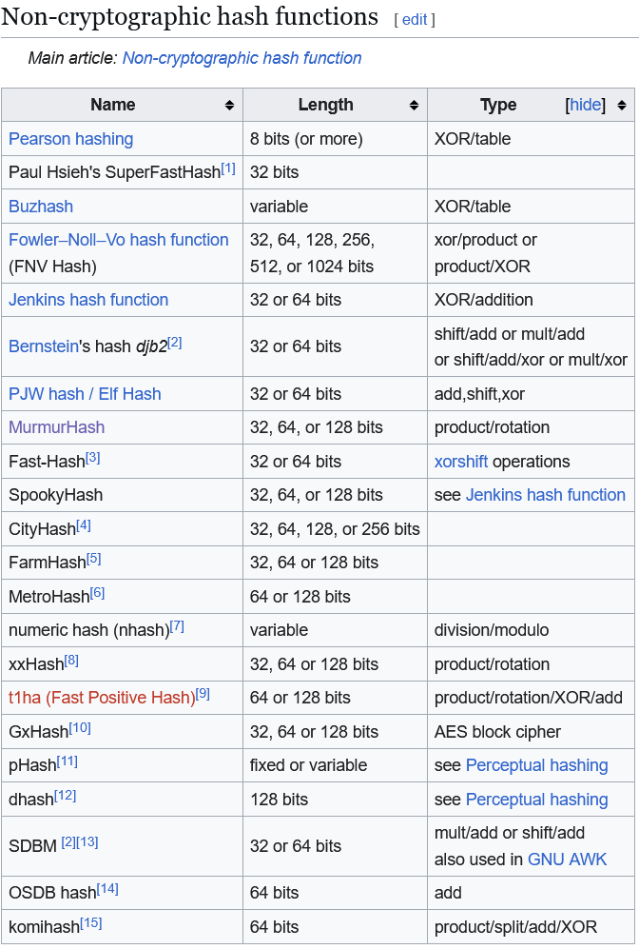
Aside on Hashing
Bloom filters are dependent on fast collision resistant hashing
Our implementation uses MurmurHash3
However, any of these are suitable
NOTE: These are not cryptographically secure and prioritize speed. Most use XOR/shifting/rotation, which are fast but reversible
Taken from https://en.wikipedia.org/wiki/List_of_hash_functions
Notes:
Emily

Slide 5
Back to Bloom Filters - Insert
O(k) runtime and can be parallelized
Remember k = 2 and m = 17!
In our implementation, this array stores seed values for MurmurHash3, which are used by the algorithm.
Values to add:
123
3433333
5
43843
Floryan
void insert(var add) {
for (int i = 0; i < k; i++) {
int h = mmh3(add, seeds[i]);
bit[h % m] = 1;
}
}
seeds =
12345678 | 4395494
Adapted from our Java solution
Non-deterministic!
bit =
0 | 0 | 0 | 0 | 0 | 0 | 0 | 0 | 0 | 0 | 0 | 0 | 0 | 0 | 0 | 0 | 0
0 | 1 | 2 | 3 | 4 | 5 | 6 | 7 | 8 | 9 | 10 | 11 | 12 | 13 | 14 | 15 | 16
Notes:
Livvy
The insert function takes in a value to insert, then k different hashes of this value are computed, the result of each hash is moduloed by m (the size of the array) to return an index within the array. The associated values of these indices within the bit array are set to 1. Of note, our implementation also stores seed values for the hashing function to be used by the algorithm. This function has a runtime of O(k) where k is the number of hashes computed and it can be parallelized.

Slide 6
Insert
VALUE | FIRST HASH | SECOND HASH | INDICES
123 | 3745691713 | 2789295015 | [11, 6]
3433333 | 3403737752 | 3907732286 | [13, 1]
5 | 3583103607 | 1711168676 | [7, 16]
43843 | 2699127394 | 3469492224 | [11, 15]
Floryan | 2174324956 | 885440771 | [0, 4]
Indices are computed by i = hash % m
seeds =
12345678 | 4395494
This allows for false positives
bit =
1 | 1 | 0 | 0 | 1 | 0 | 1 | 1 | 0 | 0 | 0 | 1 | 0 | 1 | 0 | 1 | 1
0 | 1 | 2 | 3 | 4 | 5 | 6 | 7 | 8 | 9 | 10 | 11 | 12 | 13 | 14 | 15 | 16
Notes:
Livvy
Note that the insertion/query of ‘123’ and ‘43843’ allows for false positives

Slide 7
Contains
VALUE | FIRST HASH | SECOND HASH | INDICES
Algorithm | 3043067305 | 269599843 | [2, 5]
bad | 106033911 | 3595602067 | [15, 16]
Floryan | 2174324956 | 885440771 | [0, 4]
Same code as insert, just checks if the index is true rather than setting it!
seeds =
12345678 | 4395494
Is a member!
Not a member!
Is this a member?
bit =
1 | 1 | 0 | 0 | 1 | 0 | 1 | 1 | 0 | 0 | 0 | 1 | 0 | 1 | 0 | 1 | 1
0 | 1 | 2 | 3 | 4 | 5 | 6 | 7 | 8 | 9 | 10 | 11 | 12 | 13 | 14 | 15 | 16
Notes:
Emily

Slide 8
Delete?
***This is a modification of a Bloom Filter that allows for deletions***
VALUE | INDICES
123 | [11, 6]
43843 | [11, 15]
delete(123)
How do we deal with this?
bit =
1 | 1 | 0 | 0 | 1 | 0 | 1 | 1 | 0 | 0 | 0 | 1 | 0 | 1 | 0 | 1 | 1
0 | 1 | 2 | 3 | 4 | 5 | 6 | 7 | 8 | 9 | 10 | 11 | 12 | 13 | 14 | 15 | 16
bit’ =
1 | 1 | 0 | 0 | 1 | 0 | 1 | 1 | 0 | 0 | 0 | 2 | 0 | 1 | 0 | 1 | 1
del =
0 | 0 | 0 | 0 | 0 | 0 | 1 | 0 | 0 | 0 | 0 | 1 | 0 | 0 | 0 | 0 | 0
Two different ways to solve delete, both with clear drawbacks
Notes:
Brian

