Slide 1
The Machine Learning Landscape

Slide 2
What is AI?
Artificial Intelligence (AI), Machine Learning (ML) and Deep Learning (DL) are often used interchangeably
AI includes everything from the development of robots to systems that can mimic human intelligence
AI can be thought of as the general goal of making machines intelligent
It can be achieved through various techniques: one of the most well-known methods is machine learning

Slide 3
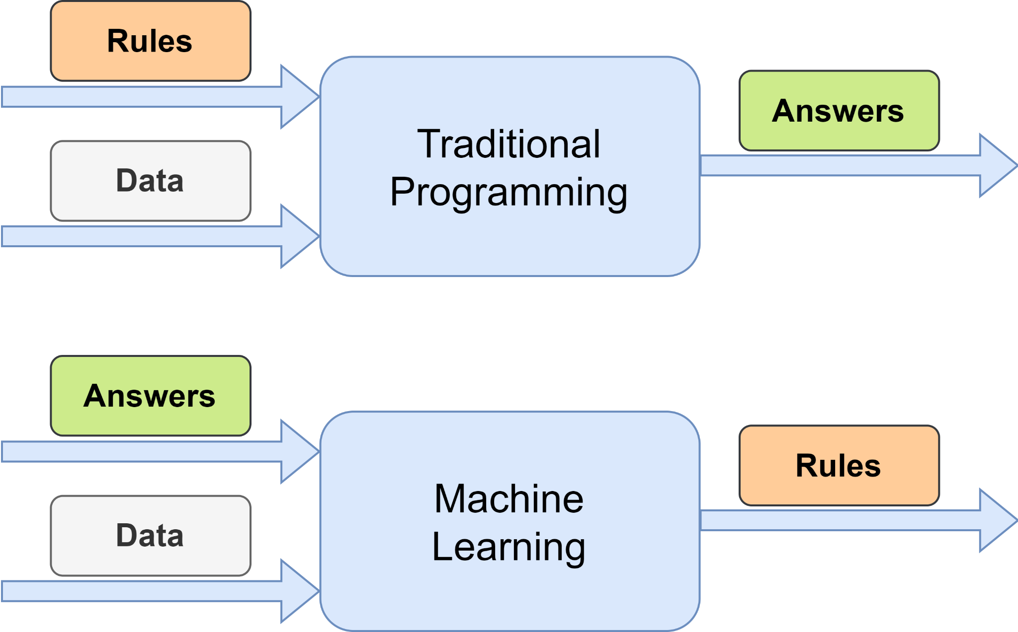
Machine Learning
ML is about algorithms that enable computers to learn from data
Instead of relying on programming a explicit set of rules, ML algorithms adapt to the underlying data to improve their performance
ML plays an important role in a variety of applications like recommendation systems or image recognition

Slide 4
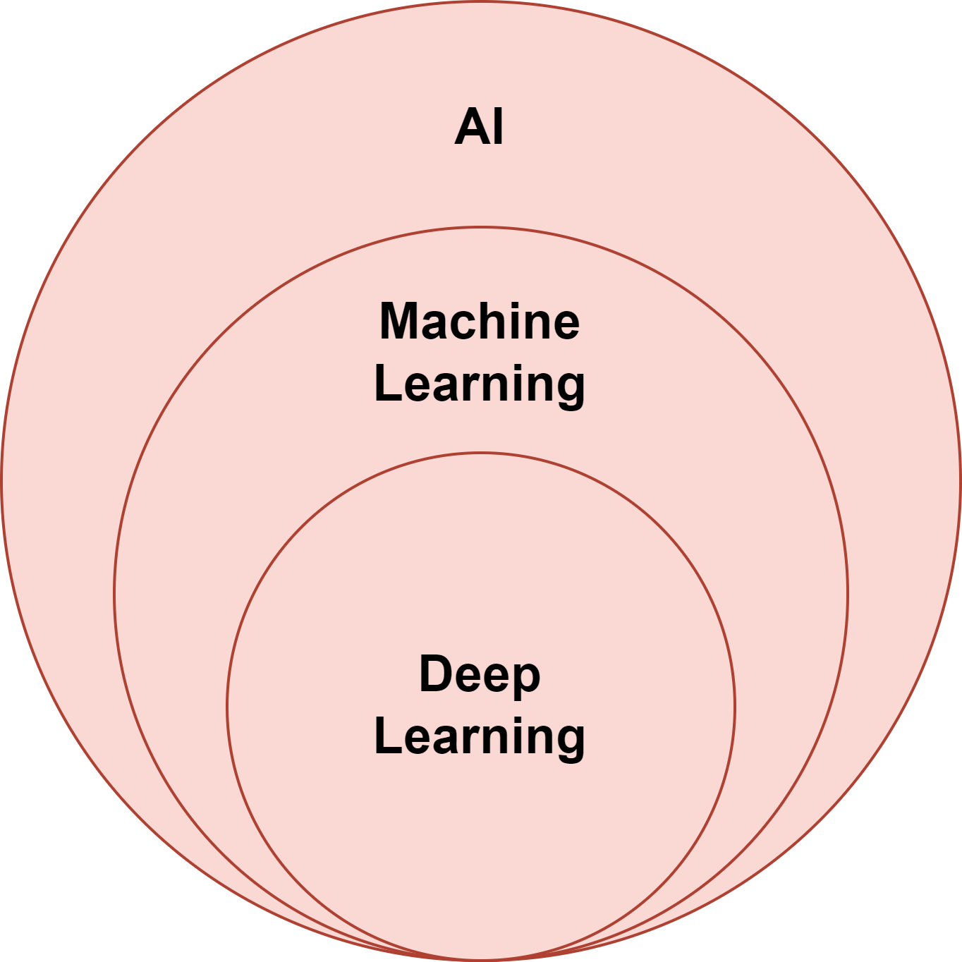
Deep Learning
DL is a subfield of ML that uses Artificial Neural Networks (ANN)
ANNs consist of layers of interconnected nodes that process and transform data
DL has shown remarkable success in complex tasks like image and speech recognition or natural language processing
Think of AI as the overarching goal, ML as one of the primary methods to achieve AI, and DL as an effective approach within ML

Slide 5
The ML Landscape
ML involves a large amount of different types of machine learning systems
It can be useful to classify them in broad categories, based on different criteria:
How they are supervised during training?
Do they learn incrementally or on the fly?
Do they compare new data points to known ones, or do they detect patterns in the training data to build a predictive model?
These criteria are not mutually exclusive and can be combined
For example, a E-Mail spam filter may learn on the fly using a deep neural network model trained using human-provided examples of spam and ham, which makes it an online, model-based, supervised learning system

Slide 6
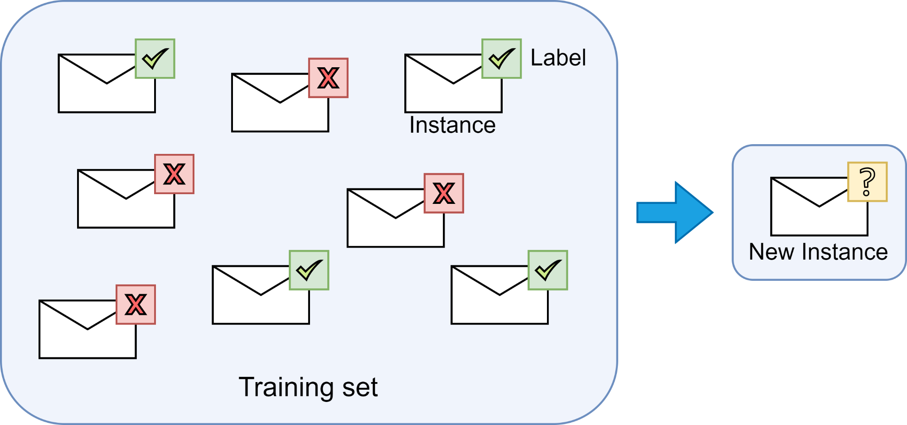
Training Supervision - Supervised Learning
In Supervised Learning, a training set is fed to the algorithm, which includes the desired solutions, called labels
Supervised Learning tasks can be divided in classification and regression tasks
classification: predicting categorical class labels Example: A spam filter: it is trained with many example emails along with their classes (spam or ham)
regression: predicting continuous numerical values Example: predicting the price of a car, given a set of features (mileage, age, brand, etc.)

Slide 7
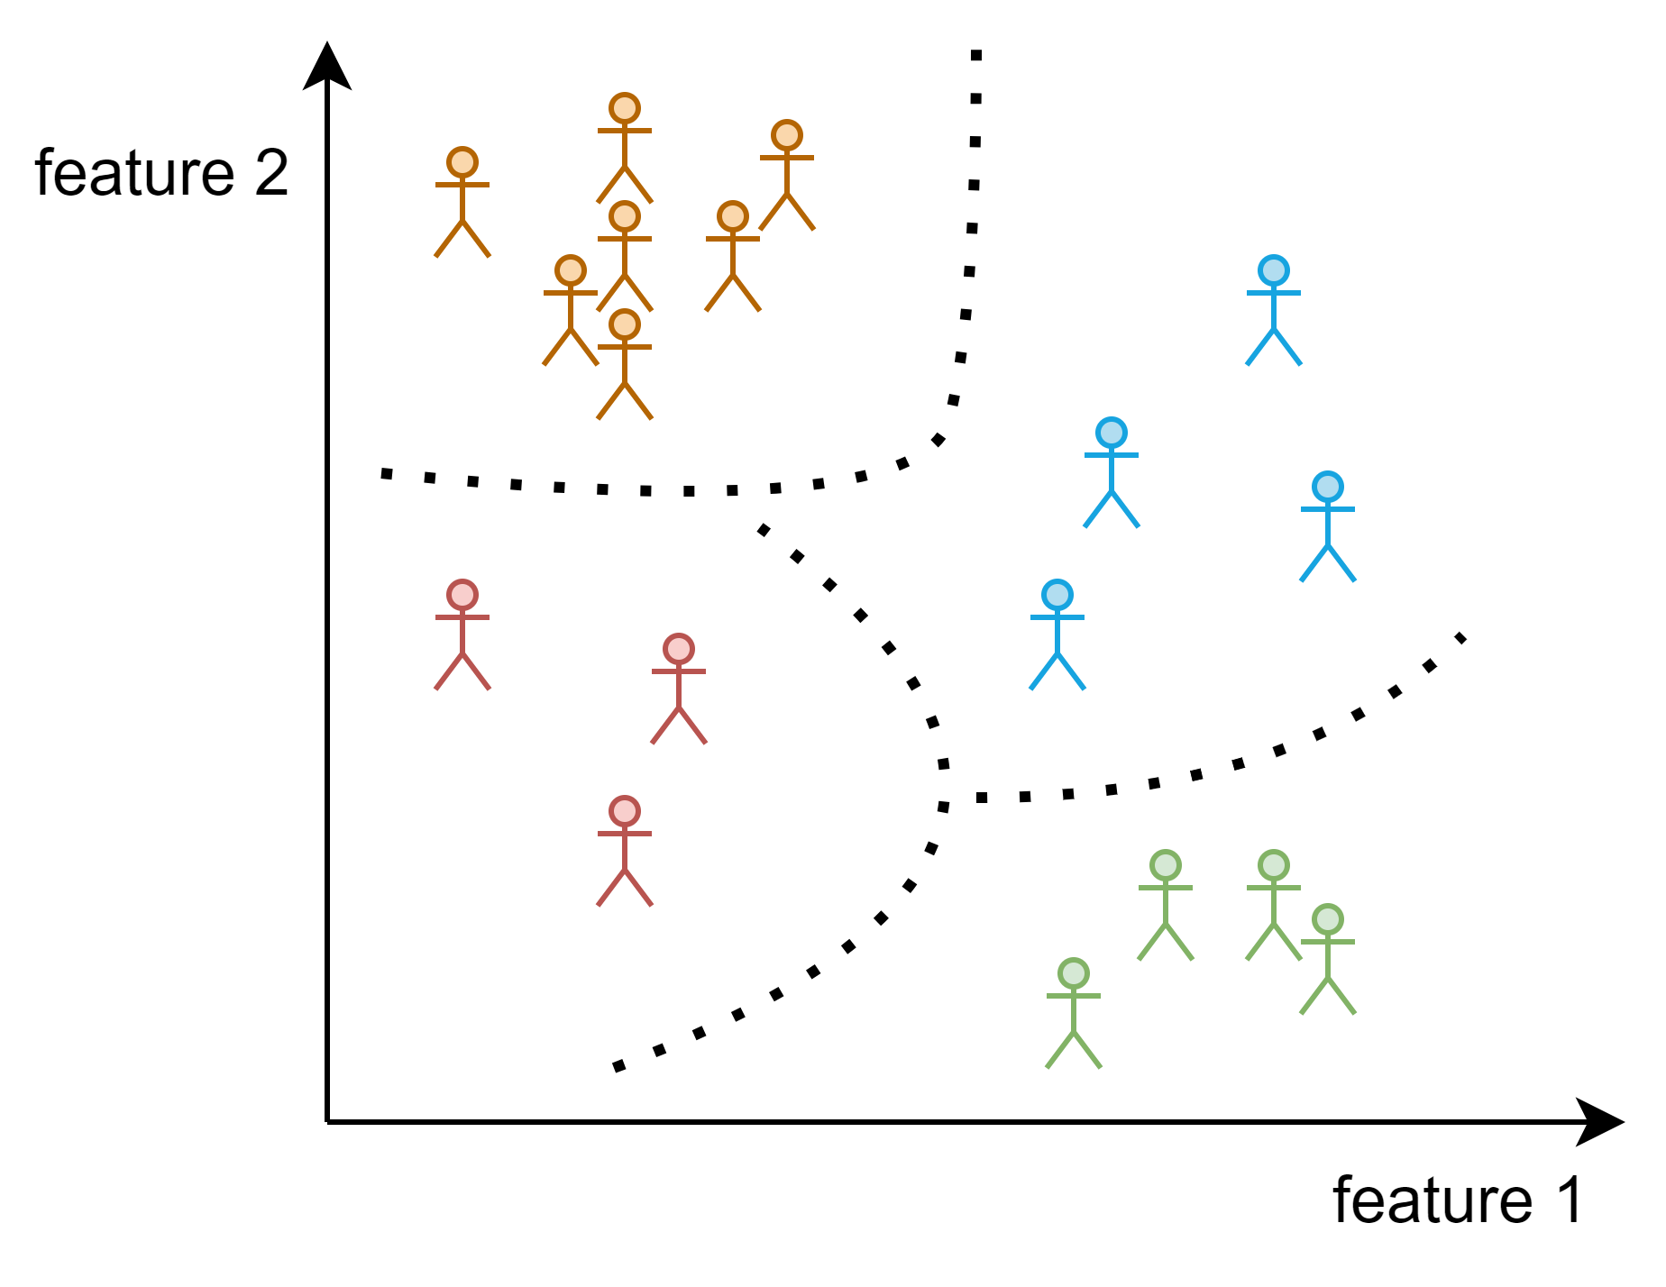
Training Supervision - Unsupervised Learning
In Unsupervised Learning, the training data is unlabeled
Example: You own an internet store
To improve user targeting, you can run a clustering algorithm to try to detect groups of similar visitors
Algorithm does not know which group a visitor belongs to
Connections autonomously discovered without assistance

Slide 8
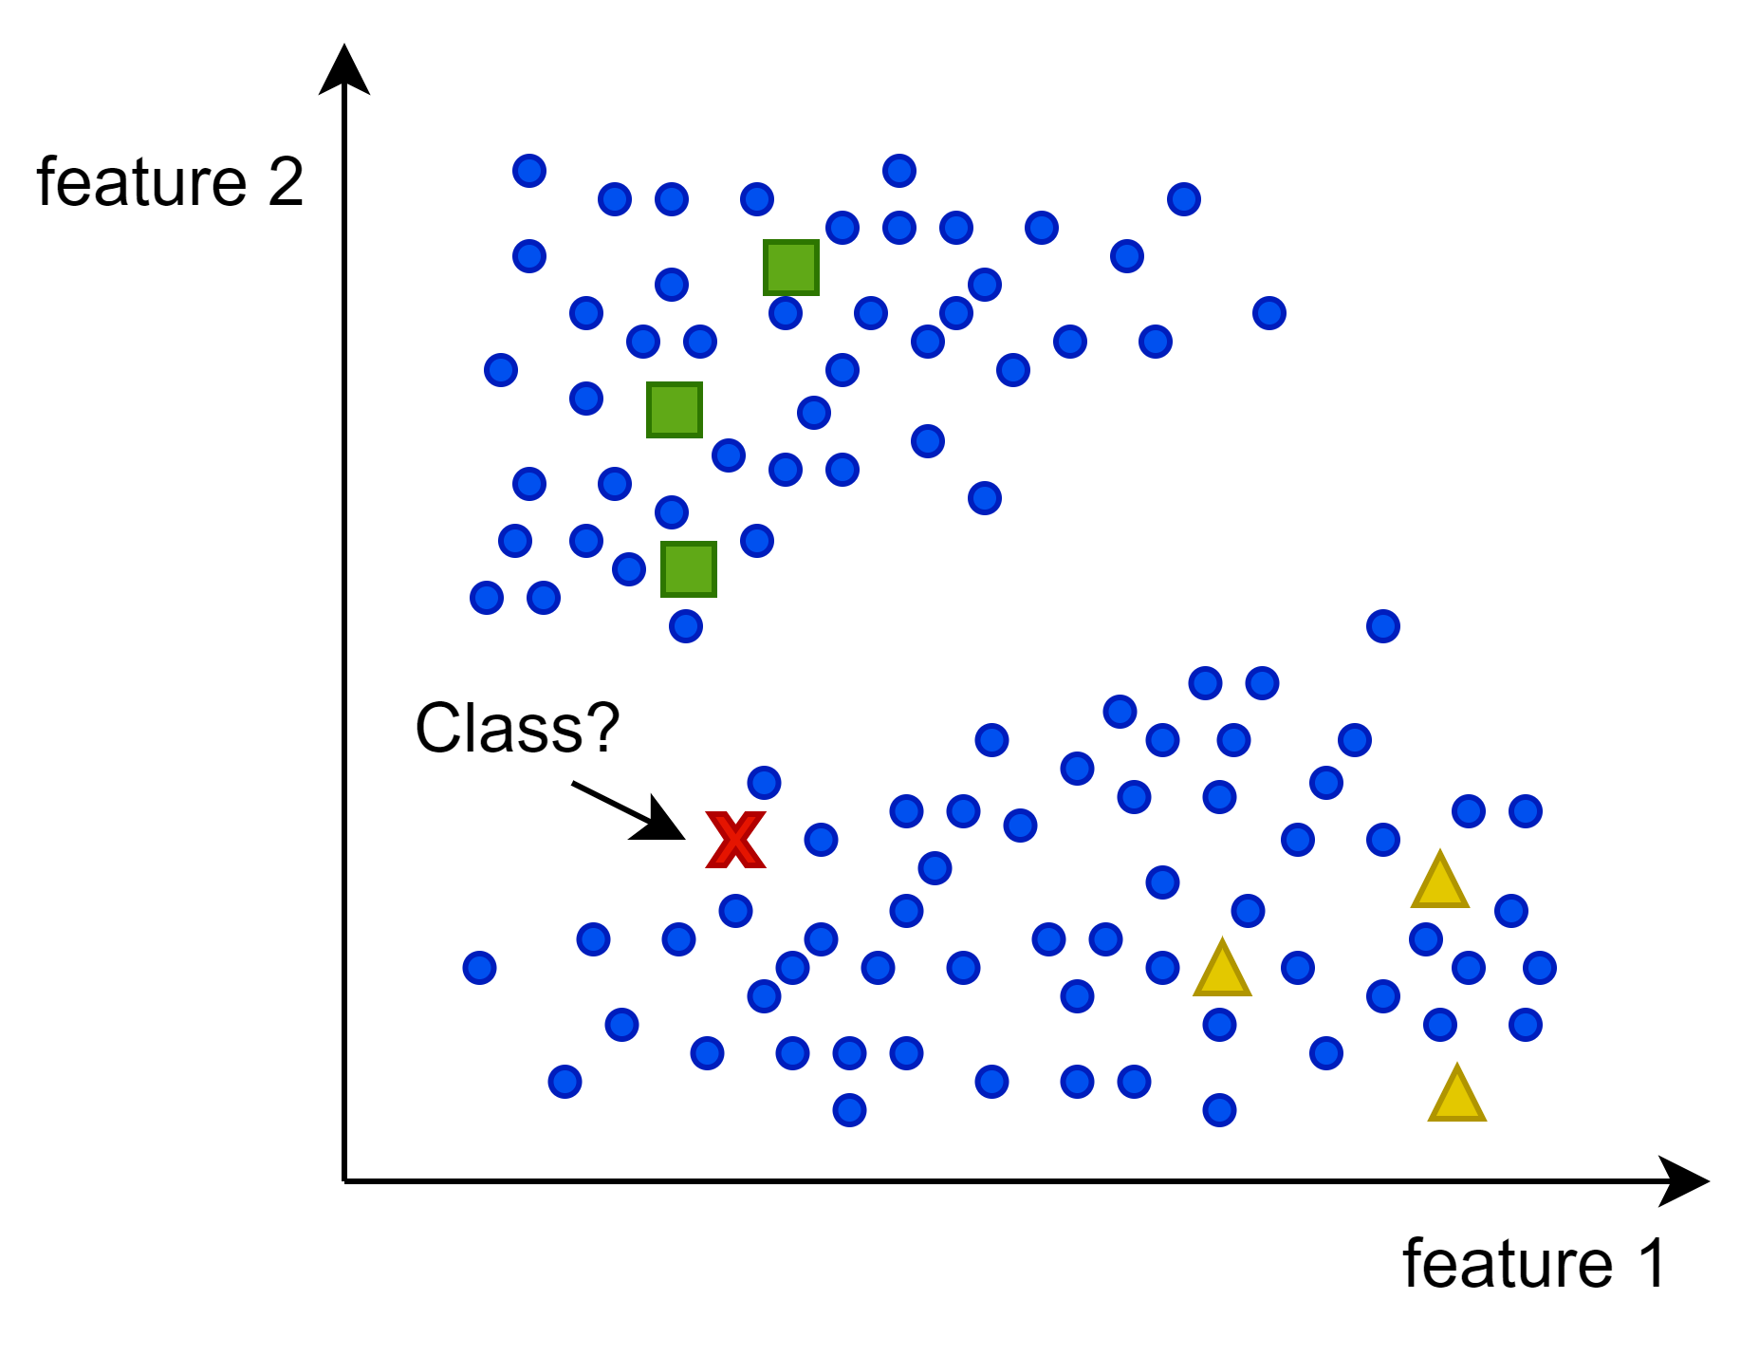
Training Supervision - Semi-Supervised Learning
Labeling data is time-consuming and costly
Semi-Supervised Learning algorithms can handle partially labeled data
Example: You upload photos to a photo hosting service
Service automatically recognizes that the same person A shows up in photos 1, 5, and 11, while another person B shows up in photos 2, 5, and 7 (clustering)
Add one label per person and the service is able to name everyone in every photo

Slide 9

Training Supervision - Self-Supervised Learning
Self-Supervised Learning involves generating a fully labeled dataset from a fully unlabeled one
Example: you have a large dataset of unlabeled images
Randomly mask a small part of each image and then train a model to recover the original image
During training, the masked images are used as inputs for the model and the original images are used as labels
Resulting model can be used to repair damaged images or fine-tuned for different tasks

Slide 10
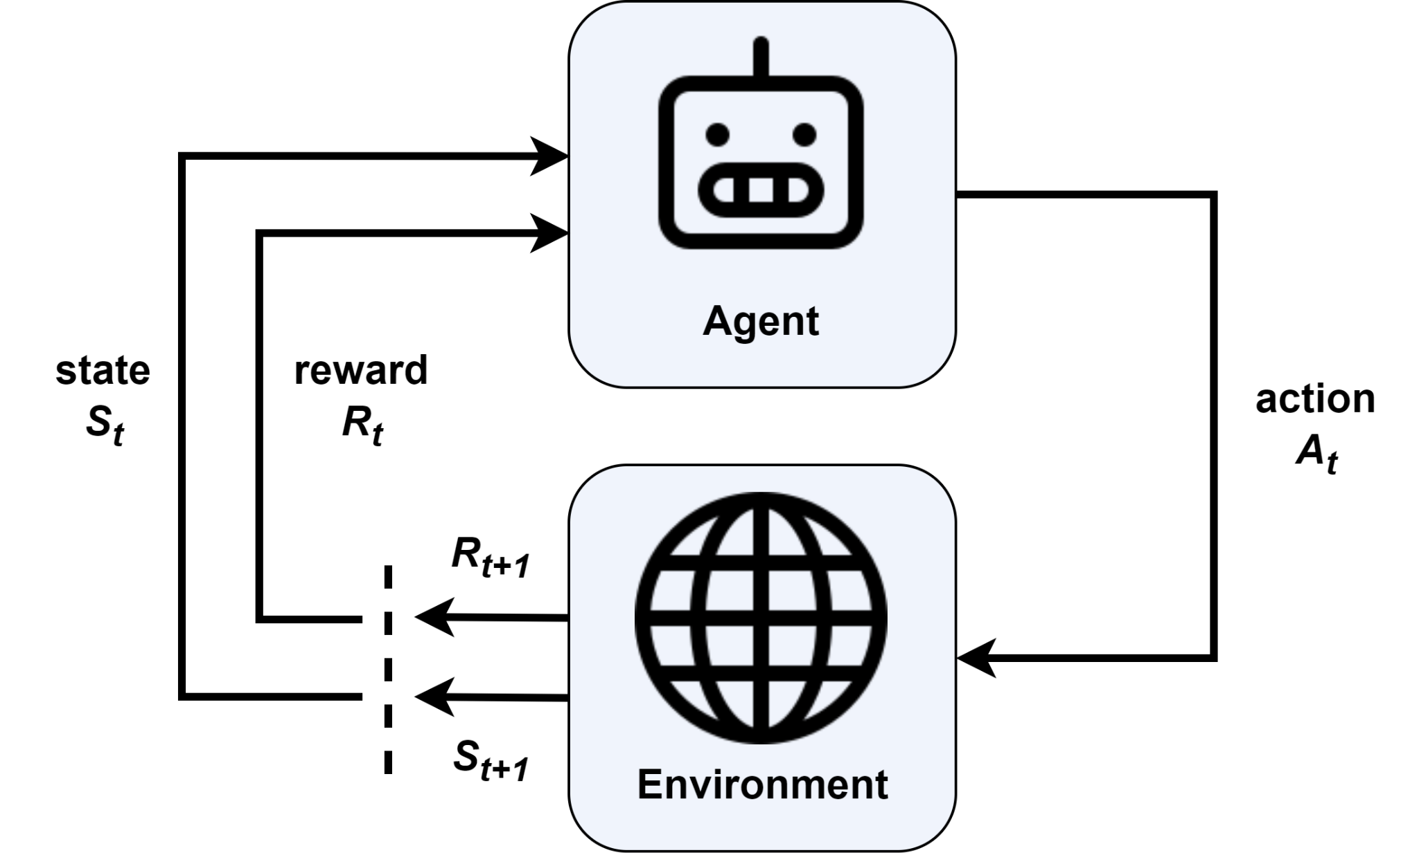
Training Supervision - Reinforcement Learning
In Reinforcement learning an agent can observe its environment
The agent can select and perform an action, and gets the changed state of its environment and a reward in return
Agent must learn by itself what is the best strategy, called a policy, to get the most reward over time

Slide 11
Batch vs. Online - Batch Learning
In Batch Learning a ML system trains on the entire dataset at once
Dataset can be iterated multiple times, where one learning iteration is known as epoch
ML system is trained and updated incrementally until it converges to an optimal solution or until a stopping criterion is met
After training, the ML system is deployed for making predictions on new data
A model's performance can decay slowly over time, called model rot or data drift, depending on the task
A system classifying pictures of cats and dogs will probably not drift over time
A model, which makes predictions on the financial market is likely to decay faster

Slide 12
Batch vs. Online - Online Learning
Online Learning is also known as incremental learning or streaming learning
The model is updated continuously as new data becomes available
Online learning is well-suited for scenarios where data is continuously streaming in and the model needs to adapt to changing patterns or trends in real-time
It is commonly used in applications such as recommendation systems, fraud detection, and monitoring systems where immediate responses to new data are required

Slide 13
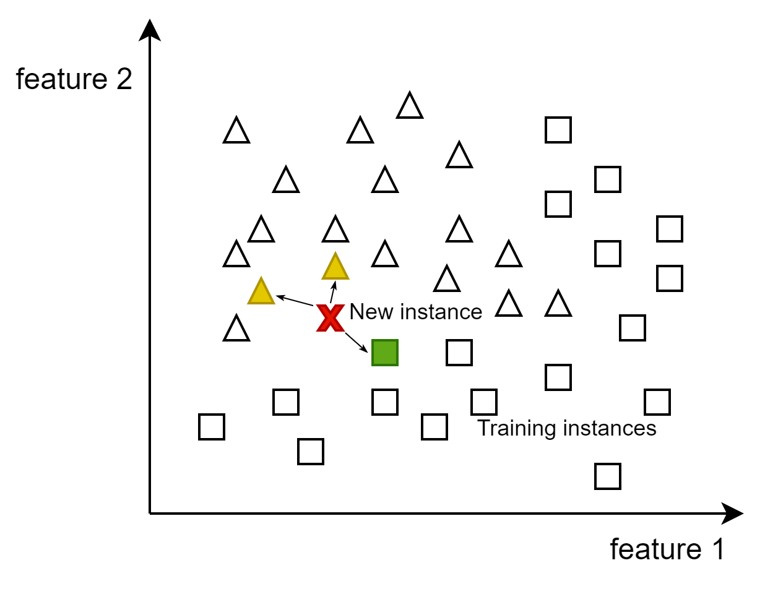
Instance vs. Model Based - Instance-Based Learning
Instance-Based Learning relies on memorized examples and compares new instances to the learned examples using a similarity measure
Example: We create a EMail spam filter
One method might be flagging emails similar to known spam, for example by counting shared words
The ML system would flag an email as spam if it has many words in common with a known spam email

Slide 14
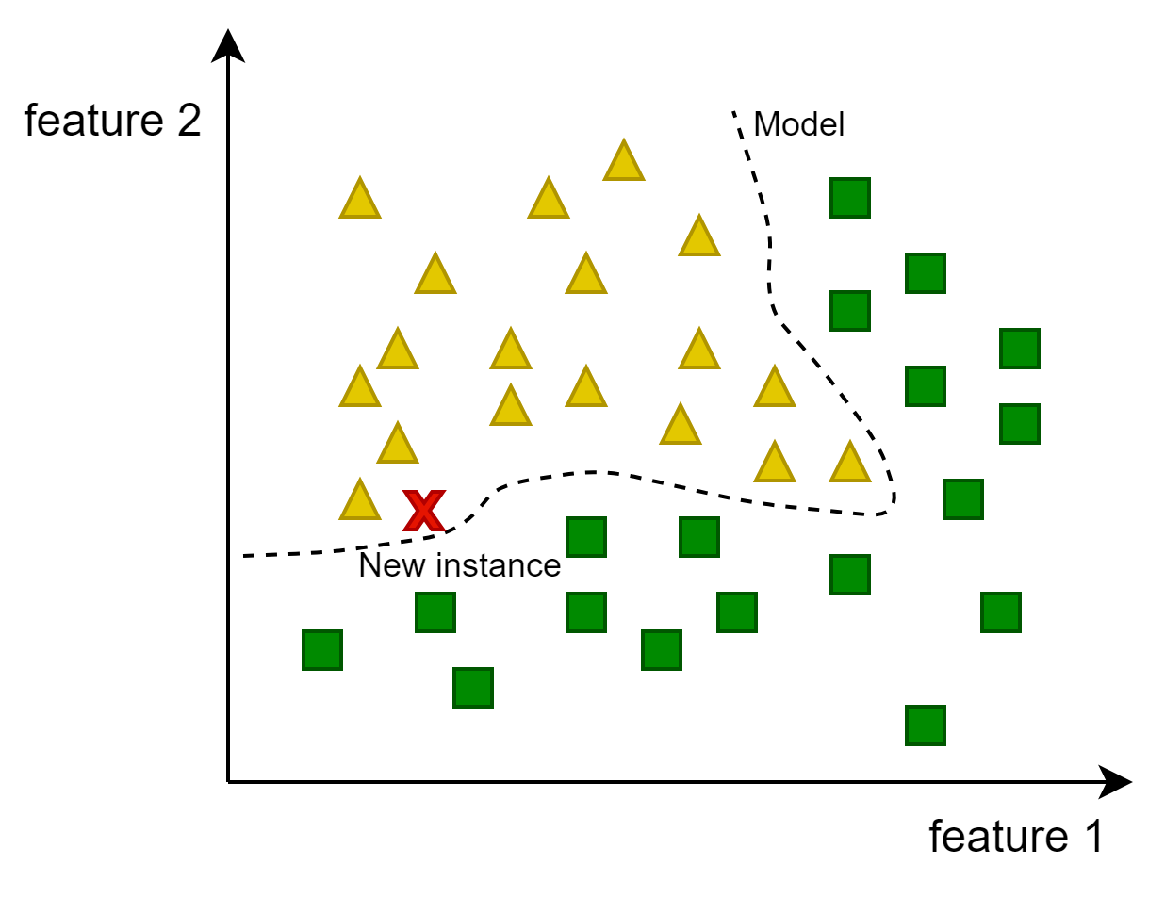
Instance vs. Model Based - Model-Based Learning
A Model-Based Learning algorithm builds a generalized model from the training data
The model can then be used to make predictions on new, unseen instances
The ML system learns parameters or coefficients that define the relationships between the input features and the target variable

