Slide 1
Artificial Neural Networks

Slide 2
Why ANNs?
First introduced in 1943 by the neurophysiologist Warren McCulloch and the mathematician Walter Pitts
Gained and lost focus of researchers many times over decades
By the 1990s other powerful machine learning techniques had been invented (e.g. support vector machines) with better results and stronger theoretical foundations
Why do we have yet another wave of interest in ANNs currently?
Relatively small tweaks in training algorithms have had a huge positive impact
Huge increase in computing power and parallel processing with GPUs
Massive increased amount of data available to train neural networks

Slide 3
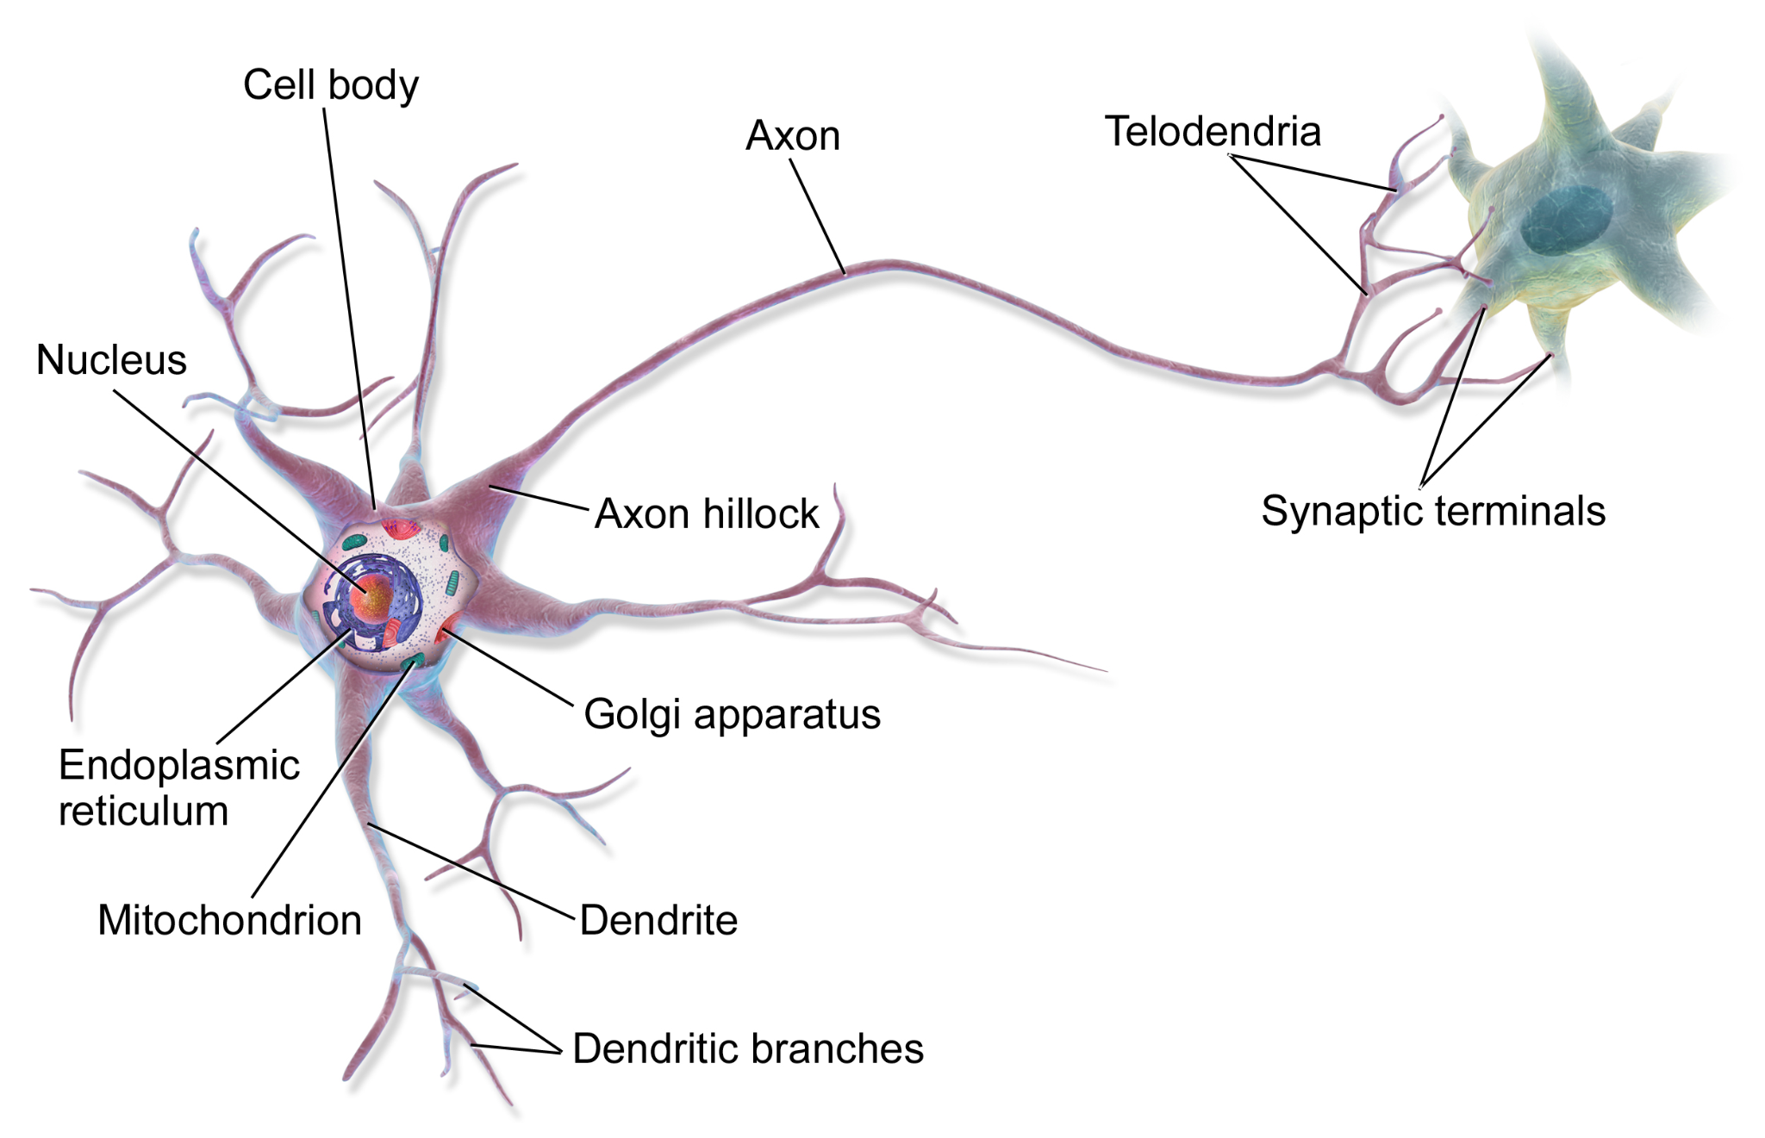
Biological Neurons
ANNs are inspired by neurons in our brain
Our brains consists of roughly 90 billion neurons on average
Neurons produce short electrical impulses (action potentials), which travel along the axons and make the synapses release chemical signals
When a neuron receives a sufficient amount of these signals within a few milliseconds, it fires its own electrical impulses
Individual biological neurons behave in a simple way, but a network of neurons can perform highly complex tasks

Slide 4
Logistic Regression
Logistic Regression is a statistical method used for binary classification tasks
It models the probability of the binary outcome using a logistic function, which is a sigmoid curve that maps any real-valued number to the range [0,1].
The input features are combined linearly using weights, and then the logistic function is applied to the result to produce the probability
Let’s see the computational graph for better understanding

Slide 5
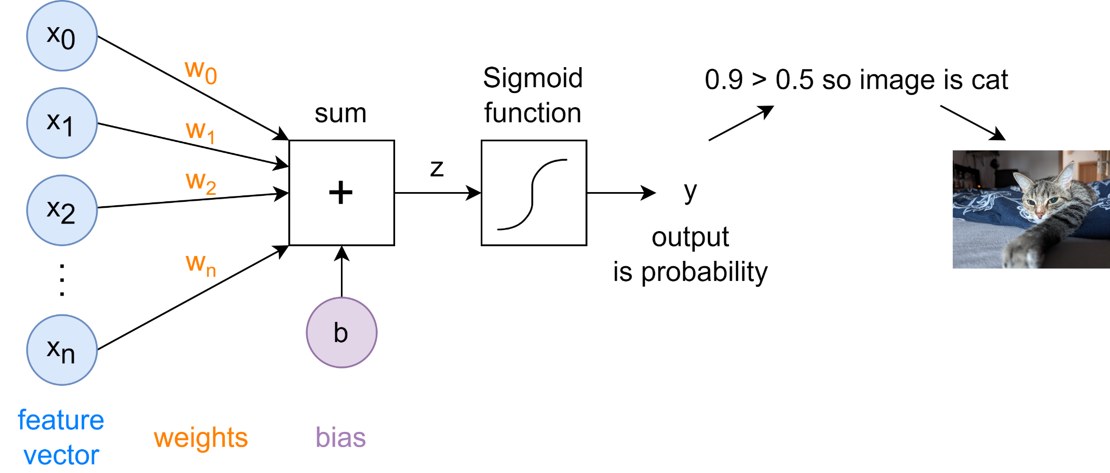
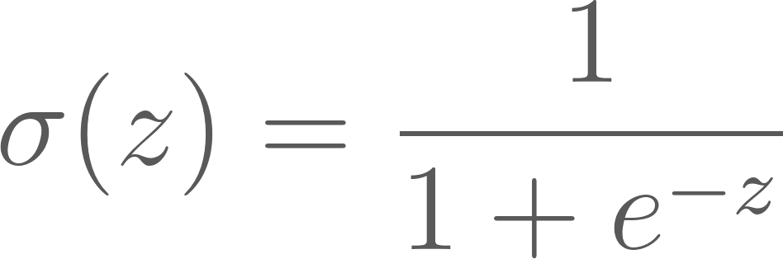
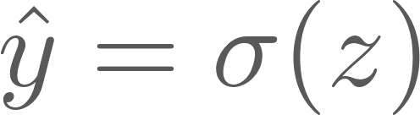
Logistic Regression
The learnable parameters are the weights and the intercept (also called bias)
z is calculated by multiplying the weight vector with the input vector and adding the intercept/bias
The output is calculated
with

Slide 6
Logistic Regression - Training
Example: Classifying grayscale image, which contains a cat (denoted with the output 1 ) or an image which contains no cat (as the output 0 )
The feature vector could be the flattened pixel values of the image
Images of size 32×32 would result in a feature vector of 1024 pixel values in the range of [0,255].
Each pixel value will be multiplied with its associated weight
The weighted pixels and bias will be summed up and used as input for the sigmoid function
The resulting value will be in range between 0 and 1 , which enables us to calculate some loss (error) function

Slide 7
Logistic Regression - Training
All these steps from pixels to calculating the loss is called forward propagation
During the back propagation our model weights are adjusted according to the gradient of the loss function with respect to the given parameter
Cycle of forward and back propagation continues with samples from our training set until we minimized our error

Slide 8
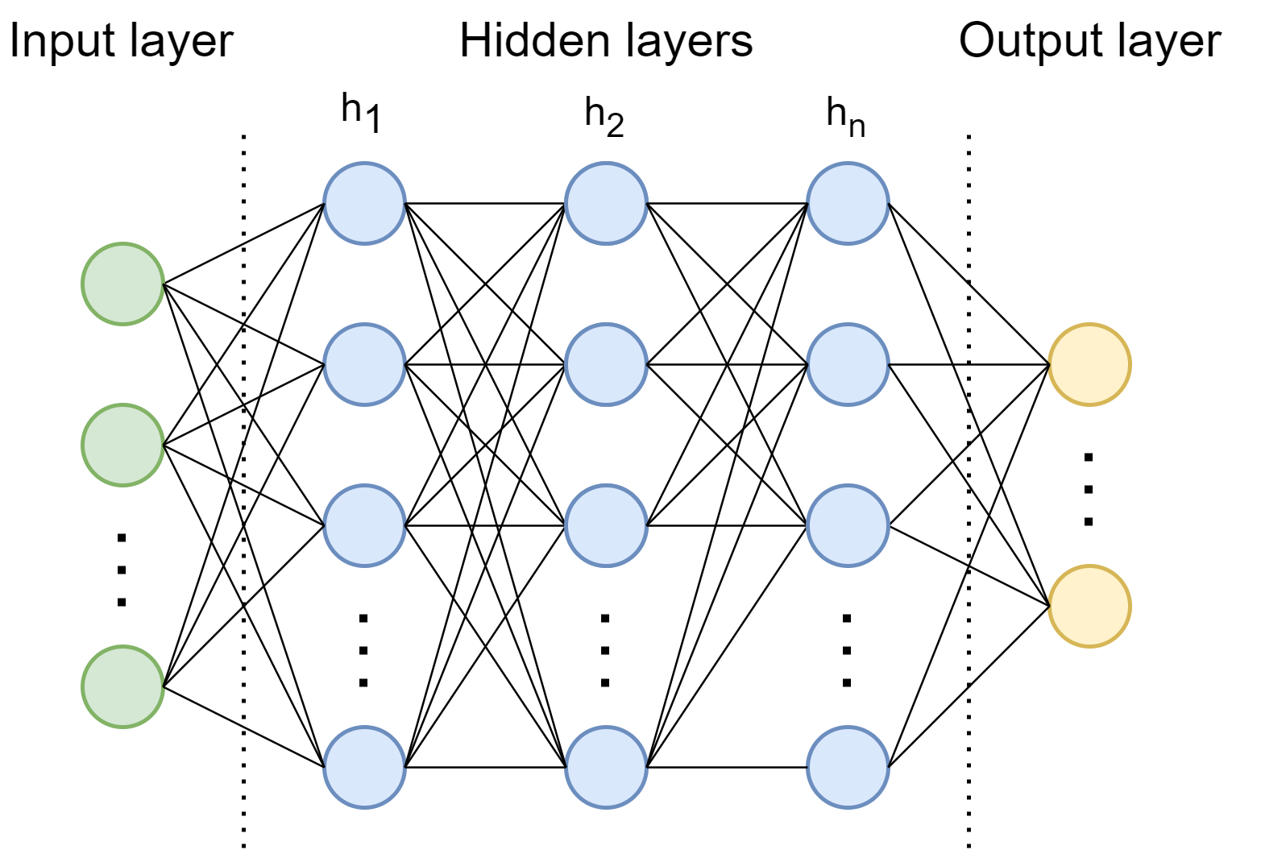
ANNs
Logistic Regression can be seen as a single-layer neural network
Neural Networks extend this concept by introducing multiple layers (hidden layers) between the input and output layers
Each layer consists of nodes (neurons), where each neuron in a layer is connected to every neuron in the subsequent layer
By stacking multiple layers and using more sophisticated activation functions, Neural Networks can capture highly non-linear relationships in the data

Slide 9
Activation Functions
The activation function serves the purpose of injecting non-linearity into the network
It enables the modeling of a response variable (target variable or class label) that varies non-linearly with its explanatory variables
If a network lacks a non-linear activation function, even if it has multiple layers, it would behave just like another linear model
Adding layers would only result in another linear function

Slide 10
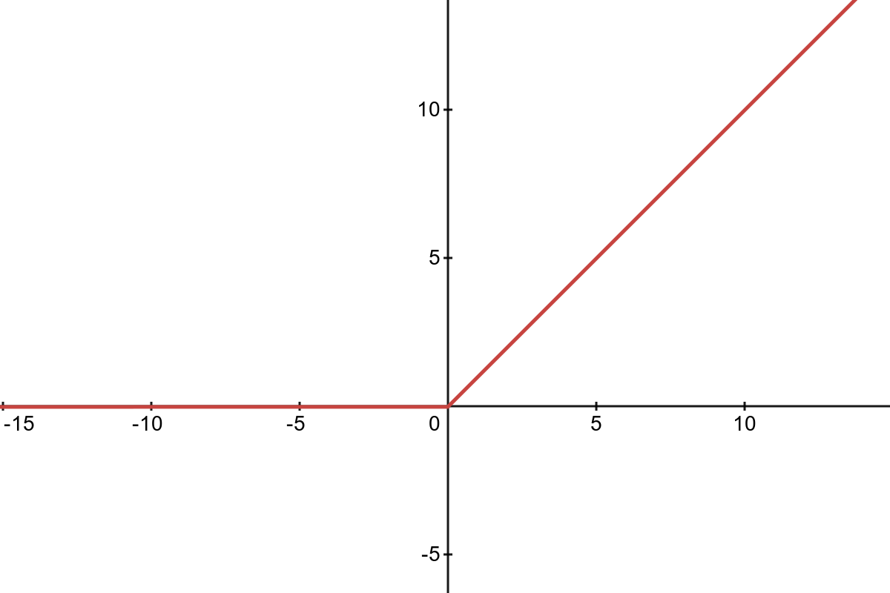
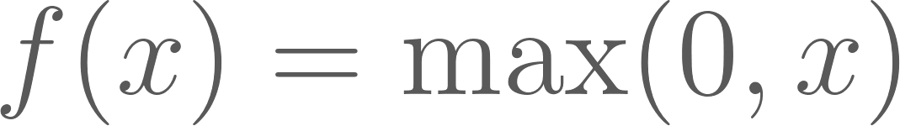
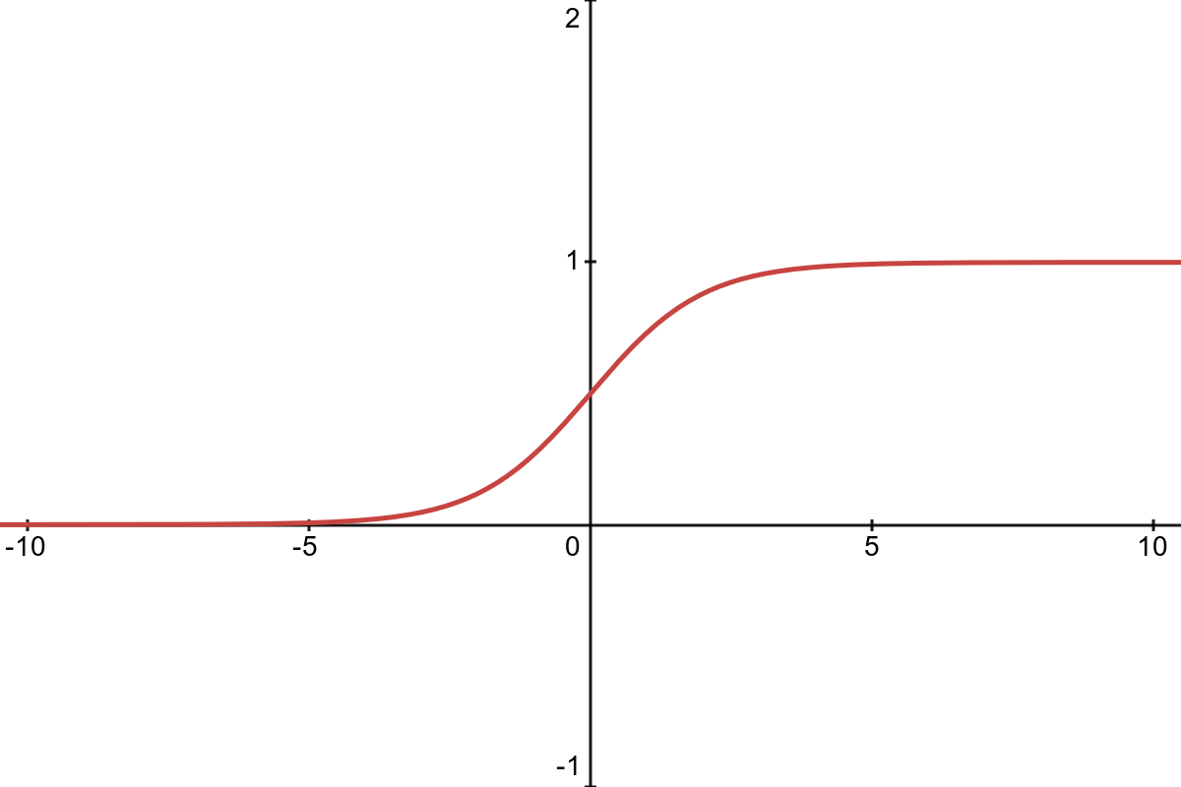
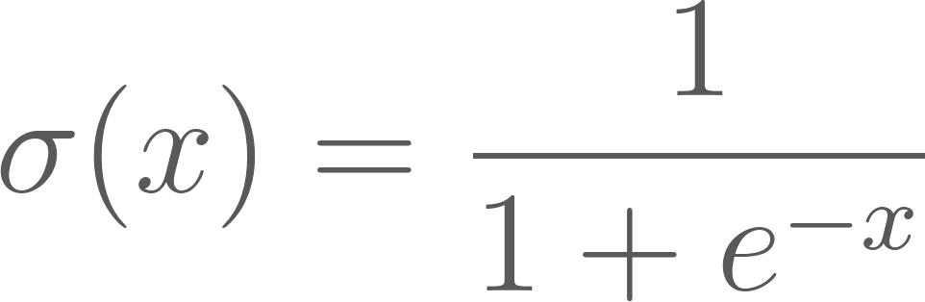
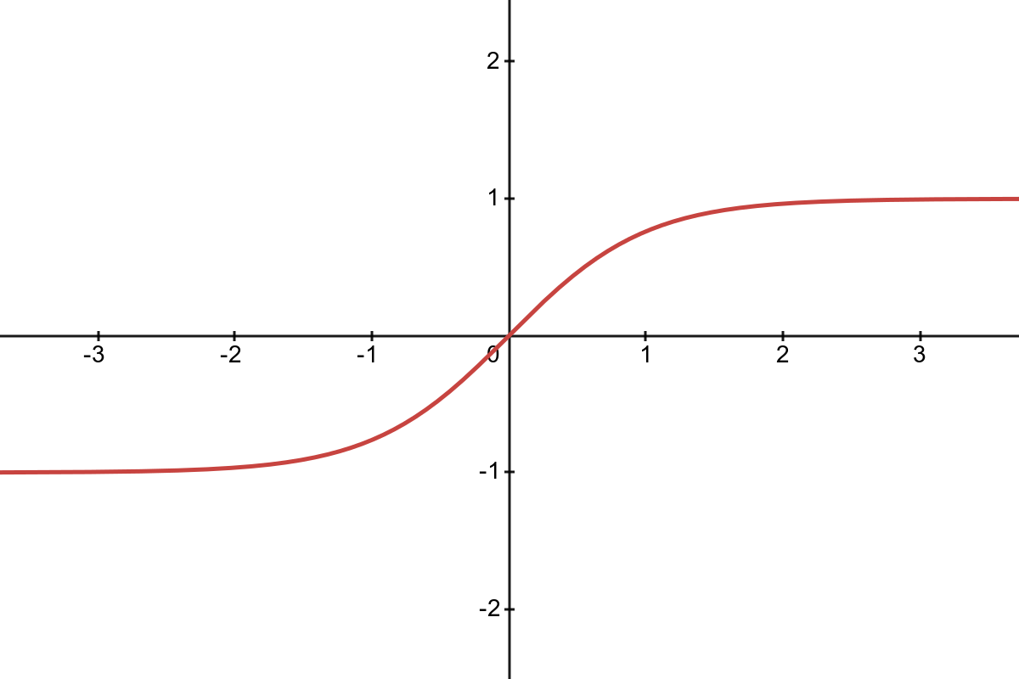
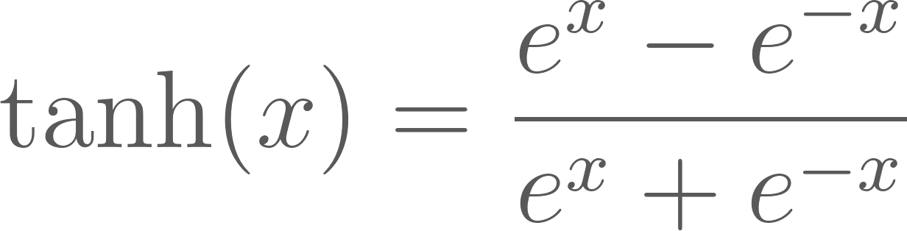
Activation Functions - Examples
ReLU
Rectified Linear Unit
Sigmoid activation function
output between 0 and 1
Tanh activation function
output between -1 and 1

