Slide 1
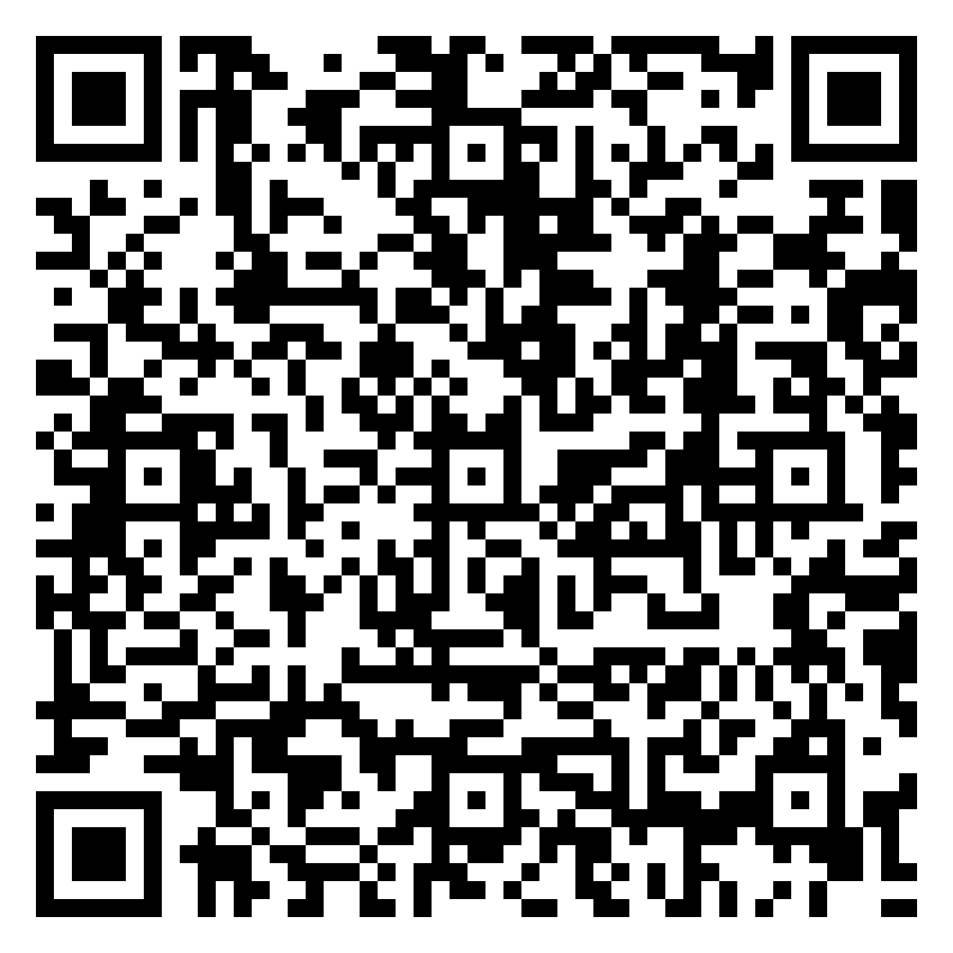
FIREFIGHTER HEALTH, FITNESS
& PERSONAL ACCOUNTABILITY
Why firefighters die young — cardiac, cancer, suicide — and the decisions that change those numbers.
CAPSTONE 3 | NFPA 1582 / 1583 | NFFF 16 LIFE SAFETY INITIATIVES
May 1, 2026 · 60-Minute Presentation
Student Roster

Slide 2
THE HARD NUMBERS
The leading causes of firefighter death and disability are not what most people imagine.
~45%
66%
of on-duty firefighter deaths each year are sudden cardiac events
of career LODDs from 2002-2019 attributed to occupational cancer (IAFF)
2-3x
16
the rate of suicide among firefighters vs the general population (some studies)
NFFF Life Safety Initiatives — the playbook the fire service wrote
NFPA 1582 / 1583 | NFFF 16 Initiatives | Mileage Design

Slide 3
LEARNING OBJECTIVES
Identify the leading causes of firefighter line-of-duty death and the data behind them
Describe the medical and fitness requirements of NFPA 1582 and NFPA 1583
Recognize warning signs of cardiac risk, occupational cancer exposure, and suicidal ideation in self and peers
Use department wellness resources — gyms, EAP, peer support, behavioral health programs
Practice personal accountability for fitness, sleep, hydration, and decontamination habits
Discuss schedule structure (24/48 vs 24/72) and its impact on recovery, family, and burnout
Build the camaraderie and intervention culture that the NFFF 16 Initiatives call for
NFPA 1582 / 1583 | NFFF 16 Initiatives | Mileage Design

Slide 4
CARDIAC RISK — THE #1 KILLER
Strenuous fireground activity, alarm-response adrenaline, and dehydration multiply existing cardiovascular risk
NFPA's annual report consistently lists overexertion / stress / medical events as the leading nature of fatal injury
Modifiable risk factors:
Hypertension — check it; treat it
Cholesterol — lipid panel at annual physical
Body composition — load on the heart under air
Tobacco / nicotine — quit programs are covered by most EAPs
Sleep apnea — common, under-diagnosed, treatable
NFPA 1582 — Comprehensive Occupational Medical Program for Fire Departments — defines the annual medical evaluation, including cardiac screening protocols
Know your numbers: BP, resting HR, lipid panel, A1c. Get them annually. Track them.
NFPA 1582 / 1583 | NFFF 16 Initiatives | Mileage Design

Slide 5
OCCUPATIONAL CANCER
Firefighters have a higher risk of certain cancers than the general public — mesothelioma, testicular, multiple myeloma (NIOSH, IARC studies)
Carcinogens come from combustion byproducts, off-gassing PPE, and contaminated equipment — absorbed through skin, inhaled through soot, ingested at the kitchen table
The cleanest fireground habits:
Mask on at the door; mask off only after gross decon
Gross decon at the scene — soap, water, brushes; bag the gear before getting in the cab
Wipes for skin (face, neck, hands, jaw line) before re-boarding
Shower within the hour at the station; clean uniform on; bunker gear stays out of living areas
Hood swap — hoods absorb the most particulate; rotate to a clean one
IAFF Cancer Awareness Initiative: "no shortcuts on decon, ever"
NFPA 1582 / 1583 | NFFF 16 Initiatives | Mileage Design

Slide 6
MENTAL HEALTH & SUICIDE PREVENTION
Cumulative trauma exposure (PTSI — Post-Traumatic Stress Injury) is the rule, not the exception, over a 25-year career
Risk patterns:
Sleep disruption, irritability, withdrawal from family
Increased alcohol use; "two beers becomes six"
Loss of joy in activities the person used to love
Giving away possessions, sudden calmness, talking about being a burden — late warning signs
The intervention is a relationship, not a script. The line that opens the door:
"I've noticed you don't seem like yourself lately. I'm worried. What's going on?"
Then listen. Don't fix.
Resources: 988 (press 1 for veterans), IAFF Center of Excellence, peer support, EAP
Calling for a friend is not snitching — it is the job
NFPA 1582 / 1583 | NFFF 16 Initiatives | Mileage Design

Slide 7
FITNESS — NFPA 1583
NFPA 1583 — Standard on Health-Related Fitness Programs for Fire Department Members
Defines department-level program: assessment, exercise prescription, equipment, Peer Fitness Trainer (PFT) role
The job demands cardiovascular endurance + strength + mobility — not a single one will get you home alone
Practical in-station programming:
2-3 strength sessions per shift week (compound lifts, kettlebells, sled drags)
Zone 2 cardio 2-3 times per week (heart-rate based, conversational, 30-45 min)
One high-intensity day — intervals, sled push, stair climb in gear
Mobility/recovery daily — 10 minutes is enough
CPAT standards are the floor, not the ceiling
Train for the call you have not had yet — the heavy victim drag, the third-floor advance
NFPA 1582 / 1583 | NFFF 16 Initiatives | Mileage Design

Slide 8
DEPARTMENT RESOURCES & PERSONAL ACCOUNTABILITY
DEPARTMENT RESOURCES
PERSONAL ACCOUNTABILITY
Station gym — equipment maintained, hours protected from chores
EAP — free, confidential counseling (often 6-8 sessions per issue)
Peer Support Team — trained members for critical incidents
Chaplain Services — available regardless of religion
Behavioral Health Program — fire-service-fluent providers
IAFF Center of Excellence — in-patient treatment for first responders
Sleep — the recovery shift exists; use it
Hydration — water bottle on the rig; refill at every call
Nutrition — the firehouse meal can be vegetables
Annual physical — show up; do the labs; ask the questions
Decon — every time, even on the trash fire
Mental check-in — when did you last ask someone how they really were?
NFPA 1582 / 1583 | NFFF 16 Initiatives | Mileage Design

Slide 9
CAMARADERIE & INTERVENTION CULTURE
Brothers and sisters notice first — before family, before doctors, before anyone
The kitchen table is where the change happens, not the chief's office
The intervention is not heroic — "I noticed, I care, here's the number, I'll go with you"
Three-second rule for asking the hard question:
One: notice something is off
Two: decide you will say something today, not Monday
Three: open with curiosity, not diagnosis — "How are you, really?"
Confidentiality matters; gossip is the opposite of camaraderie
If a peer is in active crisis, do not leave them alone — stay, call peer support / 988, hand off in person
NFPA 1582 / 1583 | NFFF 16 Initiatives | Mileage Design

Slide 10
SCHEDULE EVOLUTION — 24/48 VS 24/72
The traditional 24/48 schedule was built around a department staffing model, not recovery science
Sleep researchers and the IAFC have noted that 48 hours is often insufficient recovery for high-call-volume shifts
Departments moving to 24/72 typically report:
Better self-reported sleep quality
Reduced sick time use
Improved family/parenting quality of life
Operational continuity (more days off allows for second jobs and education without burning out)
Mental health (MH) days — increasingly recognized as legitimate, separate from sick time
The personal piece: do you use your off-shift to recover, or to grind?
NFPA 1582 / 1583 | NFFF 16 Initiatives | Mileage Design

Slide 11
THE NFFF 16 LIFE SAFETY INITIATIVES
Published by the National Fallen Firefighters Foundation after the Tampa 2 Summit (2004)
The fire service's own roadmap to reducing line-of-duty deaths and injuries
Several initiatives speak directly to today's topics:
#1 — Cultural change toward leadership, accountability, and personal responsibility
#6 — National medical and physical fitness standards
#7 — National research agenda and data collection system
#13 — Counseling and psychological support for firefighters and families
#14 — Public education must receive more resources and emphasis
Read all 16 at everyonegoeshome.com — share them with your crew
NFPA 1582 / 1583 | NFFF 16 Initiatives | Mileage Design

Slide 12
SUMMARY & KEY TAKEAWAYS
Cardiac, cancer, and suicide are the three killers — all three are partially in your control
NFPA 1582 (medical) + 1583 (fitness) are the standards; show up for the physical, train for the job
Decon every time. Mask on at the door. Hood swap. Shower within the hour.
988 + 1, IAFF Center of Excellence, EAP, peer support — know the numbers, share them
The intervention that saves your friend's life is the question "how are you, really?"
Use your off-shift to recover. The 24/72 conversation is happening — be part of it.
Read the NFFF 16 Initiatives. Pick one. Live it.
NFPA 1582 / 1583 | NFFF 16 Initiatives | Mileage Design

Slide 13
QUIZ TIME
10 QUESTIONS
Multiple choice · Discuss as a class
Take it on your phone — scan the QR or visit the page
bbishilany.github.io/nicks-capstone/capstone-3.html#quiz
NFPA 1582 / 1583 | NFFF 16 Initiatives | Mileage Design

Slide 14
QUESTION 1 OF 10
What is the leading cause of on-duty firefighter line-of-duty death?
A
Burns from fire exposure
B
Vehicle collisions
C
Sudden cardiac events
D
Structural collapse
ANSWER: C) Sudden cardiac events
NFPA 1582 / 1583 | NFFF 16 Initiatives | Mileage Design

Slide 15
QUESTION 2 OF 10
Which NFPA standard covers the comprehensive occupational medical program for fire departments?
A
NFPA 1500
B
NFPA 1583
C
NFPA 1582
D
NFPA 1041
ANSWER: C) NFPA 1582
NFPA 1582 / 1583 | NFFF 16 Initiatives | Mileage Design

Slide 16
QUESTION 3 OF 10
Which NFPA standard governs health-related fitness programs for fire department members?
A
NFPA 1582
B
NFPA 1583
C
NFPA 1001
D
NFPA 1971
ANSWER: B) NFPA 1583
NFPA 1582 / 1583 | NFFF 16 Initiatives | Mileage Design

Slide 17
QUESTION 4 OF 10
According to IAFF data, what percentage of career firefighter LODDs from 2002-2019 were attributed to occupational cancer?
A
22%
B
41%
C
66%
D
83%
ANSWER: C) 66%
NFPA 1582 / 1583 | NFFF 16 Initiatives | Mileage Design

Slide 18
QUESTION 5 OF 10
Which of the following is NOT a recommended on-scene decon practice?
A
Mask on at the door, mask off only after gross decon
B
Soap, water, and brushes for gross decon before bagging gear
C
Wipes for face, neck, hands, and jaw line before re-boarding
D
Walking back through the kitchen in turnouts to share war stories
ANSWER: D) Walking back through the kitchen in turnouts to share war stories
NFPA 1582 / 1583 | NFFF 16 Initiatives | Mileage Design

Slide 19
QUESTION 6 OF 10
The number to call for the 988 Suicide & Crisis Lifeline (with veteran-specific routing) is:
A
911 then ask for behavioral health
B
988, then press 1 for the Veterans Crisis Line
C
800-273-TALK only
D
Call your chief first; never call 988
ANSWER: B) 988, then press 1 for the Veterans Crisis Line
NFPA 1582 / 1583 | NFFF 16 Initiatives | Mileage Design

Slide 20
QUESTION 7 OF 10
The IAFF Center of Excellence in Maryland provides:
A
In-patient behavioral health treatment specifically for first responders
B
NFPA standard publication and revision
C
Apparatus driver/operator certification
D
Cancer screening exclusively for retired firefighters
ANSWER: A) In-patient behavioral health treatment specifically for first responders
NFPA 1582 / 1583 | NFFF 16 Initiatives | Mileage Design

Slide 21
QUESTION 8 OF 10
The NFFF 16 Life Safety Initiatives were published after which event?
A
The 2001 World Trade Center attacks
B
The Tampa 2 Summit in 2004
C
The Charleston Sofa Super Store fire (2007)
D
The Yarnell Hill fire (2013)
ANSWER: B) The Tampa 2 Summit in 2004
NFPA 1582 / 1583 | NFFF 16 Initiatives | Mileage Design

Slide 22
QUESTION 9 OF 10
Which schedule change has been associated with better self-reported sleep, reduced sick time, and improved family quality of life in some departments?
A
Moving from 12-hour shifts to 24-hour shifts
B
Moving from 24/72 to 24/48
C
Moving from 24/48 to 24/72
D
Eliminating shift work and going to 8-hour days
ANSWER: C) Moving from 24/48 to 24/72
NFPA 1582 / 1583 | NFFF 16 Initiatives | Mileage Design

Slide 23
QUESTION 10 OF 10
The single most effective mental-health intervention available to a peer is:
A
Diagnosing the friend's specific condition
B
Telling the friend to "tough it out"
C
Asking honestly how they are doing, listening without fixing, and connecting them to help
D
Reporting them to the chief immediately
ANSWER: C) Asking honestly how they are doing, listening without fixing, and connecting them to help
NFPA 1582 / 1583 | NFFF 16 Initiatives | Mileage Design

Slide 24
REFERENCES
NFPA 1582: Comprehensive Occupational Medical Program for Fire Departments (2022)
NFPA 1583: Health-Related Fitness Programs for Fire Department Members (2022)
NFFF — 16 Firefighter Life Safety Initiatives — everyonegoeshome.com
NFPA Research — Firefighter Fatalities in the United States (annual)
IAFF Cancer Awareness Initiative — iaff.org/cancer
NIOSH Firefighter Cancer Studies — cdc.gov/niosh/fire-fighters/cancer
988 Suicide & Crisis Lifeline — 988lifeline.org
IAFF Center of Excellence — iaffrecoverycenter.com
Firefighter Behavioral Health Alliance — ffbha.org
NFPA 1582 / 1583 | NFFF 16 Initiatives | Mileage Design

Slide 25
EVERYONE GOES HOME
Cardiac. Cancer. Behavioral health. We change the numbers.
If you or a peer needs help: 988 (press 1 for veterans)
Capstone 3 · NFPA 1582 / 1583 · bbishilany.github.io/nicks-capstone
NFPA 1582 / 1583 | NFFF 16 Initiatives | Mileage Design

