Slide 1
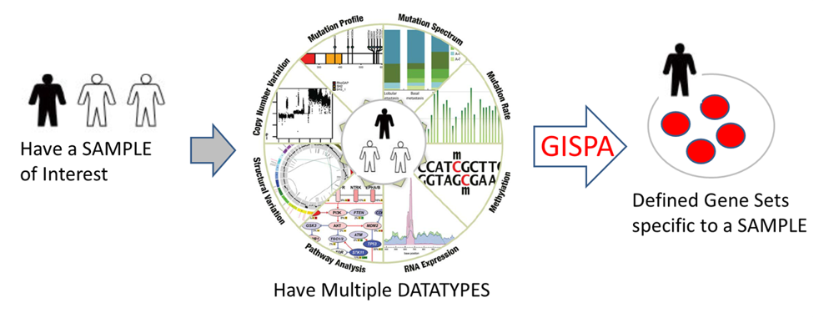
shinyGISPA
Workshop (June 2nd2017)
Gene Integrated Set Profile Analysis with Shiny
With GISPA, you can use:
Any combination of genome-wide molecular data
As few as a single sample per phenotypic group
With GISPA, you can define:
Gene signatures for as few as a single sample
Subtype based on integrating gene microarray-based expression with RNA-Seq-based expression.

Slide 2
Sign-up on Emory Yammer Network
https://www.yammer.com/emory.edu/
Enter your Emory Work Email
Check your email: Complete Signup to activate your account
Go to Emory Group: GISPA
Download/access/share files
Post questions, ideas and comments to the group

Slide 3
Where to Find?
shiny-Web-interface
Emory campus*:
http://bbisr-tools.winship.emory.edu:3838/shinyGISPA/
Anywhere:
http://shinygispa.winship.emory.edu/shinyGISPA/
Stand-alone version
Bio-conductor: https://bioconductor.org/packages/GISPA/
GitHub: https://github.com/BhaktiDwivedi/shinyGISPA

Slide 4
How to Run?
Insert manual

Slide 5
Demo Example Data sets
Genome-wide data on three Multiple Myeloma (MM) cell lines
KMS11
MM1s
RPMI8226
RNA-seq derived Gene Expression (EXP) = ‘MM_exp.txt’
RNA-seq derived Variants (VAR) = ‘MM_var.txt’
DNA-seq derived Copy Number Change (CNV) = ‘MM_cnv.txt’

Slide 6
Where to Find the Example Data sets?
Yammer: Emory Group GISPA under Files
GitHub:
https://github.com/BhaktiDwivedi/shinyGISPA

Slide 7
Thank you!
Please take our brief survey! https://www.surveymonkey.com/r/BBISRworkshops
Post questions, ideas and comments to the Emory Yammer GISPA group
Please contact us for any questions or concerns.
Algorithm/Method: Jeanne.kowalski@emory.edu
Package/Tool: Bhakti.dwivedi@emory.edu

Slide 11
(B) Allows Input From Multiple Data & Multiple Platforms
Epigenetics
Data
Genomics
Data
WGBS
RRBS
Methylation
RNA-seq
Expression
SNP
CNV
LOH

Slide 12
(C) Gene Set Profiles
(1D or 2D or 3D)
Genes
Expression
Cell lines
Genes
Expression
Methylation
Cell lines
Cell lines
Genes
Expression
Variants
Methylation
Cell lines
Cell lines
Cell lines

