Slide 1



Cloud Foundry Basics
Rough draft Month 00, 2015
Internal

Slide 2

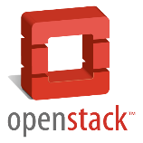

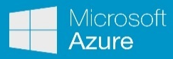

From Traditional Development to PaaS
Application Code
SaaS Applications
PaaS
Database
Webserver
Search Index
Message Bus
File Storage
OS
IaaS
[ Virtualization ]
Hardware: CPU, Memory, Disks, networks, …

Slide 3
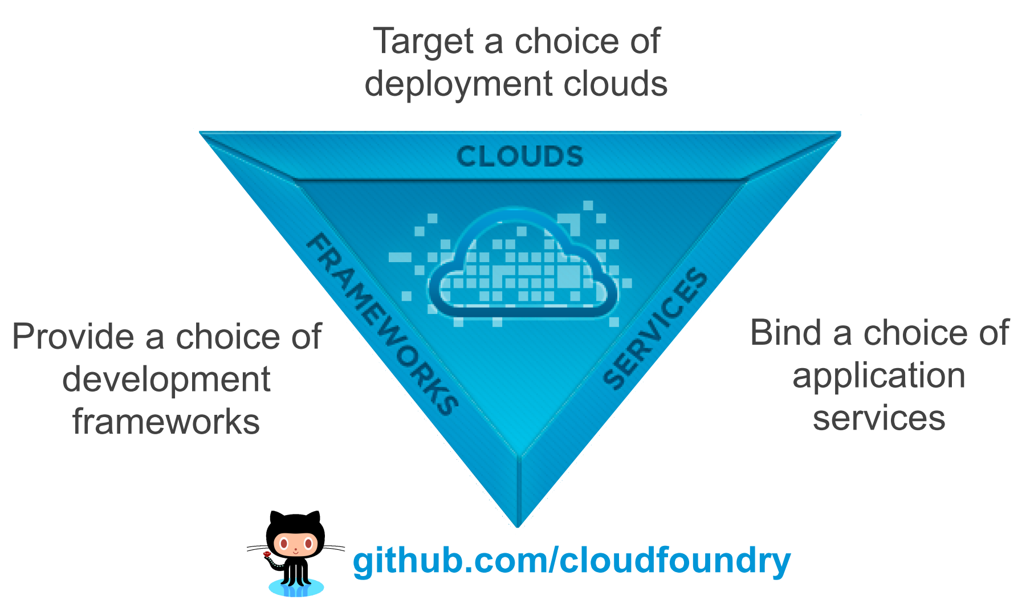
What is Cloud Foundry?

Slide 4
What is Cloud Foundry?

Slide 5
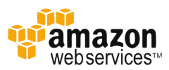



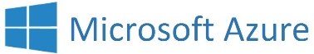




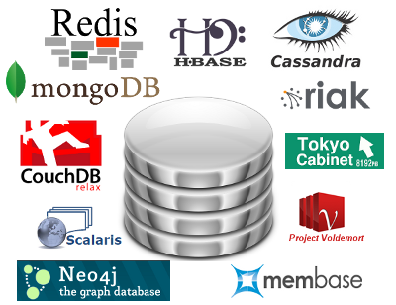













What is Cloud Foundry?
Data Services
…
Messaging
Other
…
…

Slide 6





SAP's HCP Cloud Foundry extension
Data Services
Messaging
…
Other
…
binary

Slide 7

Key Elements of a PaaS / Cloud Foundry
Software as a Service (SaaS)
A PaaS (Platform-as-a-Service) is the foundation of your application
Cloud Foundry (any PaaS) gives you
Multi language environment (use what fits best): Java, Node, Go, …
Many 'backing services': DBs (SQL, No-SQL), Messaging, Blobstore, …
Resilience: High availability, no single-point-of-failure (SPOF), self-healing
Boundless scalability (theoretical): → need to program differently
All resources virtualized: CPUs, memory, disks, networks, routers, …
Monitoring: Detailed transparency on load and issues
Simple deployment (automated), simplifies devops
No manual software install, no OS maintenance
Platform as a Service (PaaS)
Infrastructure as a Service (IaaS)

Slide 8
Reference: CF commands to deploy a service
(Prep: Cloud Foundry Command Line Interface CLI was installed as part of Environment Setup)
cf api https://api.cf.neo.ondemand.com | 'Connect' to a cloud foundry provider (URL of cloud controller). Setting is remembered.
cf login [–u username –o org] | Log in as user (use SAP domain user and password) and with an org
cf target [ –s space ] | Show or set a target space (where apps are deployed)
cf apps | Show running apps
cf push | Push app in current directory using manifest.yml to CF
cf scale –i 5 | Create 5 instances of the app
CF command cheat sheet from AnyNines

Slide 9
Exercise: Deploy a Service to Cloud Foundry
DEMO

Slide 10




cf push
app1.domain.com
Developer PC / CI Server
load balancer / router
diego
…/app1/
CLI
cf push
cloud controller
cells
space (trial)
space (prod)
app1
app1
build pack
build pack
build pack
container
container
blob store
Backing Services

Slide 11
cf scale –i 2
app1.domain.com
Developer PC / CI Server
load balancer / router
diego
CLI
cf scale
cloud controller
cells
space (trial)
space (prod)
app1
app1
app1
container
container
container
blob store
Backing Services

Slide 12
cf bind-service
Developer PC / CI Server
diego
CLI
cf bind- service
cloud controller
cells
space (trial)
space (prod)
app1
app1
app1
container
container
container
VCAP_SERVICES
Backing Services

Slide 13
cf push –n Orgs, Spaces, Users, …
*.domain.com
load balancer / router
app1-a.domain.com
app1-b.domain.com
Org: D012345trial_trial
Org: I099887trial_trial
space (dev)
space (dev)
app1
app2
app1
app2
Backing Services

Slide 14
CF HL Architecture
CLI
app client
http
http
authentication / UAA
load balancer + (application) router
cloud controller
blob store (buildpacks, app code, droplets)
diego
log aggregator
bulletin board system (bbs)
metrics collector
diego brain
Messaging (NATS, HTTP/S)
Cells with garden containers
Cells with garden containers
app
app
app
managed service instances
user provided
services
external services
service broker

Slide 15
BACKUP

Slide 16
Vagrant image to provide local backing services
vagrant
image descriptors
vagrant
1
controls
VirtualBox / VMWare Player
VM
vagrantfile
3
Chef
chef marketplace cookbooks and recipes
installs & configures
Commands:
vagrant help
vagrant provision
vagrant up
vagrant halt
anything
srvc1
srvc2
2
OS: Ubuntu (or anything else)
start base OS

