Slide 1
Detection And Classification Of Incipient Faults In Automotive Using Machine Learning Approach
Peculiar_Panch
Binny Mathew
Jay Thakkar
Fraz Ansari
Bhushan Naware

Slide 2
Existing Methods and Corresponding Performance
Existing approach vary with what kind of faults are to be detected. There exists an entire ecosystem of fault diagnosis depending on the industry , application and other subtle intricacies.
Here we are enlisting some of the existing methods purely w.r.t vehicular fault detection.
For the existing training data we are referring to the work done in NP-MASS lab in EE engineering as preliminary reference.
S.No | Fault | Methods
1 | Fuel System Faults | ANN , Fuzzy Based, Model Based
2 | Misfire detection | Threshold Checking
3 | Knock Monitoring | Time-Frequency Analysis, Fourier based

Slide 3
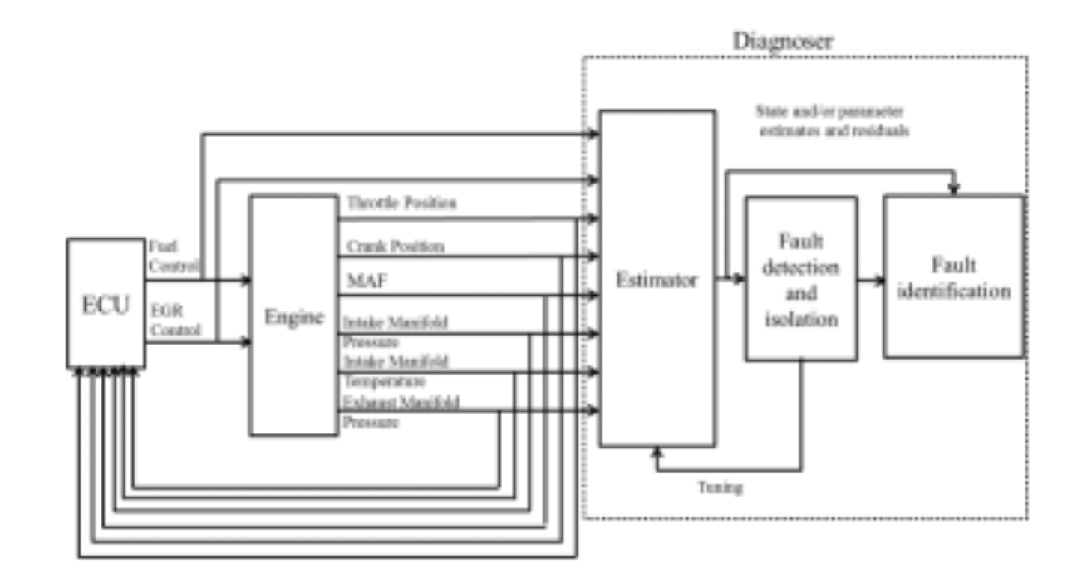
Methods to be Implemented (i)
Existing methodology in the NP-MASS lab for fault detection on TATA Nano

Slide 4
Methods to be Implemented (ii)
A (E+ML)
B
(ML SA)
What we Intend to Do over the course of this project .

Slide 5
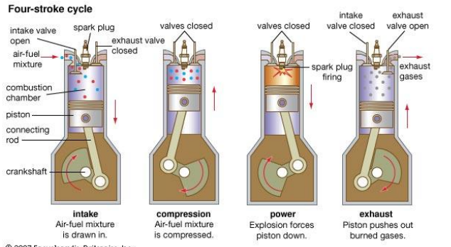
Data Set : Elaboration
Data set consists.
Temperature Sensor
Pressure Sensor
Throttle
Crank angle
Vehicle speed et.al

Slide 6
Roadmap & Progress
Problem Identification
Literature Survey
Approach to be used
Implementation of ML Technique
Performance comparison
Standalone & Hybrid Variants (Refer previous slide)
Conclusion

