Slide 1
DetektDx: A Convertor from Detekt Output to Valid Dx-Platform Input
Analyzing Detekt, kotlinx.coroutines
CES - 2021
Bogdan-Călin Bogorodea

Slide 2
Case Study
Detekt is a static code analysis tool for the Kotlin programming language. It operates on the abstract syntax tree provided by the Kotlin compiler and can detect and report information such as information on complexity based on code smells, cyclomatic complexity, and number of lines of code.
kotlin.coroutines is a library multiplatform support for Kotlin coroutines.

Slide 3
1100+ files
150+ contributors
3500+ commits
4 years
Detekt

Slide 4
900+ files
170+ contributors
2200+ commits
4 years
kotlinx.coroutines

Slide 5
Steps:
Detekt Output
DetektDx
DetektDx Ouput for Detekt
Importing Detekt DetektDx Output in Dx-Platform
System Map for Detekt
DetektDx Output for kotlinx.coroutines
Importing kotlinx.couroutines DetektDx Output in Dx-Platform
System Map for kotlinx.couroutines

Slide 6
Detekt Output

Slide 7
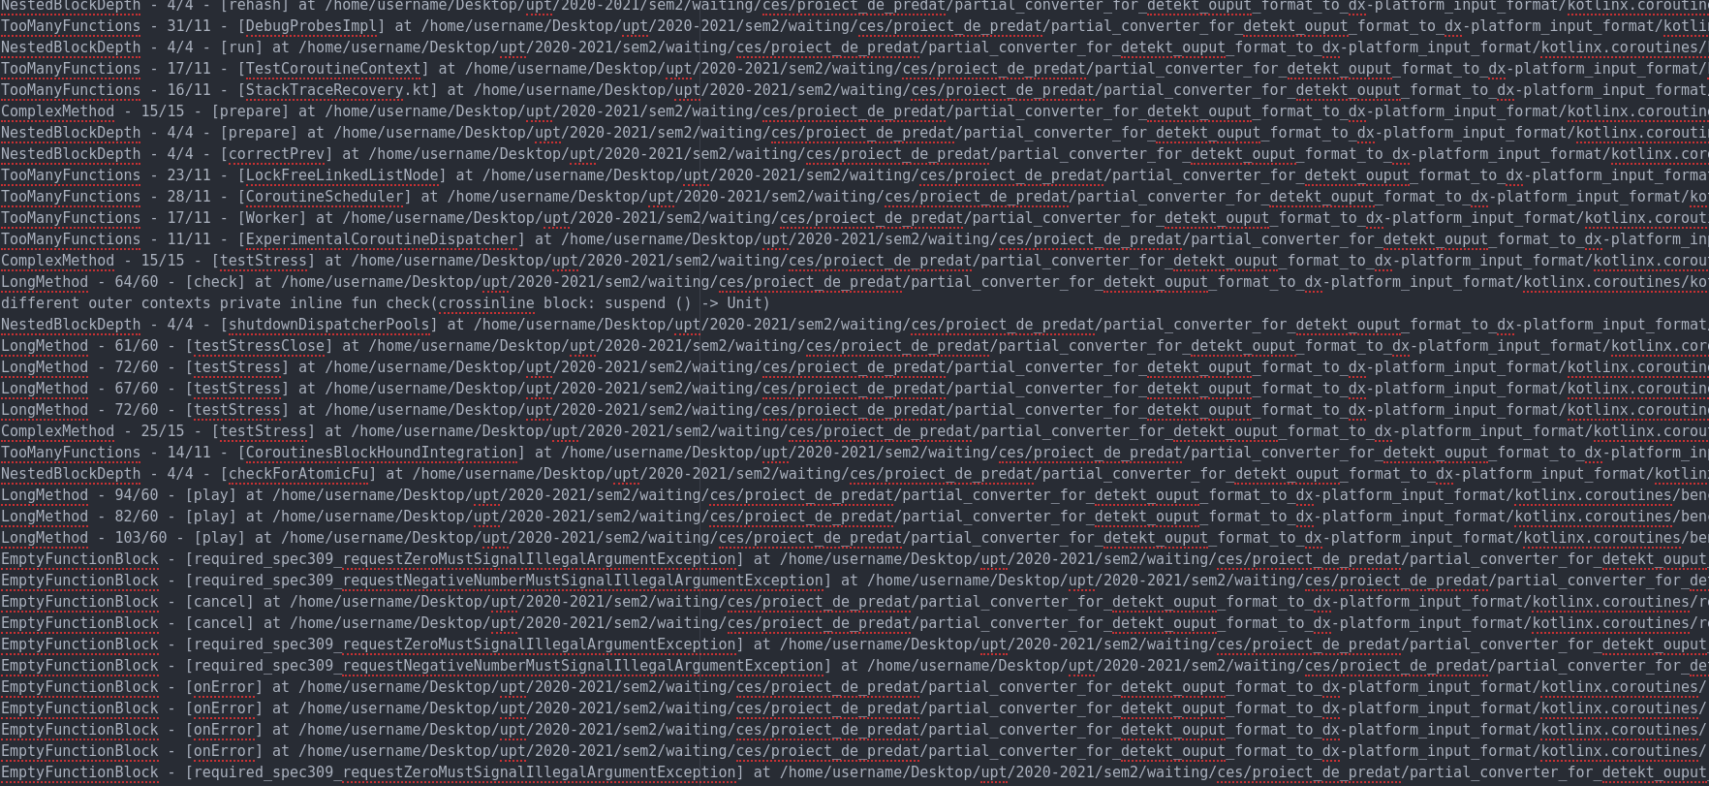
1. Detekt Output
Below is a screenshot that captures a part of the .txt report generated by Detekt for a Kotlin project. This report was opened in Atom. It can be seen in it that some lines have a part x/y, e.g. 103/60, 82/60, and some don’t. In spite of such differences, the DetektDx generates .json that can be understood by Dx-Platform.

Slide 8
2. DetektDx

Slide 9
DetektDx
DetektDx is a project able convert the output of Detekt static analysis to data that is understandable by Dx-Platform. That helps Dx-Platform display more and likely useful information for Kotlin projects. That is particularly useful when you have a Kotlin project, but you want more than each of Dx-Platform and Detekt can offer separately.
Detekt
DetektDx
Dx-Platform

Slide 10
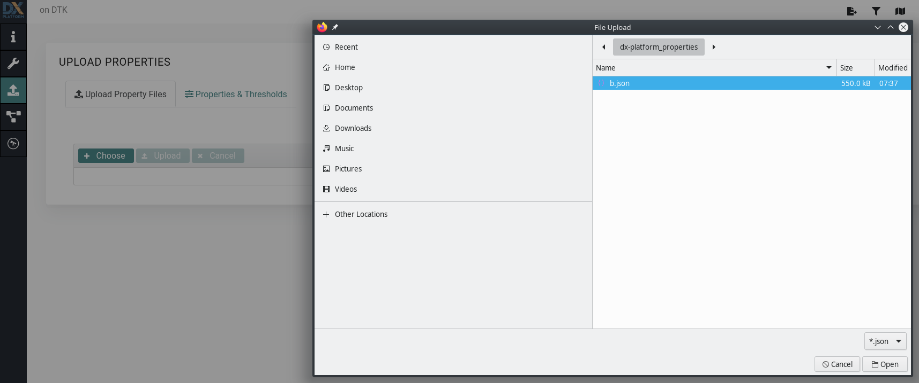
DetektDx - Configuration
DetektDx generates a .json file at the given path that can be uploaded to Dx-Platform. Below, as example, the Docker command is executed for analyzing with detektDx the detekt Kotlin project. For other Kotlin projects it is sufficient to change appropriately what is in underlined with red. The output is generated in the directory /dx-platform_properties. The three linked arrows show the steps and the left arrow shows that the a part of the command “$PWD/dx-platform_properties caused the b.json to be written at this path.

Slide 11
3. DetektDx Output for Detekt

Slide 12
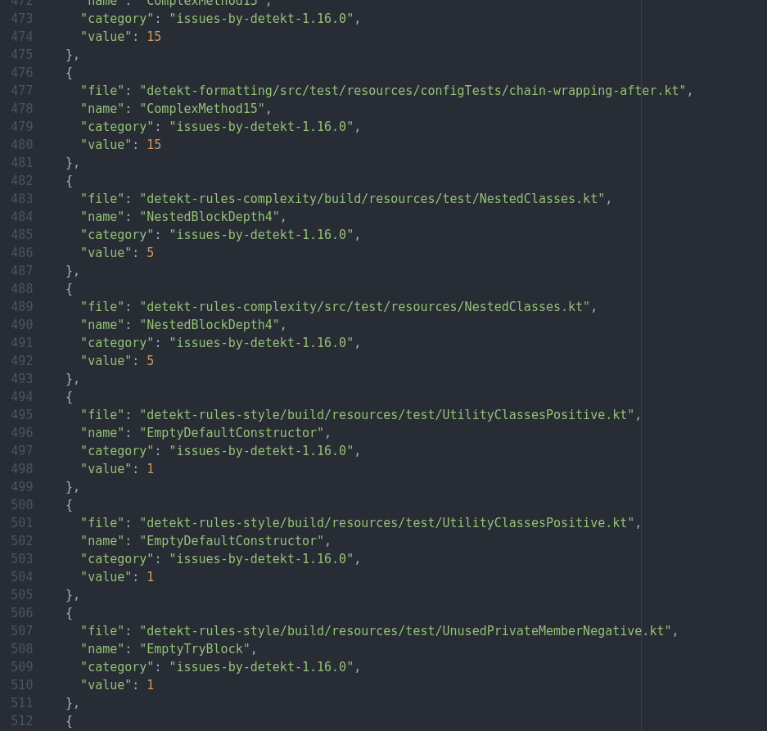
3. DetektDx Output for Detekt
Below is a screenshot that captures a part of the b.json file generated for the Detekt project. b.json was opened in Atom.
If the property name of the property has a value appended to it, then this value is greater or equal with with the value of the number appended to the name. These two numbers have a meaning, depending on the detected issue, e.g. Method Complexity, Depth of Nested Blocks. Examples in the capture:
Example 1: see lines 478 and 480 (also pointed with the red arrows):
ComplexMethod15 => the number appended to the name is 15. The value is also 15, so the value is greater or equal to the number appended to name. These values represent the Complexity of Method found in the file located at the path from the line 477.
Example 2: see lines 484 and 486 (also pointed with the red arrows)
NestedBlockDepth4 => the number appended to the name is 4. The value is also 5, so the value is greater or equal to the number appended to name. These values represent the Depth of a Nested Block in the file located at the path from the line 483.
If the property name does not have a value appended to it, the value key of the property is 1 by default. As example, see the lines pointed by the red arrows, i.e. the lines 496 and 498.

Slide 13
4. Importing Detekt DetektDx Output in Dx-Platform

Slide 14
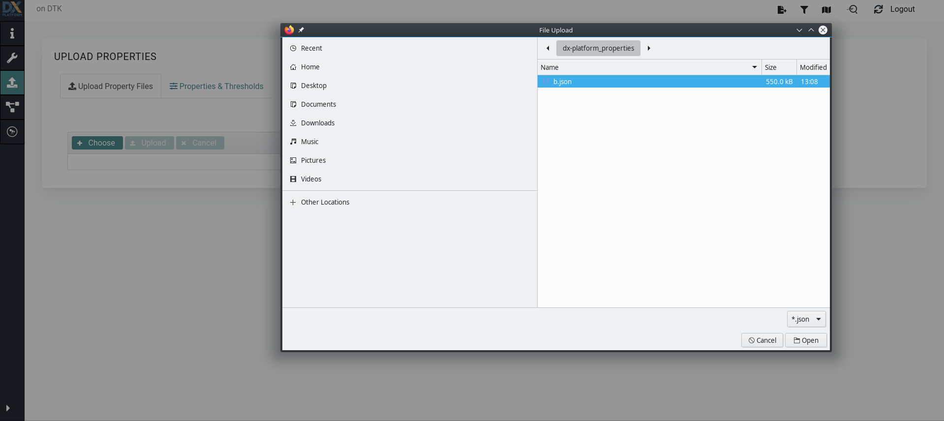
4. Importing Detekt DetektDx Output in Dx-Platform

Slide 15
5. System Map for Detekt

Slide 16
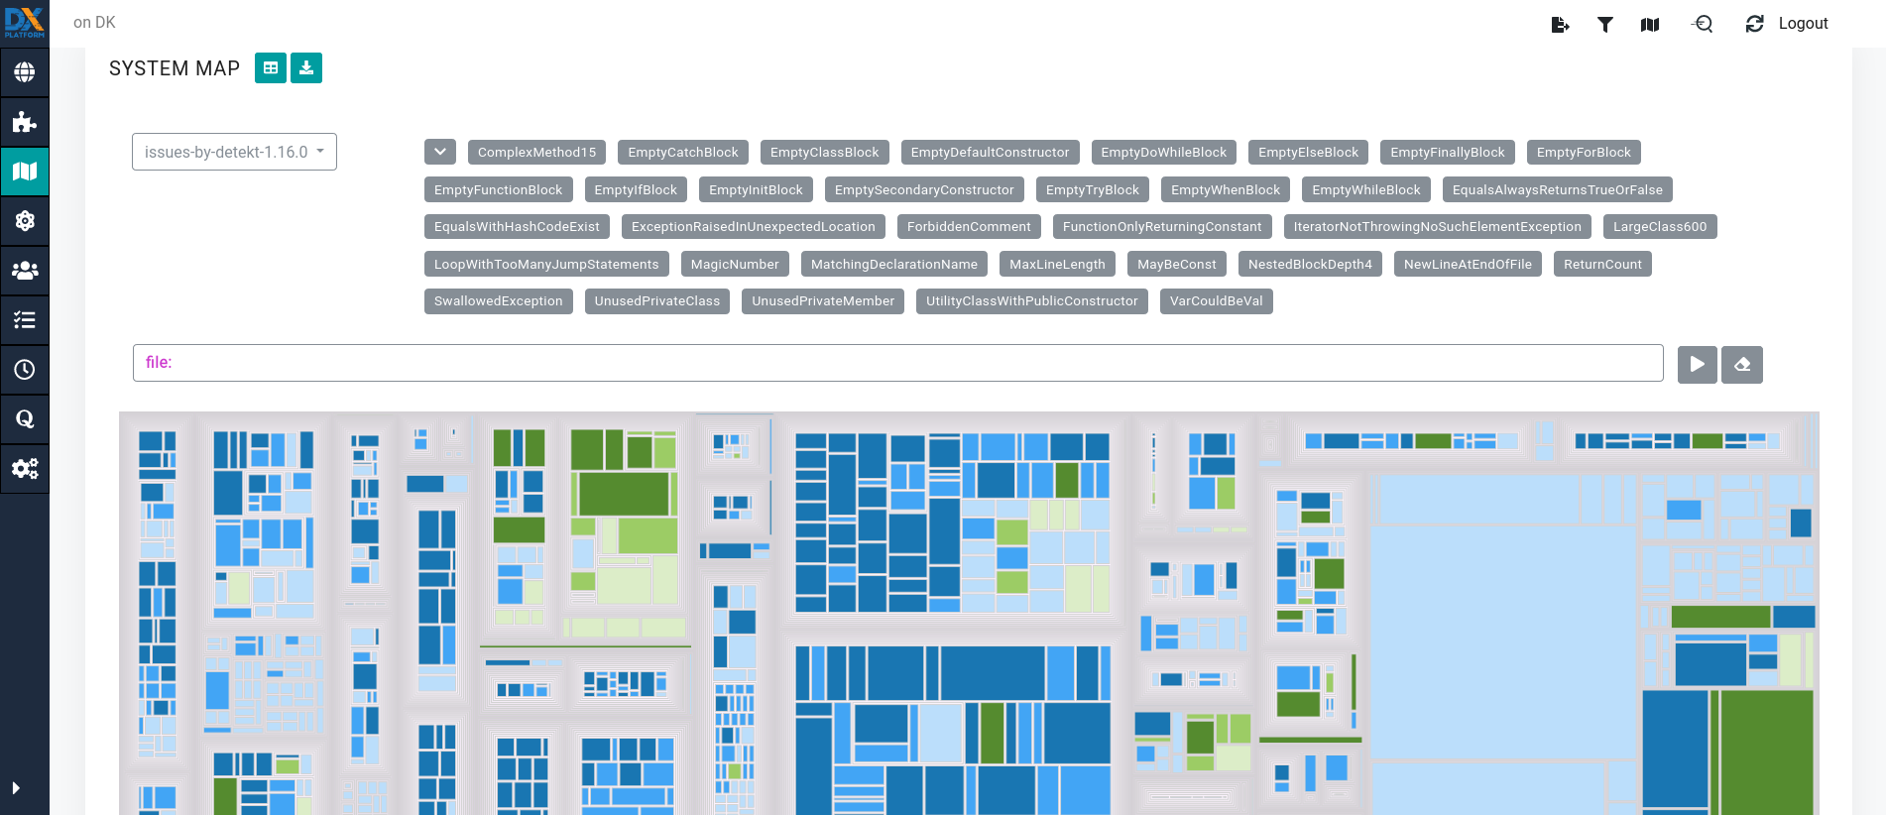
5. System Map for Detekt

Slide 17
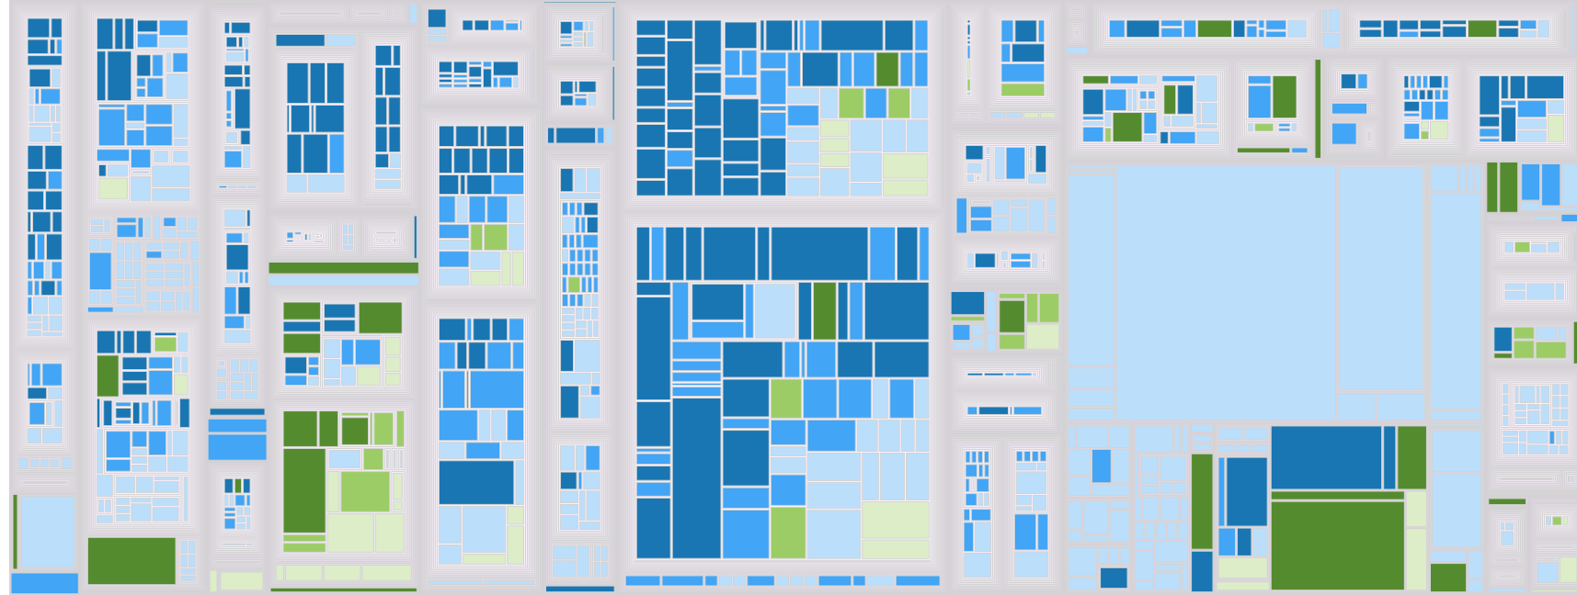
5. System Map for Detekt

Slide 18
6. DetektDx Output for kotlinx.coroutines

Slide 19
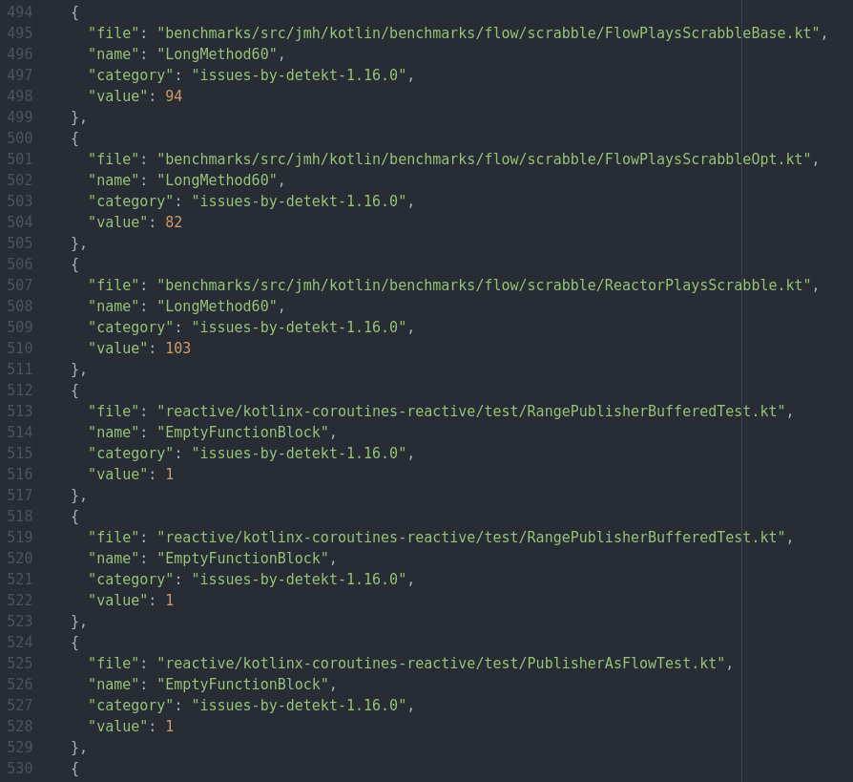
6. DetektDx Output for kotlinx.coroutines
Below is a screenshot that captures a part of the b.json file generated for the kotlinx.coroutines project. b.json was opened in Atom.

Slide 20
7. Importing kotlinx.coroutines DetektDx Output in Dx-Platform

Slide 21
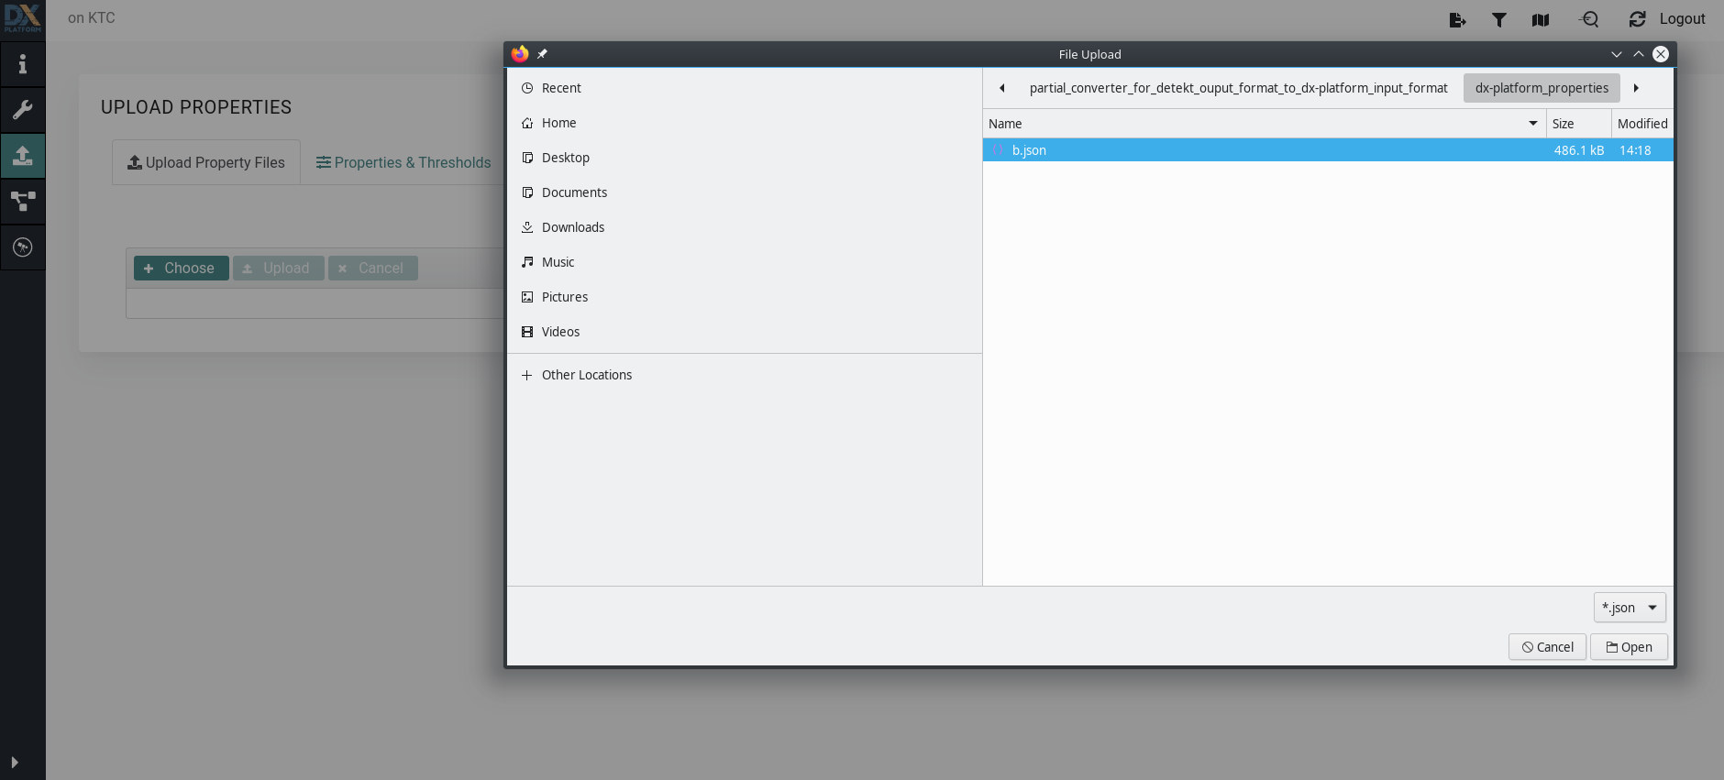
7. Importing kotlinx.coroutines DetektDx Output in Dx-Platform

Slide 22
8. System Map for kotlinx.coroutines

Slide 23
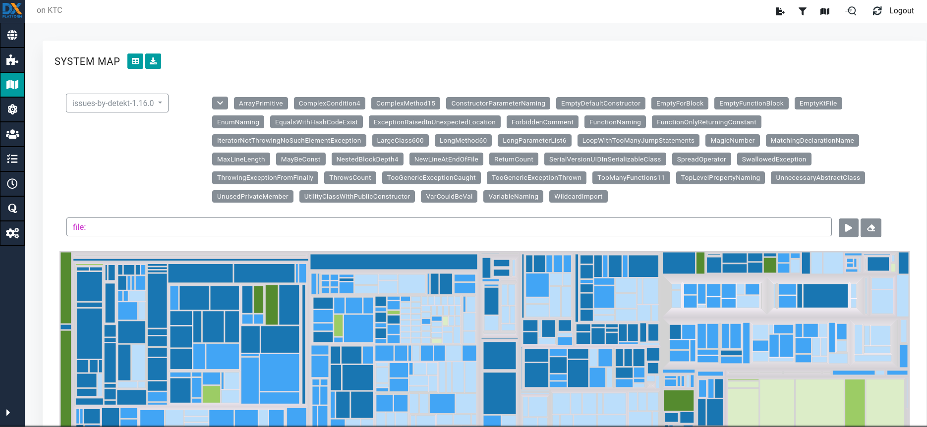
8. System Map for kotlinx.coroutines

Slide 24
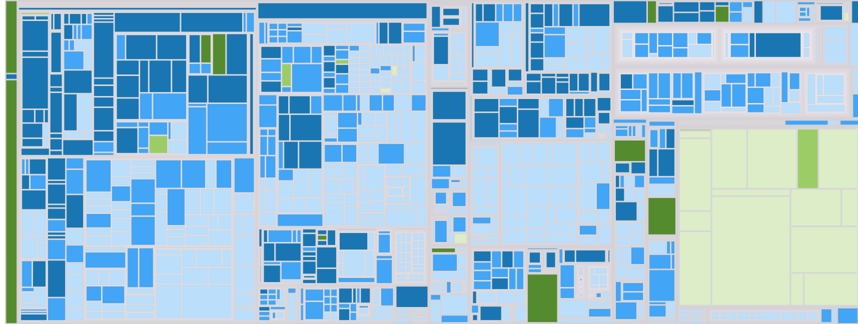
8. System Map for kotlinx.coroutines

